Slide 1











Fine-Tuning AraBART for Arabic Text Summarization
A Deep Learning Approach to Summarize Arabic Texts

Slide 2




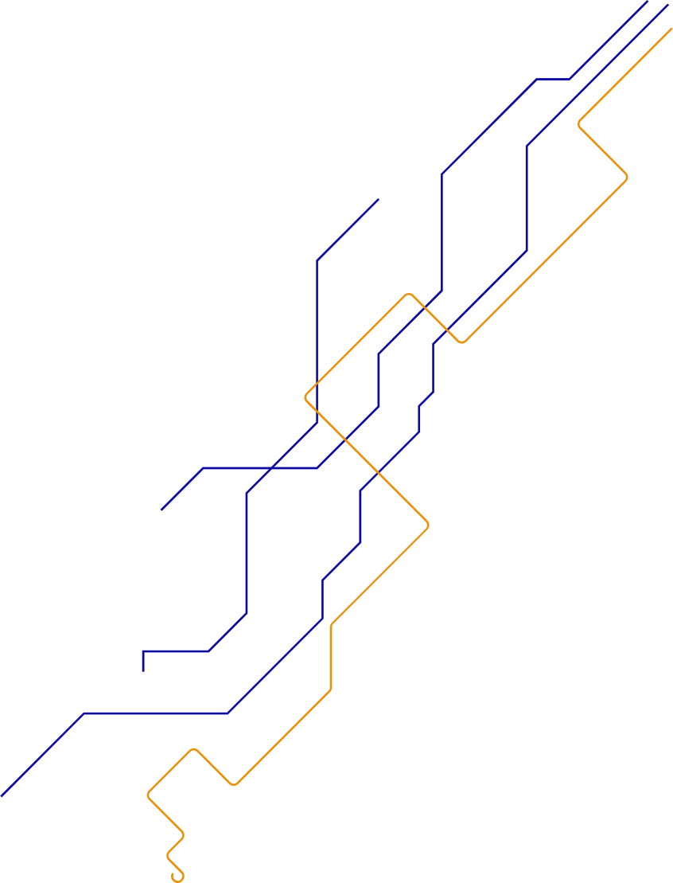

.
Objective:
Develop an Arabic text summarization model using the AraBART pre-trained transformer model.
Implement preprocessing techniques to clean the dataset and prepare it for model training.
Fine-tune the model on a custom dataset and evaluate its performance.

Slide 3


.
.
.
.
Table of contents
01
02
Dataset
Model
03
Model limitation

Slide 4
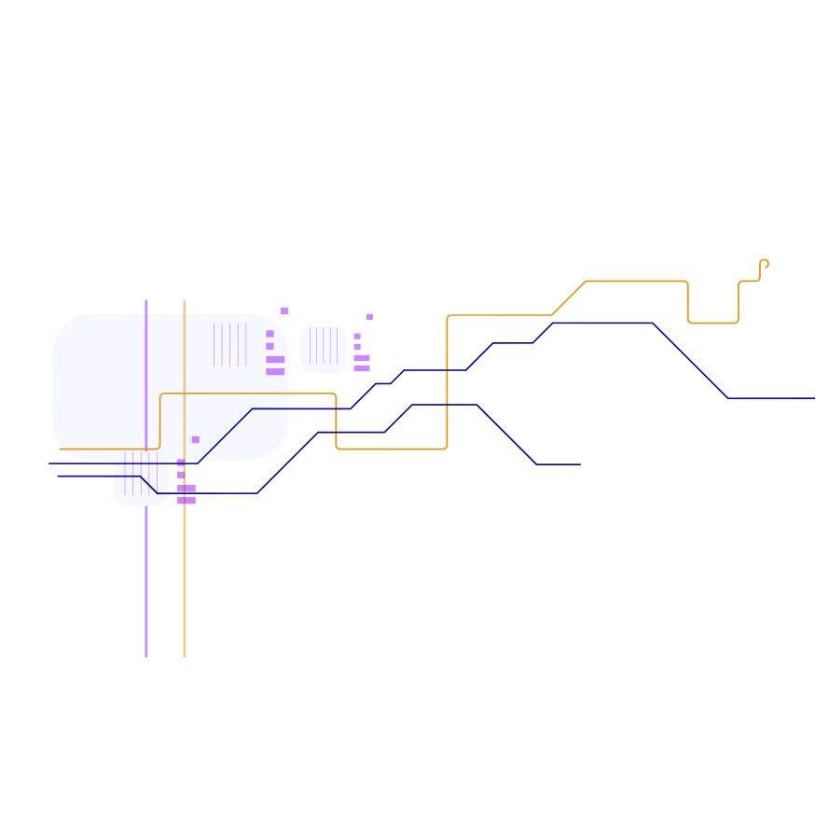







01
Dataset
.

Slide 5
Arabic Text Summarization Datase
.
Columns:
Processed Text → Input to the model
summarizer → Target summaries
Preprocessing Steps:
Clean text by removing unwanted characters (e.g., punctuation, non-Arabic characters).
Filter out stop words.

Slide 6



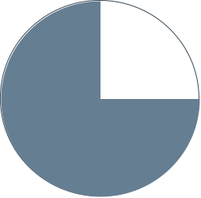







Split:
Training Data: 80% of the dataset
Validation Data: 10% of the dataset
Test Data: 10% of the dataset
.

Slide 7
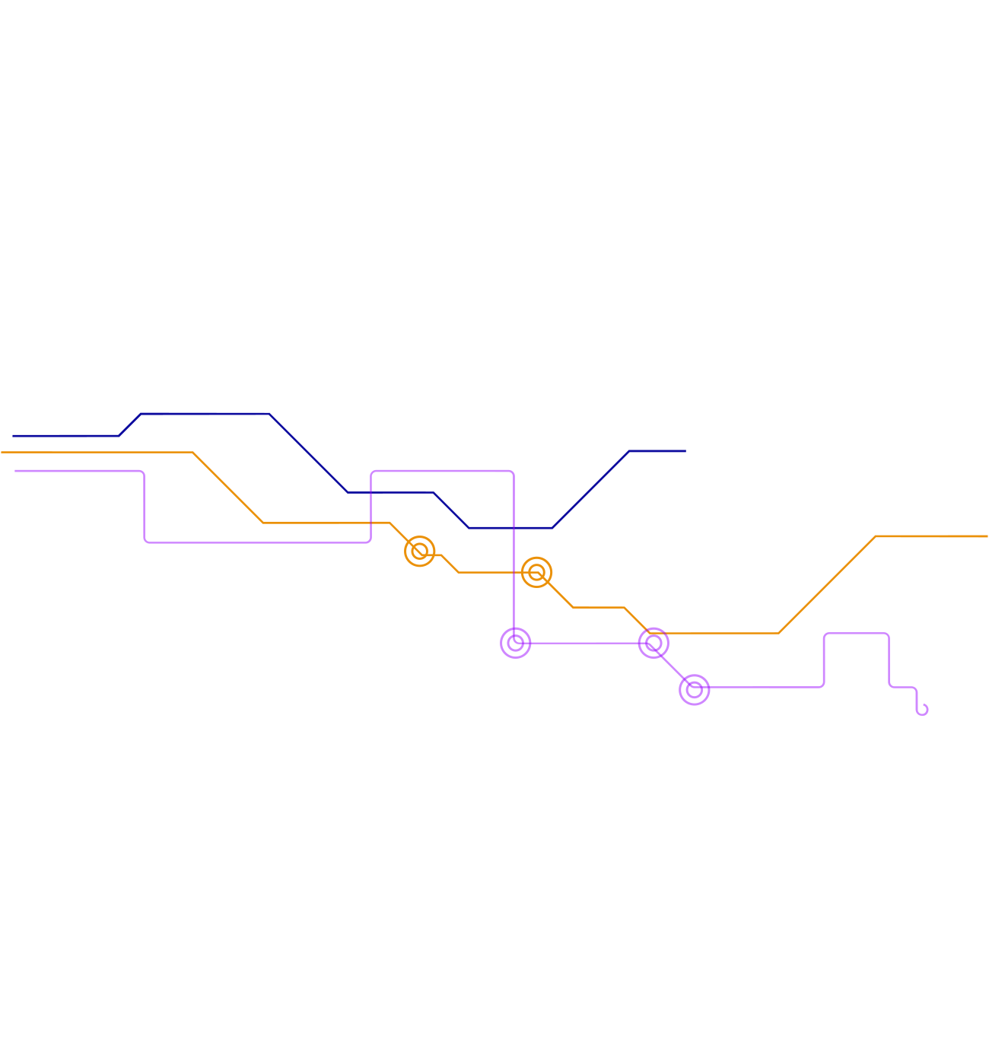

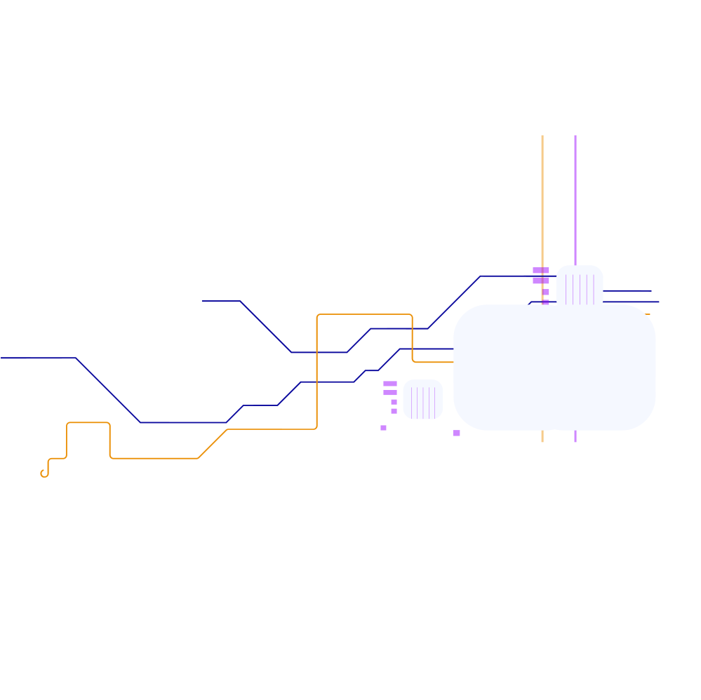

02
Model

Slide 8
Model Architecture
.
Model: AraBART (Arabic BART)
Encoder-Decoder Transformer
Pretrained for Arabic language generation
Why AraBART?
Trained on large Arabic corpora
Supports sequence-to-sequence tasks

Slide 9
Model Architecture
.
Hyperparameters:
Learning Rate: 5e-5
Batch Size: 8
Max Length for Input: 512 tokens
Max Length for Output (Summary): 110 tokens
Number of Epochs: 10
Optimizer: AdamW
Loss Function: Cross-Entropy Loss

Slide 10
Data Preprocessing
Cleaning and Tokenization:
Remove non-Arabic characters using regular expressions.
Remove extra spaces and fix punctuation errors.
Stop Words Removal
.

Slide 11
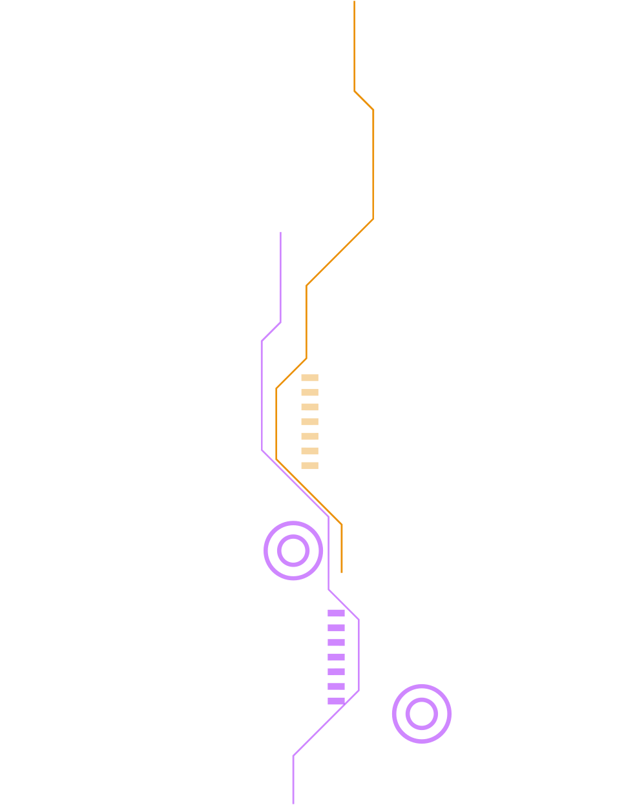
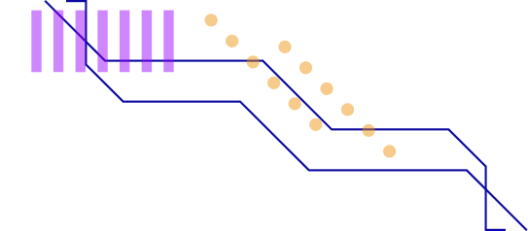
Training & Fine-Tuning
Training Process:
Fine-tuned on a custom dataset using the AraBART model.
Used PyTorch and Hugging Face’s Transformers library.
Training performed using GPU (CUDA).
Loss Function:
The model is optimized using Cross-Entropy loss for sequence generation tasks.

Slide 12
Evaluation Metrics
.
ROUGE Score:
ROUGE-1: Measures unigrams overlap between summary and reference.
ROUGE-2: Measures bigrams overlap.
ROUGE-L: Measures longest common subsequences.
BLEU Score:
Measures n-gram precision between generated and reference summaries..

Slide 13
Results and Performance
.
Evaluation on Test Set:
ROUGE-1: 0.0421
ROUGE-2: 0.0015
ROUGE-L: 0.0421
BLEU Score: 0.2341
Fine-Tuned Model vs Pretrained:
Fine-tuned model performed better in ROUGE and BLEU metrics compared to the pretrained AraBART model.

Slide 14
03
Model limitation

Slide 15
Contextual Understanding: The model may not capture deep semantic meaning, especially for complex paragraphs.
Data Dependency: Performance heavily relies on the quality and size of the training dataset.
Summary Length: The model may generate overly concise or verbose summaries based on the length constraints.
Generalization: Model might struggle with out-of-domain texts or very different writing styles.
.

Slide 16
Conclusion:
Summary: The fine-tuned AraBART model performs well in generating summaries for Arabic text, with competitive results on ROUGE and BLEU metrics.
Future Directions: Exploring further fine-tuning and augmenting the model with additional knowledge sources for better performance.

