Slide 1
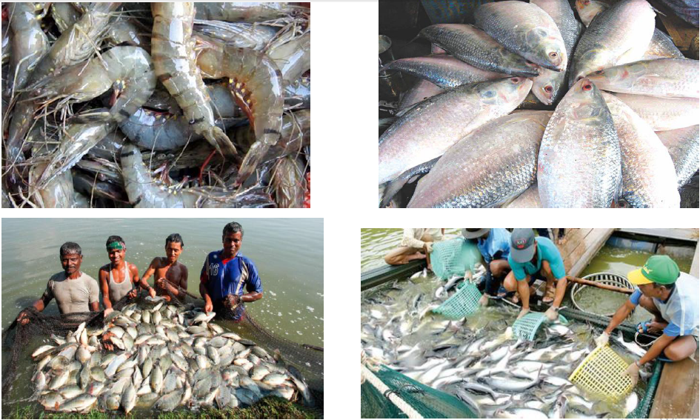
E-fisheries: A Digital App for Fish Farming

Slide 2
Introduction - Company
Department of Computer Science and Engineering (CSE), University of Barisal, Barisal, Bangladesh

Slide 3
Introduction – Management Team
PRINCIPLE INVESTIGATOR
Md. Mostafijur Rahman, Lecturer, CSE, University of Barisal
INVESTIGATORS
- Shanto Rahman, Senior Software Engineer, Samsung R&D Ltd., Bangladesh
- Md. Rasel, CSE, University of Barisal
- Badal Chandra Mitra, CSE, University of Barisal
- Umme Habiba Khan, CSE, University of Barisal

Slide 4
Brief Project Description
Fish culture plays an important role to the national economic growth in Bangladesh.
Major part of the total population are directly or indirectly involved with fish related business.
Khulna, Barisal, Bagerhat, etc. are considered as the best places for commercial fish farming.
Bangladeshi people are known as “মাছে ভাতে বাঙালী”.
Annual fish production is only 3.8 million tons (ASI-2015, BBS).
The fish farmers of Bangladesh are lacked of proper guideline for fish farming.
Tremendous opportunities for fisheries development

Slide 5
Project Background
Private and Govt. firms arranges different trainings to increase the production of fish.
Training programs are concerned on multiple issues such as
Pond’s soil fertilization (e.g., Uria, TSP, Cow dung, polarity, etc.)
Phytoplankton, zooplankton related knowledge.
The size of the pond related knowledge are also discussed
The food habit of fish
Liming of the ponds, test of natural productivity of the water

Slide 6
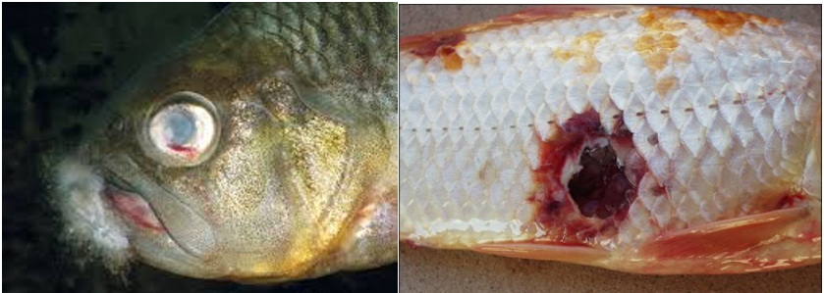
Project Background
Besides knowledge sharing or training process, observation is an important part of fish cultivation.
The fishermen observe the fish and if they find any problem of fishes, they go to the local fisheries office and talk to the officer.
The officer observes the fish, and suggests some treatments to the fisherman.
Fig. 1: Fungus Diseases

Slide 7
Current Problems
The training is informative.
The fishermen may forget all the things learned from the training when that information is necessary
Mistake may be done in fish firming
Proper treatment of fishes may be affected by manual process

Slide 8
Solution/ Way forward
To become one of the most digital countries in the world, we need digitalization/ automation in all the aspects of our life. So it is a crying need to develop an automatic application to share fish firming related knowledge among the mass people of Bangladesh. This will help to achieve the Vision 2021 to become a Digital Bangladesh.
An automatic application for fish skin diseases identification is necessary for rapid treatment.

Slide 9
Market Validation/ Market Research
At present there is no application which provides fish firming related digital contents in Bangali language.
Many working facilities can be created through high tech commercial fish farming system.
The unemployed educated people can also contribute this business and create a lucrative business and earning opportunity for them.
Earn more foreign currencies
Following entities will be benefited by this project
- Bangladesh Fisheries Research Institute (BFRI)
- Bangladesh Fisheries Development Corporation (BFDC)
- Fisherman
- Government of Bangladesh

Slide 10
Project Objectives
This application will provide step by step information (pond selection, preparation, etc.) for fish cultivation in Bengali language.
Build a fish database where at least 50 types of commonly firmed fish information will be stored.
App will contain different videos of fishes for increasing motivation in fish farming.
This app will also be acted as a doctor of fish.
Arrange some training or seminar for fish farmer on how to use this App.

Slide 11
Project Methodology
Knowledge Acquisition
Data Collection
Disease Identification and Treatment Process

Slide 12
Project Methodology
Application Design
ই – মৎস্য সার্ভিস
মাছ
মৎস্যচাষ পদ্ধতি
ছোট মাছ
মাছ
মৎস্যচাষ
বড়মাছ
উপযুক্ত জায়গা বাছাই
লোনাপানির মাছ
রোগ
প্রযুক্তি
পুকুর তৈরি ও সাজানো
মিঠাপানির মাছ
যোগাযোগ
সামুদ্রিক মাছ
মাছের প্রজাতি বাছাইকরণ
অর্থনৈতিক মাছ
ডাউনলড
যত্ন ও তত্ত্বাবধান

Slide 13
Project Methodology
App Development
Application
Mobile Based Solution
Web Based Solution
Database Development & Knowledge Sharing
Fish Disease Identification
Database Development & Knowledge Sharing

Slide 14
Project Methodology
Web and android based applications
Computer vision based fish disease identification
Release Phase
Training / Seminars

Slide 15
Project Technologies
Primary Programming Languages
Java
JavaScript
C/C++
PHP

Slide 16
Project Outcome
Globally Compatible Fish Farmers
Newly Joined Fish Farmers
Fish Doctor at Hand
Web Based Application
Revenue Growth in Fish Industry

Slide 17
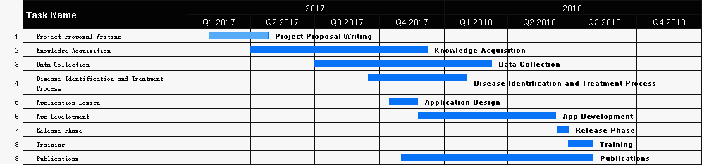
Project Timeline

Slide 18
Conclusion
As fish farming in Bangladesh has many benefits and opportunities, it is necessary to improve this earning opportunities for making a good profit from fish farming business.
So, in this proposal we have planned to prepare an android mobile based solution which will include
a structured step by step guideline for fish farming
identify the disease of the fish skin with proper prescription.
The successful completion of this project will lead to Bangladesh one step upward to achieve the Vision 2021 and 2041.

