Slide 1
Noise Adaptive Binary Pattern for Face Image
Analysis
Md. Mostafijur Rahman, Shanto Rahman, Minhas Kamal,
M. Abdullah-Al-Wadud, Emon Kumar Dey
and Mohammad Shoyaib
Presented By
Md. Mostafijur Rahman
Institute of Information Technology
University of Dhaka

Slide 2
Outline
Introduction
Existing Works
Problem Specification
Proposed Solution
Experimental Results and Discussion
  Face Recognition
  Gender Classification
  Expression Recognition
ICCIT 2015

Slide 3
Introduction
Face image analysis has recently gained popularity for different applications in computer vision including
  Face recognition
  Facial expression recognition
  Gender classification and
  Age recognition
Applications
  Biometrics
  Access control
  Surveillance System
  Market demand analysis etc.
ICCIT 2015

Slide 4
General Framework
Input Image
Feature Extraction
Feature Representation
Classification
Fig. 1: General steps in applications using face image classification
ICCIT 2015

Slide 5
Existing Works
Broadly categorized into two types of techniques
  Gradient based
    Histogram of Gradient (HOG) and its variants
    Scale Invariant Feature Transform (SIFT)
    Gabor Filters, etc.
  LBP based
    Local Binary Pattern (LBP)
    Local Gradient Pattern (LGP)
    Local Ternary Pattern (LTP)
    Local Tetra Pattern (LTrP)
    Local Direction Number Pattern (LDN)
    Local Derivative Pattern (LDP), etc.
ICCIT 2015

Slide 6
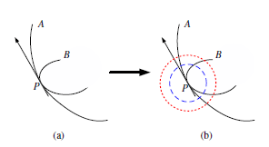
Problem Specification
Weakness of gradient based techniques
  Two same gradients may correspond to rather different local structures.
Fig. 2: Limitation of gradient based techniques
ICCIT 2015

Slide 7

Problem Specification
Basic LBP
5 | 9 | 1
4 | 4 | 6
7 | 2 | 3
1 | 1 | 0
1 |  | 1
1 | 0 | 0
Fig. 3: Basic LBP
ICCIT 2015

Slide 8
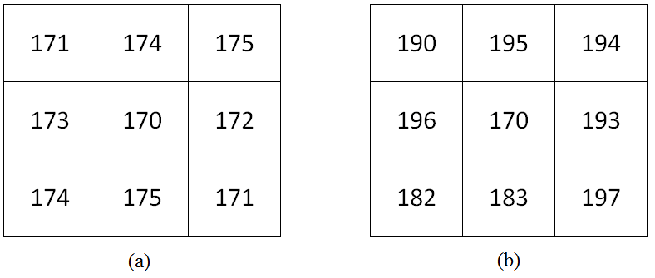
Problem Specification
Weakness of LBP based techniques
  Lack of discriminative power
Fig. 4: LBP produces same pattern for (a) small and (b) large differences
ICCIT 2015

Slide 9
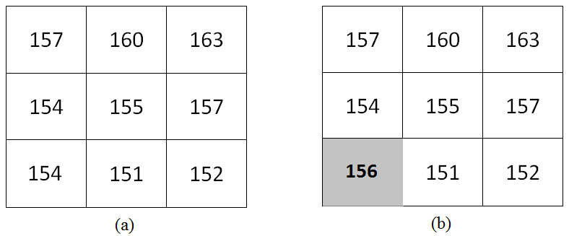
Problem Specification
Weakness of LBP based techniques
  Sensitive to noisy intensity fluctuation
Fig. 5: (a) Original texture, (b) texture change for intensity fluctuation
ICCIT 2015

Slide 10
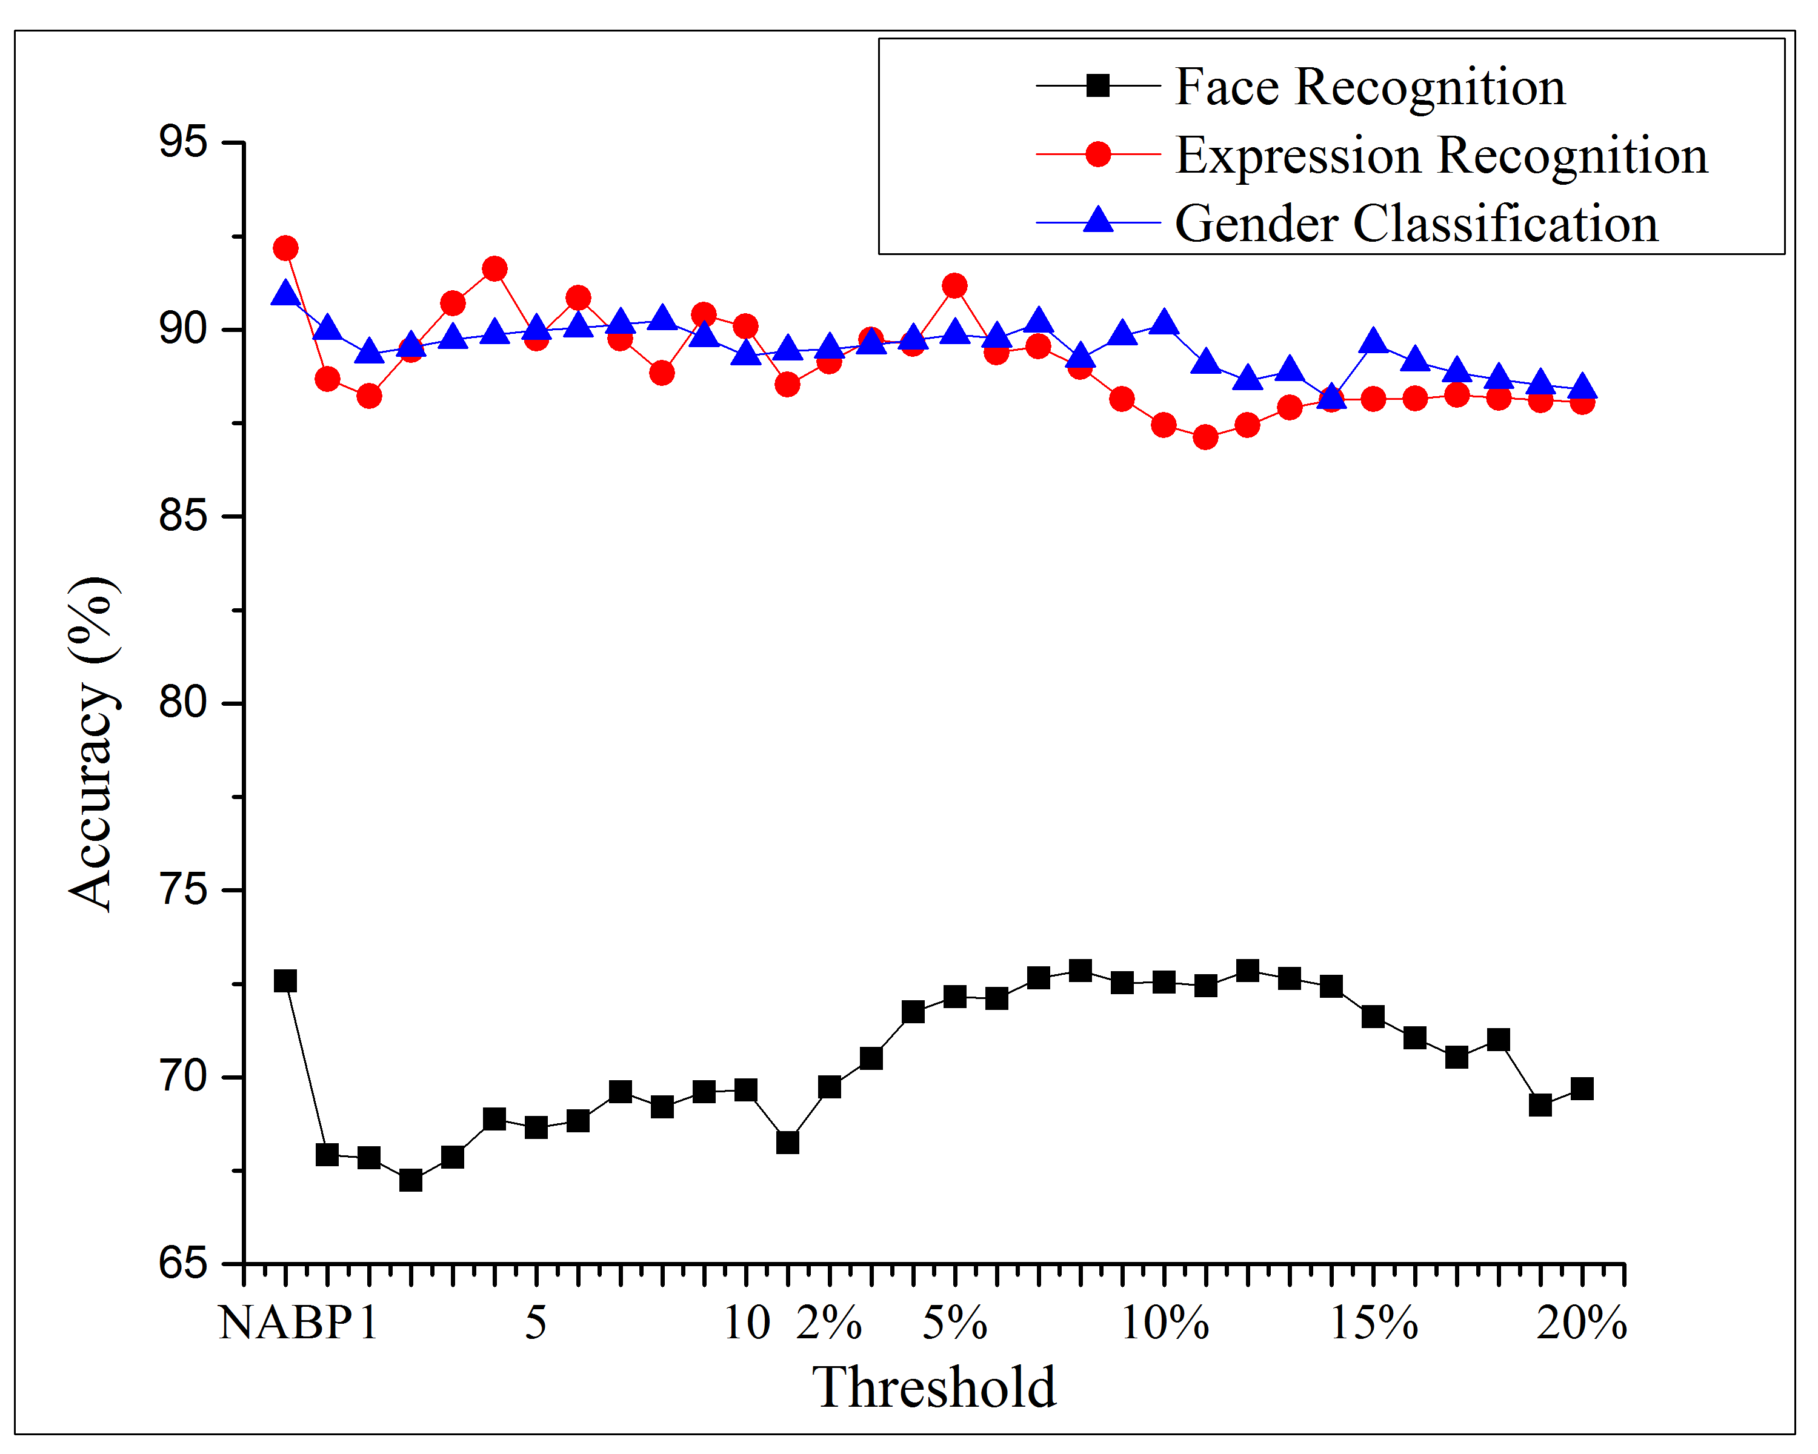
Analyzing the thresholds
LBP
Fig. 7: Face, gender and expression recognition using different thresholds
ICCIT 2015

Slide 11

Proposed Solution
Feature extraction using adaptive threshold
Fig. 8: NABP feature coding procedure where Ta=3
ICCIT 2015

Slide 12
Properties of NABP
Discriminative power
Fig. 9: NABP produces different patterns for (a) small and (b) large differences
ICCIT 2015

Slide 13
Properties of NABP
Noise adaptive
Fig. 10: Noise adaptiveness of NABP (a) original texture, (b) texture change for intensity fluctuation
ICCIT 2015

Slide 14
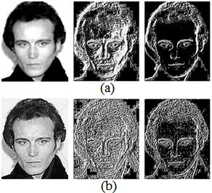
Noise Adaptiveness of NABP
Fig. 11: Validating noise adaptiveness of NABP (a) original texture, (b) noisy texture
ICCIT 2015

Slide 15
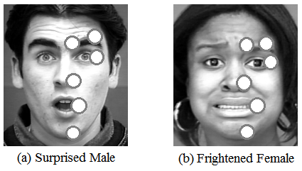
Nature of Face Image
Fig. 12: Some prominent points in face
ICCIT 2015

Slide 16
Experimental Evaluation
Face Recognition
  Original LFW and LFW aligned datasets
Expression Recognition
  Extended Cohn Kanade (CK+) dataset
Gender Classification
  LFW dataset
ICCIT 2015

Slide 17
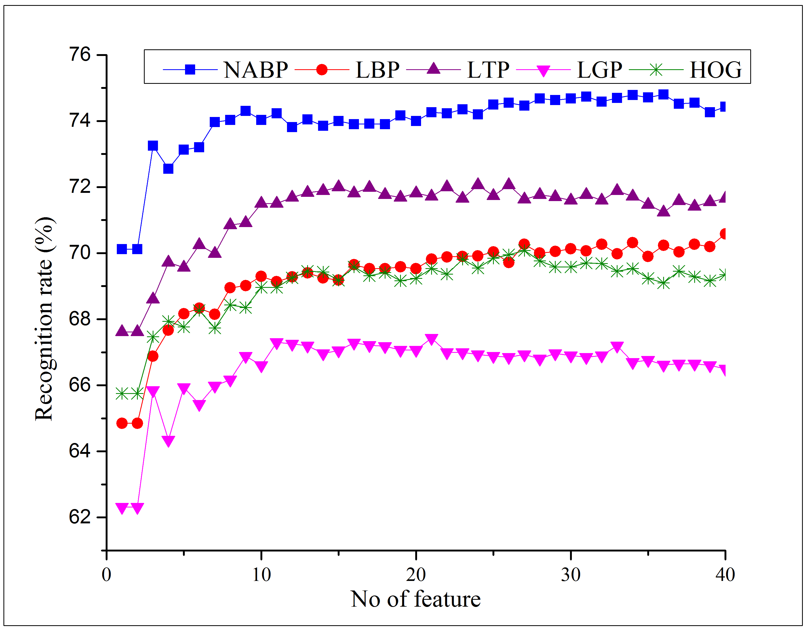
Face Recognition Results
Fig. 6: NABP feature coding procedure where Ta=3
Fig. 13: Face recognition results in LFW
ICCIT 2015

Slide 18
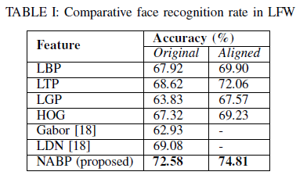
Face Recognition Results
ICCIT 2015

Slide 19
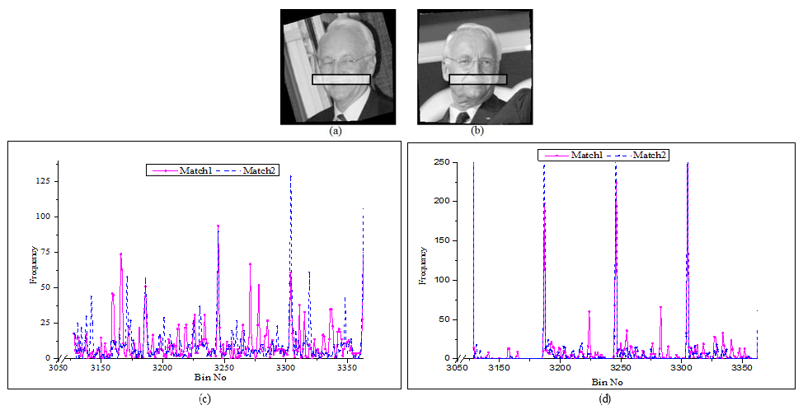
Discussion
ICCIT 2015

Slide 20
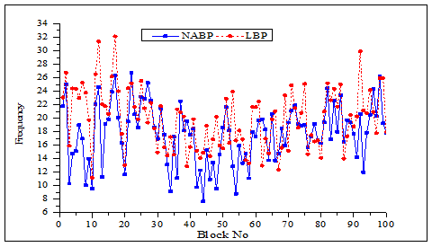
Discussion
ICCIT 2015

Slide 21
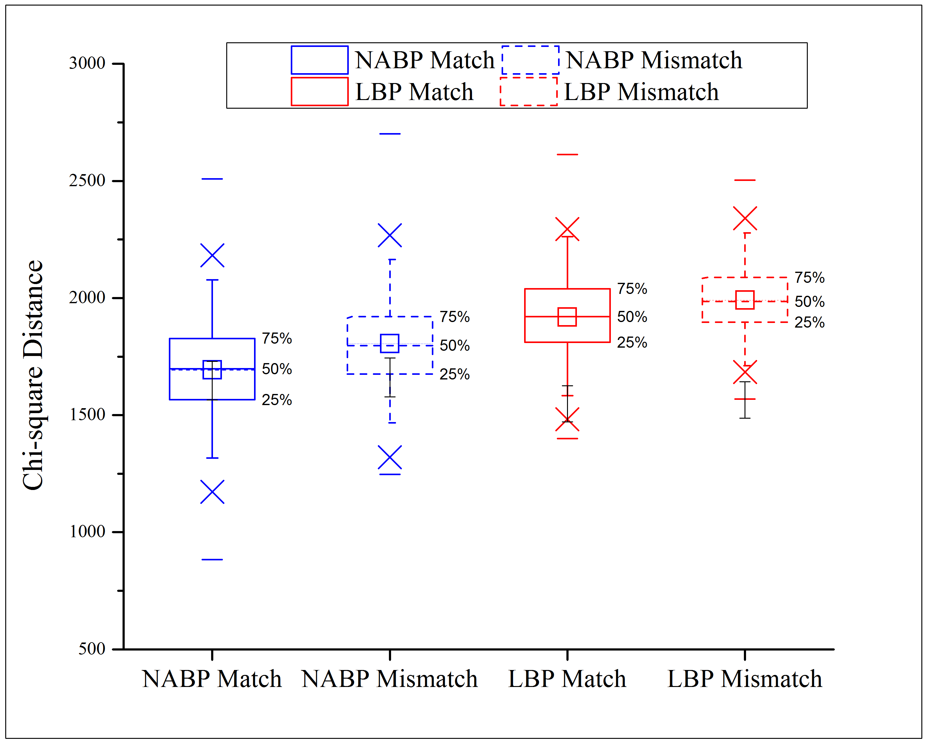
Discussion
ICCIT 2015

Slide 22
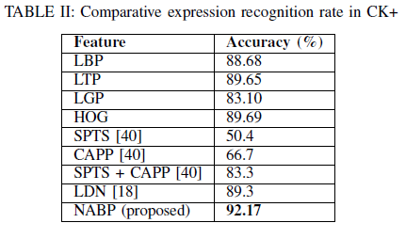
Expression Recognition Results
ICCIT 2015

Slide 23
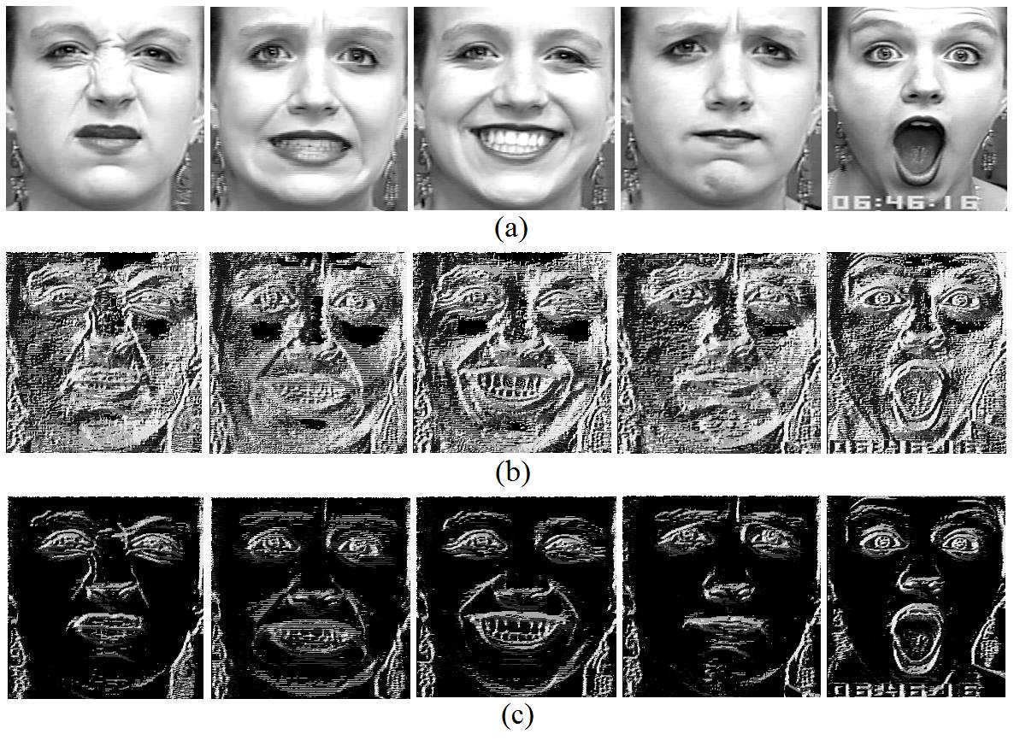
Discussion
ICCIT 2015

Slide 24
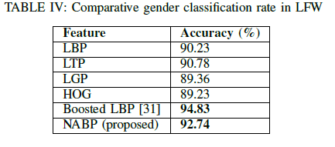
Gender Classification Results
ICCIT 2015

Slide 25
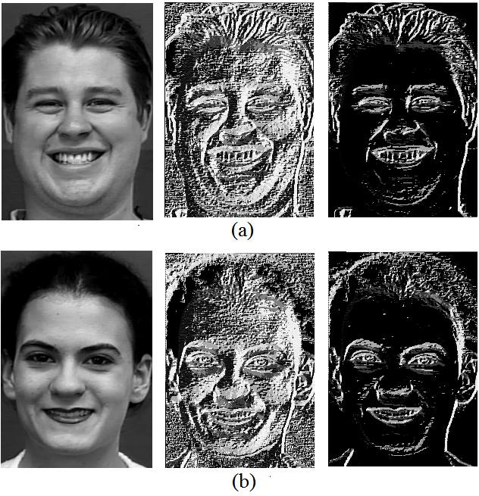
Discussion
ICCIT 2015

Slide 26
References
[1] Ojala, Timo, Matti Pietikäinen, and Topi Mäenpää. "Multiresolution gray-scale and rotation invariant texture classification with local binary patterns." Pattern Analysis and Machine Intelligence, IEEE Transactions on 24, no. 7 (2002): 971-987.
[2] Ahonen, Timo, Abdenour Hadid, and Matti Pietikainen. "Face description with local binary patterns: Application to face recognition." Pattern Analysis and Machine Intelligence, IEEE Transactions on 28, no. 12 (2006): 2037-2041.
ICCIT 2015

Slide 27
Any Question?
ICCIT 2015

Slide 28
Thank You
ICCIT 2015

