Slide 1

Student ID: M25011974
FRAUD DETECTION SYSTEM
BFDS FalconEye
Real-Time Fraud Detection
& Investigation Platform
Presented by:
Md Mostafijur Rahman Student ID: M25011974
Jyotish Batra Student ID: J24020471
Date: 23 April, 2026

Slide 2




Executive Summary
Project Overview
Purpose
Comprehensive fraud detection platform combining SQL Server automation, Flask REST API, and web-based UI.
Detect suspicious transaction patterns, alert investigators, and provide real-time monitoring.
Key Value
Technology Stack
Automated rule-based detection with role-based access control for secure investigation workflows.
Python / Flask · SQL Server · HTML / JavaScript · bcrypt password hashing
2 / 12

Slide 3



System Architecture
Database Layer
API Layer
UI Layer
SQL Server · Tables · Triggers · Stored Procedures
Flask REST API · JWT Auth · ODBC · 20+ Endpoints
HTML Dashboard · Real-Time Monitoring · Role-Based Navigation
Transactions
→
SQL Triggers
→
Fraud Rules
→
Alerts
→
Dashboard
3 / 12

Slide 4
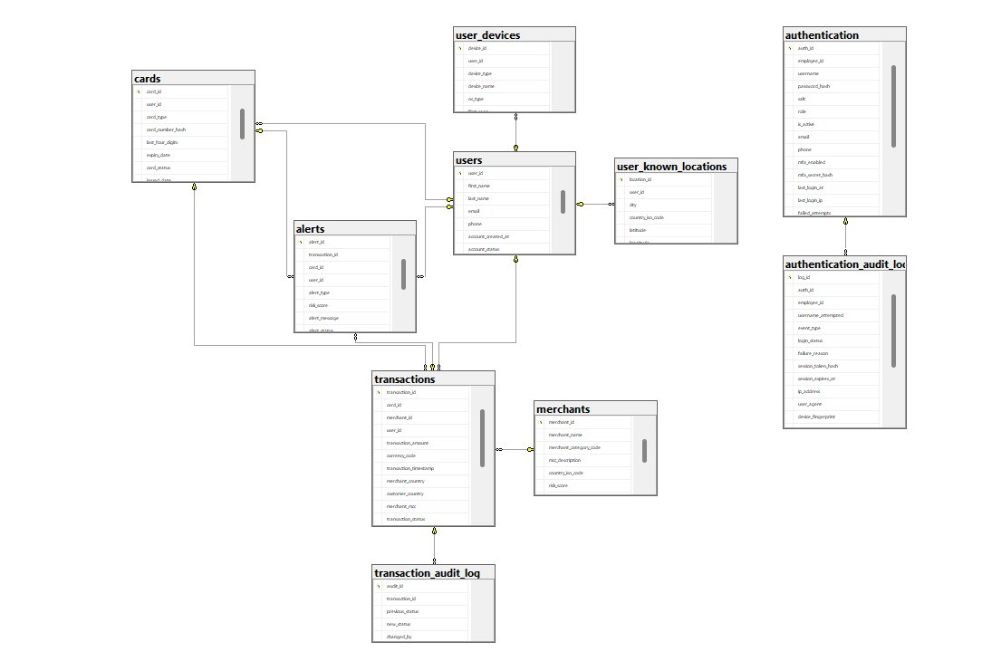
Database Schema Overview
4 / 12

Slide 5


Fraud Detection Rules
Rule 1: Geographic Impossibility
Rule 2: Structured Transactions
Detects transactions from physically impossible locations
Identifies transactions just below reporting thresholds
Threshold: 900 km/h (commercial airline speed ceiling)
Detects multiple small transactions to avoid detection
Uses Haversine formula for great-circle distance
Stored procedure analyzes transaction patterns
Automatically declines suspicious transactions
Generates alerts for suspicious structuring behavior
5 / 12

Slide 6


Technical Implementation
Backend (Python / Flask)
Frontend (HTML / JavaScript)
RESTful API with 20+ endpoints
Single-page application architecture
JWT authentication with bcrypt password hashing
Dynamic data loading from API
ODBC connection to SQL Server
Role-based navigation filtering
CORS enabled for cross-origin requests
Modal forms for record creation & updates
Environment-based configuration (.env)
Real-time dashboard statistics
6 / 12

Slide 7



Role-Based Access Control
Super Admin
Analyst
Compliance
Full system access & user management
View & investigate alerts, update transactions
Create records, update merchant & user data
Security Features
Auto-generated employee IDs (EMP-{ROLE}-{XXX})
bcrypt password hashing
Failed attempt tracking with account lockout
Immutable authentication audit logging
Multi-factor authentication (MFA) support
7 / 12

Slide 8
Fraud Detection Workflow
Automated Detection
Investigation Workflow
1
Transaction Inserted
Analyst Reviews Alert
Record added to transactions table
Alert details and transaction context
2
SQL Trigger Fires
ON INSERT trigger activates
Updates Investigation
Adds notes and findings
3
Rules Evaluated
Stored procedure checks fraud rules
Status Progression
open → acknowledged → resolved
4
Violation Detected
Status set to 'declined' + alert created
False Positive Reversal
5
Dashboard Updated
Transaction status can be corrected
Real-time alert for investigator
8 / 12

Slide 9



Key Features & Capabilities
Real-Time Detection
Investigation Tools
Security & Compliance
Automated trigger-based fraud detection
Alert filtering by status and type
Immutable audit logging
Instant alert generation
Transaction audit trail
Role-based permissions
Transaction status updates
Geographic visualization
Merchant blacklisting
Device trust management
Account lockout after failed attempts
9 / 12

Slide 10
Deployment Architecture
Development Environment
Production Considerations
Python 3.9+ virtual environment
nginx reverse proxy
HTTPS / TLS encryption
SQL Server 2016+ (or Azure SQL)
Restricted CORS origins
ODBC Driver 17 / 18
Dedicated SQL login (minimal permissions)
Flask development server
Strong JWT secrets
10 / 12

Slide 11


Project Status & Future Enhancements
Current Status (v1.0)
Future Enhancements
Complete database schema
Machine learning-based fraud detection
Role-based authentication system
Real-time transaction streaming
Geographic impossibility detection
Structured transaction pattern detection
Advanced analytics dashboard
Flask REST API with JWT authentication
Mobile application
Web-based monitoring UI
Integration with external fraud databases
Automated alert generation
11 / 12

Slide 12
Questions & Discussion
FalconEye · Bank Fraud Detection System
Thank you for your attention

