Slide 1


Mathbazar
Fresh for you

Slide 2


Our Team
Mostafizur Rahman
221-15-5316
Khatmoon Nur Maharu
221-15-5421
Sakibul hassan Omi
221-15-5518
Redita Islam Katha
221-15-5328

Slide 3


Introduction
Our website is food delivery based.We strive to make sure that our clients receive the products we provide, which originate directly from the farms or fields of our farmers and vendors, within the allocated time span.

Slide 4

Motivation
Lack of Proper platform
knowledge gap
Lack of Faithfullnes

Slide 5
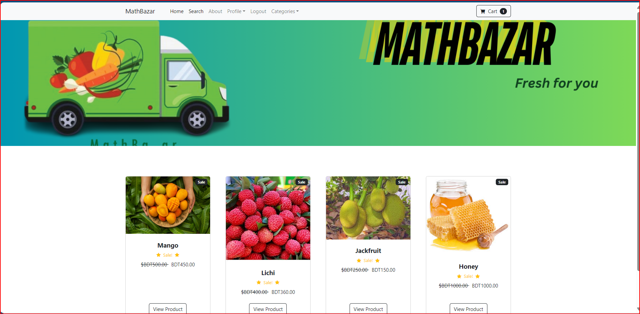
Our website

Slide 6
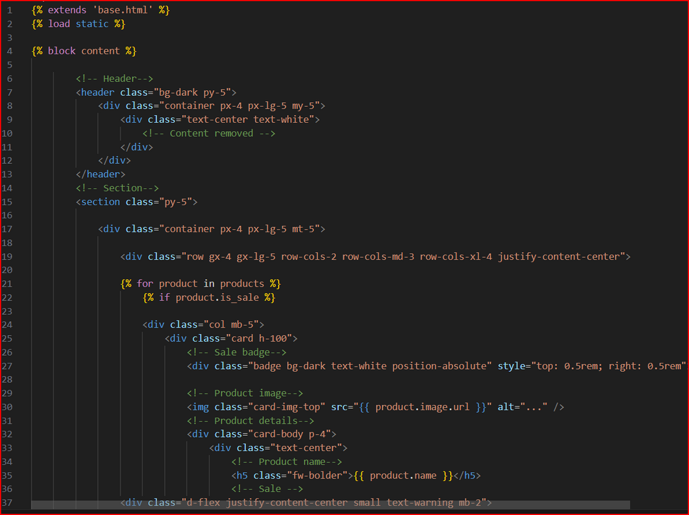
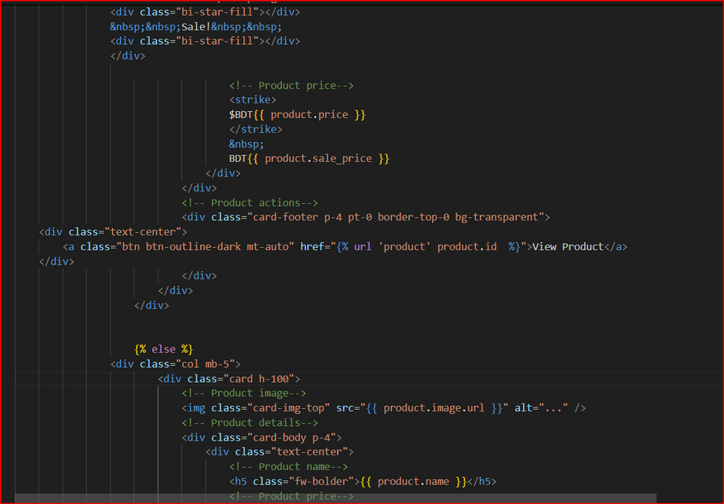
Home page code

Slide 7





Main Process
AGENT
Customer
Seller

Slide 8


Reference
Foodpanda
Chaldal

Slide 9



Our uniqueness
Proper information
Fesh food
proper management
Farmer and customer benefit
time sense

Slide 10
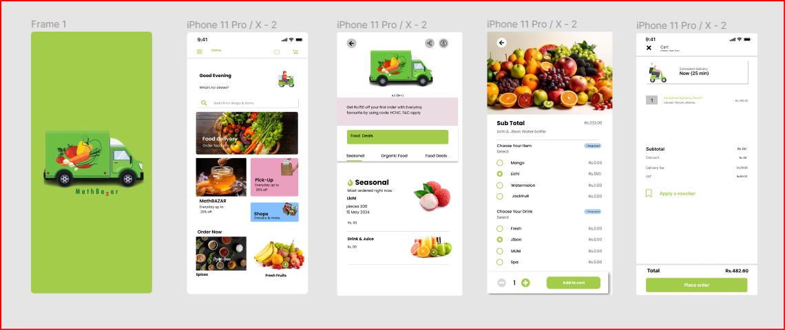
Future Goal

Slide 11




Tools
Front End
Framework
Backend
Html,
Css,
java script
Django
java

Slide 12
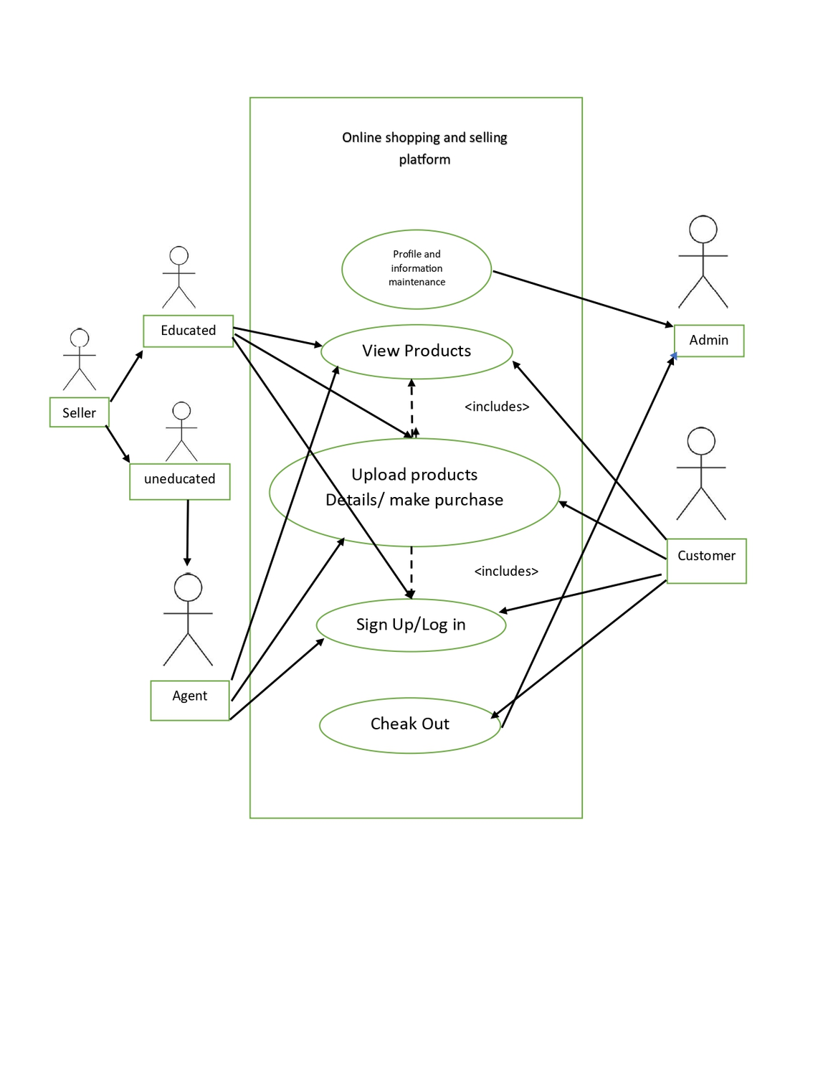
Process

Slide 13


Future Goal
Mobile Application
Buyer seller chat
Agent modification
AI based features

Slide 14




Thanks!
Do you have any questions?
mathbazar@gmail.com
+8801310251899
mathbazar.com
.

