Slide 1
Welcome to
Meeting Call
Web application Project

Slide 2
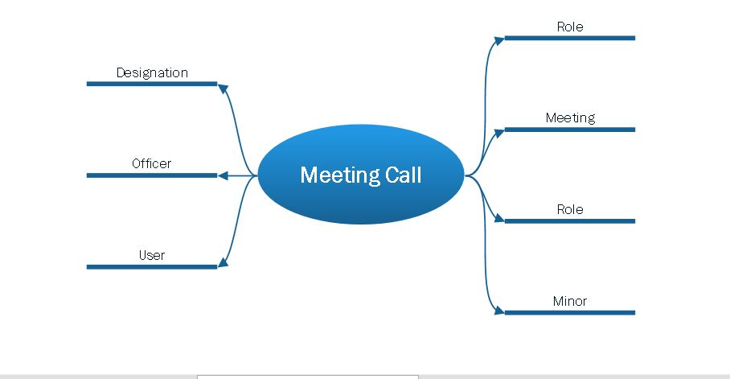
Brain Storming

Slide 3
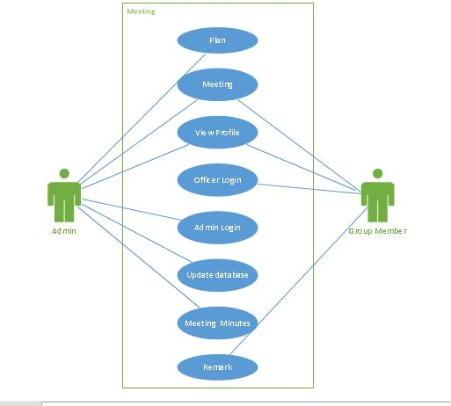
Use Case

Slide 4
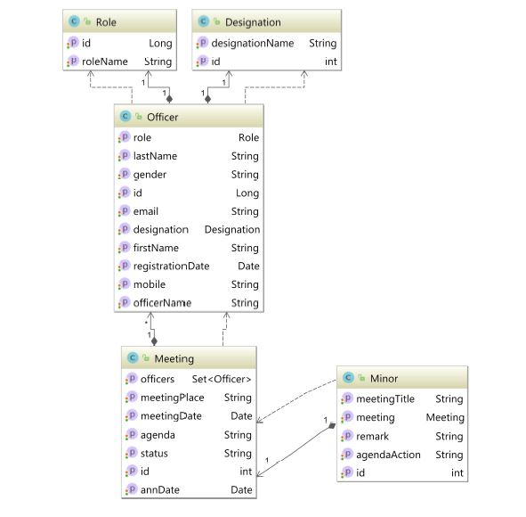
Entity Relationship Diagram

Slide 5
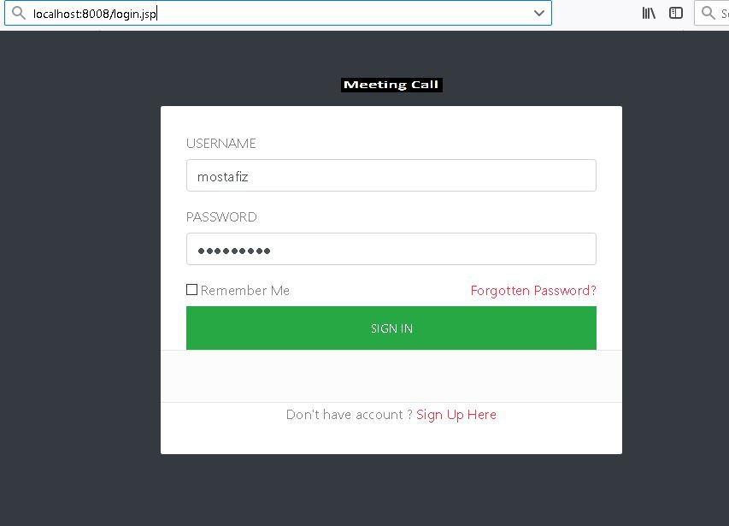
Login

Slide 6
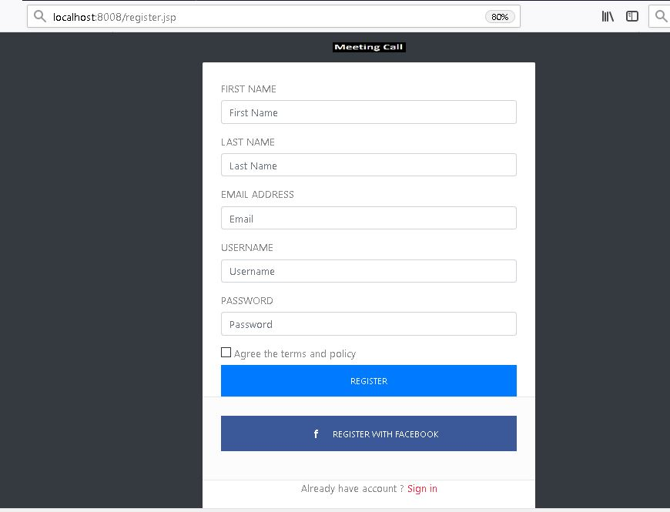
Registration

Slide 7
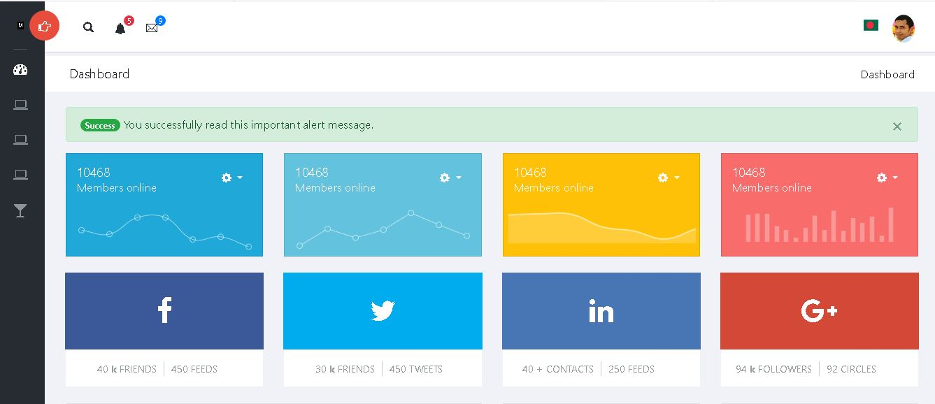
Dash Broad

Slide 8
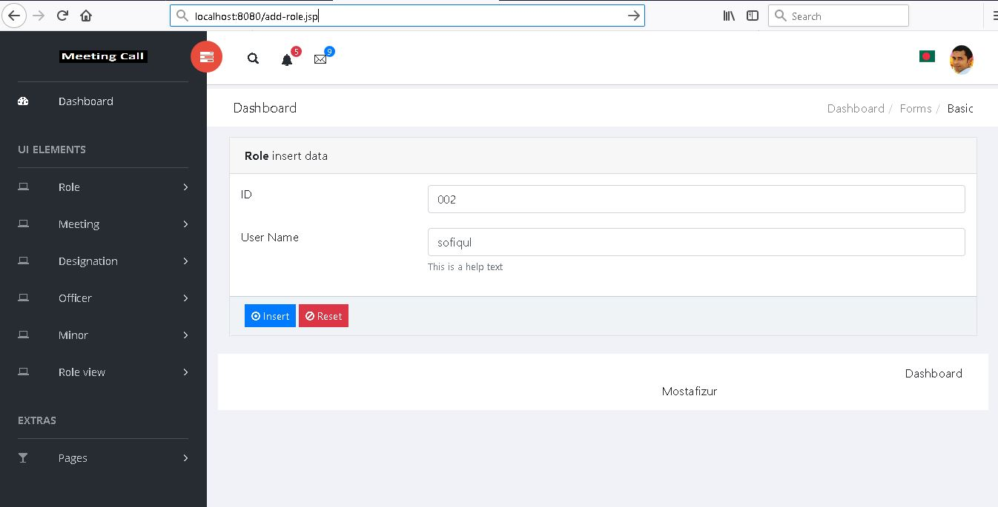
Role

Slide 9
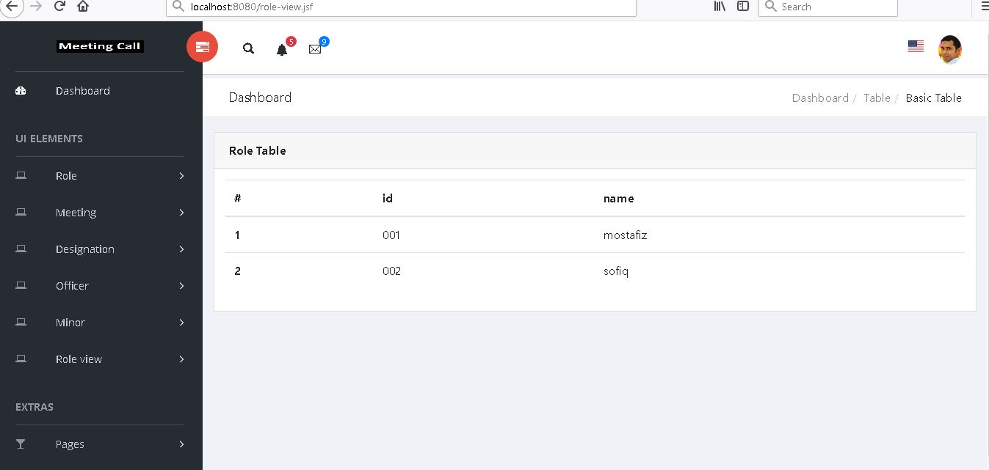
Role View

Slide 10
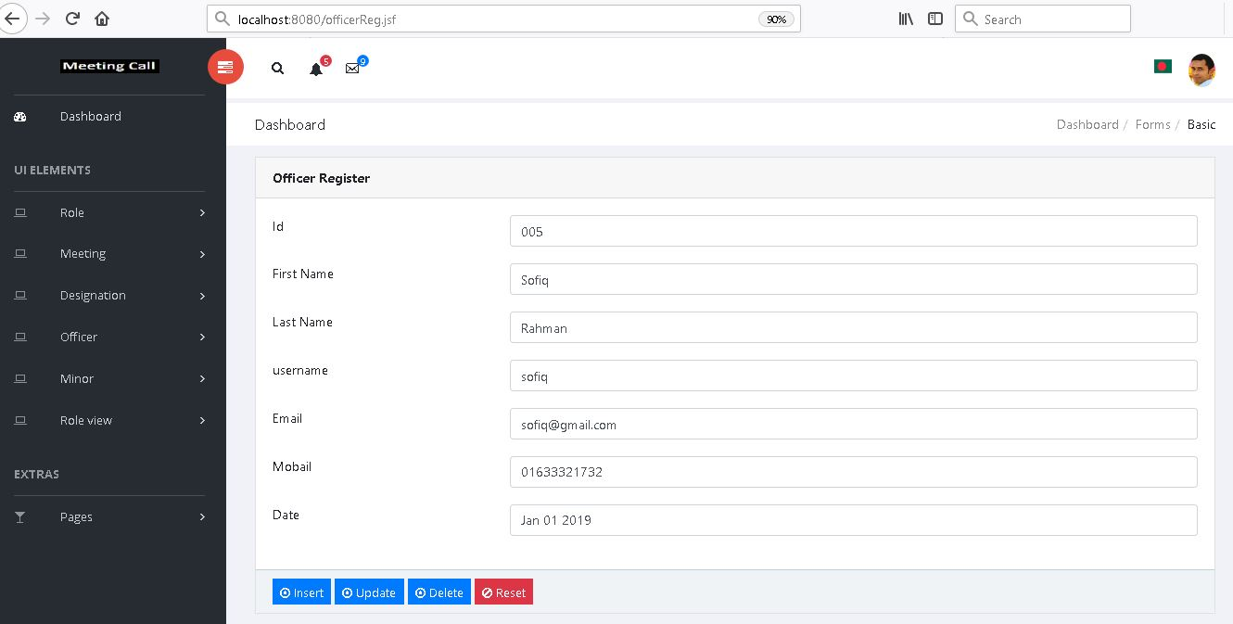
Officer Registration

Slide 11
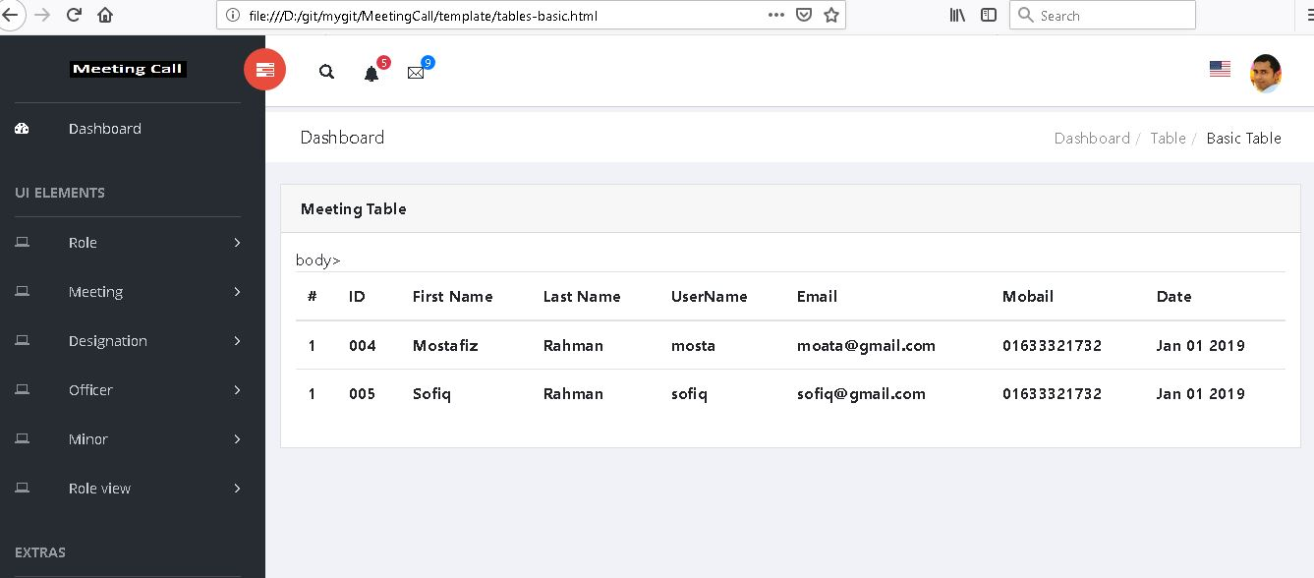
Officer Registration

Slide 12
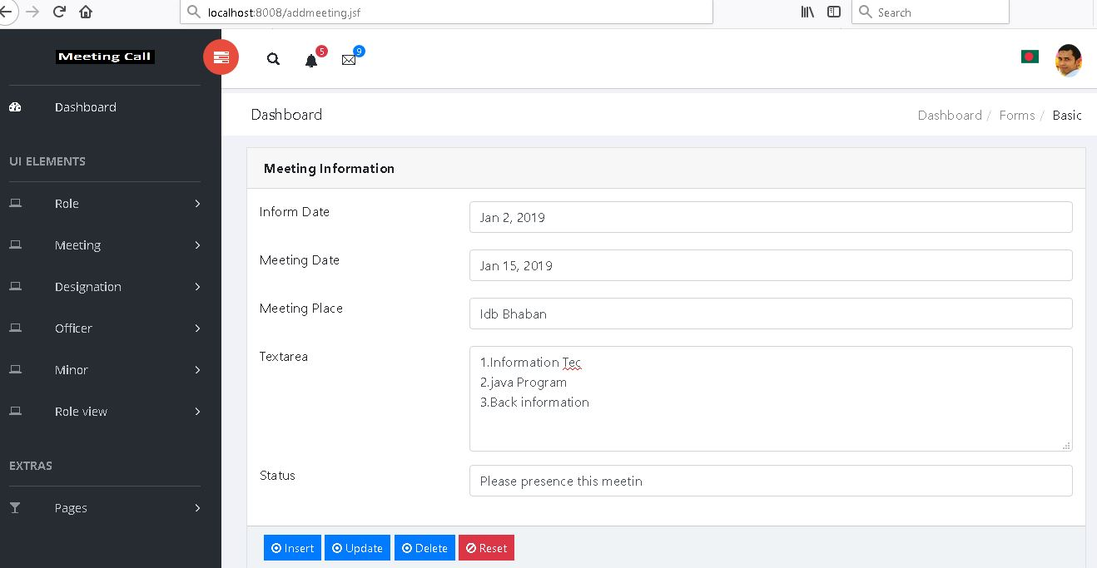
Meeting call

Slide 13
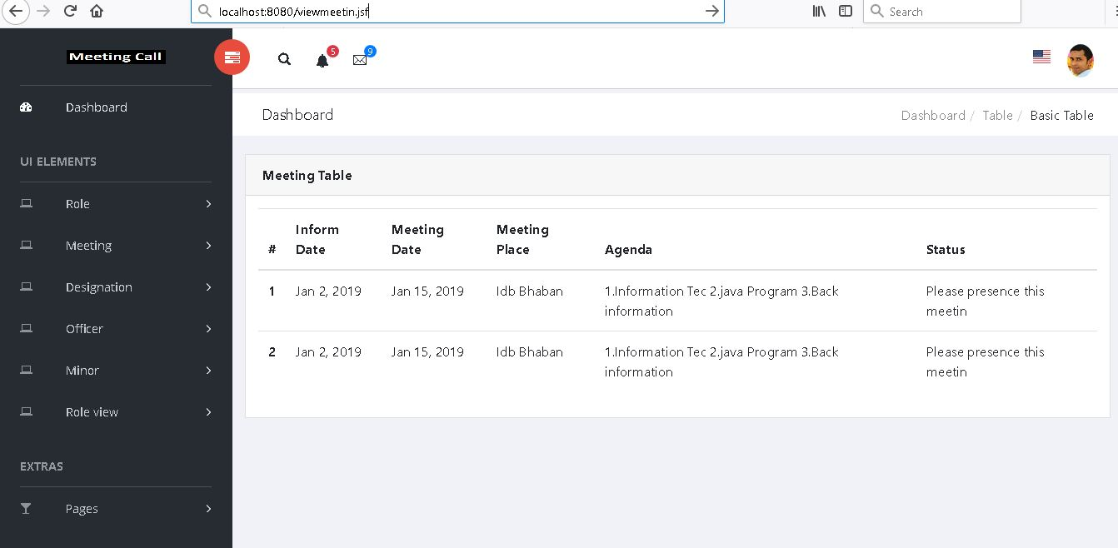
Meeting view

Slide 14
Thank you sir

