Slide 1
Welcome to
Meeting Call
Web application Project

Slide 2
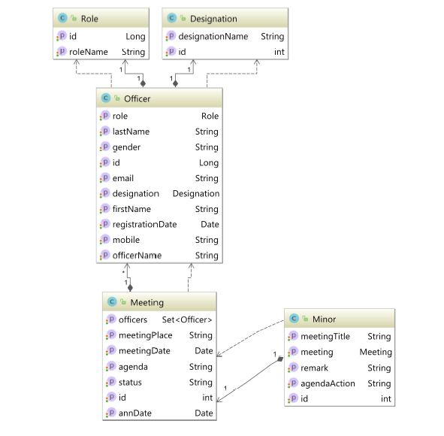
Entity Relationship Diagram

Slide 3
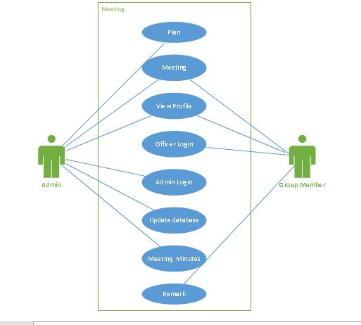
Use Case

Slide 4
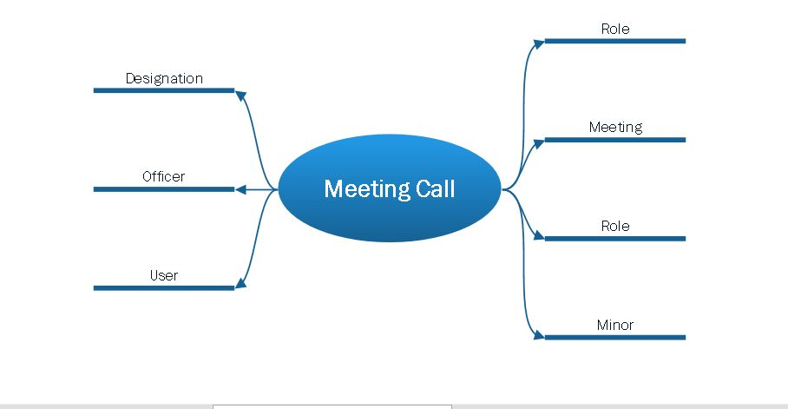
Brain Storming

Slide 5
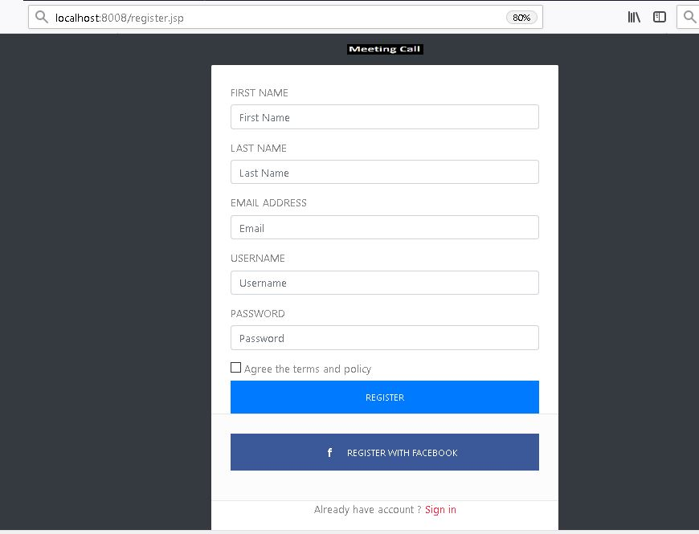
Registration

Slide 6
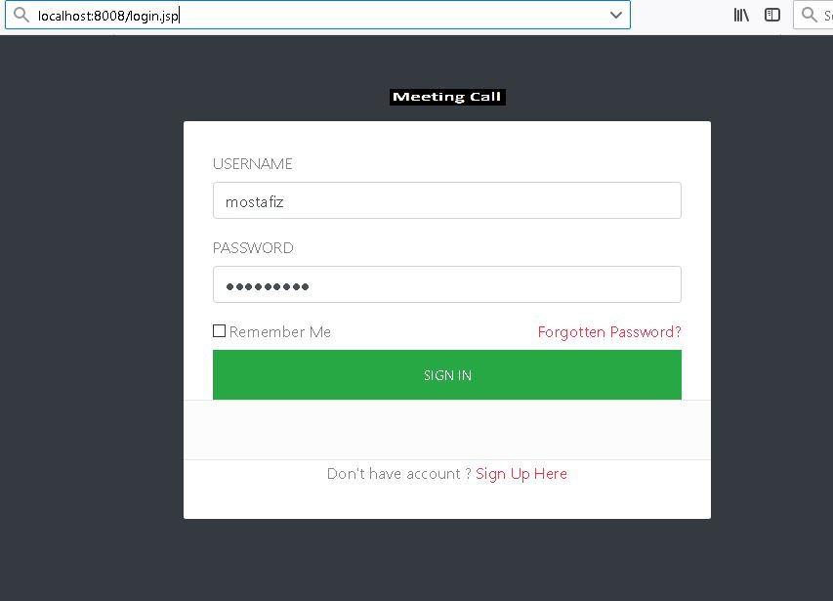
Login

Slide 7
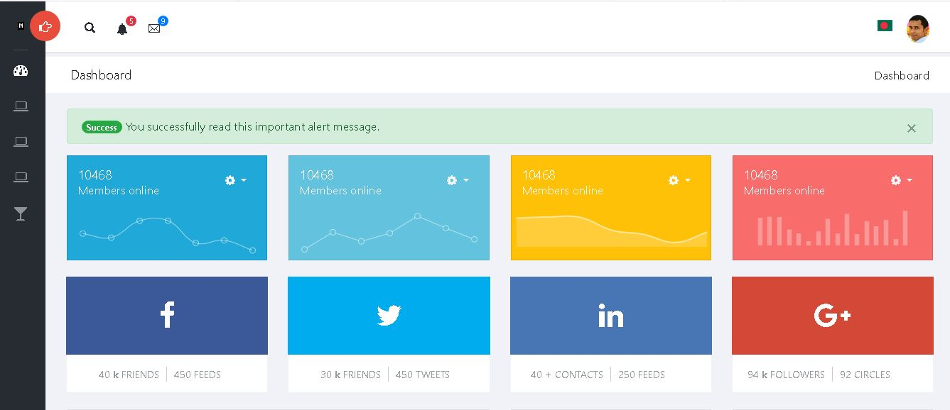
Dash Broad

Slide 8
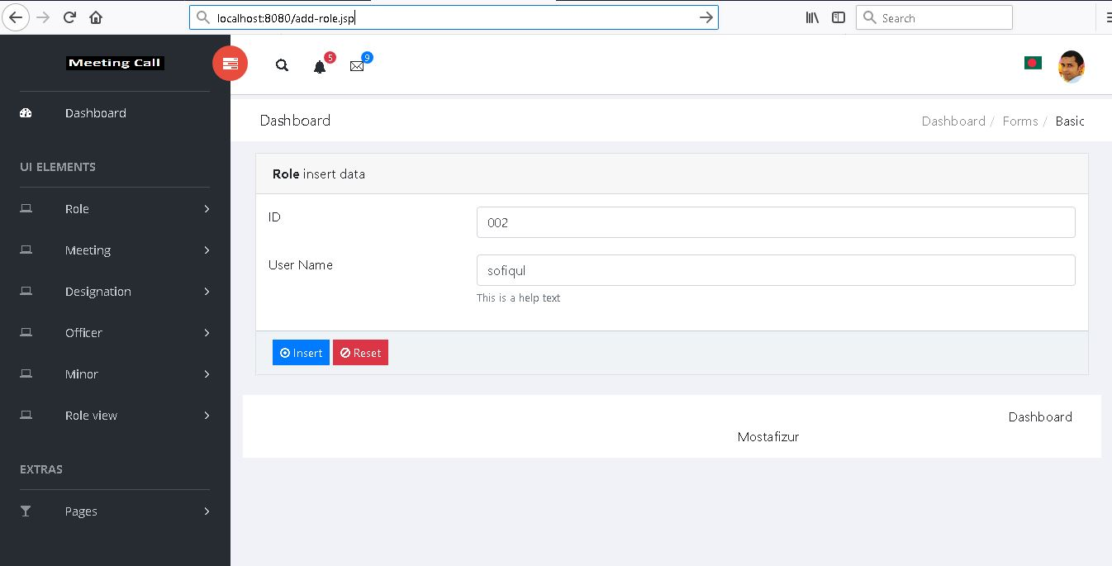
Role

Slide 9
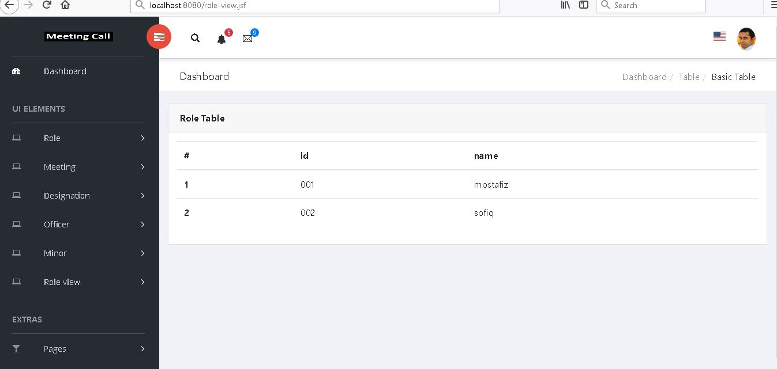
Role View

Slide 10
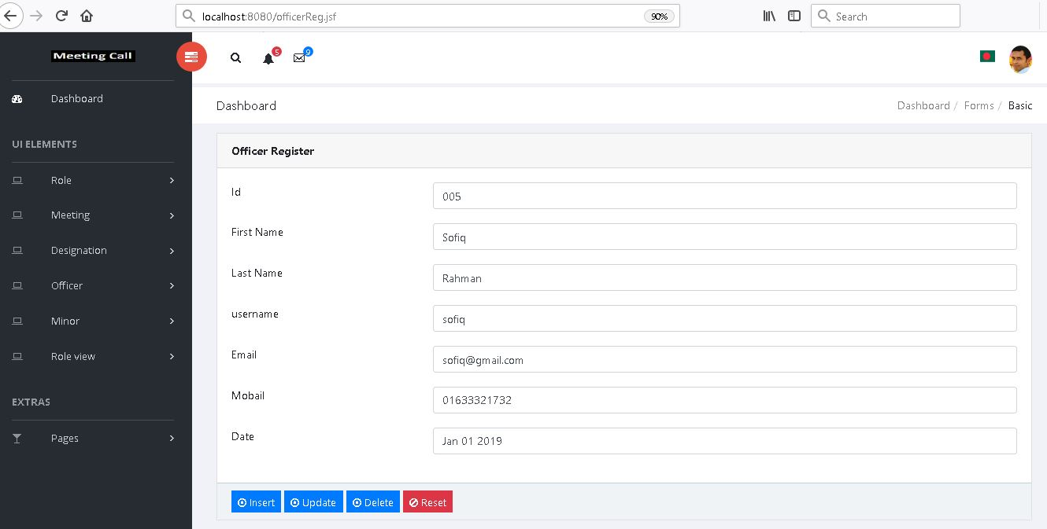
Officer Registration

Slide 11
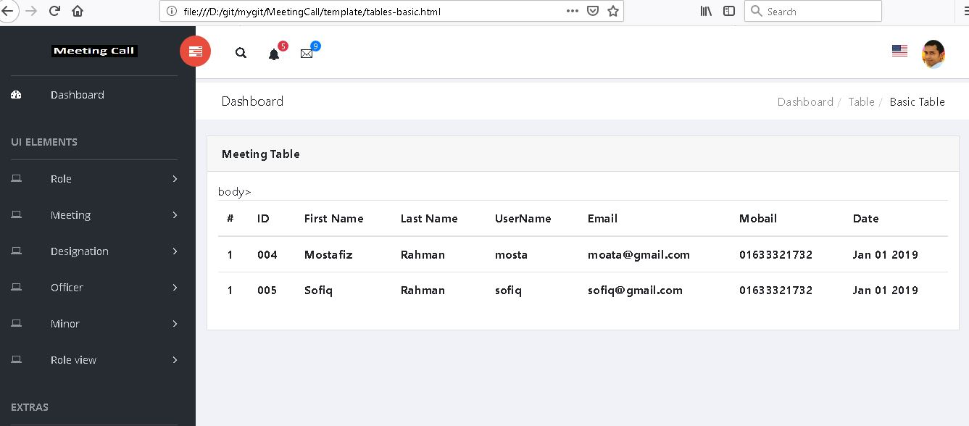
Officer Registration

Slide 12
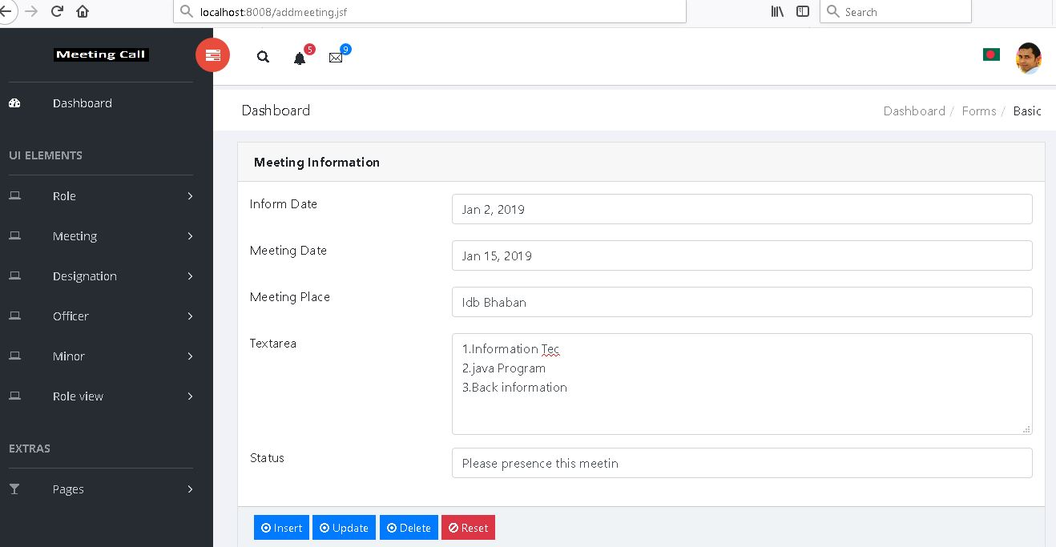
Meeting call

Slide 13
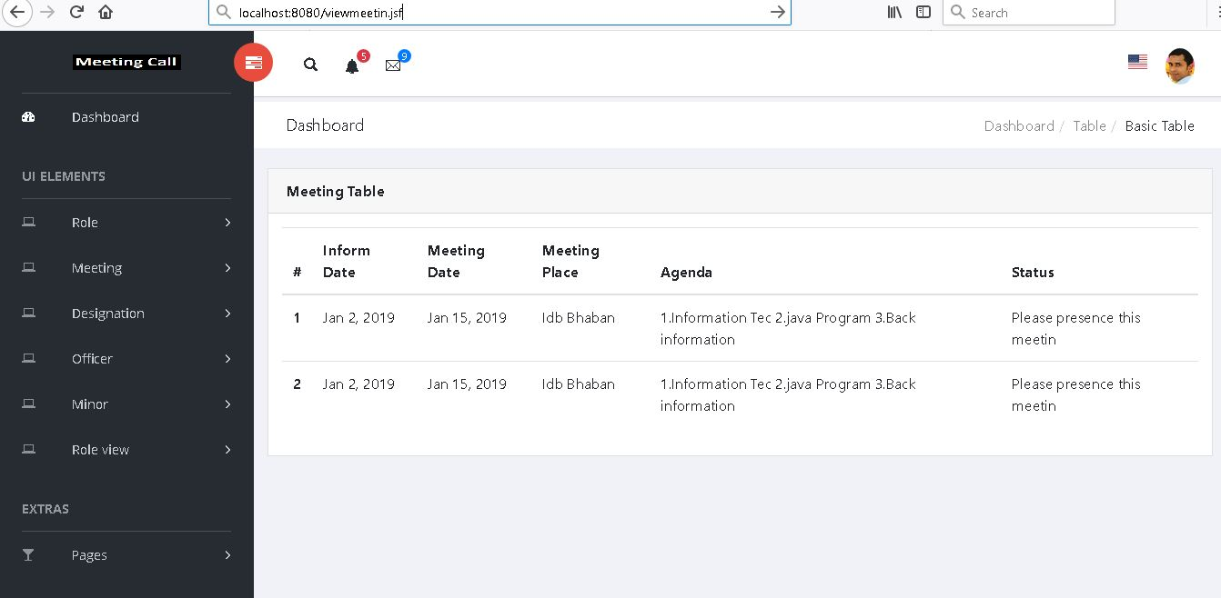
Meeting view

Slide 14
Thank you sir

