Slide 1
Welcome
Name
Roll Bach Id
Email

Slide 2
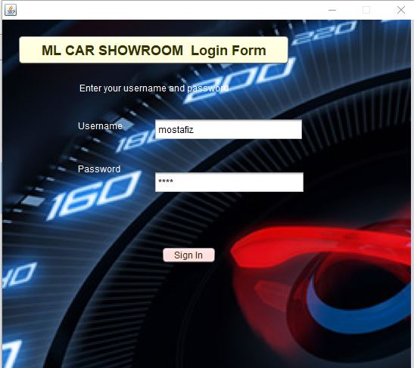
Login Page

Slide 3
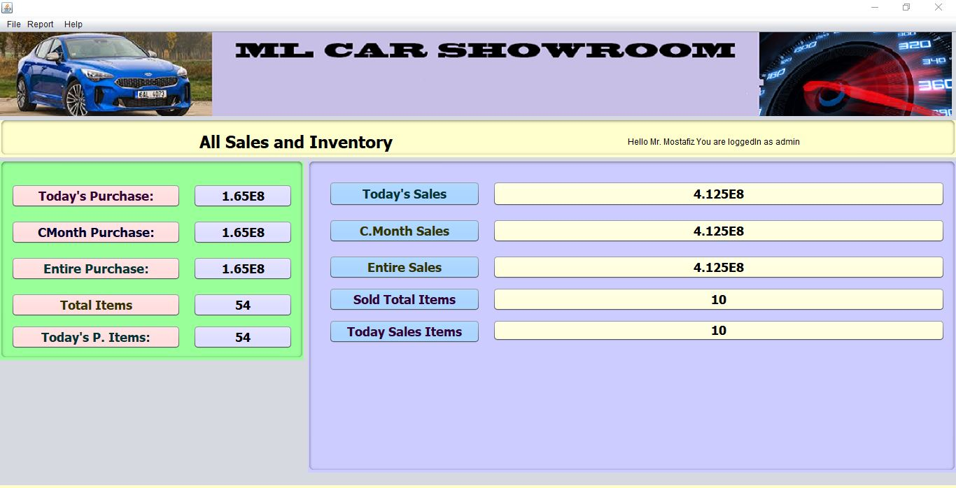
Purchase and sales Report

Slide 4
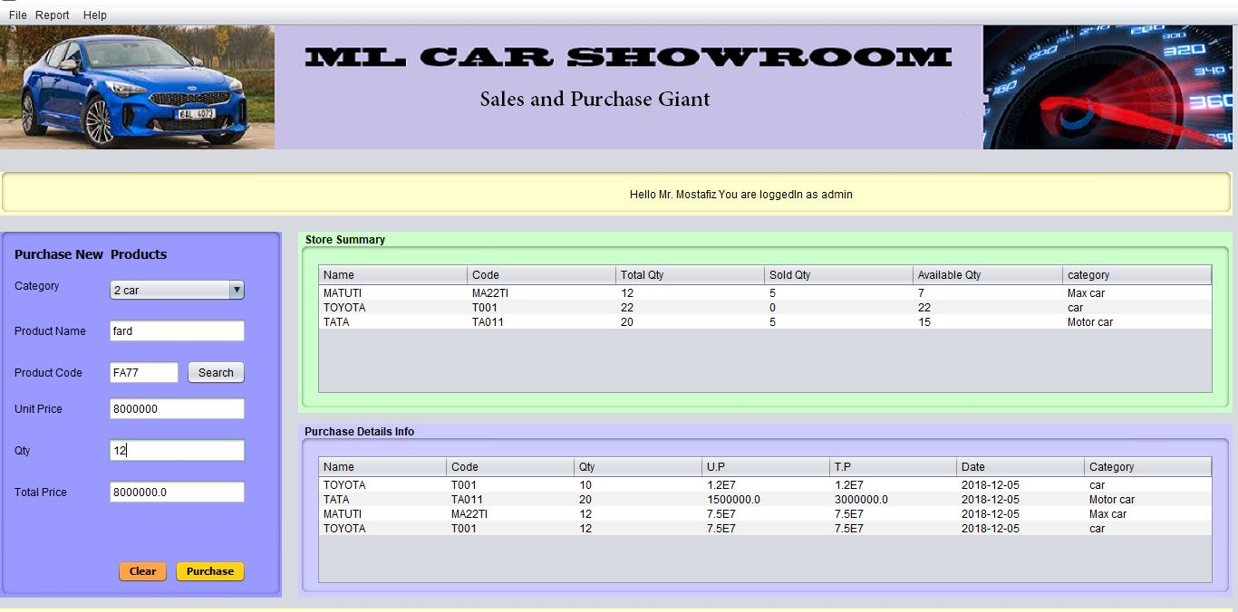
Purchase

Slide 5

After Purchase

Slide 6
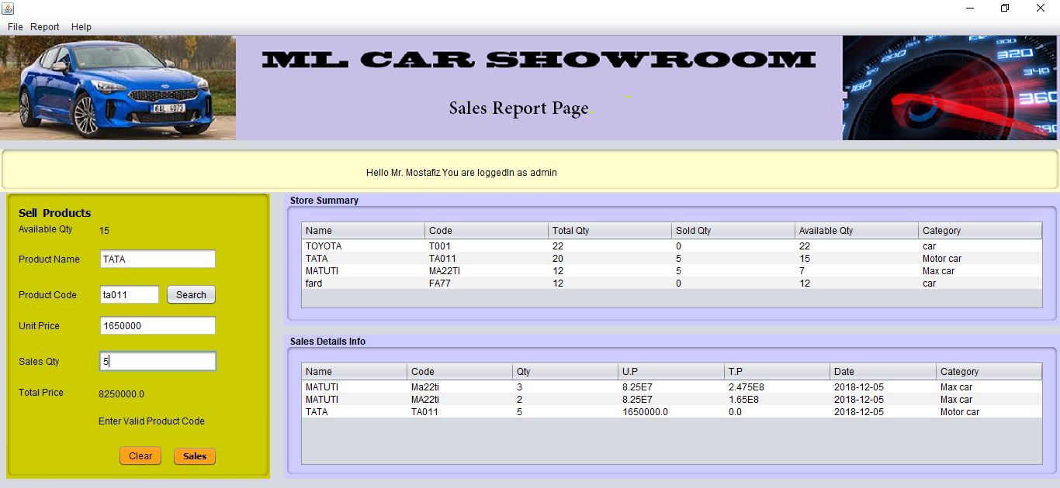
Sales

Slide 7
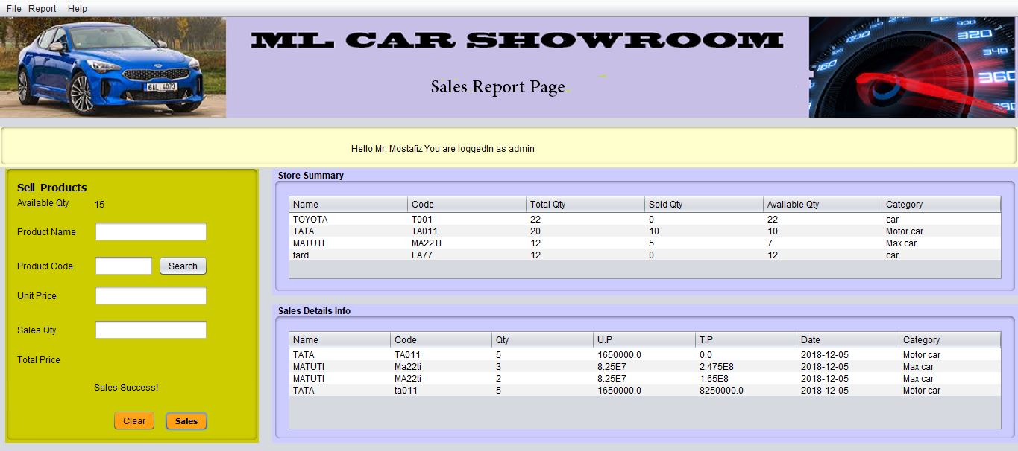
After Sales

Slide 8
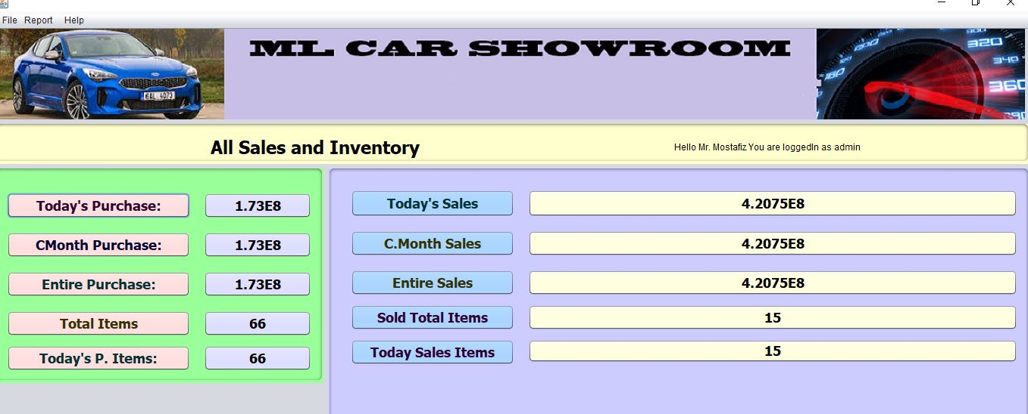

Slide 9
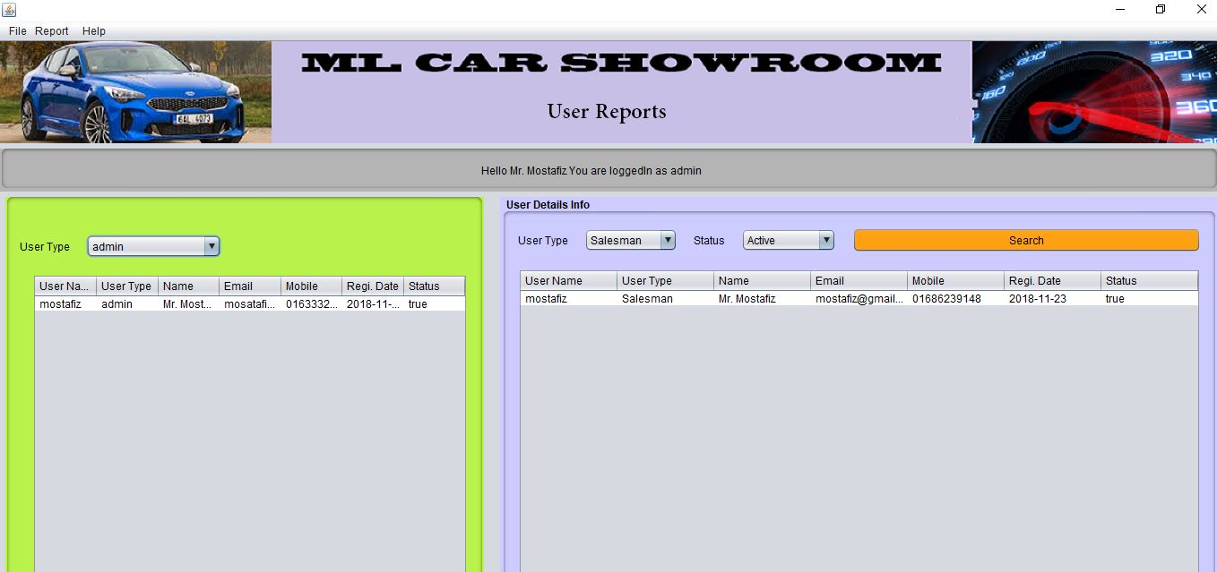
User Report

Slide 10
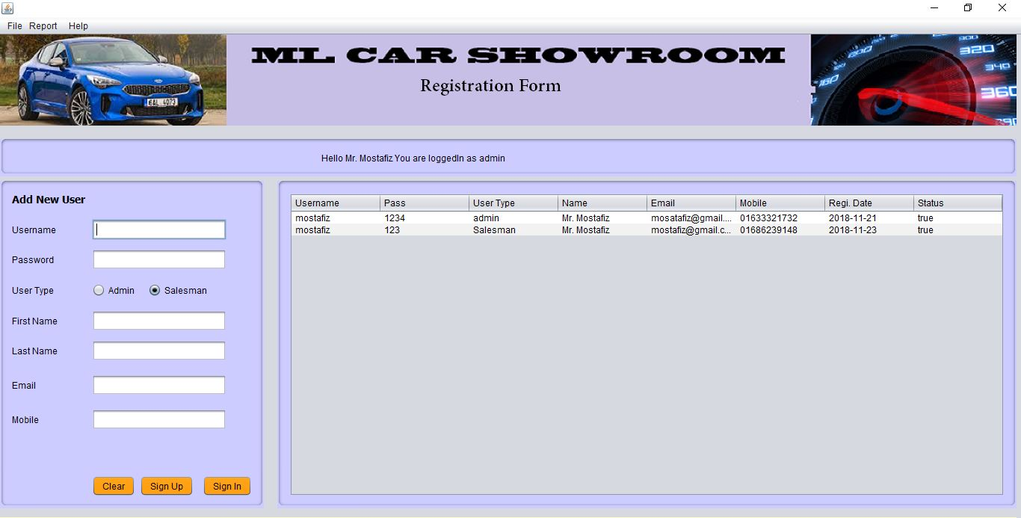
User Registration

Slide 11
Thank you sir
For visiting inventory management system

