Slide 1
Discrete Mathematics
Introduction

Slide 2
Discrete mathematics
Course No.: CSE 2101
Course Title: Discrete Mathematics
Prerequisite: None (√CSE 1101 & √ CSE 1201)
Contact hours/week: 3
Credits: 3.00

Slide 3
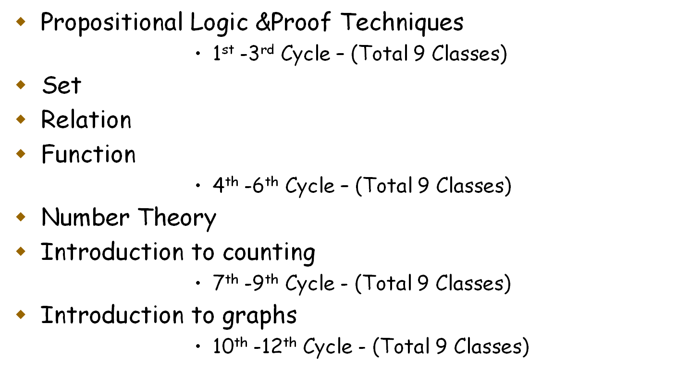
Course Description

Slide 4
Grading
Quizzes/Class Test: 20 Marks*
  (3 best out of 4 quizzes/class tests may be taken for awarding grade)
Homework’s/Attendance: 8 Marks*
Semester Exam: 72 Marks
* - We reserve the right to change the above grading scheme.

Slide 5
Homework’s
A new homework is released and is then due after 9 days.
No grade will be given to homework submitted afterwards.
Homework solutions should be written and submitted individually.

Slide 6
Referred Books
Kenneth H. Rosen - Discrete Mathematics and its Applications, Tata McGraw-Hill. (7th Edition)
Eric Lehman, F. Thomson Leighton, Albert R. Meyer - Mathematics for Computer Science.
Rnald L. Graham, Donald E. Knuth and Oren Patashnik – Concrete Mathematics.
S. G. Telang – Number Theory.
Other…

Slide 7
Sessional Based on CSE 2101
Course No.: CSE 2102
Course Title: Sessional Based on CSE 2101
Prerequisite: None (√CSE 1102 & √ CSE 1202)
Contact hours/week: 3.00
Credits: 1.5

Slide 8
Outline
Module No | Topics | Chapter*
01 | The Foundations: Logic and Proof | 01
02 | Basic Structures: Sets, Functions, Sequences and Sum | 02
03 | The Fundamentals: Algorithms, the Integers and Matrices | 03 & 04
04 | Induction and Recursion | 05
05 | Counting | 06
06 | Advanced Counting Techniques | 08
07 | Relation | 09
08 | Graph | 10
*Extra:
Module No | Topics | Chapter*
09 | Discrete Probability | 07
10 | Trees × | 11
11 | Boolean Algebra | 12
12 | Modeling Computation | 13
Ref: Kenneth H. Rosen –
Discrete Mathematics and its Applications, Tata McGraw-Hill. (7th Edition)

Slide 9
Grading
Quiz Test: 20 Marks*
Homework’s/Attendance: 8 Marks*
Others: 47 Marks*
* - We reserve the right to change the above grading scheme.
 | Marks Distribution
Lab Report (Individual)* | 20
Lab Performance(Individual)* Example: Average Performance(Every Lab) – 17 Viva – 10 (Average) | 27
Total | 47

Slide 10
Attendance
Roll No | Name | 1D
1603001 | … | √
1603002 | …
1603003 | … | √
1603004 | … | √
. . . .
1603059 |  | √
1603060

Slide 11
In Lab
Individual
      Lab Report
      Books
      Papers
      Pens
      Laptop* (if individual PC/LAPTOP is not available)

Slide 12
Class Resources
Web Link:
  https://sites.google.com/site/t062000/
  Discrete Mathematics
    Your series i.e. series 2018-19

Slide 13
Query???

