Slide 1
Propositional Equivalences
Section 1.3

Slide 2
Section Summary
Tautologies, Contradictions, and Contingencies.
Logical Equivalence
Important Logical Equivalences
Showing Logical Equivalence
Propositional Satisfiability
Sudoku Example

Slide 3
Tautologies, Contradictions, and Contingencies
A tautology is a proposition which is always true.
Example: p ∨¬p
A contradiction is a proposition which is always false.
Example: p ∧¬p
A contingency is a proposition which is neither a tautology nor a contradiction, such as p
p | ¬p | p ∨¬p | p ∧¬p
T | F | T | F
F | T | T | F

Slide 4
Logically Equivalent
Two compound propositions p and q are logically equivalent if p↔q is a tautology.
We write this as p⇔q or as p≡q where p and q are compound propositions.
This truth table shows that ¬a ∨ b is equivalent to a → b.
p: ¬a ∨ b
q: a → b
a | b | ¬a | ¬a ∨ b | a→ b | p ↔q
T | T | F | T | T | T
T | F | F | F | F | T
F | T | T | T | T | T
F | F | T | T | T | T

Slide 5
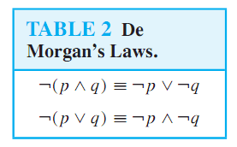
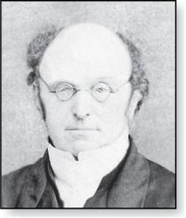
De Morgan’s Laws
Augustus De Morgan 1806-1871
This truth table shows that De Morgan’s Second Law holds.
p | q | ¬p | ¬q | (p∨q) | ¬(p∨q) | ¬p∧¬q
T | T | F | F | T | F | F
T | F | F | T | T | F | F
F | T | T | F | T | F | F
F | F | T | T | F | T | T

Slide 6
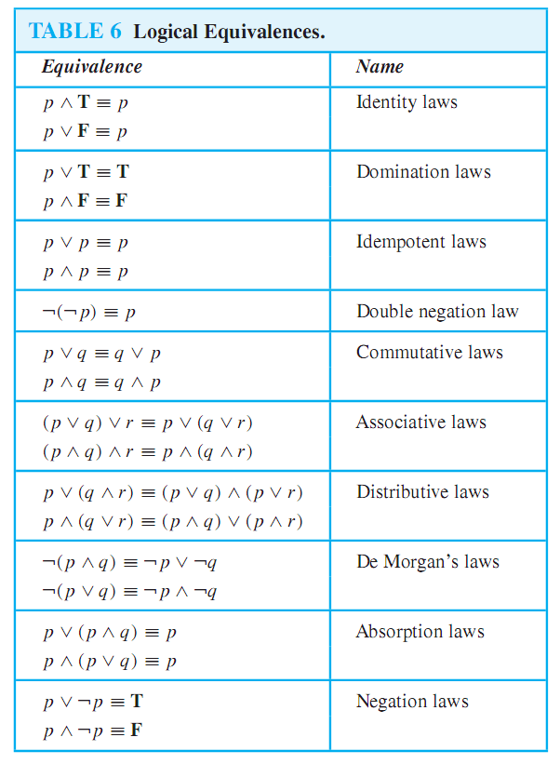
Key Logical Equivalences

Slide 7
Key Logical Equivalences (cont)

Slide 8
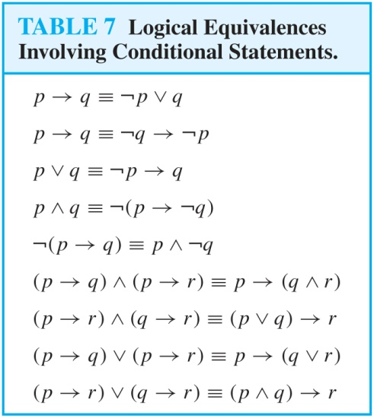
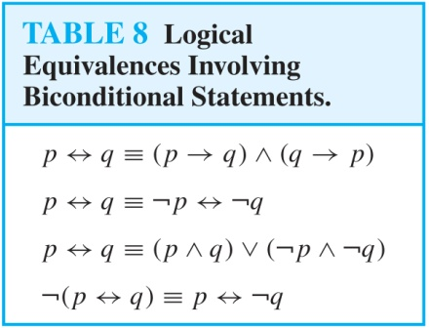
More Logical Equivalences

Slide 9
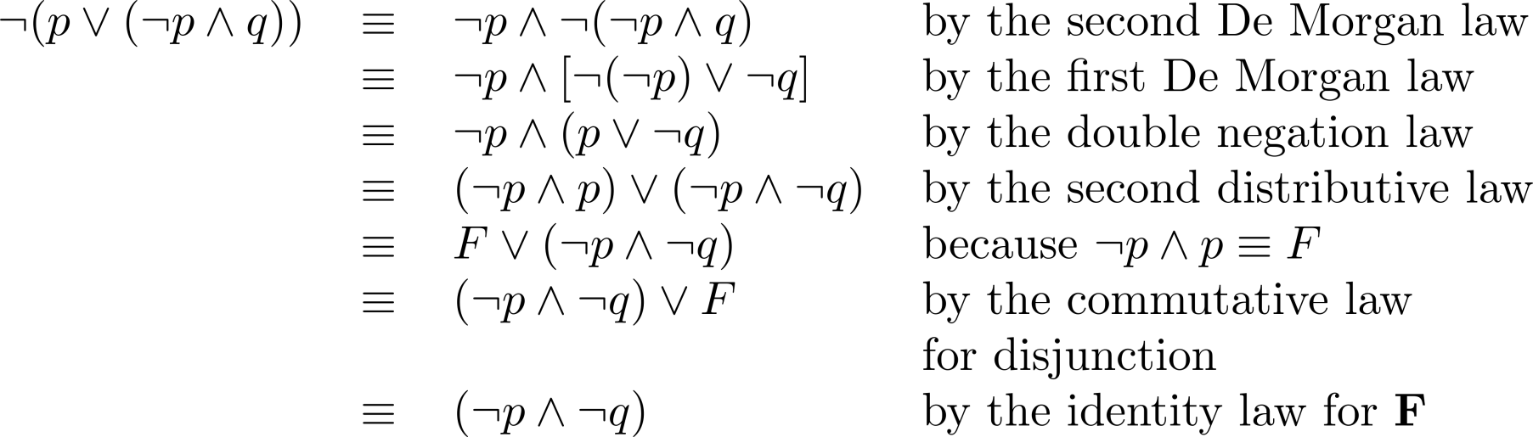
Equivalence Proofs
Example: Show that ¬(p∨(¬p ∧q)) is logically equivalent to ¬p∧¬q
Solution:

Slide 10
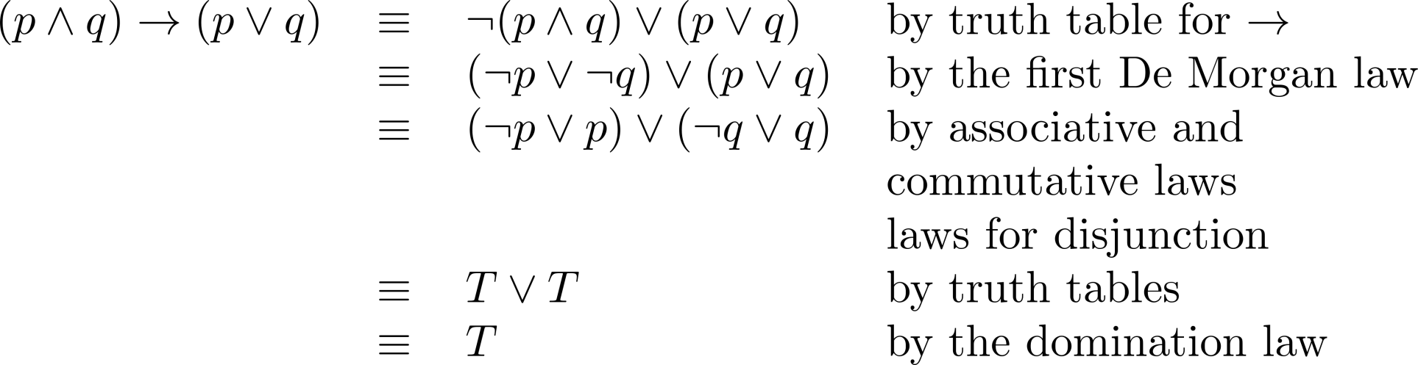
Equivalence Proofs
Example: Show that (p∧q)⟶(p∨q) is a tautology.
Solution:

Slide 11
Propositional Satisfiability
A compound proposition is satisfiable if there is an assignment of truth values to its variables that make it true. When no such assignments exist, the compound proposition is unsatisfiable.
A compound proposition is unsatisfiable if and only if its negation is a tautology.

Slide 12
Questions on Propositional Satisfiability
Example: Determine the satisfiability of the following compound propositions:
Solution: Satisfiable. Assign T to p, q, and r.
Solution: Satisfiable. Assign T to p and F to q.
Solution: Not satisfiable. Check each possible assignment of truth values to the propositional variables and none will make the proposition true.

Slide 13
Notation
Needed for the next example.

Slide 14
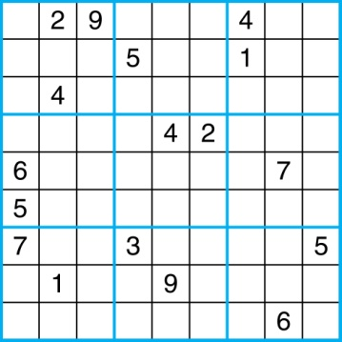
Sudoku
A Sudoku puzzle is represented by a 9×9 grid made up of nine 3×3 subgrids, known as blocks. Some of the 81 cells of the puzzle are assigned one of the numbers 1,2, …, 9.
The puzzle is solved by assigning numbers to each blank cell so that every row, column and block contains each of the nine possible numbers.
Example

Slide 15
Encoding as a Satisfiability Problem
Let p(i,j,n) denote the proposition that is true when the number n is in the cell in the ith row and the jth column.
There are 9×9 × 9 = 729 such propositions.
In the sample puzzle p(5,1,6) is true, but p(5,j,6) is false for j = 2,3,…9

Slide 16
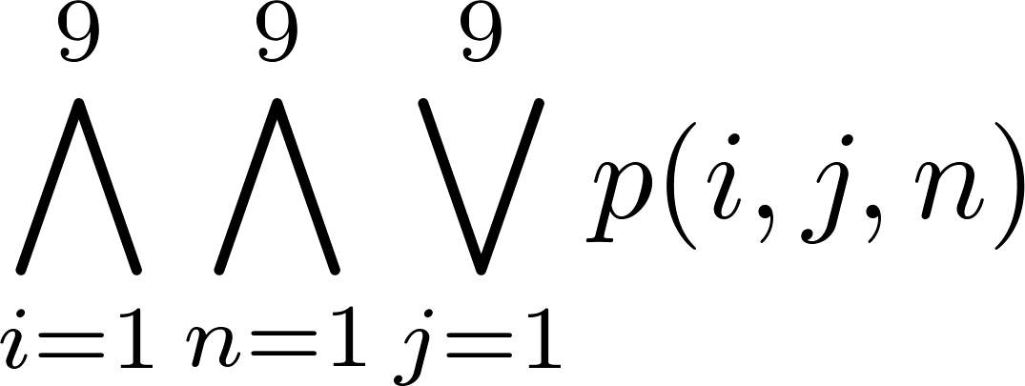
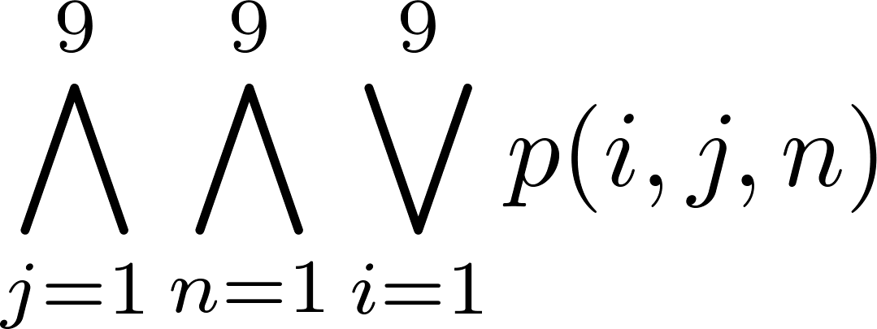
Encoding (cont)
For each cell with a given value, assert p(i,j,n), when the cell in row i and column j has the given value.
Assert that every row contains every number.
Assert that every column contains every number.

Slide 17
Query??

