Slide 1
Basic Principles of Synthetic Biology
Engineering Biology for Innovation Magnus Stefansson, MBA, Ph.D.

Slide 2
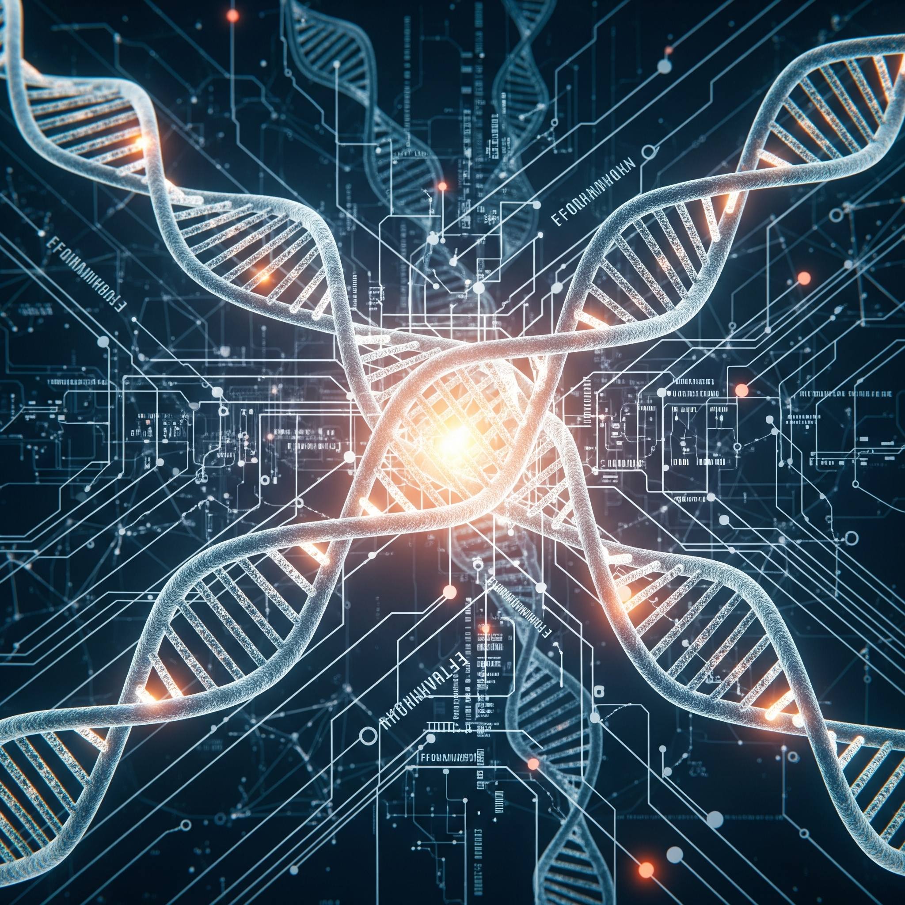
Course Overview
Today’s Learning Objectives:
Define synthetic biology and its core principles
Understand key engineering approaches in biology
Explore standardization and modularity concepts
Examine commercial applications and market potential
Discuss ethical considerations and future directions

Slide 3
What is Synthetic Biology?
Definition: Engineering approach to biology that applies engineering principles to biological systems
Goal: Design and construct new biological parts, devices, and systems
Approach: Redesign existing natural biological systems for useful purposes
Interdisciplinary field: Combines biology, engineering, computer science, and chemistry
Bottom-up construction: Building biological systems from well-characterized parts
Source: Nature Reviews Molecular Cell Biology (2016)

Slide 4
Historical Context and Key Milestones
Key Milestones:

Slide 5

1970s: Recombinant DNA technology foundations
2000: First synthetic genome (φX174 bacteriophage)
2003: BioBricks and standardized parts concept
2010: First synthetic bacterial genome (Mycoplasma mycoides)
2016: Synthetic yeast chromosome project
2020s: CRISPR integration and advanced gene circuits

Slide 6
Core Principle 1: Engineering Design Cycle
Traditional Engineering Approach:
Design: Specify system requirements
Build: Construct the system
Test: Measure performance
Learn: Analyze results and iterate
Applied to Biology:
Design: Define biological function
Build: Assemble genetic circuits
Test: Measure biological output
Learn: Optimize and redesign

Slide 7
Source: Nature Biotechnology (2018)

Slide 8
Core Principle 2: Standardization
BioBricks: Standardized biological parts with defined interfaces
RFC Standards: Request for Comments defining part specifications
Interchangeable components: Parts that work together predictably
Characterization: Quantitative description of part behavior
Registries: Databases of characterized biological parts
Source: iGEM Foundation, Registry of Standard Biological Parts

Slide 9
Core Principle 3: Modularity
Hierarchical Organization:
Parts: Basic functional units (promoters, genes, terminators)
Devices: Combinations of parts with specific functions
Systems: Multiple devices working together
Chassis: Host organisms containing the systems
AI-generated modular system diagram

Slide 10
Core Principle 4: Abstraction
Physical Layer: DNA sequences, proteins, metabolites
Device Layer: Functional units (sensors, actuators, logic gates)
System Layer: Complete biological programs
Application Layer: Real-world functions and purposes
Benefit: Enables specialists to work at different levels without understanding all details
Source: Molecular Systems Biology (2017)

Slide 11
Genetic Circuits and Logic Gates
Boolean Logic in Biology:
AND gates: Multiple inputs required
OR gates: Any input sufficient
NOT gates: Inverter circuits
Toggle switches: Bistable systems
Oscillators: Periodic behavior
Applications:
Biosensors for environmental monitoring
Therapeutic circuits in medicine
Metabolic pathway control
Cell fate determination

Slide 12
Source: Science (2013) - Genetic logic circuits

Slide 13
Chassis Organisms
Escherichia coli: Most common, well-characterized, fast growth
Saccharomyces cerevisiae: Eukaryotic system, post-translational modifications
Bacillus subtilis: Gram-positive, protein secretion capabilities
Pichia pastoris: High protein expression levels
Mammalian cells: Complex protein folding, human-compatible
Minimal cells: Reduced genomes for predictable behavior
AI-generated comparison of different chassis organisms

Slide 14
Synthetic Biology Toolbox
DNA Assembly Methods:
BioBrick assembly
Gibson assembly
Golden Gate assembly
SLIC (Sequence and Ligation Independent Cloning)
CPEC (Circular Polymerase Extension Cloning)
Characterization Tools:
Flow cytometry
Fluorescence microscopy
RNA sequencing
Proteomics
Metabolomics

Slide 15
Source: Nature Methods (2019)

Slide 16
CRISPR Integration in Synthetic Biology
Programmable gene editing: Precise DNA modifications
CRISPRa/CRISPRi: Activation and interference systems -Base editing: Single nucleotide changes without double-strand breaks
Prime editing: Precise insertions, deletions, and substitutions
Multiplexed editing: Simultaneous modification of multiple targets
Source: Nature Reviews Genetics (2020)

Slide 17
Metabolic Engineering Principles
Pathway Design Strategies:
Heterologous pathway expression: Introducing foreign pathways
Pathway optimization: Balancing enzyme levels
Cofactor engineering: Managing cellular resources
Compartmentalization: Organizing reactions spatially
Dynamic regulation: Responsive pathway control
AI-generated metabolic pathway diagram

Slide 18
Protein Design and Engineering
Directed evolution: Laboratory-based protein evolution
Rational design: Structure-based protein modification
De novo design: Creating proteins from scratch
Protein-protein interactions: Engineering binding specificity
Allosteric regulation: Designing responsive proteins
Source: Nature Chemical Biology (2018)

Slide 19
Biosafety and Containment
Physical Containment:
Laboratory biosafety levels
Specialized equipment and facilities
Training and protocols
Waste management procedures
Biological Containment:
Auxotrophic strains (nutrient dependencies)
Kill switches and terminator genes
Orthogonal biological systems
Genetic firewalls

Slide 20
AI-generated biosafety illustration

Slide 21
Commercial Example 1: Ginkgo Bioworks
Business Model:
“Organism company” - designs custom microbes
Automated strain engineering platform
Applications in pharmaceuticals, agriculture, food
Partnerships with major corporations
Valuation: $15+ billion (2021)
Key Technologies:
High-throughput DNA assembly
Automated testing and optimization
Machine learning for design
Standardized biological parts

Slide 22
Source: Ginkgo Bioworks company materials

Slide 23
Commercial Example 2: Synthetic Spider Silk
Companies: Bolt Threads, Spiber, Modern Meadow
Product: Recombinant spider silk proteins in microorganisms
Properties: Stronger than steel, biodegradable, lightweight
Applications: Textiles, medical devices, protective equipment
Market potential: $1.3 billion by 2027
Source: Nature Materials (2019)

Slide 24
Commercial Example 3: Biofuels and Chemicals
Zymergen (acquired by Ginkgo):
Microbial strain optimization
Machine learning-guided engineering
Focus on specialty chemicals
Amyris:
Synthetic artemisinin production
Renewable chemicals from sugar
Cosmetics and fragrance ingredients

Slide 25
AI-generated biofuel production flowchart

Slide 26
Commercial Example 4: Synthetic Biology in Medicine
CAR-T cell therapy: Engineered immune cells for cancer treatment
Biosynthetic insulin: Recombinant human insulin production
Synthetic antibiotics: Novel antimicrobial compounds
Personalized medicine: Tailored therapeutic approaches
Market size: $39 billion by 2027
Source: Nature Biotechnology (2020)

Slide 27
Commercial Example 5: Food and Agriculture
Applications:
Impossible Foods: Plant-based meat with synthetic heme
Perfect Day: Animal-free dairy proteins
Motif FoodWorks: Designer food ingredients
Crop enhancement: Improved yield and nutrition
Benefits:
Reduced environmental impact
Enhanced nutritional content
Novel flavors and textures
Sustainable production

Slide 28
AI-generated sustainable food production ::::::::::::::::::::::::::::::::::::::

