Slide 1
CS 157B / SE 157B SJSU Spring 2013 Project #3: Web Service
Instructor: Ron Mak
Team VoidStar
Date: March 18, 2013

Slide 2
Description
This project will give your team experience creating web service providers and clients using NetBeans and other Java tools
Create a Java web service provider that is itself a client to two or more existing web services

Slide 3
Tools
NetBeans
Server GlassFish 3+
2 existing Web Services

Slide 4
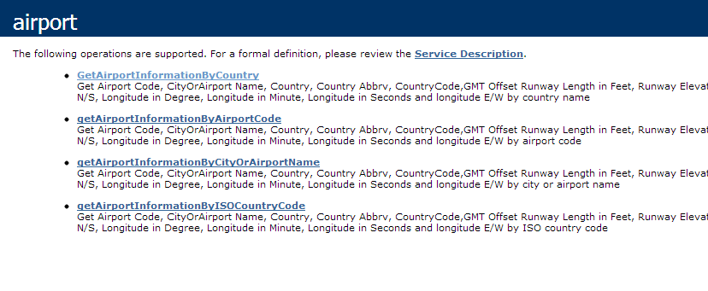
2 Existing Web Services
Airport Information Webservice
http://www.webservicex.net/airport.asmx

Slide 5
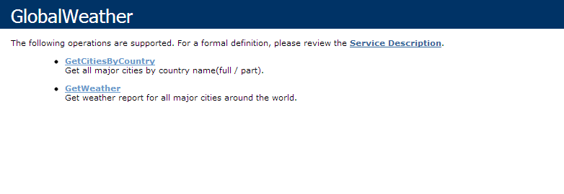
2 Existing Web Services
Global Weather
http://www.webservicex.net/globalweather.asmx

Slide 6
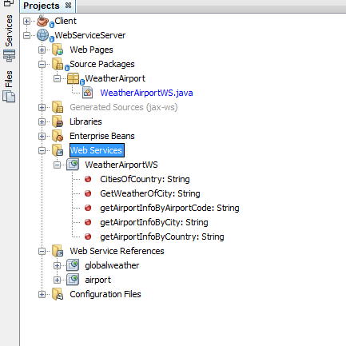
Web Service Server
Create Web Application
Add 2 existing WS as WS clients
Create new WS construct some operations

Slide 7
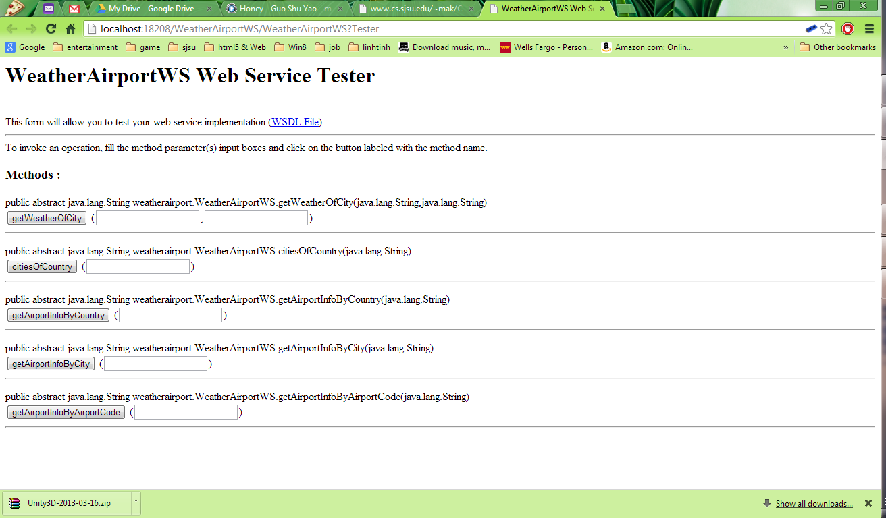
Web Service Server
5 operations

Slide 8
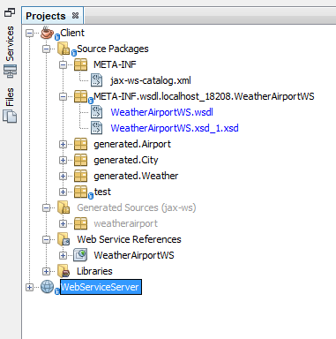
Web Service Client
Create new Applicaition named Client
Add the WS client of the WS server

Slide 9
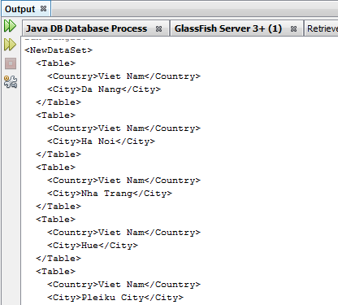
Web Service Client
Problem: The output of WS is only String with XML syntax

Slide 10
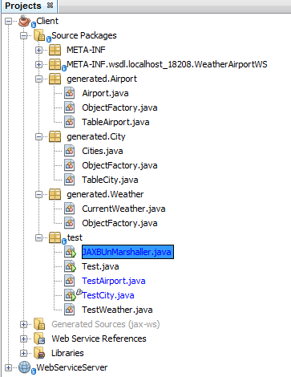
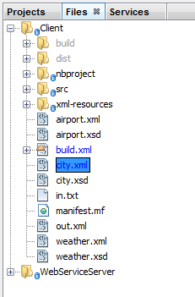
Web Service Client
Solution:
Write to a XML File
Unmarshall it by JAXBUnMarshaller

Slide 11
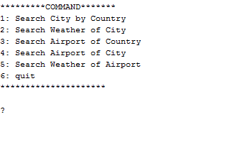
Demo

Slide 12
THANK YOU

