Slide 1
Feature Engineering on Wisconsin breast cancer (diagnosis) dataset
Course: Machine Learning for Engineers
Presented by:
Arup Dey
Mostofa Ahsan

Slide 2
Motivation
Facilitating data visualization and data understanding,
Improving Efficiency
Reducing the complexity of a model
Reducing the measurement and storage requirements,
Improving Prediction Performance of the predictors in the model
Defying the curse of dimensionality to improve prediction performance

Slide 3
Dataset Description
Dataset source: UCI machine learning repository
Number of features: 30
Number of instances: 569
real-valued Parameters
Radius
Texture
Perimeter
Area
Smoothness
Compactness
Concavity
Concave points
Symmetry
Fractal dimension

Slide 4

Feature Selection methods
Point Biserial Correlation
Relief algorithm
Fisher Score
Pearson correlation
Principal Component Analysis (PCA)
Point Biserial Correlation
$$r_{pb}=\frac{M_{1}−M_{0}}{S_{n}}\sqrt{\frac{n_{1}n_{0}}{n^{2}}}$$
$$S_{n}=\sqrt{\frac{1}{n}\sum_{i=1}^{n}{{\left(X_{i}−\overline{X}\right)}^{2}}}$$

Slide 5
Results
SL. No. | Point Biserial Correlation | Fisher Score | Relief Algorithm
1 | concave points_worst | concave points_worst | concave points_worst
2 | perimeter_worst | perimeter_worst | compactness_worst
3 | concave points_mean | concave points_mean | smoothness_worst
4 | radius_worst | radius_worst | concavity_worst
5 | perimeter_mean | perimeter_mean | compactness_mean
6 | area_worst | area_worst | compactness_worst
7 | radius_mean | radius_mean | concavity_mean
8 | area_mean | area_mean | concave points_mean
9 | concavity_mean | concavity_mean | symmetry_worst
10 | concavity_worst | concavity_worst | fractal_dimension_worst
11 | compactness_mean | compactness_mean | texture_mean
12 | compactness_worst | compactness_worst | smoothness_mean
13 | radius_se | radius_se | fractal_dimension_mean
14 | perimeter_se | perimeter_se | symmetry_mean
15 | area_se | area_se | perimeter_worst
16 | texture_worst | texture_worst | radius_worst
17 | smoothness_worst | smoothness_worst | area_worst
18 | symmetry_worst | symmetry_worst | perimeter_mean
19 | texture_mean | texture_mean | radius_mean
20 | concave points_se | concave points_se | area_mean
21 | Smoothness_mean | Smoothness_mean | compactness_se
22 | symmetry_mean | symmetry_mean | perimeter_se
23 | fractal_dimension_worst | fractal_dimension_worst | concave points_se

Slide 6
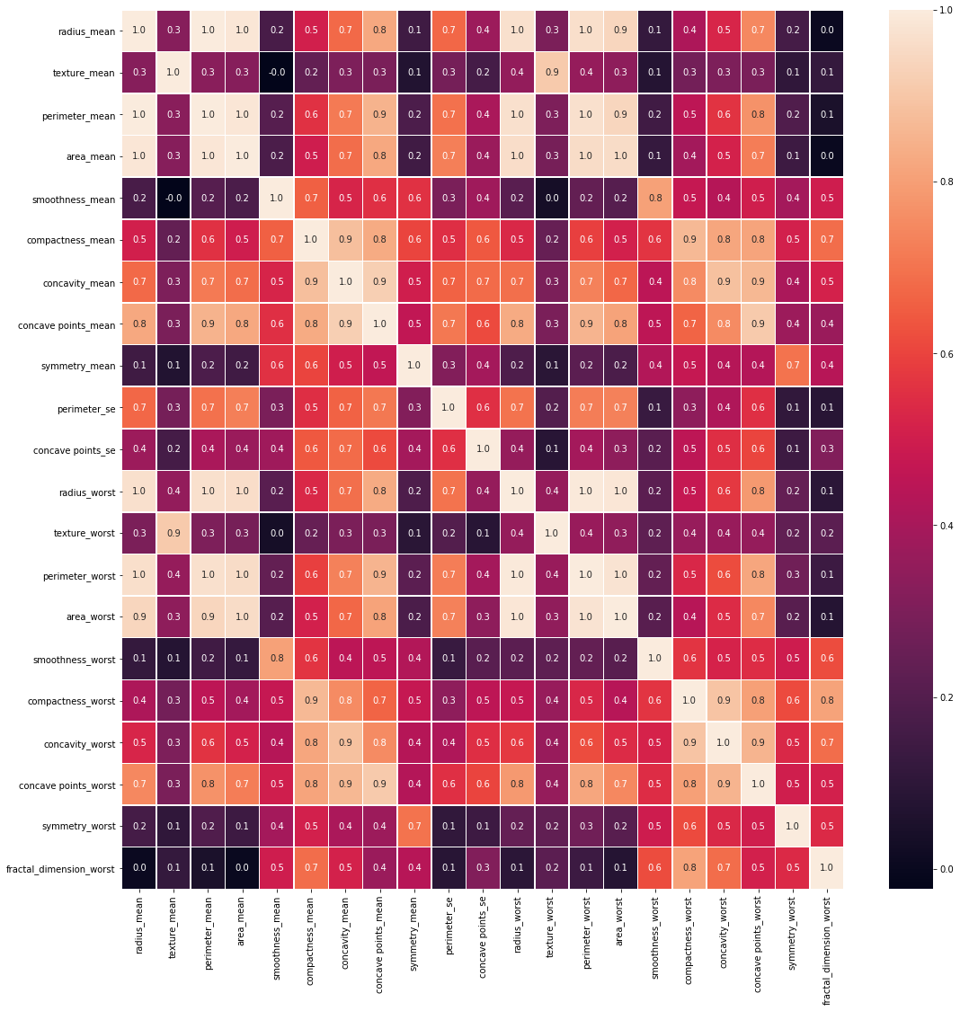
Reduced Features Analysis
SL. No. | Features that are common in three methods
1 | concave points_worst
2 | perimeter_worst
3 | concave points_mean
4 | radius_worst
5 | perimeter_mean
6 | area_worst
7 | radius_mean
8 | area_mean
9 | concavity_mean
10 | concavity_worst
11 | compactness_mean
12 | compactness_mean
13 | perimeter_se
14 | texture_worst
15 | smoothness_worst
16 | symmetry_worst
17 | texture_mean
18 | concave points_se
19 | concave points_se
20 | symmetry_mean
21 | fractal_dimension_worst

Slide 7
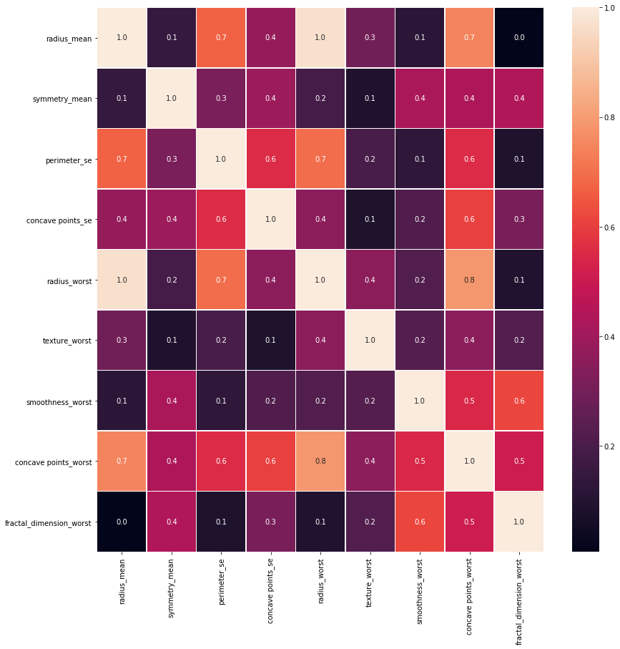
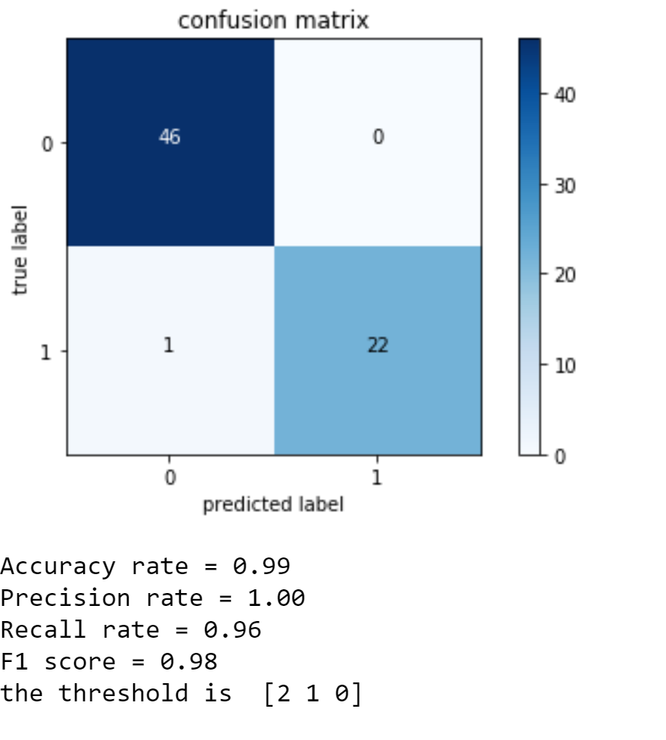
Final Selected Features
SL. No. | Features
1 | concave points_worst
2 | radius_worst
3 | radius_mean
4 | perimeter_se
5 | texture_worst
6 | smoothness_worst
7 | symmetry_worst
8 | concave points_se
9 | symmetry_mean
10 | fractal_dimension_worst

Slide 8
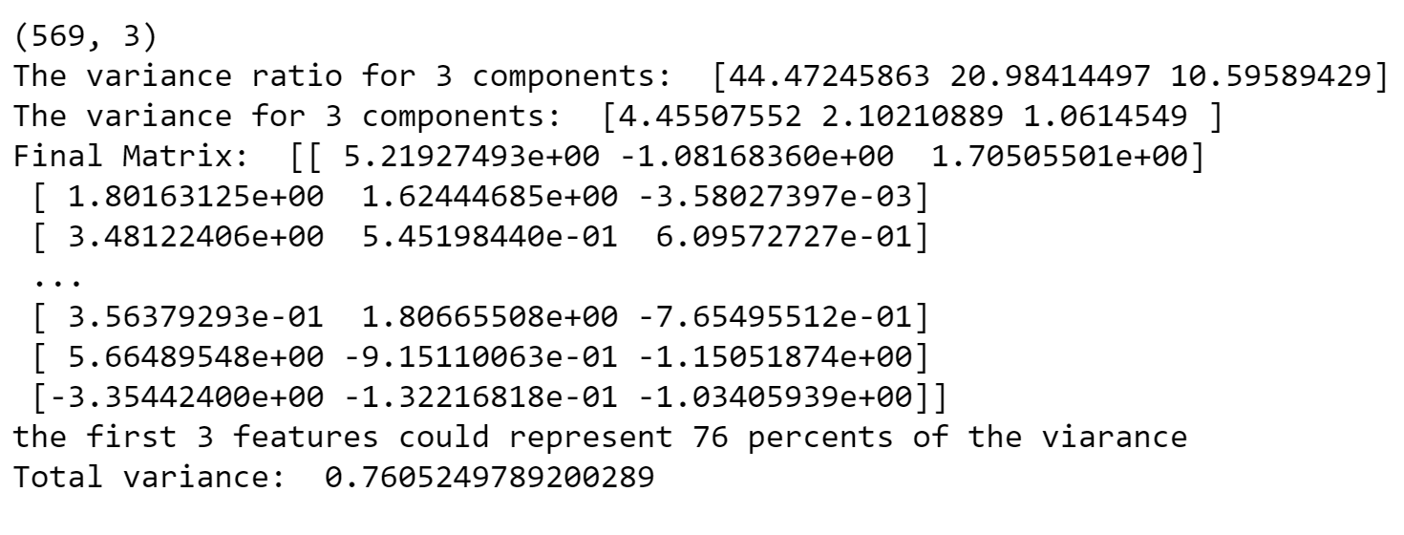
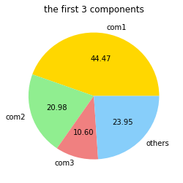
Dimension reduction using PCA

Slide 9
Conclusion
We have performed 3 feature selection methods to investigate the relationship between Target variable and features.
We have performed Pearson Correlation to find out the redundant elements within features.
We have performed Principal Component Analysis to reduce the dimension of dataset to 3 components for visualization.

Slide 10
Thank you all
Questions????

