Slide 1

BDANN: BERT-Based Domain Adaptation Neural Network for Multi-Modal Fake News Detection by Tong Zhang, Di Wang, Huanhuan Chen, Zhiwei Zeng, Wei Guo, Chunyan Miao and Lizhen Cui
CSE712
Mahrin Tasfe [18166012]
Mostofa Kamal Sagor [22166010]
Shakib Mahmud Dipto [22166030]
Irfana Afifa [22166047]
Group-10

Slide 2
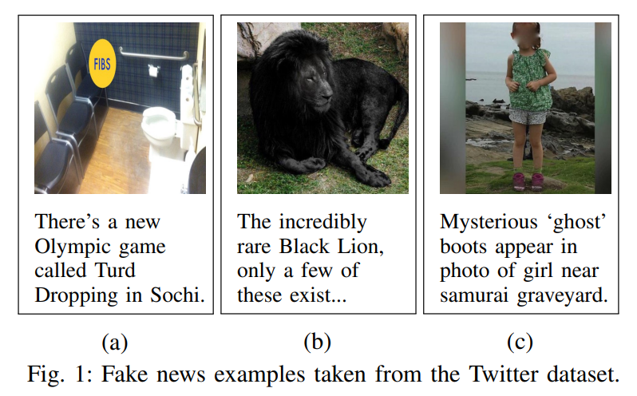
Introduction
Fake news
Misleading
Sensationalized report
Harm a person's reputation
Primary contributions
Eliminate the social context feature
Use the visual feature
Use an event classifier
1

Slide 3
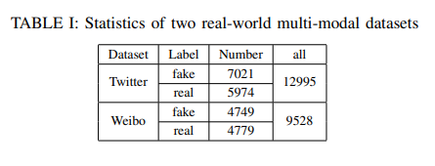
Dataset Description
Datasets
Twitter dataset
Weibo dataset
Baseline models to compare with
the novel model
Single Modality Models
Text-Only, Image-Only
Multi-modal Models
NeuralTalk, att-RNN, EANN
Variants of BDANN
BDANN-v, BDANN-d
2

Slide 4
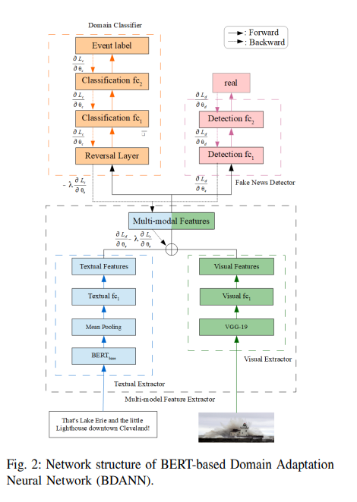
Proposed Model
Multi-Modal Feature Extractor
Textual Feature Extractor
Visual Feature Extractor
Fake News Detector
Latent multi-modal features
Domain Classifier
Classifies the posts to different events
Removes the event-special features
3

Slide 5
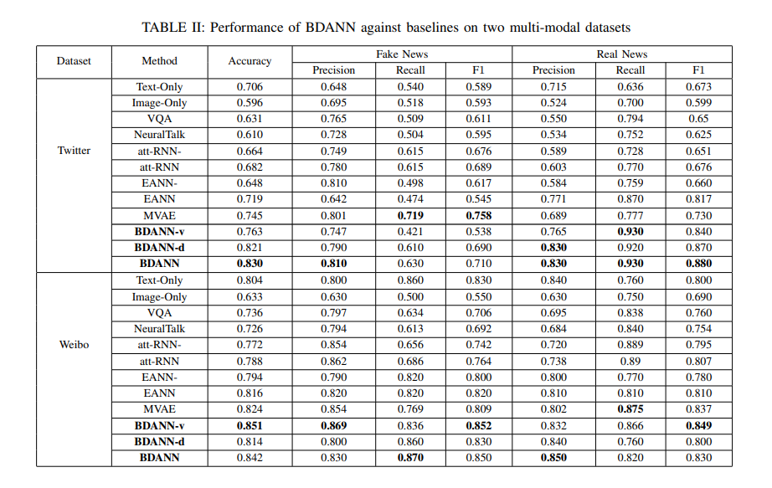
Results
4

Slide 6
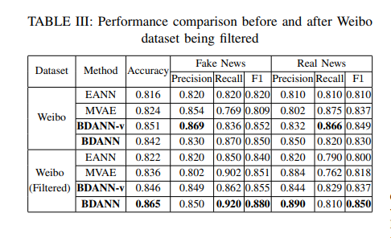
Comparison
5

Slide 7
Future Work
Applying BDANN to other similar fake news detection datasets
Employ the probabilistic model
Propose a deep model
6

