Slide 1
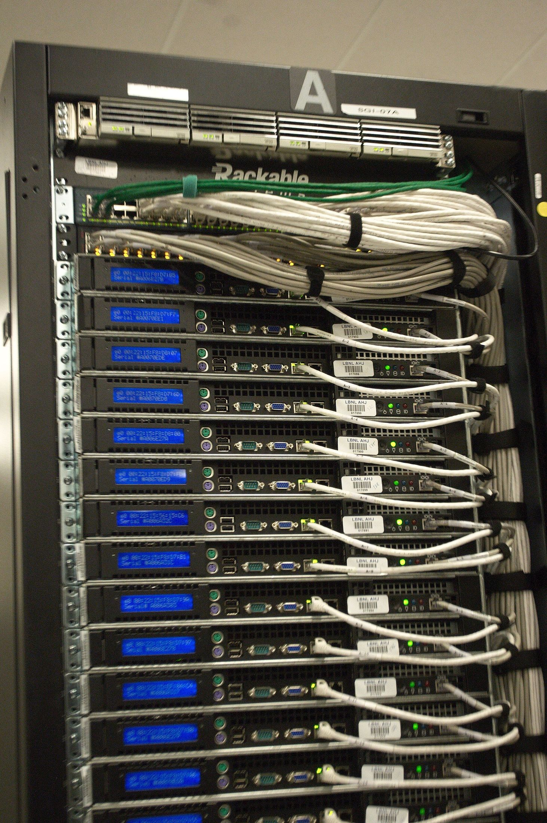

NETAJI SUBHAS UNIVERSITY OF TECHNOLOGY
New Delhi, India
B.TECH MINOR PROJECT
Web Bot Auth:
From Signatures
to Enforcement
An Internet-scale measurement of whether websites actually verify
cryptographically signed bot requests.
TEAM
DEPARTMENT
DATE
Sumit Sagar
Tanishka Sharma
Gautam Bajaj
Computer Science
& Engineering
September 2026

Slide 2

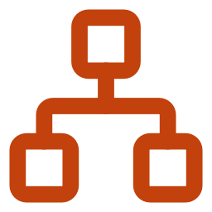


THE PROJECT IN ONE SLIDE
What we built, ran and measured
A complete Internet-measurement pipeline, written from scratch, plus ten experiments against the live web.
34,900
10,000
10
20
distinct hosts censused
for key directories
origins in the matched-pair
access experiment
experiments, each removing
one rival explanation
committed result files,
re-analysable end to end
Instruments written
scan.py · differential.py · keyfetch.py · decompose.py · rfc9421_scope.py · nearmiss.py · tollbooth.py · confound.py
Infrastructure operated
an instrumented Cloudflare Worker serving our own key directory and logging every retrieval
Discipline
pre-registration before collection · randomised arm order · two repetitions · errors treated as missing data
Web Bot Auth: From Signatures to Enforcement
02 / 17

Slide 3
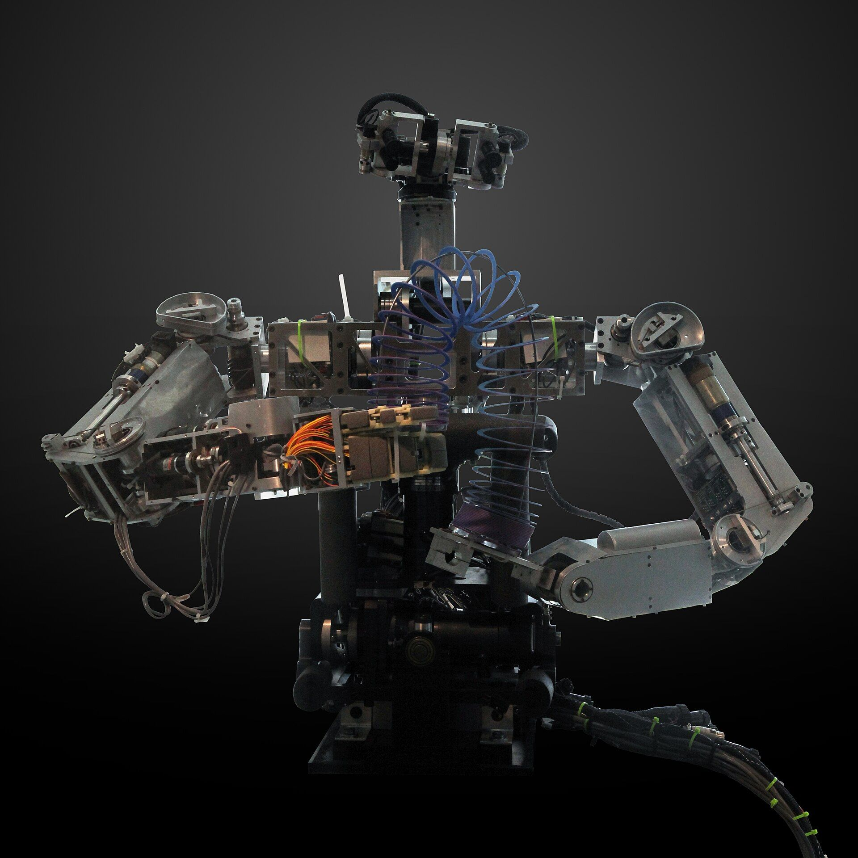


THE PROBLEM
Today a bot is simply whoever it claims to be
The real Googlebot
An impostor
BOTH SEND THE SAME UNAUTHENTICATED STRING
User-Agent: Googlebot/2.1
Web Bot Auth (IETF Standards Track, 1 September 2026) replaces the string with an Ed25519 signature over the request, and publishes the public key at a well-known URL.
Major CDNs now grant signed agents a privileged “signed lane” on that basis.
Web Bot Auth: From Signatures to Enforcement
03 / 17

Slide 4


THE DISTINCTION EVERYTHING RESTS ON
Verification and enforcement are not the same step
STEP 1
STEP 2
VERIFICATION
Cryptographic. It requires the signer's public key — so the verifier must fetch it.
ENFORCEMENT
A policy decision. It can be taken on anything at all — including the mere presence of a header.
An outside observer sees only the outcome — served or refused.
Every experiment in this project exists to tell these two steps apart from outside.
Web Bot Auth: From Signatures to Enforcement
04 / 17

Slide 5

THE RESEARCH GAP WE ARE FIXING
Four literatures touch this. None measures what a signature buys.
Do admitted bots obey the rules?
compliance GIVEN identity
Kim et al., IMC 2025 · CCS 2025
How much blocking is there?
block rates by vendor
THE GAP
No prior work runs a matched-pair signed-versus-unsigned access experiment, or checks whether verifiers ever retrieve the key that verification requires.
Detecting Bot Detection, 2026
Who is the agent?
fingerprinting undeclared agents
FP-Agent, 2026
Can publishers control crawling?
publisher-side instruments
Somesite I Used To Crawl · ai.txt
OUR UNIQUE CONTRIBUTION
We operate the key directory ourselves. That turns an unanswerable question — “did the CDN verify?” — into a measurable one, because every legitimate verification must appear in our own fetch log.
Web Bot Auth: From Signatures to Enforcement
05 / 17

Slide 6


METHOD
Three instruments, each validated before it was used
CENSUS
DIFFERENTIAL (E1)
CONFORMANCE (E2)
One HTTPS GET per host to the
well-known path. Tranco top 50,000,
provenance and SHA-256 recorded.
Matched pairs at 10,000 origins.
Arm A unsigned, arm B validly signed.
Randomised order, two repetitions.
18 cases, one deviation from the
specification each, with positive
and negative controls.
VALIDITY
The harness reproduces RFC 9421's published Ed25519 test vector, and detects exactly the four weaknesses injected into a deliberately lax origin.
RESEARCH ETHICS
Contact address and opt-out page in every User-Agent. Public paths only, rate limited, one request per host. Disclosure drafted before publication.
Web Bot Auth: From Signatures to Enforcement
06 / 17

Slide 7
THE EXPERIMENT MAP
Ten experiments, each answering one question
QUESTION
SCALE
HEADLINE RESULT
Census
How widely is it deployed?
34,900 hosts
12 operators · 0.0499%
E1
Does signing change access?
10,000 origins
298 : 9 · p = 4.7×10⁻⁷⁶
E1b
Is the cryptography checked?
94 origins
garbage 93.6% ≈ valid 96.8%
E4
Was the key ever fetched?
298 origins
0 fetches
E6
Do operators declare behaviour?
83 directories
0 / 83
E7
Which header triggers it?
296 origins
Signature-Input 96.96%
E9
Does the exact name matter?
148 origins
near-miss ≈10%
E10
Is it Web Bot Auth specific?
150 origins
bare RFC 9421 94.67%
E8
Is it our network?
198 origins
+73.74 pp · c = 0
Two experiments produced no usable data and are reported as such: E2 found no endpoint where validity is load-bearing, and E3, the honeypot, was designed but never deployed.
E5
What is HTTP 402 for?
23 origins
20 = one publisher
Web Bot Auth: From Signatures to Enforcement
07 / 17

Slide 8
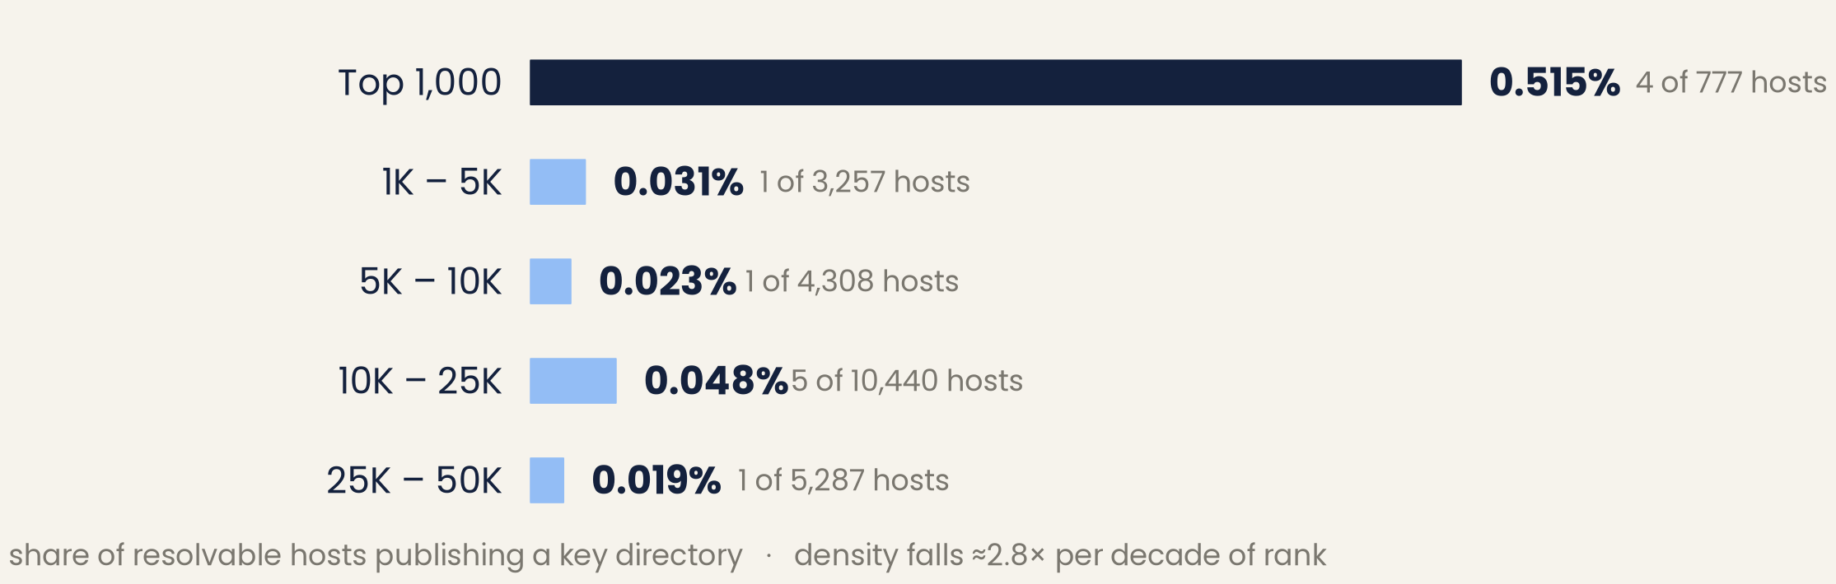
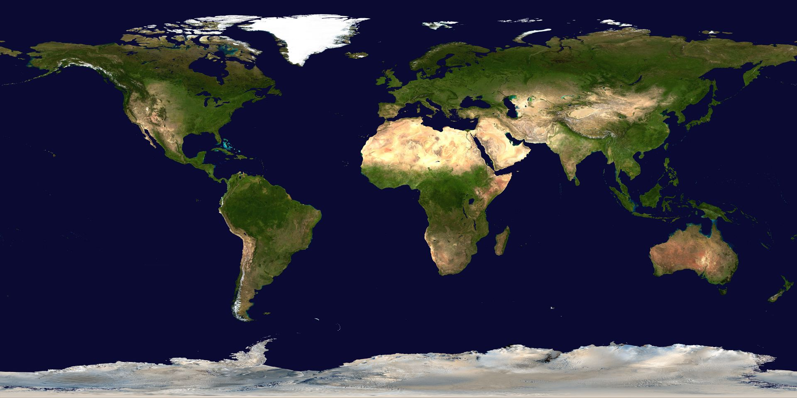
RESULT 1 · DEPLOYMENT
Almost nobody publishes a key directory
One HTTPS GET per host across the Tranco top 50,000 — 34,900 distinct hosts, 24,069 resolvable.
12
operators found in
24,069 resolvable hosts
0.0499%
density (95% CI
0.0285 – 0.0871%)
ALL TWELVE OPERATORS FOUND
ahrefs.com · builtwith.com · chatgpt.com · checkpoint.com · cybershoke.net · forter.com · fpjs.io · meta.com · pocketcasts.com · ptengine.jp · visually.io · you.com
Web Bot Auth: From Signatures to Enforcement
08 / 17

Slide 9
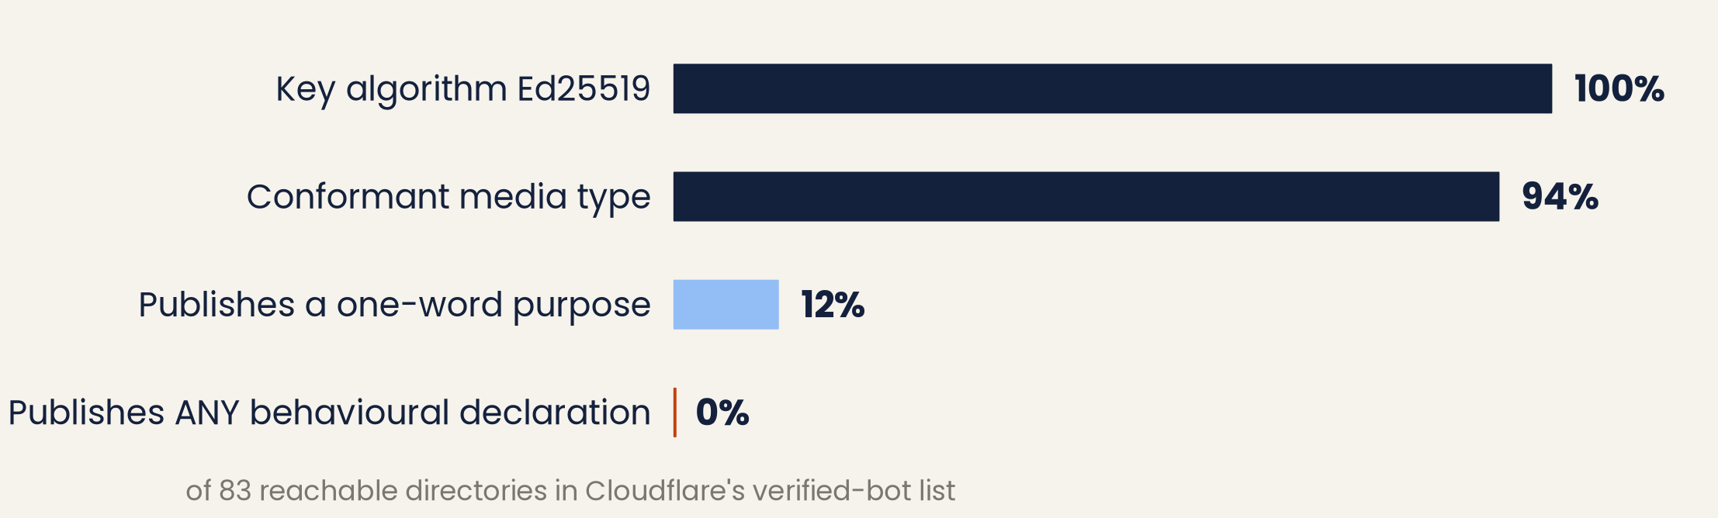
RESULT 2 · ACCOUNTABILITY
Flawless where a machine checks. Zero where it asks.
Every signature-agent directory in Cloudflare's verified-bot list, re-fetched by us: 90 entries, 83 reachable.
WHAT THE REGISTRY DRAFT DEFINES
rate-expectation · rate-control · rfc9309-compliance · expected-user-agent · targeted-content · trigger
WHAT IS ACTUALLY PUBLISHED
Nothing. Ten operators publish a one-word purpose, in eight different spellings, so even that field cannot be aggregated or enforced against.
Web Bot Auth: From Signatures to Enforcement
09 / 17

Slide 10
RESULT 3 · THE HEADLINE
A valid signature makes access worse, not better
298
origins blocked the SIGNED request
but served the identical unsigned one
$ python verify_e1.py
arms A = unsigned
B = signed, key not in any
CDN directory
origins probed 10000
clean pairs 7267
excluded 2733 (an arm errored)
arm A blocked 1156 (15.91%)
arm B blocked 1445 (19.88%)
paired difference +3.98 pp
McNemar b : c 298 : 9
exact p 4.69e-76
matches the published figures
9
did the reverse
+3.98 pp
more blocking when the request
carried a valid signature
Reproducible from the committed data: results/differential/e1_summary.json · 7,267 matched pairs · McNemar exact test
Web Bot Auth: From Signatures to Enforcement
10 / 17

Slide 11
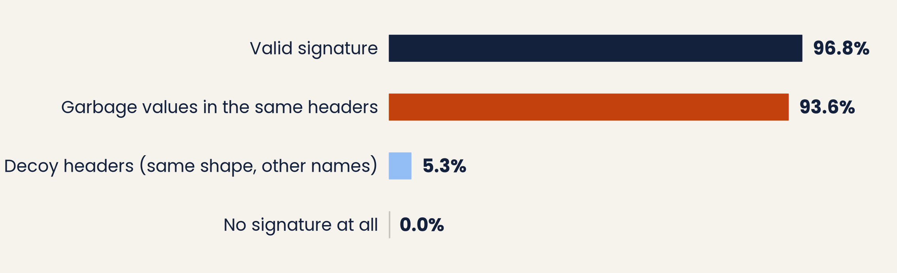
RESULT 4 · IS THE CRYPTOGRAPHY CHECKED?
Garbage behaves almost exactly like a valid signature
Four variants sent to the 94 origins that reacted in E1 and answered cleanly on all four arms.
If the signature were being verified, garbage values should behave nothing like a valid signature. They blocked at 93.6% against 96.8%. Decoy headers of identical shape but unrelated names blocked at just 5.3% — so it is not header novelty either.
Web Bot Auth: From Signatures to Enforcement
11 / 17

Slide 12
RESULT 5 · VERIFICATION
Not one blocking origin ever fetched our key
We served the key directory from our own instrumented Cloudflare Worker and logged every retrieval.
OUR SIGNER
298 ORIGINS
OUR KEY DIRECTORY
——›
one validly signed
request per origin
that blocked the
signed arm in E1
instrumented ·
logs every fetch
never happened
293 / 298
blocked again (98.32%)
$ wrangler kv key get hits --json
before the run total_fetches: 4
after the run total_fetches: 4
counter delta ............... 0
all 4 entries were our own setup calls
ZERO
key retrievals, from anyone
The refusal cannot be a verification failure, because verification was never even attempted.
Web Bot Auth: From Signatures to Enforcement
12 / 17

Slide 13
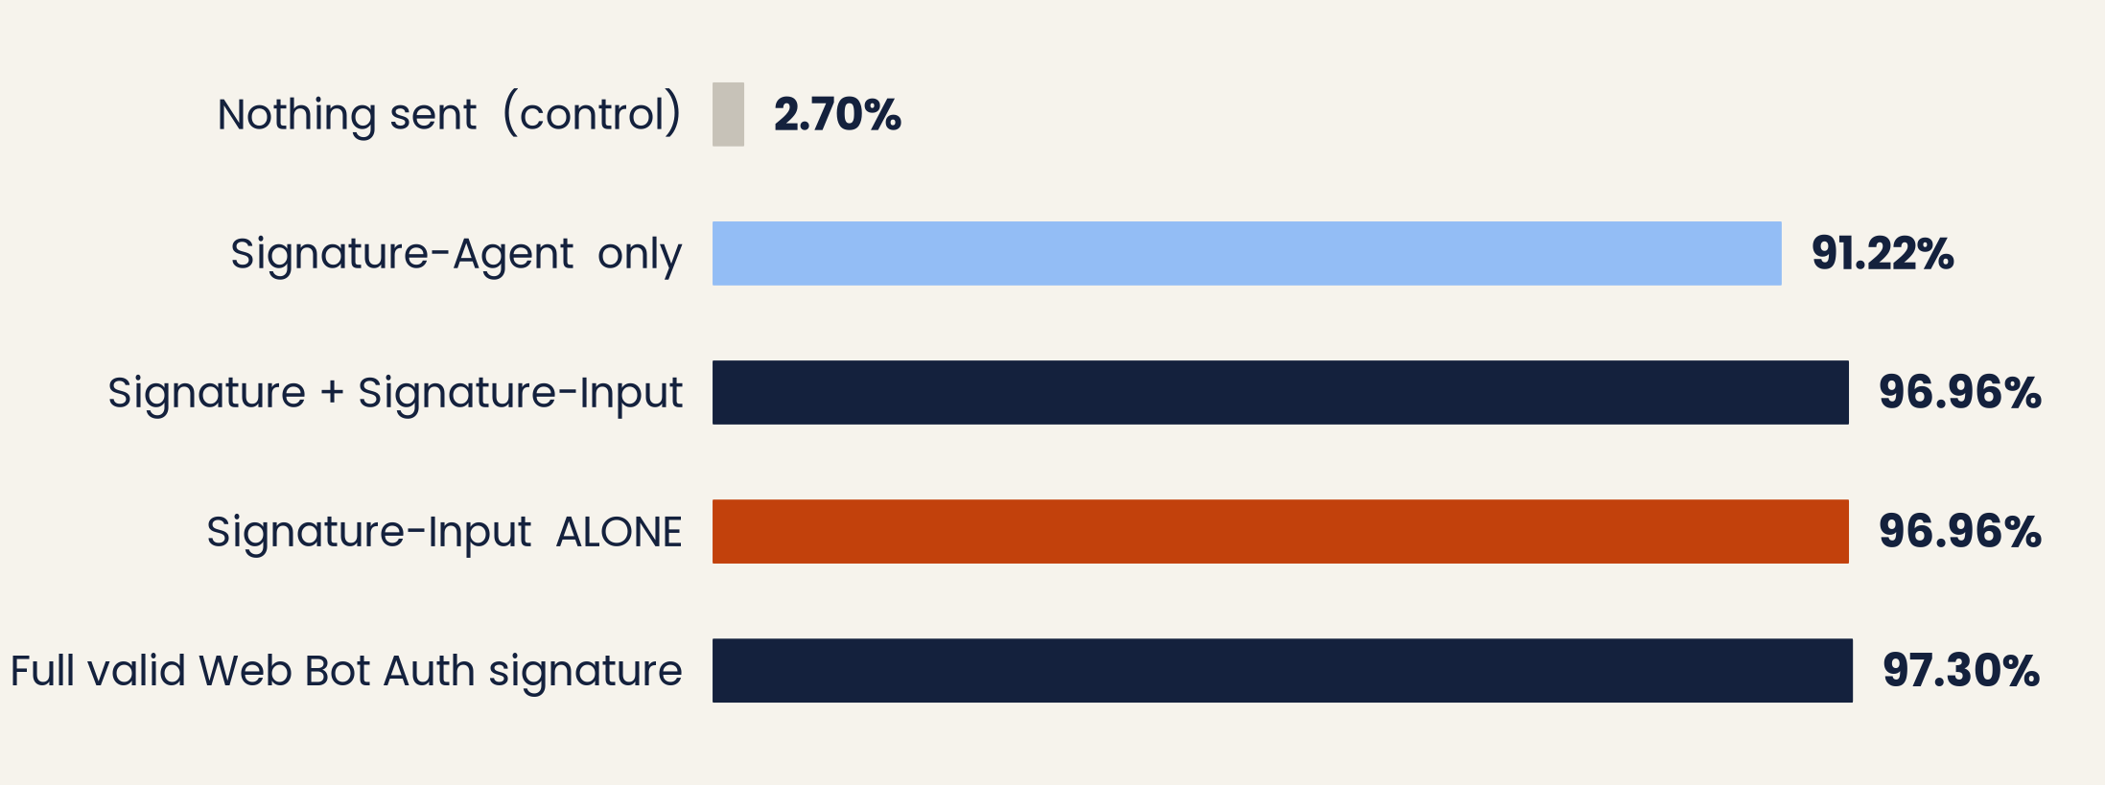
RESULT 6 · MECHANISM
The trigger is one exact header name
Left: five arms over 296 origins. Right: misspell the header by one letter and the effect collapses.
E9 · NEAR-MISS NAMES (n = 148)
Signature-Input
96.62%
X-Signature-Input
10.14%
Signature-Inputs
10.81%
nothing sent
3.38%
Only the exact string matches.
Signature-Input alone is statistically indistinguishable from a complete valid signature (McNemar b=3, c=2, p = 1.0). It carries no identity, no operator URL and no proof — it is metadata about a signature, not a signature.
Web Bot Auth: From Signatures to Enforcement
13 / 17

Slide 14
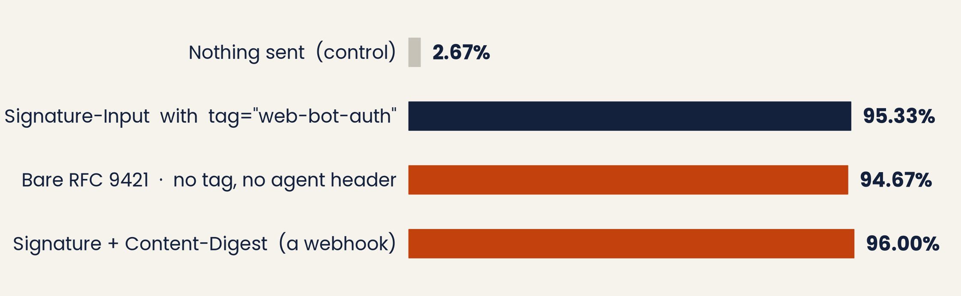
RESULT 7 · BLAST RADIUS
This is not really about bots at all
Strip the Web Bot Auth tag and the agent header, leaving a bare RFC 9421 signed request.
RFC 9421 is a general-purpose IETF standard: webhook verification, signed API calls, payment callbacks, inter-service authorisation. None of that is a bot.
An IETF mechanism for authenticating HTTP messages is being treated as a bot signature.
Web Bot Auth: From Signatures to Enforcement
14 / 17

Slide 15
RESULT 8 · ROBUSTNESS, AND A SIDE FINDING
It is not our network — and 402 is not a price
E8 · SECOND NETWORK VANTAGE
E5 · THE 402 TOLLBOOTH
Re-run from a Cloudflare Worker — different ASN, different address, no history with these origins.
20 of 23 origins returning HTTP 402 are one publisher, People Inc., with byte-identical responses.
unsigned blocked
signed blocked
HTTP/1.1 402 Payment Required
“If you would like to access our content for licensing, please contact contentlicensing@people.inc”
20.71%
94.44%
paired difference
reversals (c)
+73.74 pp
0
No price header, no price in the body, no way to transact. A correctly-signed agent is told access costs money and handed an email address for a human to write to — the economic layer is as absent as the accountability layer.
Web Bot Auth: From Signatures to Enforcement
15 / 17

Slide 16


WHAT WE CONCLUDE
Cryptography authenticates. Admission decides.
Web Bot Auth exists to replace User-Agent trust — an unauthenticated string deciding access.
For a signer outside the allowlist, it has reproduced that system exactly, with the sign flipped.
The incentive is inverted
The accountability layer is empty
The blast radius is wider
Implement the specification correctly but stay off the allowlist, and you are treated worse than a bot that ignores it.
Admission rests on behavioural promises that 0 of 83 admitted operators publish anywhere machine-readable.
The match is on an RFC 9421 header name, so webhooks and signed API calls are refused as collateral.
NEXT: deploy the honeysite (Phase II) · instrumented key-directory rotation (Phase III) · local library differentials (Phase IV) · send the coordinated disclosure
Web Bot Auth: From Signatures to Enforcement
16 / 17

Slide 17

Thank you
Questions & discussion
Sumit Sagar · Tanishka Sharma · Gautam Bajaj
Netaji Subhas University of Technology, New Delhi, India
September 2026

