Slide 1
Bill Gates
Created by Hamza

Slide 2

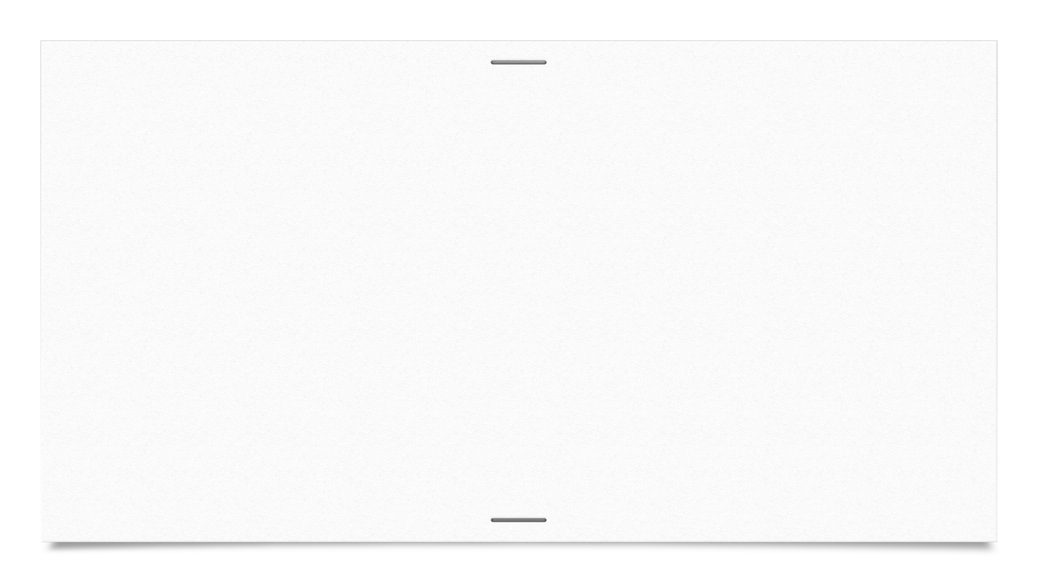
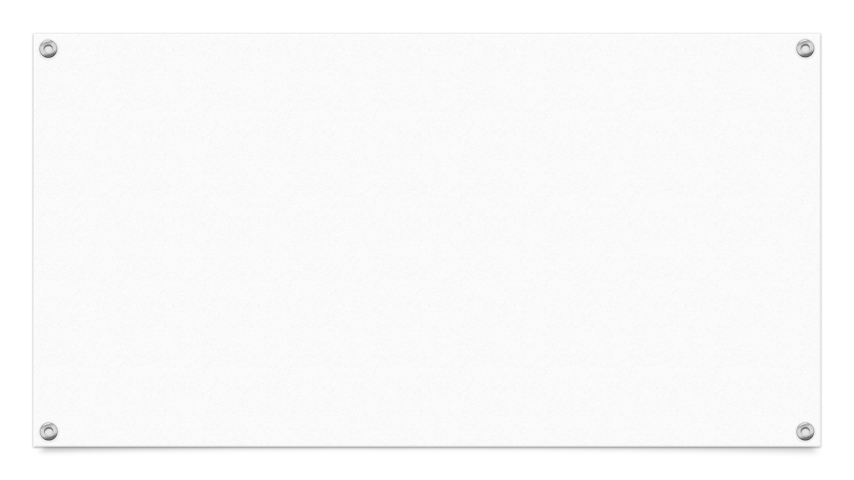


INDEX
Acknowledgement BASIC IBM partnership Windows Management style Post-Microsoft Bilbiography Thankyou

Slide 3
Acknowledgement
I would like to thank my subject teacher who gave me a golden opportunity to work on this project. I’d also like to express my gratitude to my school principal wholeheartedly.
I must also thank my parents and friends for the immense support and help during this project. Without their help, completing this project would have been very difficult.

Slide 4
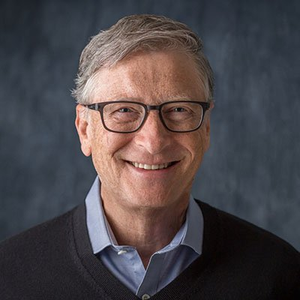
1. BASIC
Gates read the January 1975 issue of Popular Electronics which demonstrated the Altair 8800, and he contacted Micro Instrumentation and Telemetry Systems to inform them that he and others were working on a BASIC interpreter for the platform. In reality, Gates and Allen did not have an Altair and had not written code for it; they merely wanted to gauge MITS's interest. MITS president Ed Roberts agreed to meet them for a demonstration, and over the course of a few weeks they developed an Altair emulator that ran on a minicomputer, and then the BASIC interpreter. The demonstration was held at MITS's offices in Albuquerque, New Mexico; it was a success and resulted in a deal with MITS to distribute the interpreter as Altair BASIC. MITS hired Allen, and Gates took a leave of absence from Harvard to work with him at MITS in November 1975. Allen named their partnership "Micro-Soft", a combination of "microcomputer" and "software", and their first office was in Albuquerque. The first employee Gates and Allen hired was their high school collaborator Ric Weiland. They dropped the hyphen within a year and officially registered the trade name "Microsoft" with the Secretary of the State of New Mexico on November 26, 1976. Gates never returned to Harvard to complete his studies

Slide 5
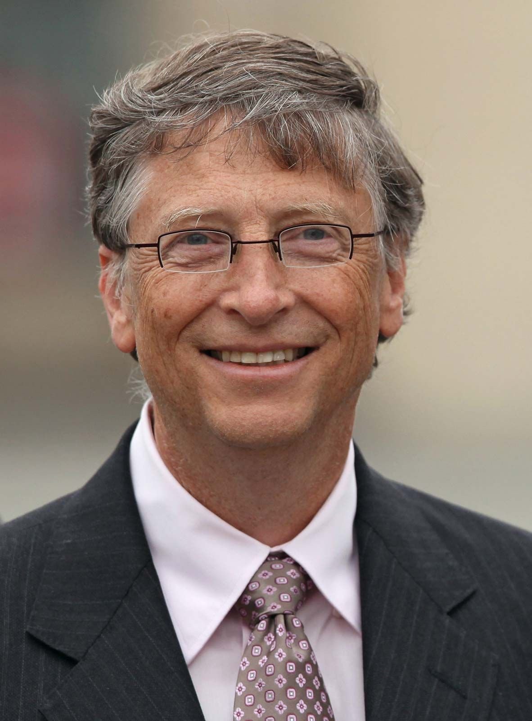
2. IBM partnership
IBM, the leading supplier of computer equipment to commercial enterprises at the time, approached Microsoft in July 1980 concerning software for its upcoming personal computer, the IBM PC, after Bill Gates's mother, Mary Maxwell Gates, mentioned Microsoft to John Opel, IBM's CEO. IBM first proposed that Microsoft write the BASIC interpreter. IBM's representatives also mentioned that they needed an operating system, and Gates referred them to Digital Research , makers of the widely used CP/M operating system. IBM's discussions with Digital Research went poorly, however, and they did not reach a licensing agreement. IBM representative Jack Sams mentioned the licensing difficulties during a subsequent meeting with Gates and asked if Microsoft could provide an operating system. A few weeks later, Gates and Allen proposed using 86-DOS, an operating system similar to CP/M, that Tim Paterson of Seattle Computer Products had made for hardware similar to the PC. Microsoft made a deal with SCP to be the exclusive licensing agent of 86-DOS, and later the full owner. Microsoft employed Paterson to adapt the operating system for the PC and delivered it to IBM as PC DOS for a one-time fee of $50,000

Slide 6
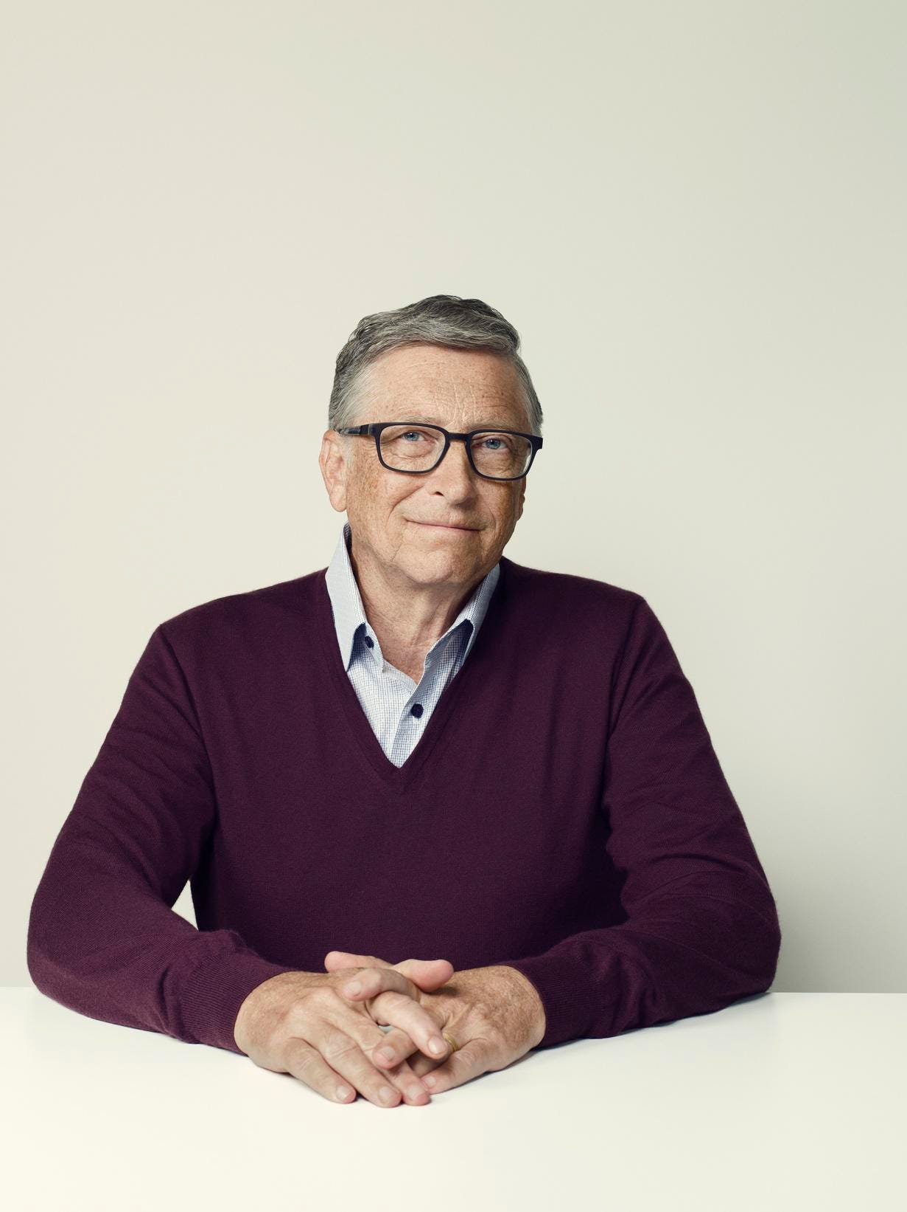
3. Windows
Microsoft and Gates launched their first retail version of Microsoft Windows on November 20, 1985, in an attempt to fend off competition from Apple's Macintosh GUI, which had captivated consumers with its simplicity and ease of use. In August of the following year, the company struck a deal with IBM to develop a separate operating system called OS/2. Although the two companies successfully developed the first version of the new system, the partnership deteriorated due to mounting creative differences. The operating system grew out of DOS in an organic fashion over a decade until Windows 95, which hid the DOS prompt by default. Windows XP, released one year after Gates stepped down as Microsoft CEO, was the first to not be based on DOS. Windows 8.1 was the last version of the OS released before Gates left the chair of the firm to John W. Thompson on February 5, 2014

Slide 7
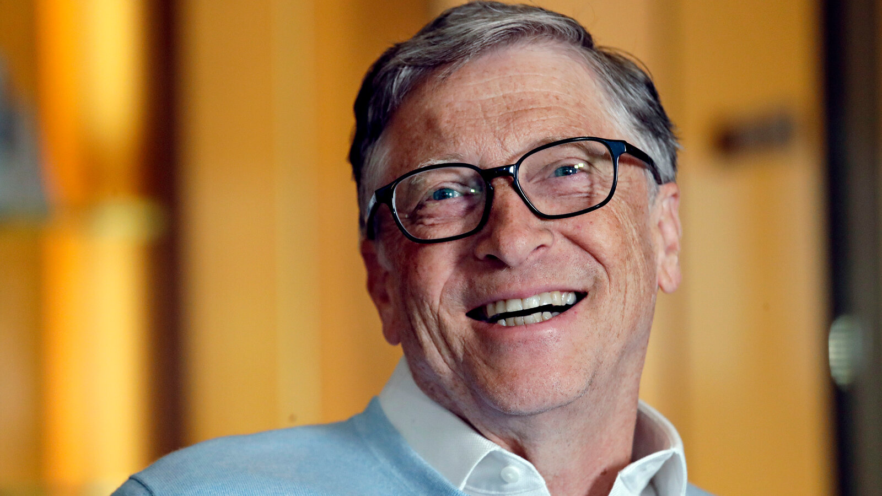
4. Management style
During Microsoft's early years, Gates was an active software developer, particularly in the company's programming language products, but his primary role in most of the company's history was as a manager and executive. He has not officially been on a development team since working on the TRS-80 Model 100, but he wrote code that shipped with the company's products as late as 1989. Jerry Pournelle wrote in 1985 when Gates announced Microsoft Excel: "Bill Gates likes the program, not because it's going to make him a lot of money , but because it's a neat hack.

Slide 8
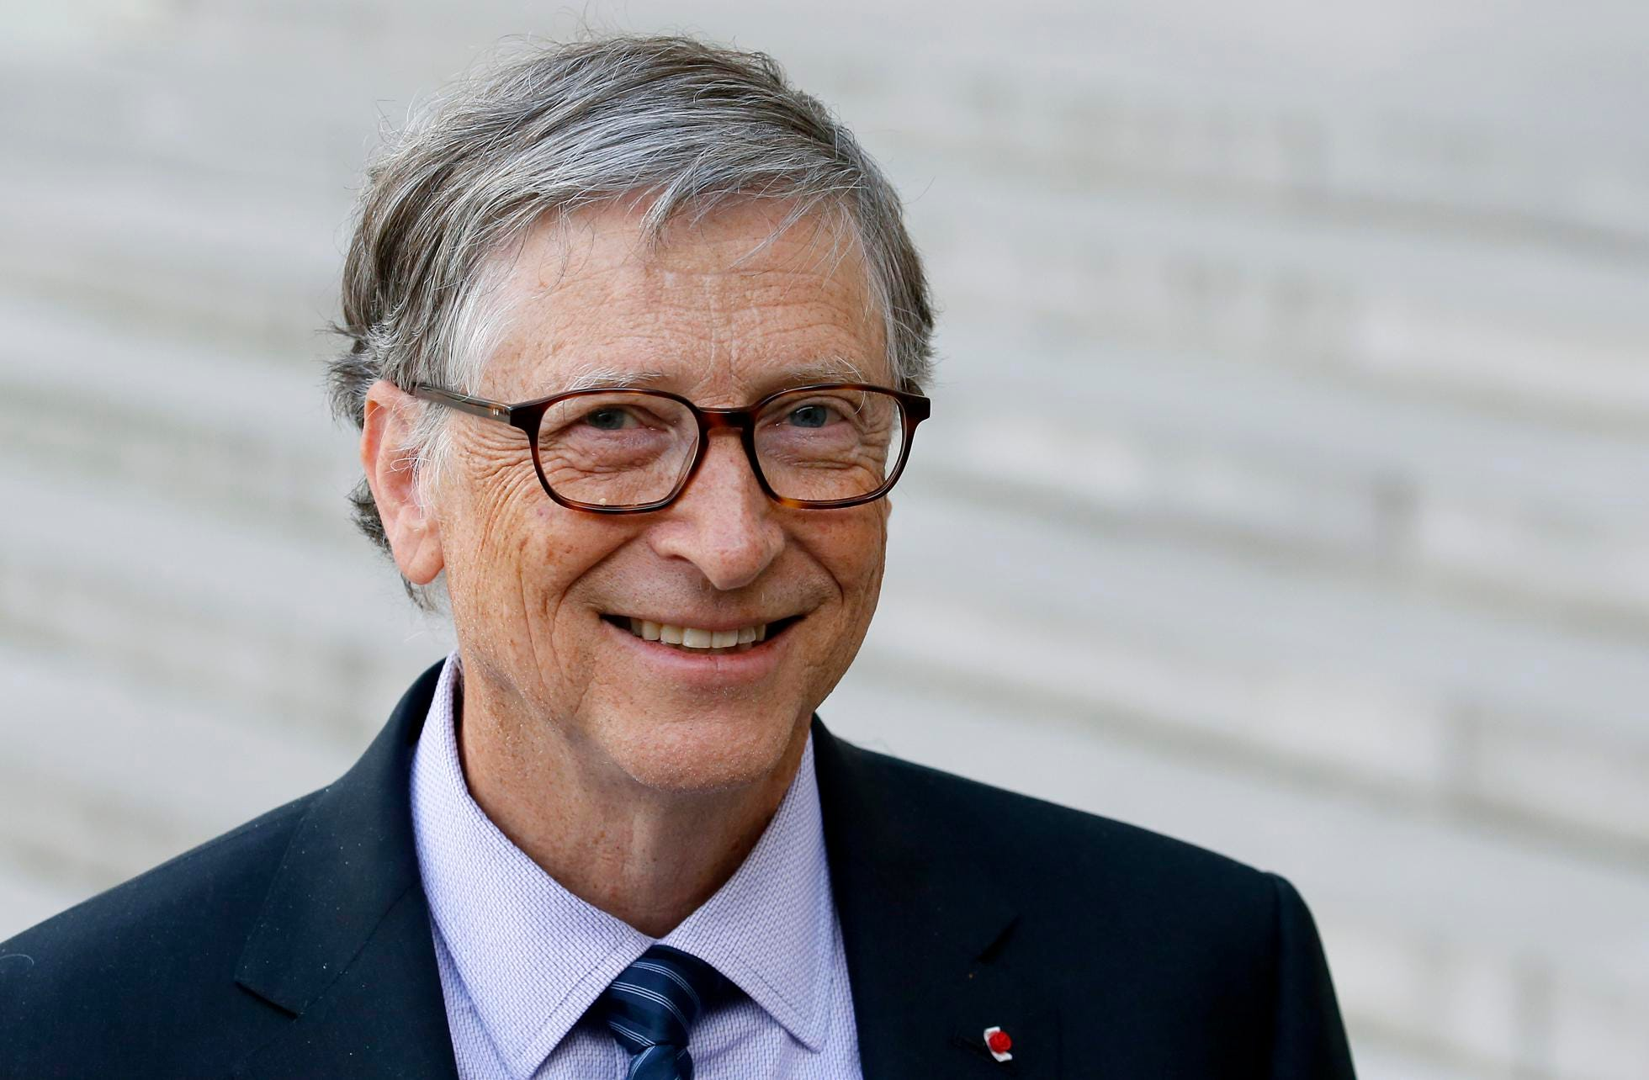
5. Post-Microsoft
Since leaving day-to-day operations at Microsoft, Gates has continued his philanthropy and works on other projects

Slide 9
Bibliography
1. Wikipedia.org - (For Information)
2 . Google.com/images - (For Images)

Slide 10
Thanks For Watching

