Slide 1
Capstone Project – The Battle of Neighborhoods Finding a Better Place in Scarborough, Toronto

Slide 2
Introduction
The purpose of this Project is to help people in exploring better facilities around their neighborhood.
This project is for those people who are looking for better neighborhoods. For ease of accessing to Cafe, School, Super market, medical shops, grocery shops, mall, theatre, hospital, like minded people, etc.
This Project aim to create an analysis of features for a people migrating to Scarborough to search a best neighborhood as a comparative analysis between neighborhoods.
It will help people to get awareness of the area and neighborhood before moving to a new city, state, country or place for their work or to start a new fresh life.

Slide 3
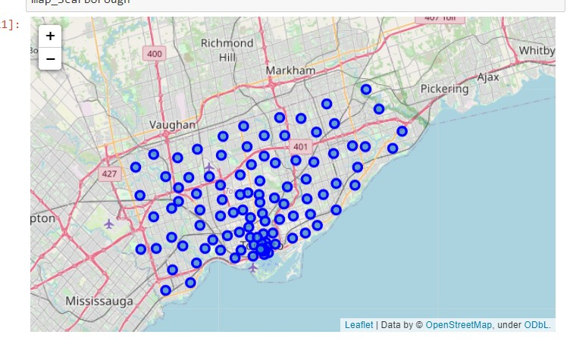
Data Section
Will use Scarborough dataset which we scrapped from wikipedia on Week 3. Dataset consisting of latitude and longitude, zip codes.
LINK: https://en.wikipedia.org/wiki/List_of_postal_codes_of_Canada:_M
Foursquare API was used to get the data about different venues in different neighborhoods.
The data retrieved from Foursquare contained following values:
Neighborhood
Neighborhood Latitude
Neighborhood Longitude
Venue
Name of the venue e.g. the name of a store or restaurant
Venue Latitude
Venue Longitude
Venue Category

Slide 4
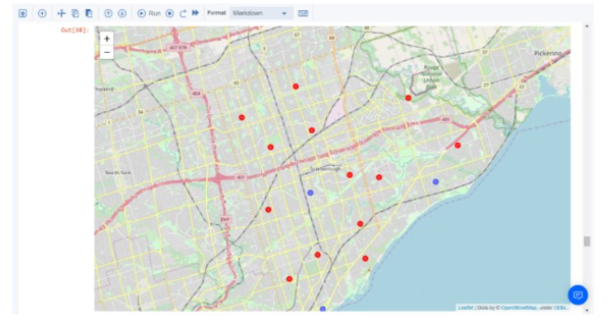
Map of Clusters in Scarborough

Slide 5
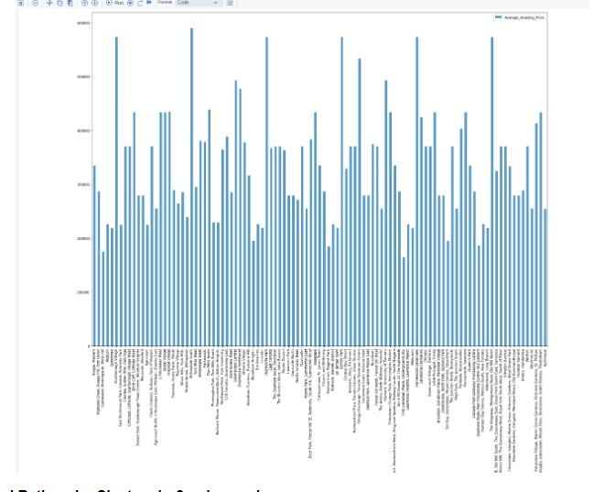
Average Housing Price by Clusters in Scarborough

Slide 6
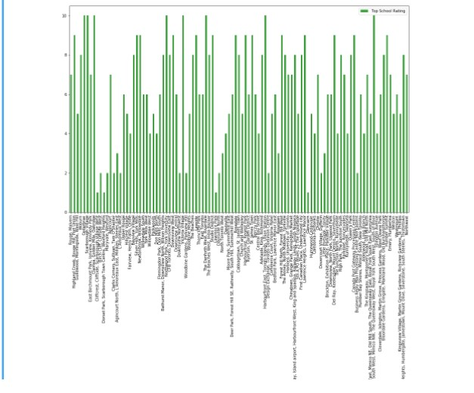
School Ratings by Clusters in Scarborough

Slide 7
Conclusion
In this project, using k-means cluster algorithm I separated the neighborhood into 10(Ten) different clusters.
For 103 different latitude and longitude from dataset, which have very-similar neighborhoods around them.
Using the charts above results presented to a particular neighborhood based on average house prices and school rating have been made.

Slide 8
Future works
This project can be continued for making it more precise in terms to find best house in Scarborough. Best means on the basis of all required things(daily needs or things we need to live a better life) around and also in terms of cost effective.

Slide 9
Libraries Used
Pandas: For creating and manipulating data frames.
Folium: Used for creating maps.
ScikitLearn: For Kmeans clustering.
JSON: Library for Jason files.
XML: To separate data for presentation and XML stores data in plain text format.
Geocoder: To retrieve location data.
Matplotlib: For plotting graphs.

Slide 10
Future works
This project can be continued for making it more precise in terms to find best house in Scarborough.
Best means on the basis of all required things(daily needs or things we need to live a better life) around and also in terms of cost effective.

Slide 11


