Slide 1



Student_Analysis

Slide 2
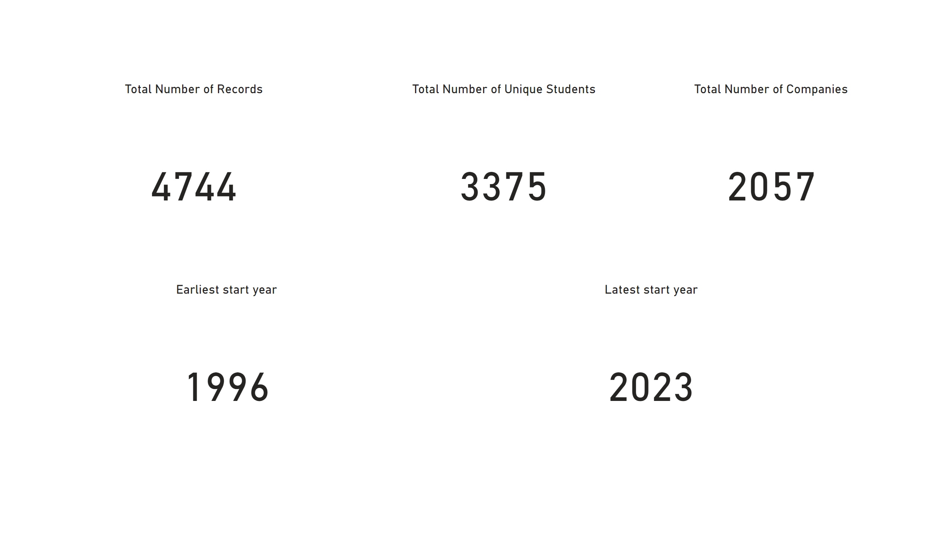
General information
Notes:
Total Number of Records
No alt text provided
Total Number of Unique Students
No alt text provided
Total Number of Companies
No alt text provided
Earliest start year
No alt text provided
Latest start year
No alt text provided

Slide 3
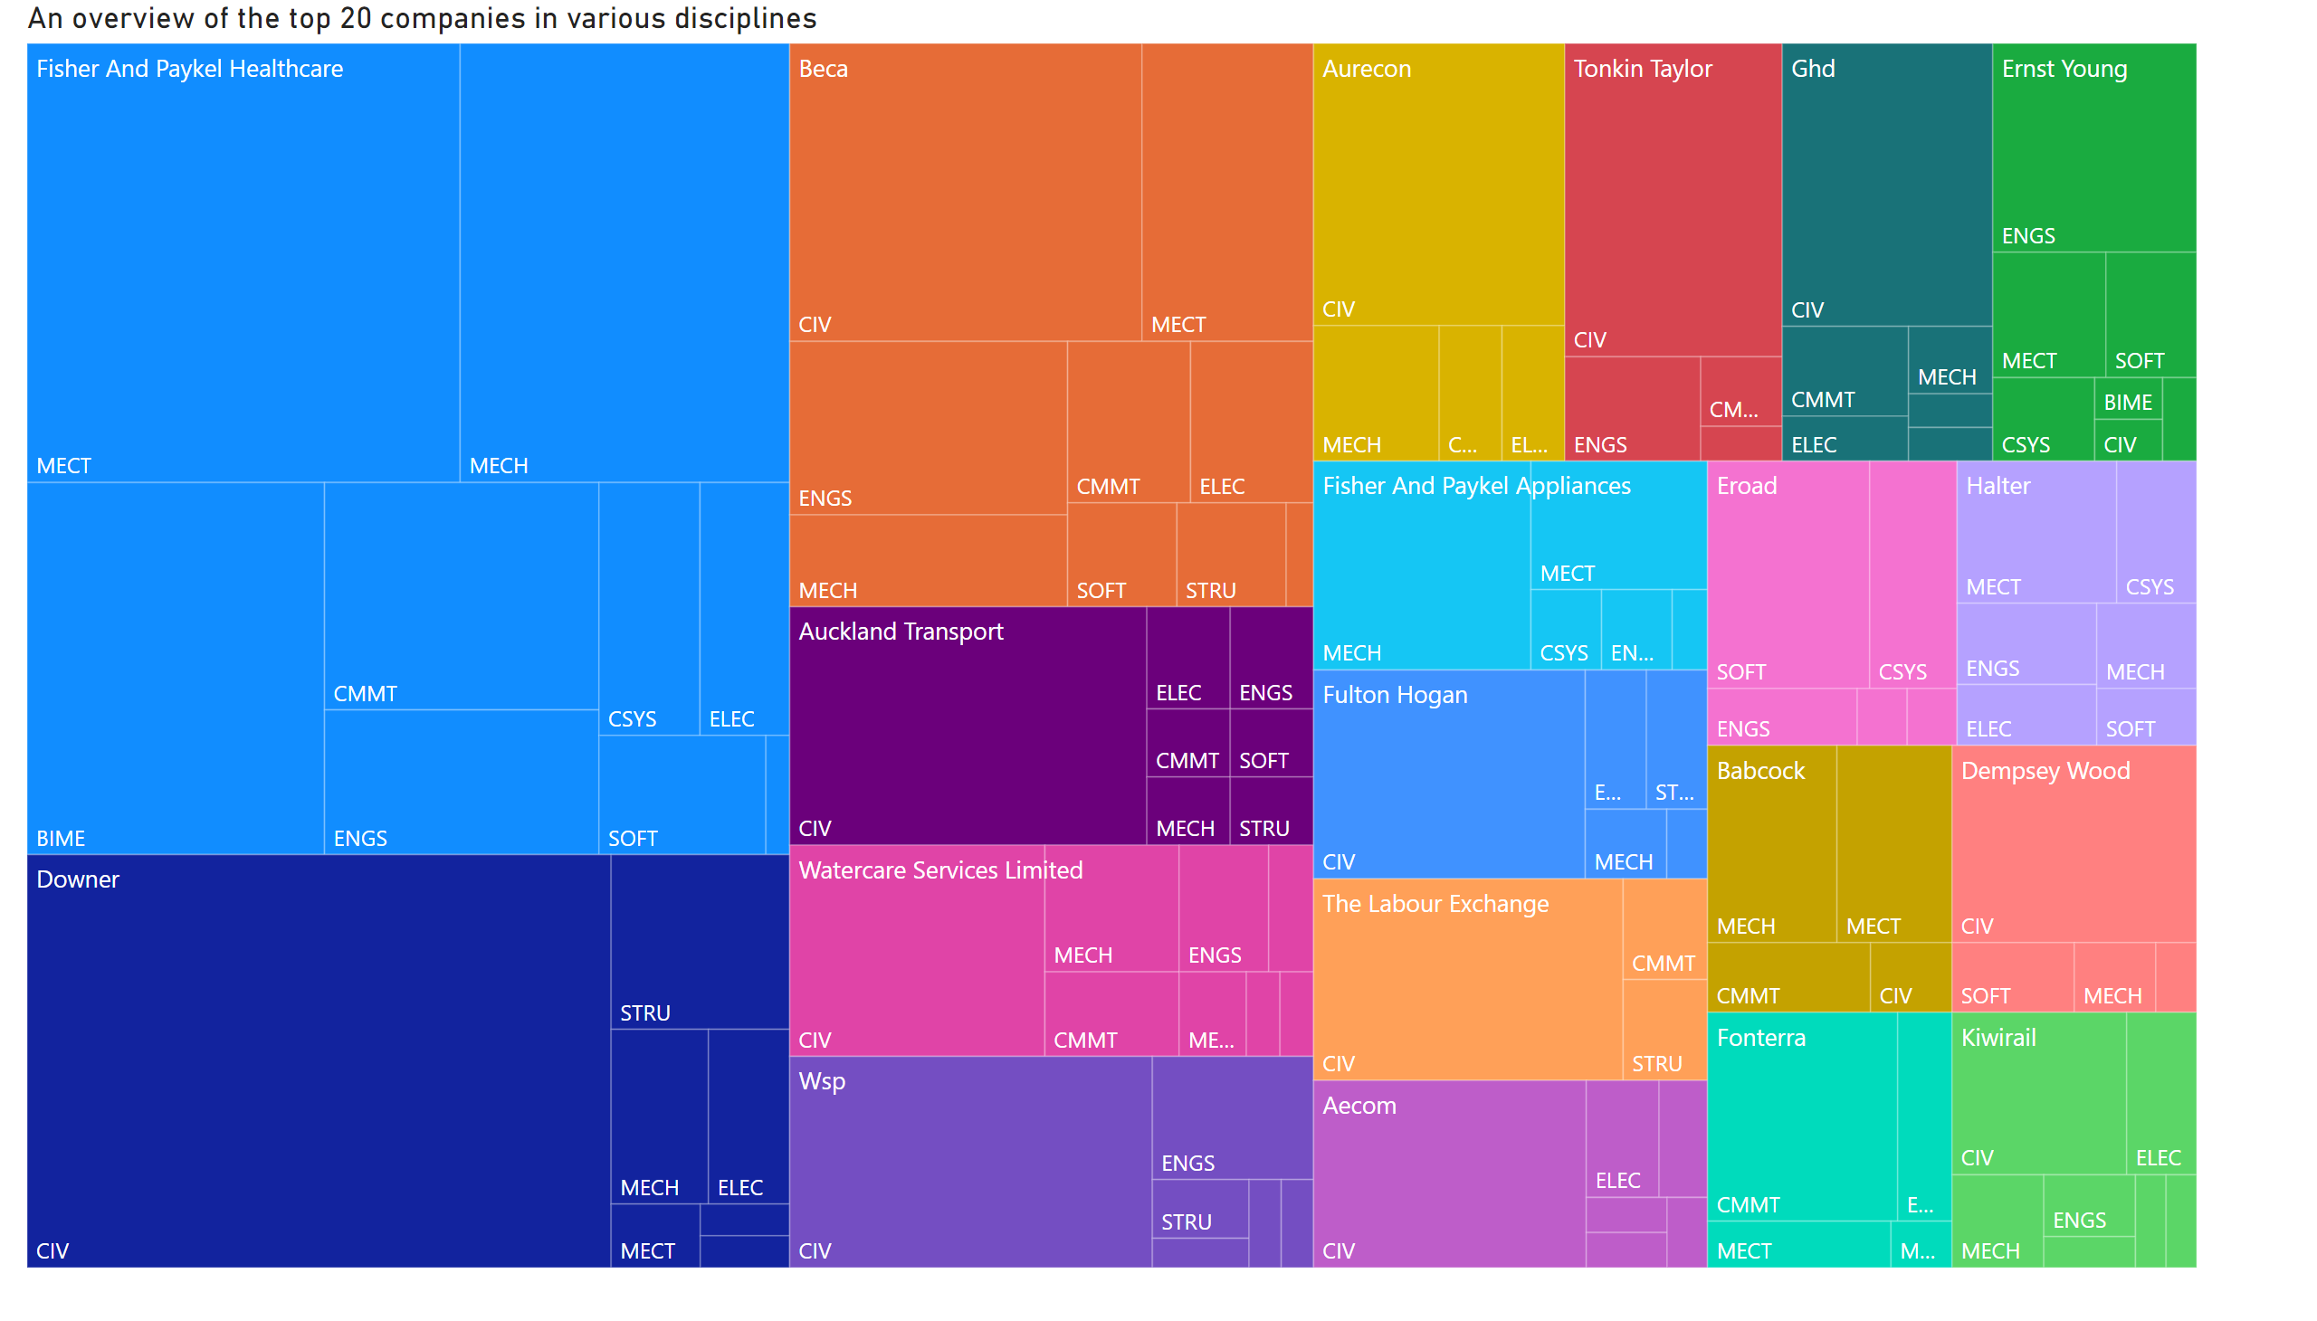
General outlook
Notes:
An overview of the top 20 companies in various disciplines
No alt text provided

Slide 4
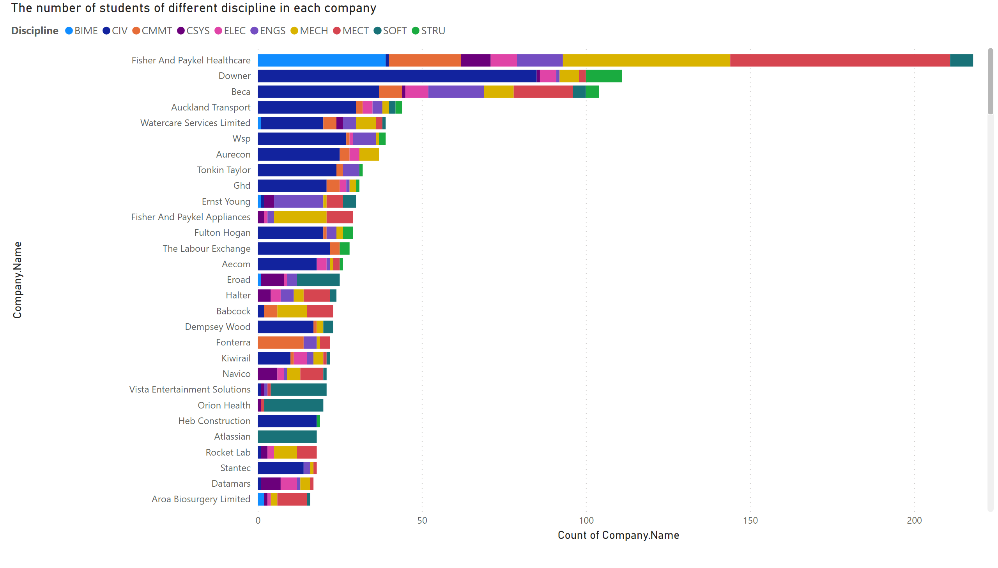
Company report
Notes:
The number of students of different discipline in each company
No alt text provided

Slide 5
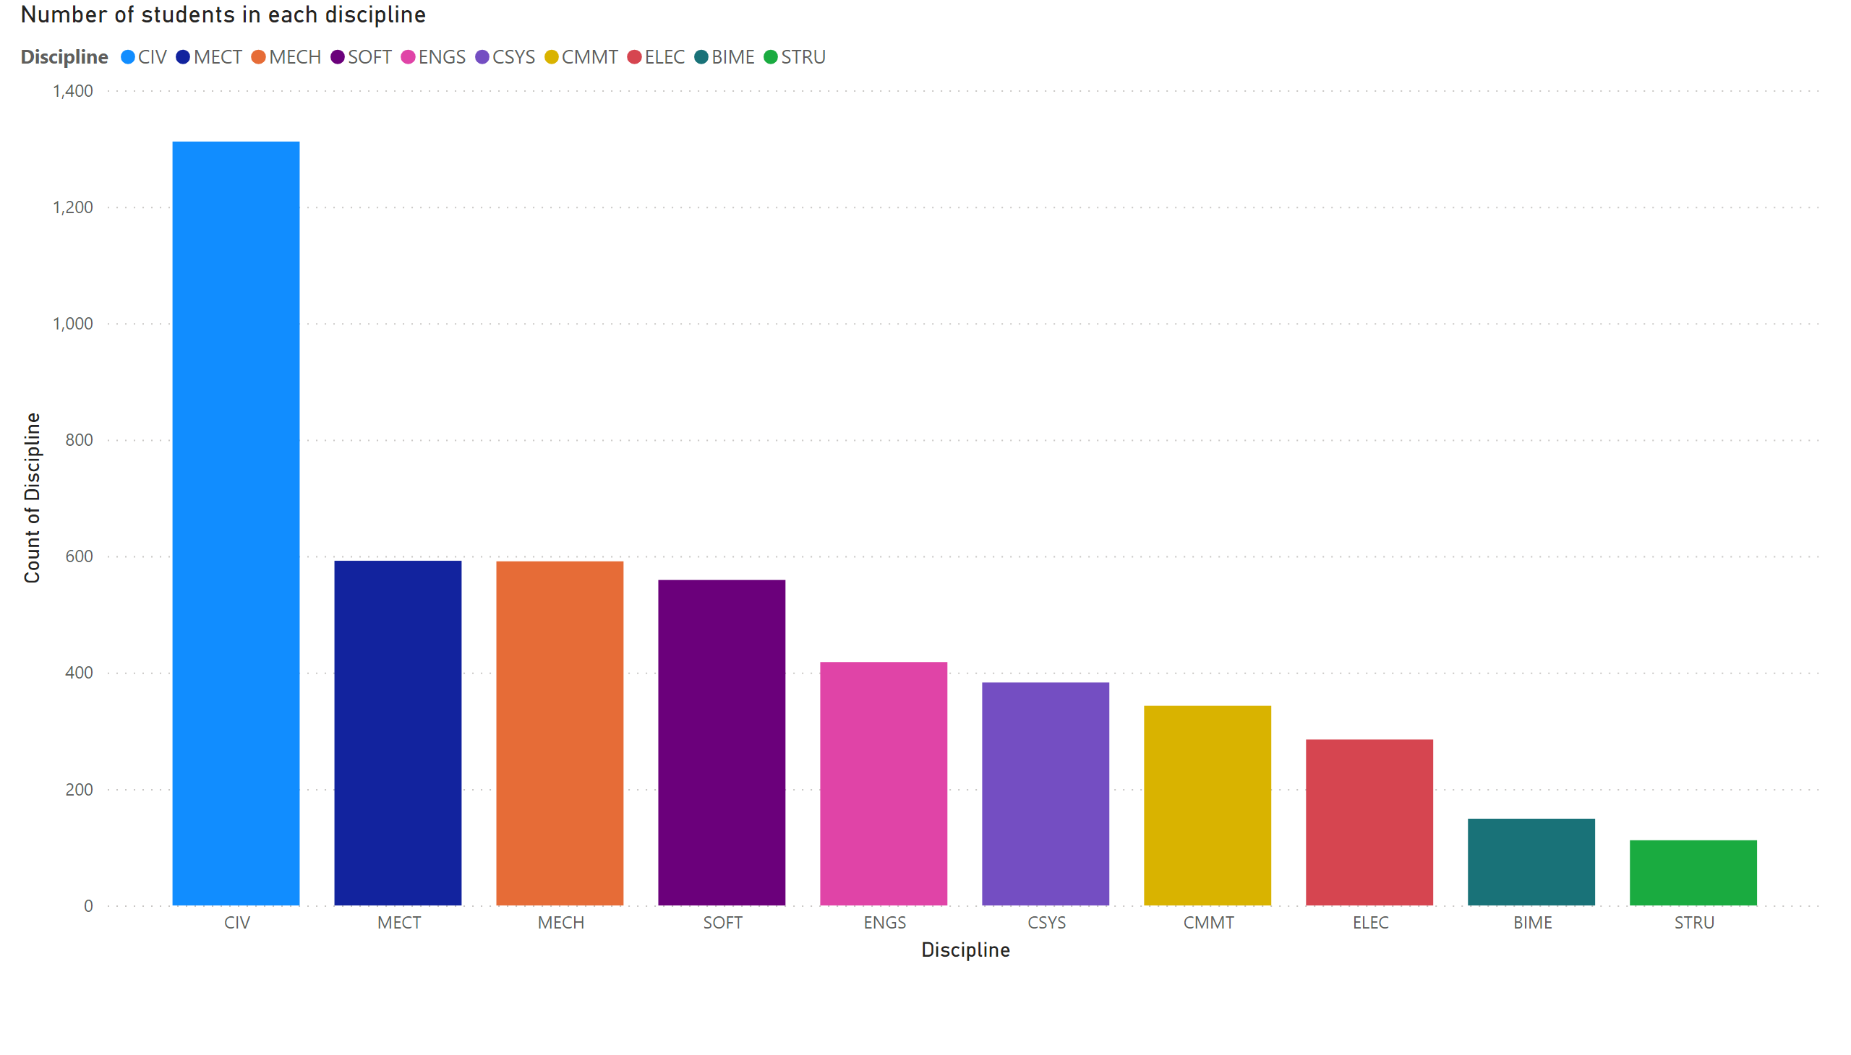
Discipline's report
Notes:
Number of students in each discipline
No alt text provided

Slide 6
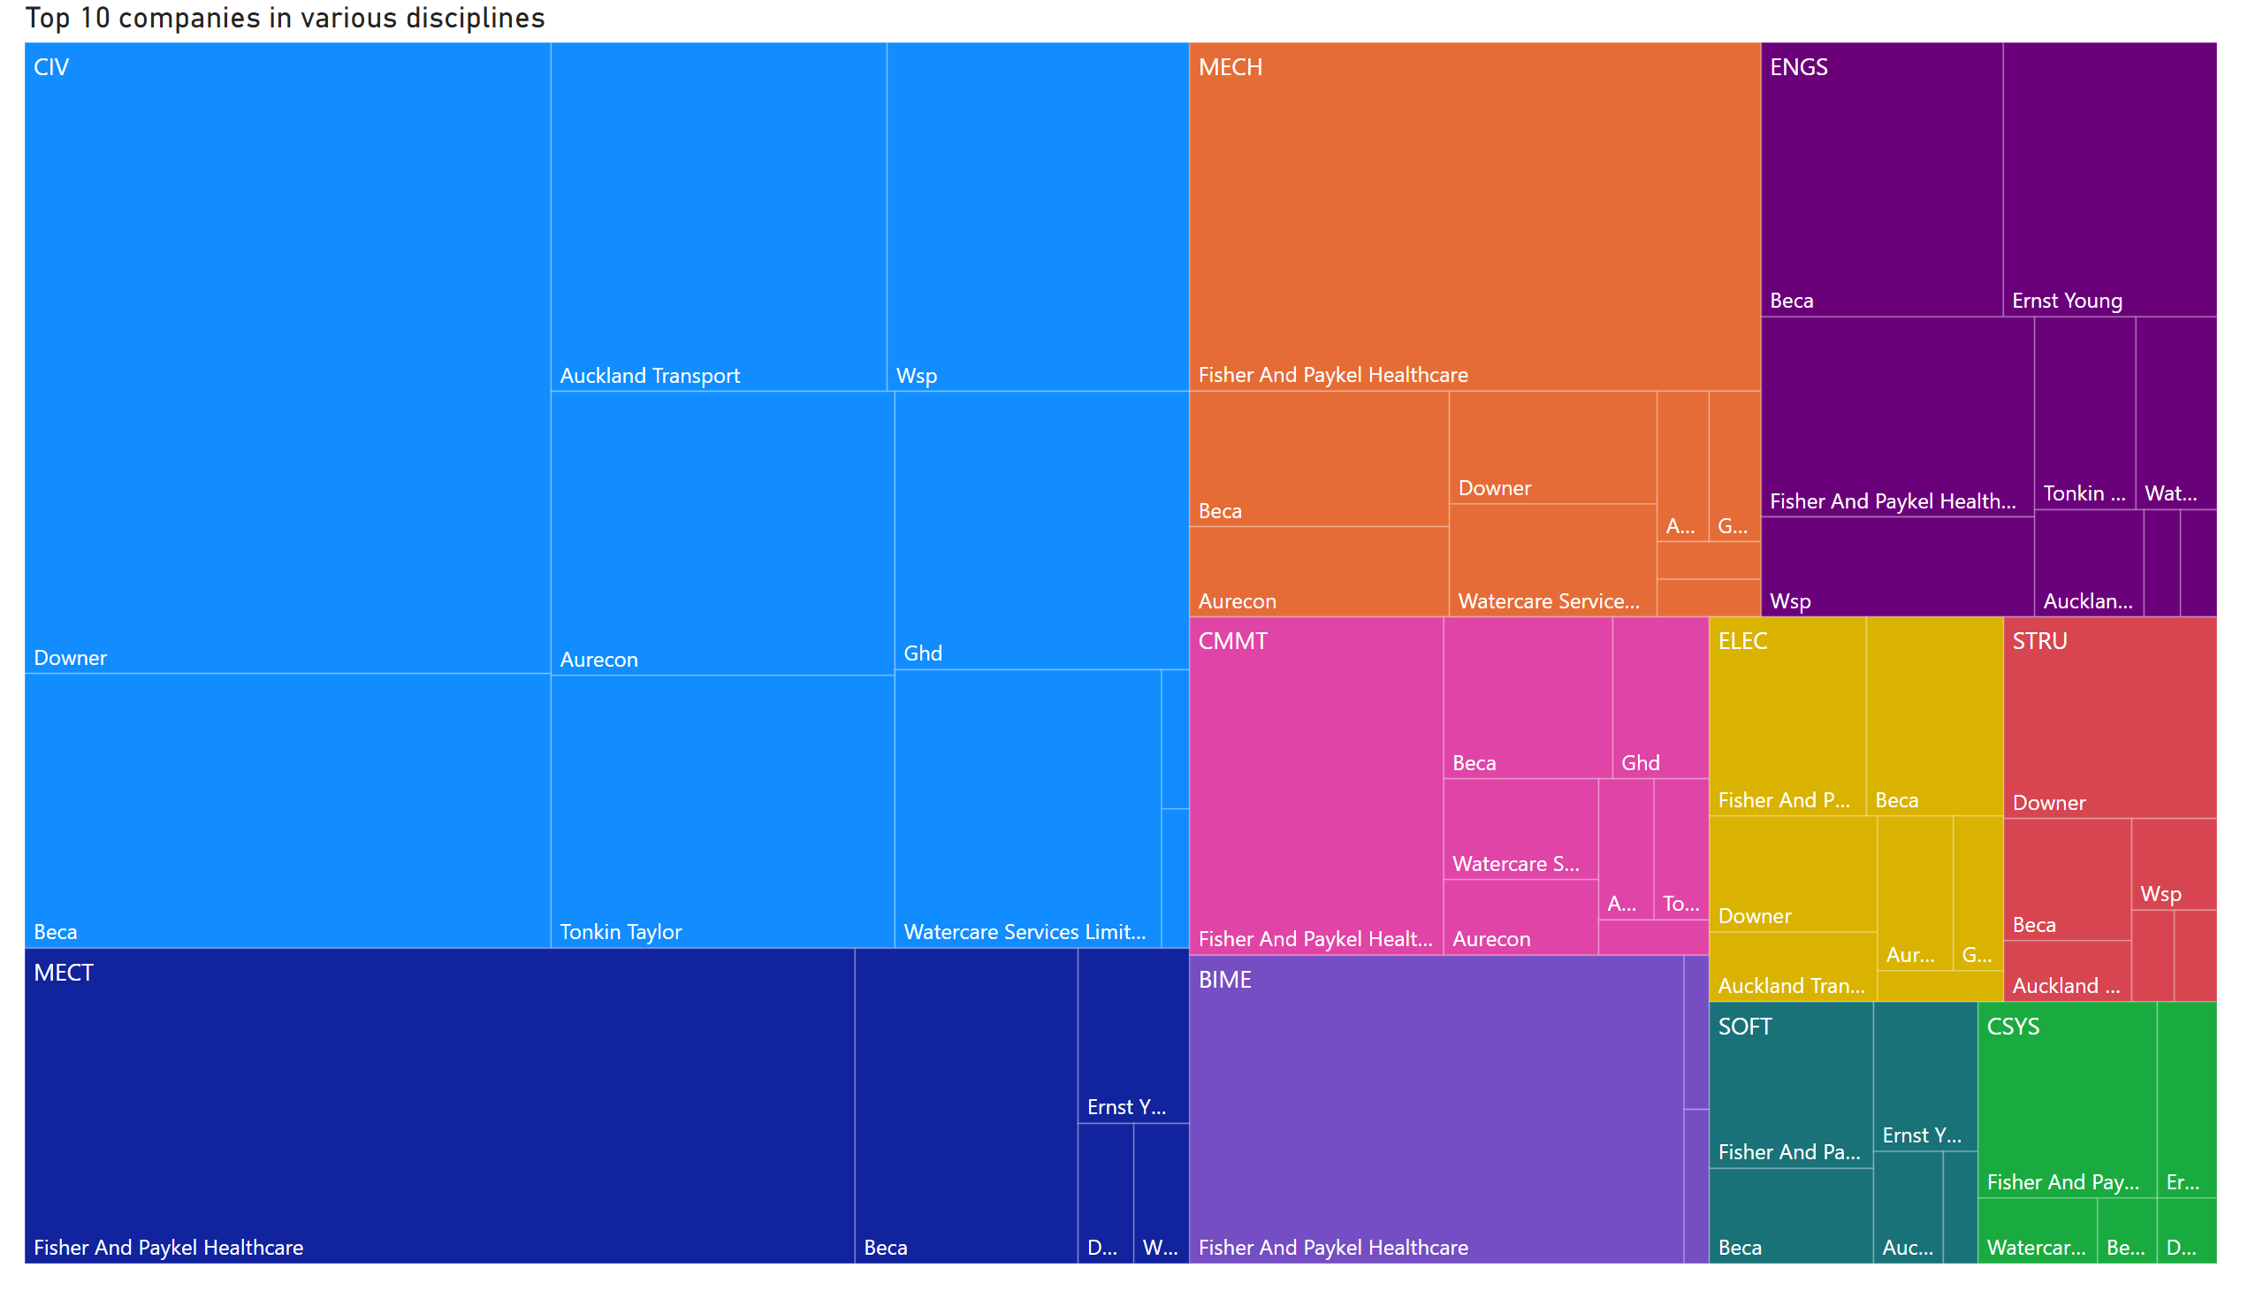
Discipline_company
Notes:
Top 10 companies in various disciplines
No alt text provided

Slide 7
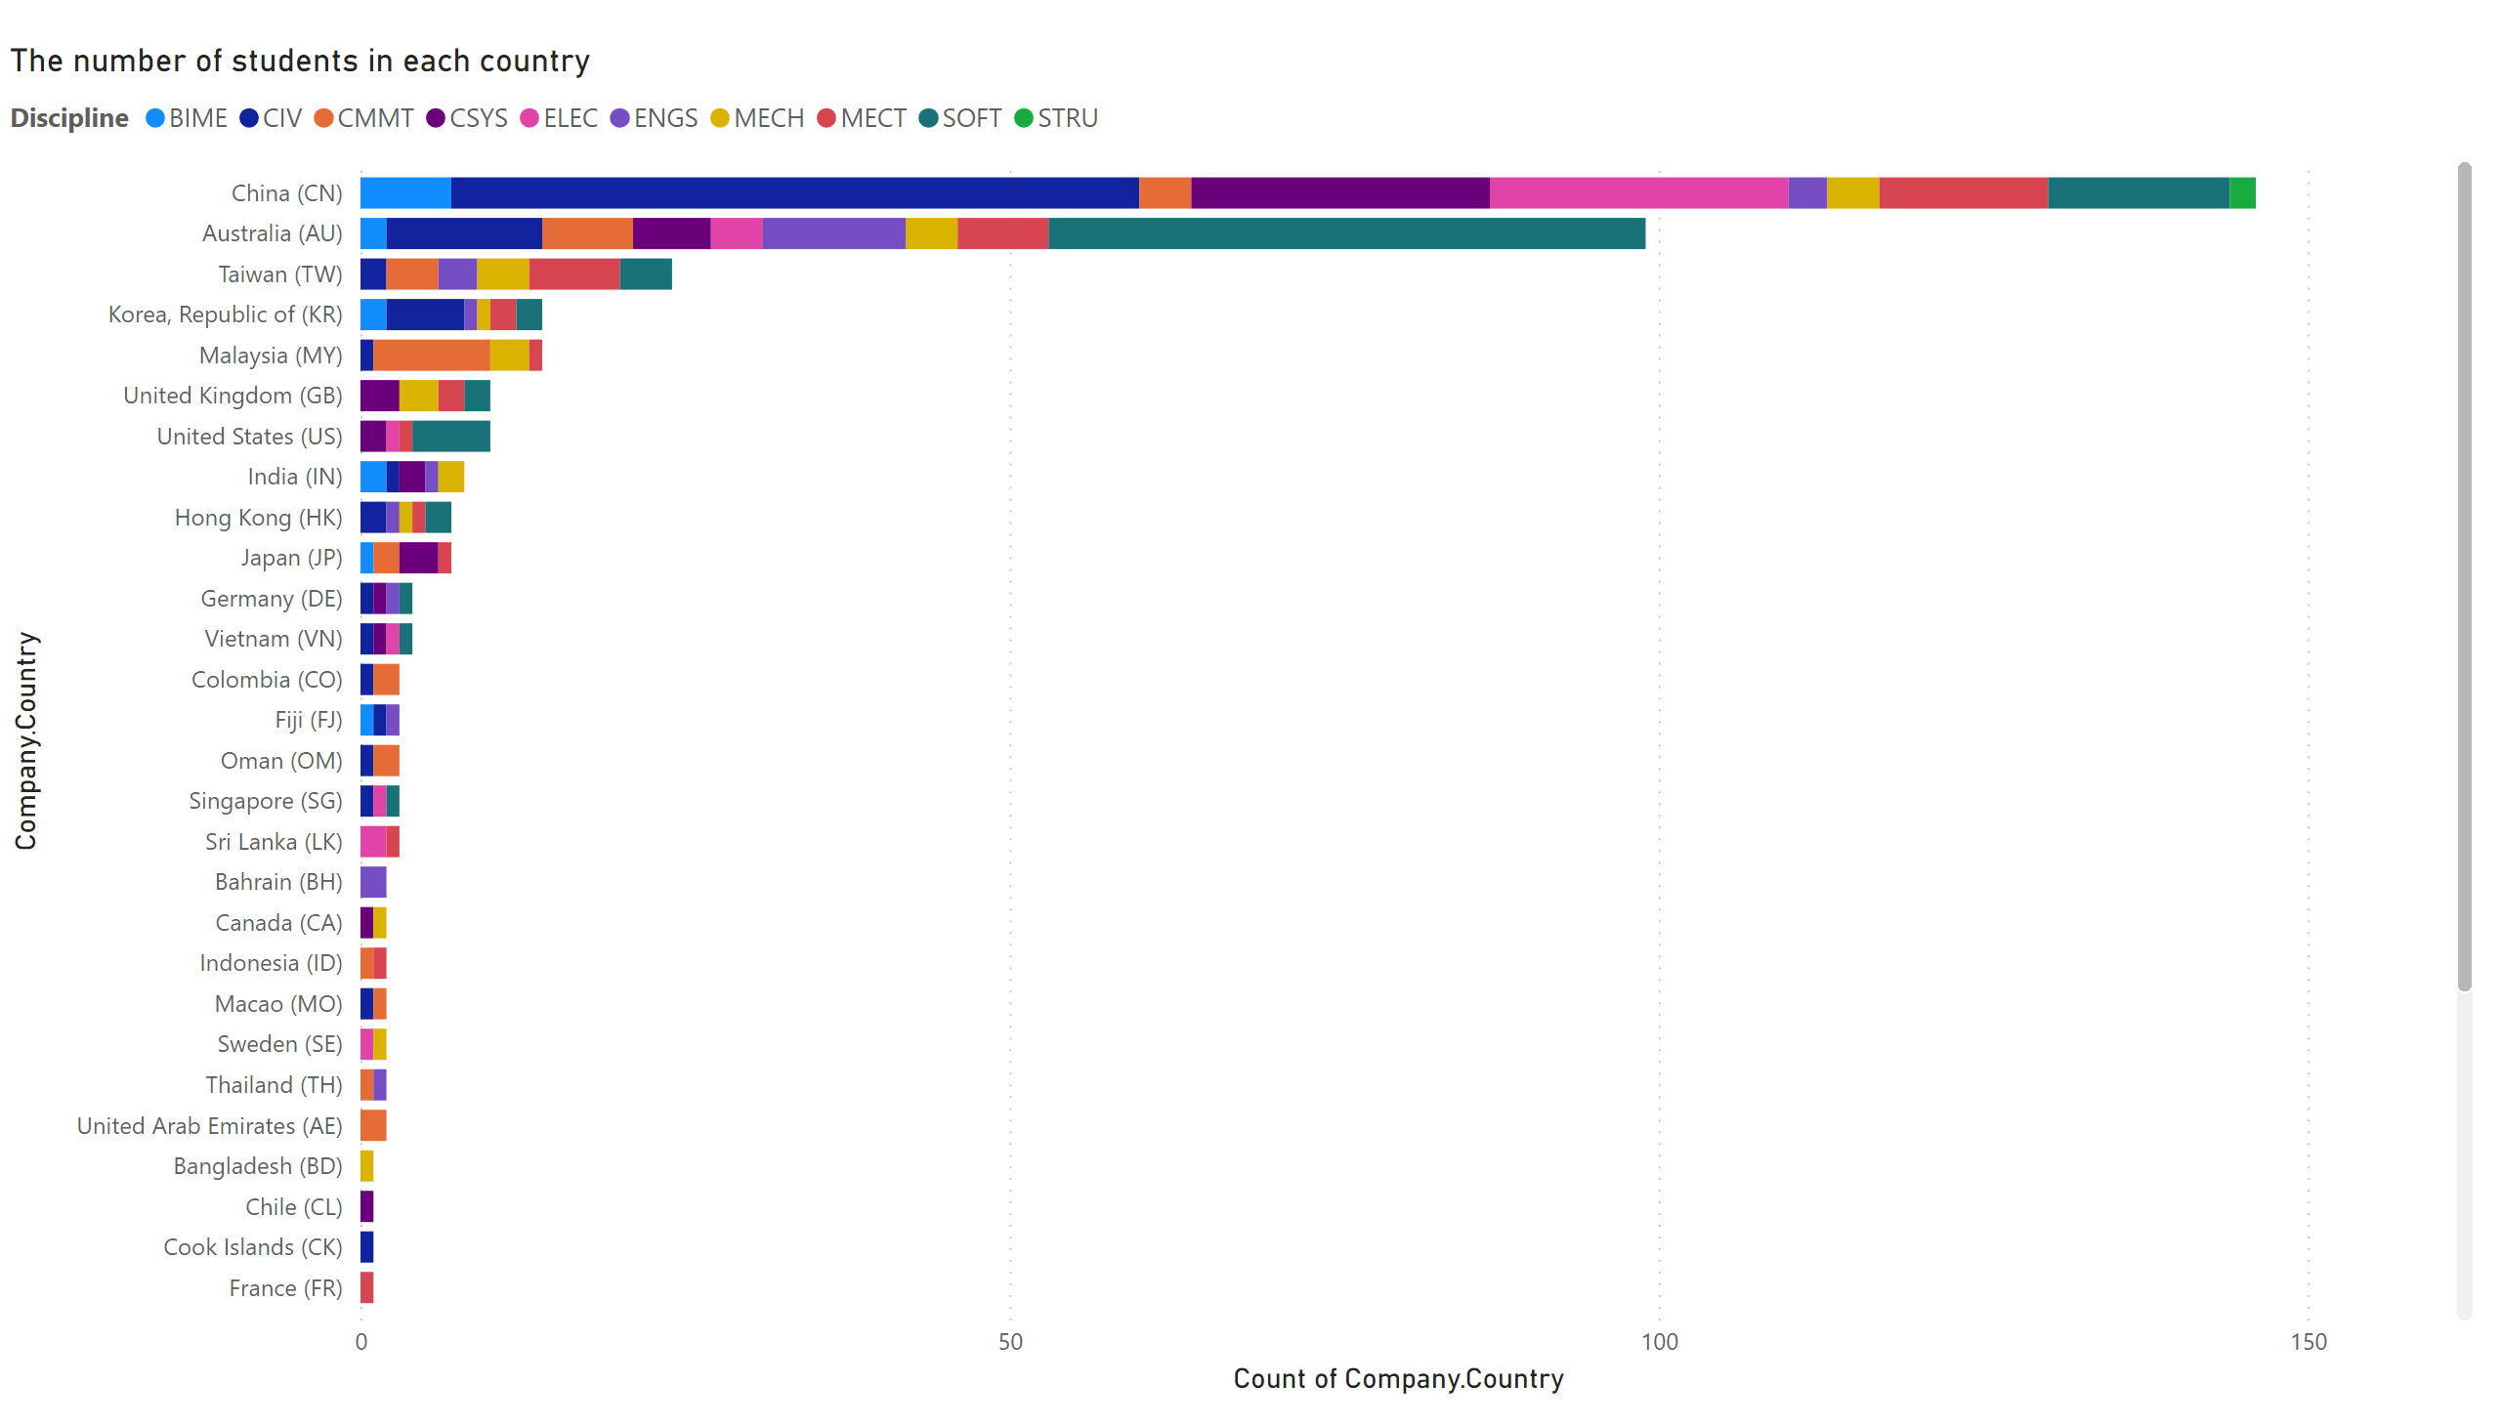
Country_Disciline
Notes:
The number of students in each country
No alt text provided

Slide 8
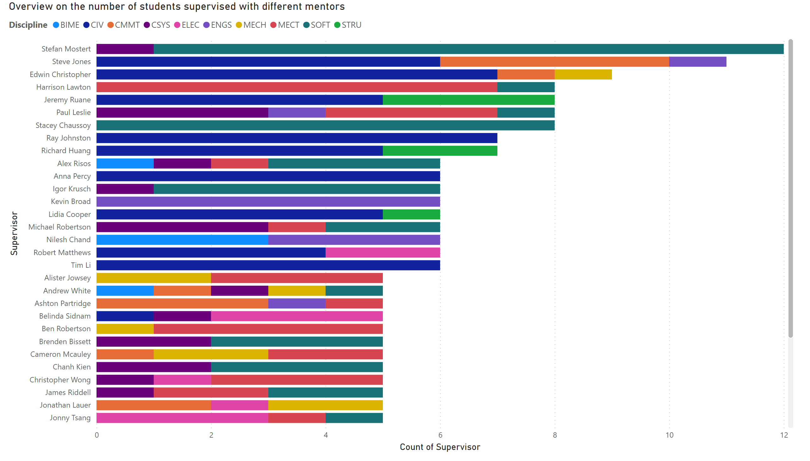
Supervvisor_Discipline_barchart
Notes:
Overview on the number of students supervised with different mentors
No alt text provided

Slide 9
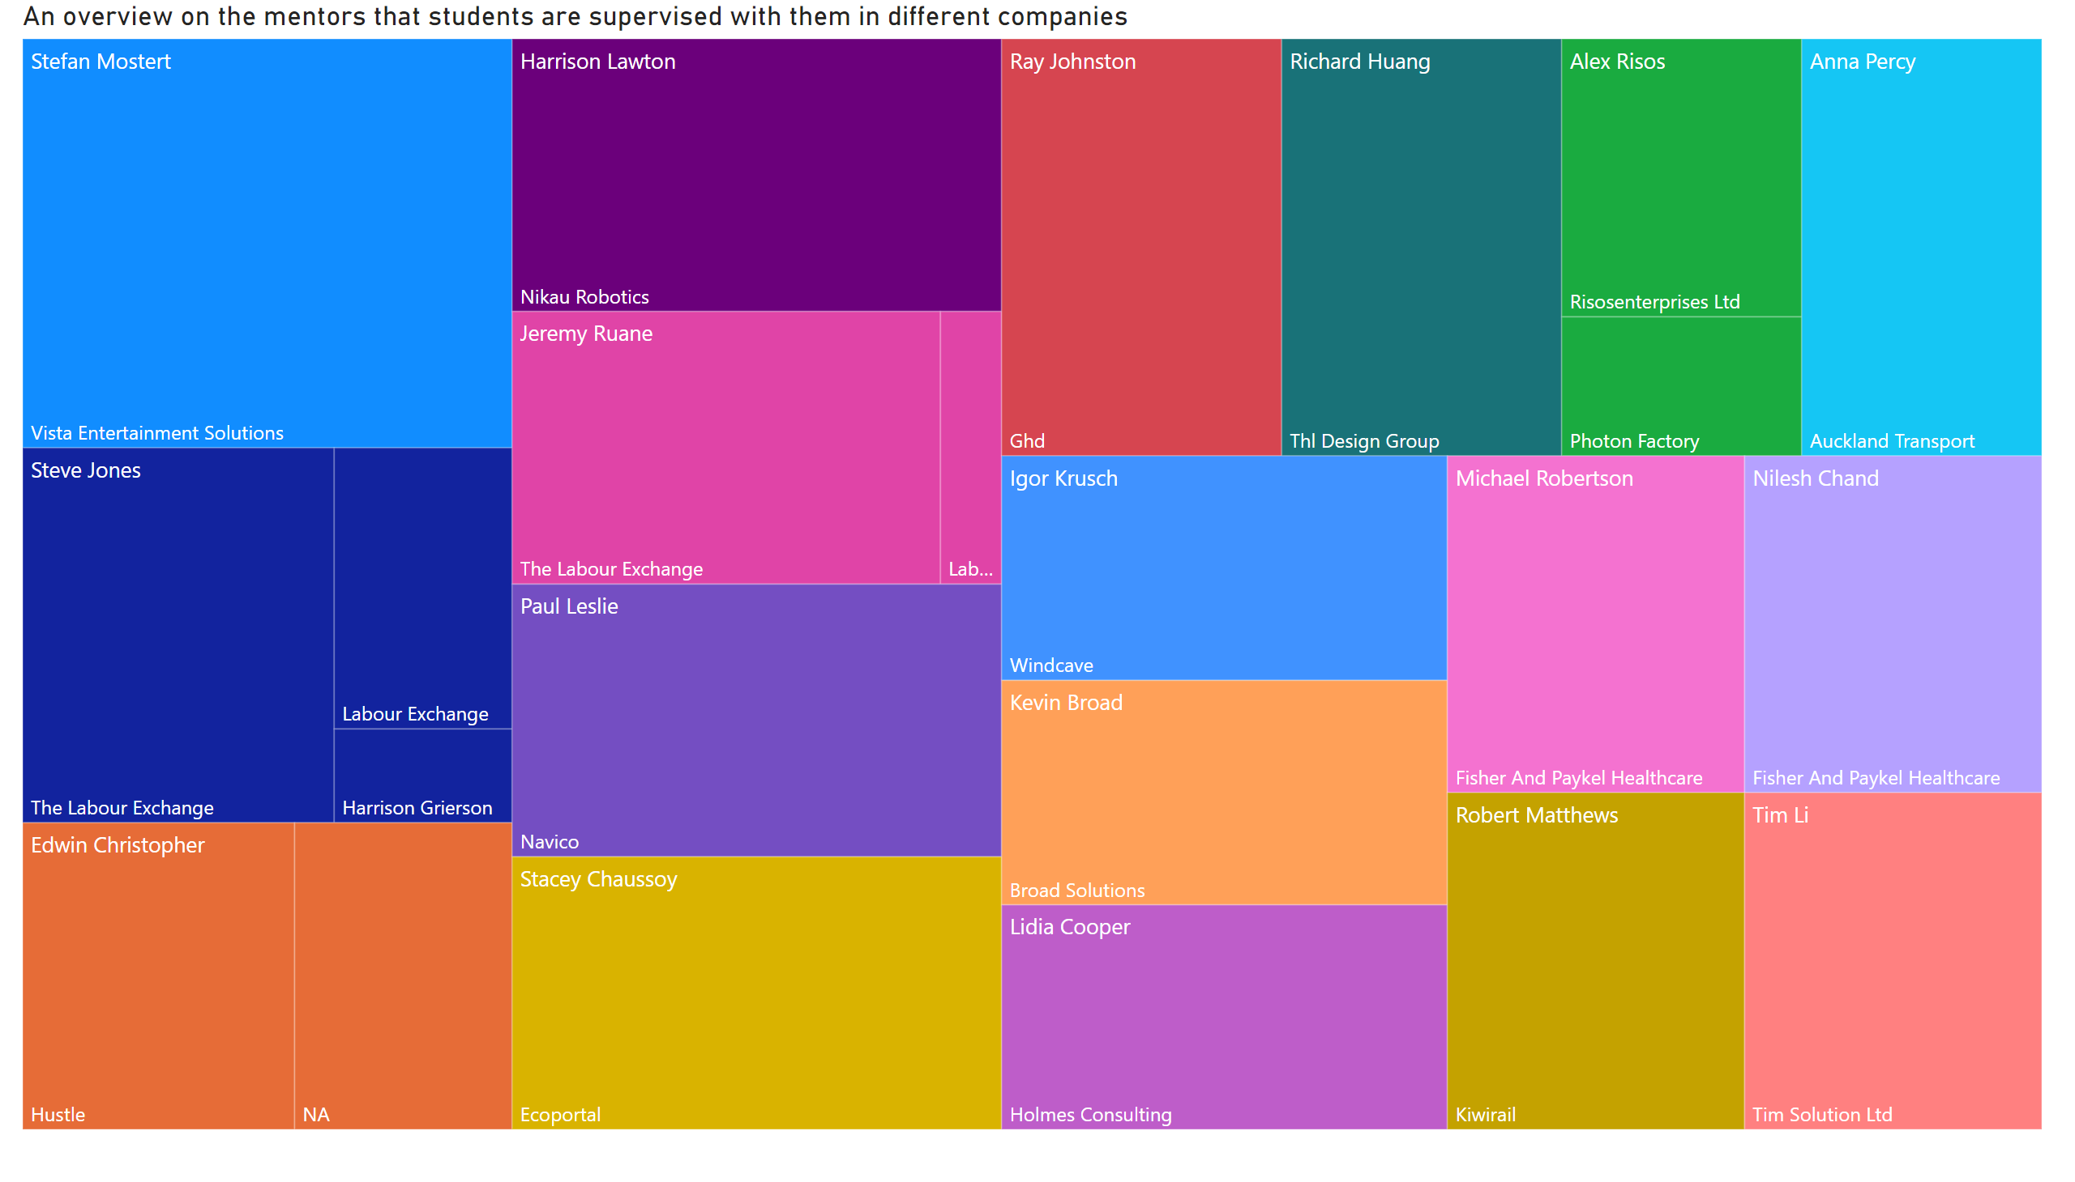
Supervisor_company
Notes:
An overview on the mentors that students are supervised with them in different companies
No alt text provided

Slide 10
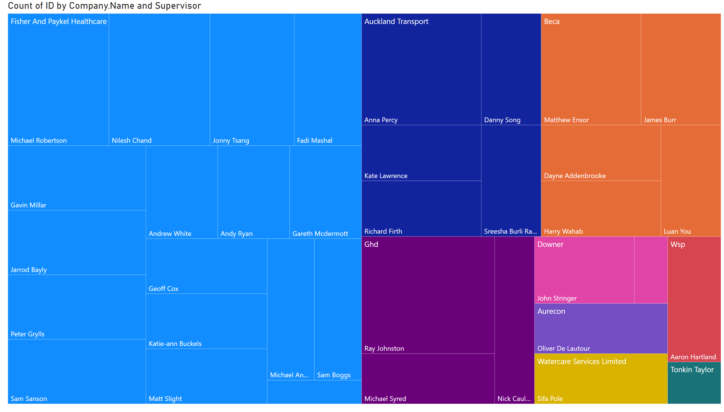
Company_Supervisor
Notes:
treemap
No alt text provided

Slide 11
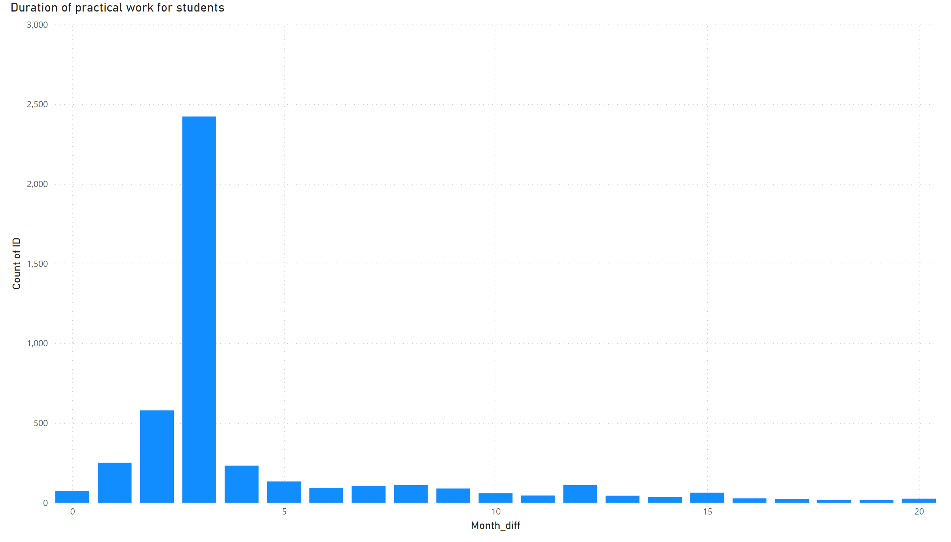
Wrok_duration
Notes:
Duration of practical work for students
No alt text provided

Slide 12
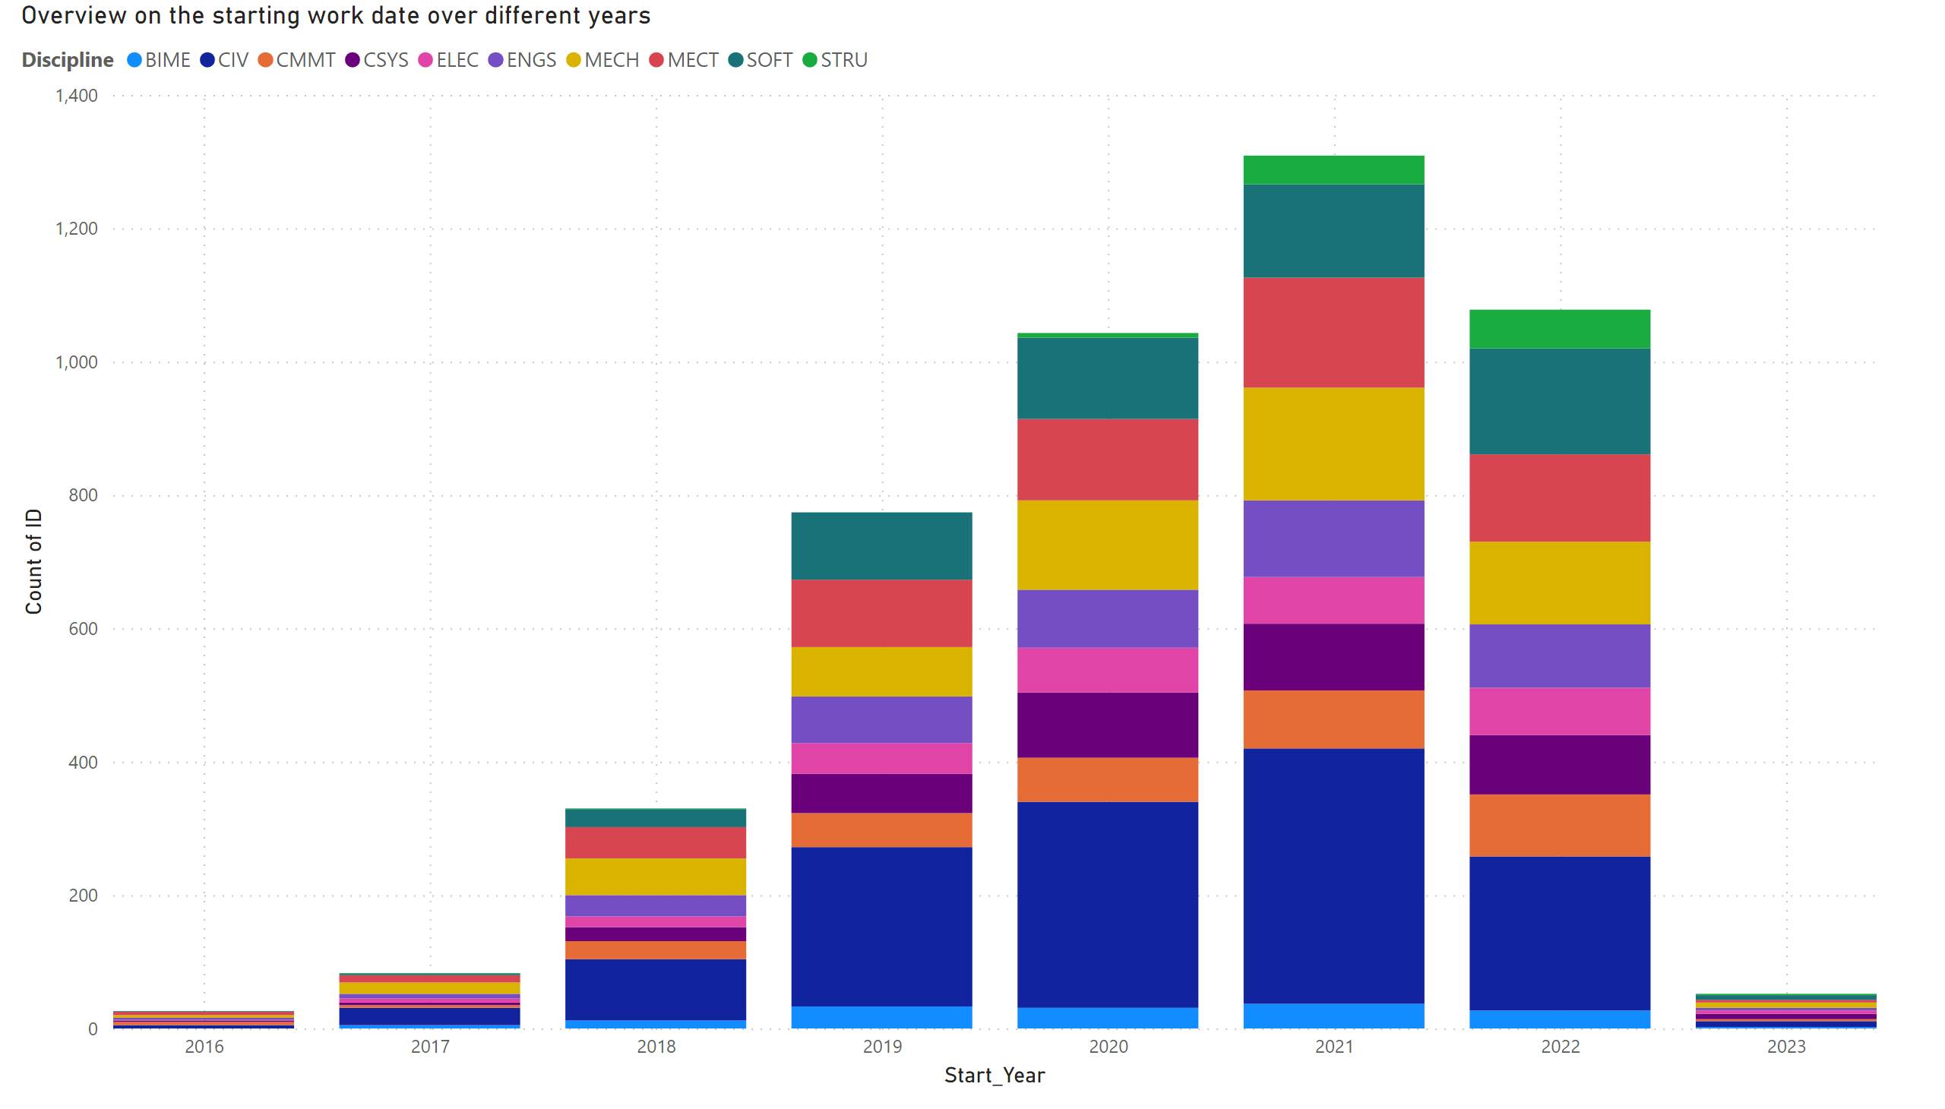
Start_Work
Notes:
Overview on the starting work date over different years
No alt text provided

Slide 13
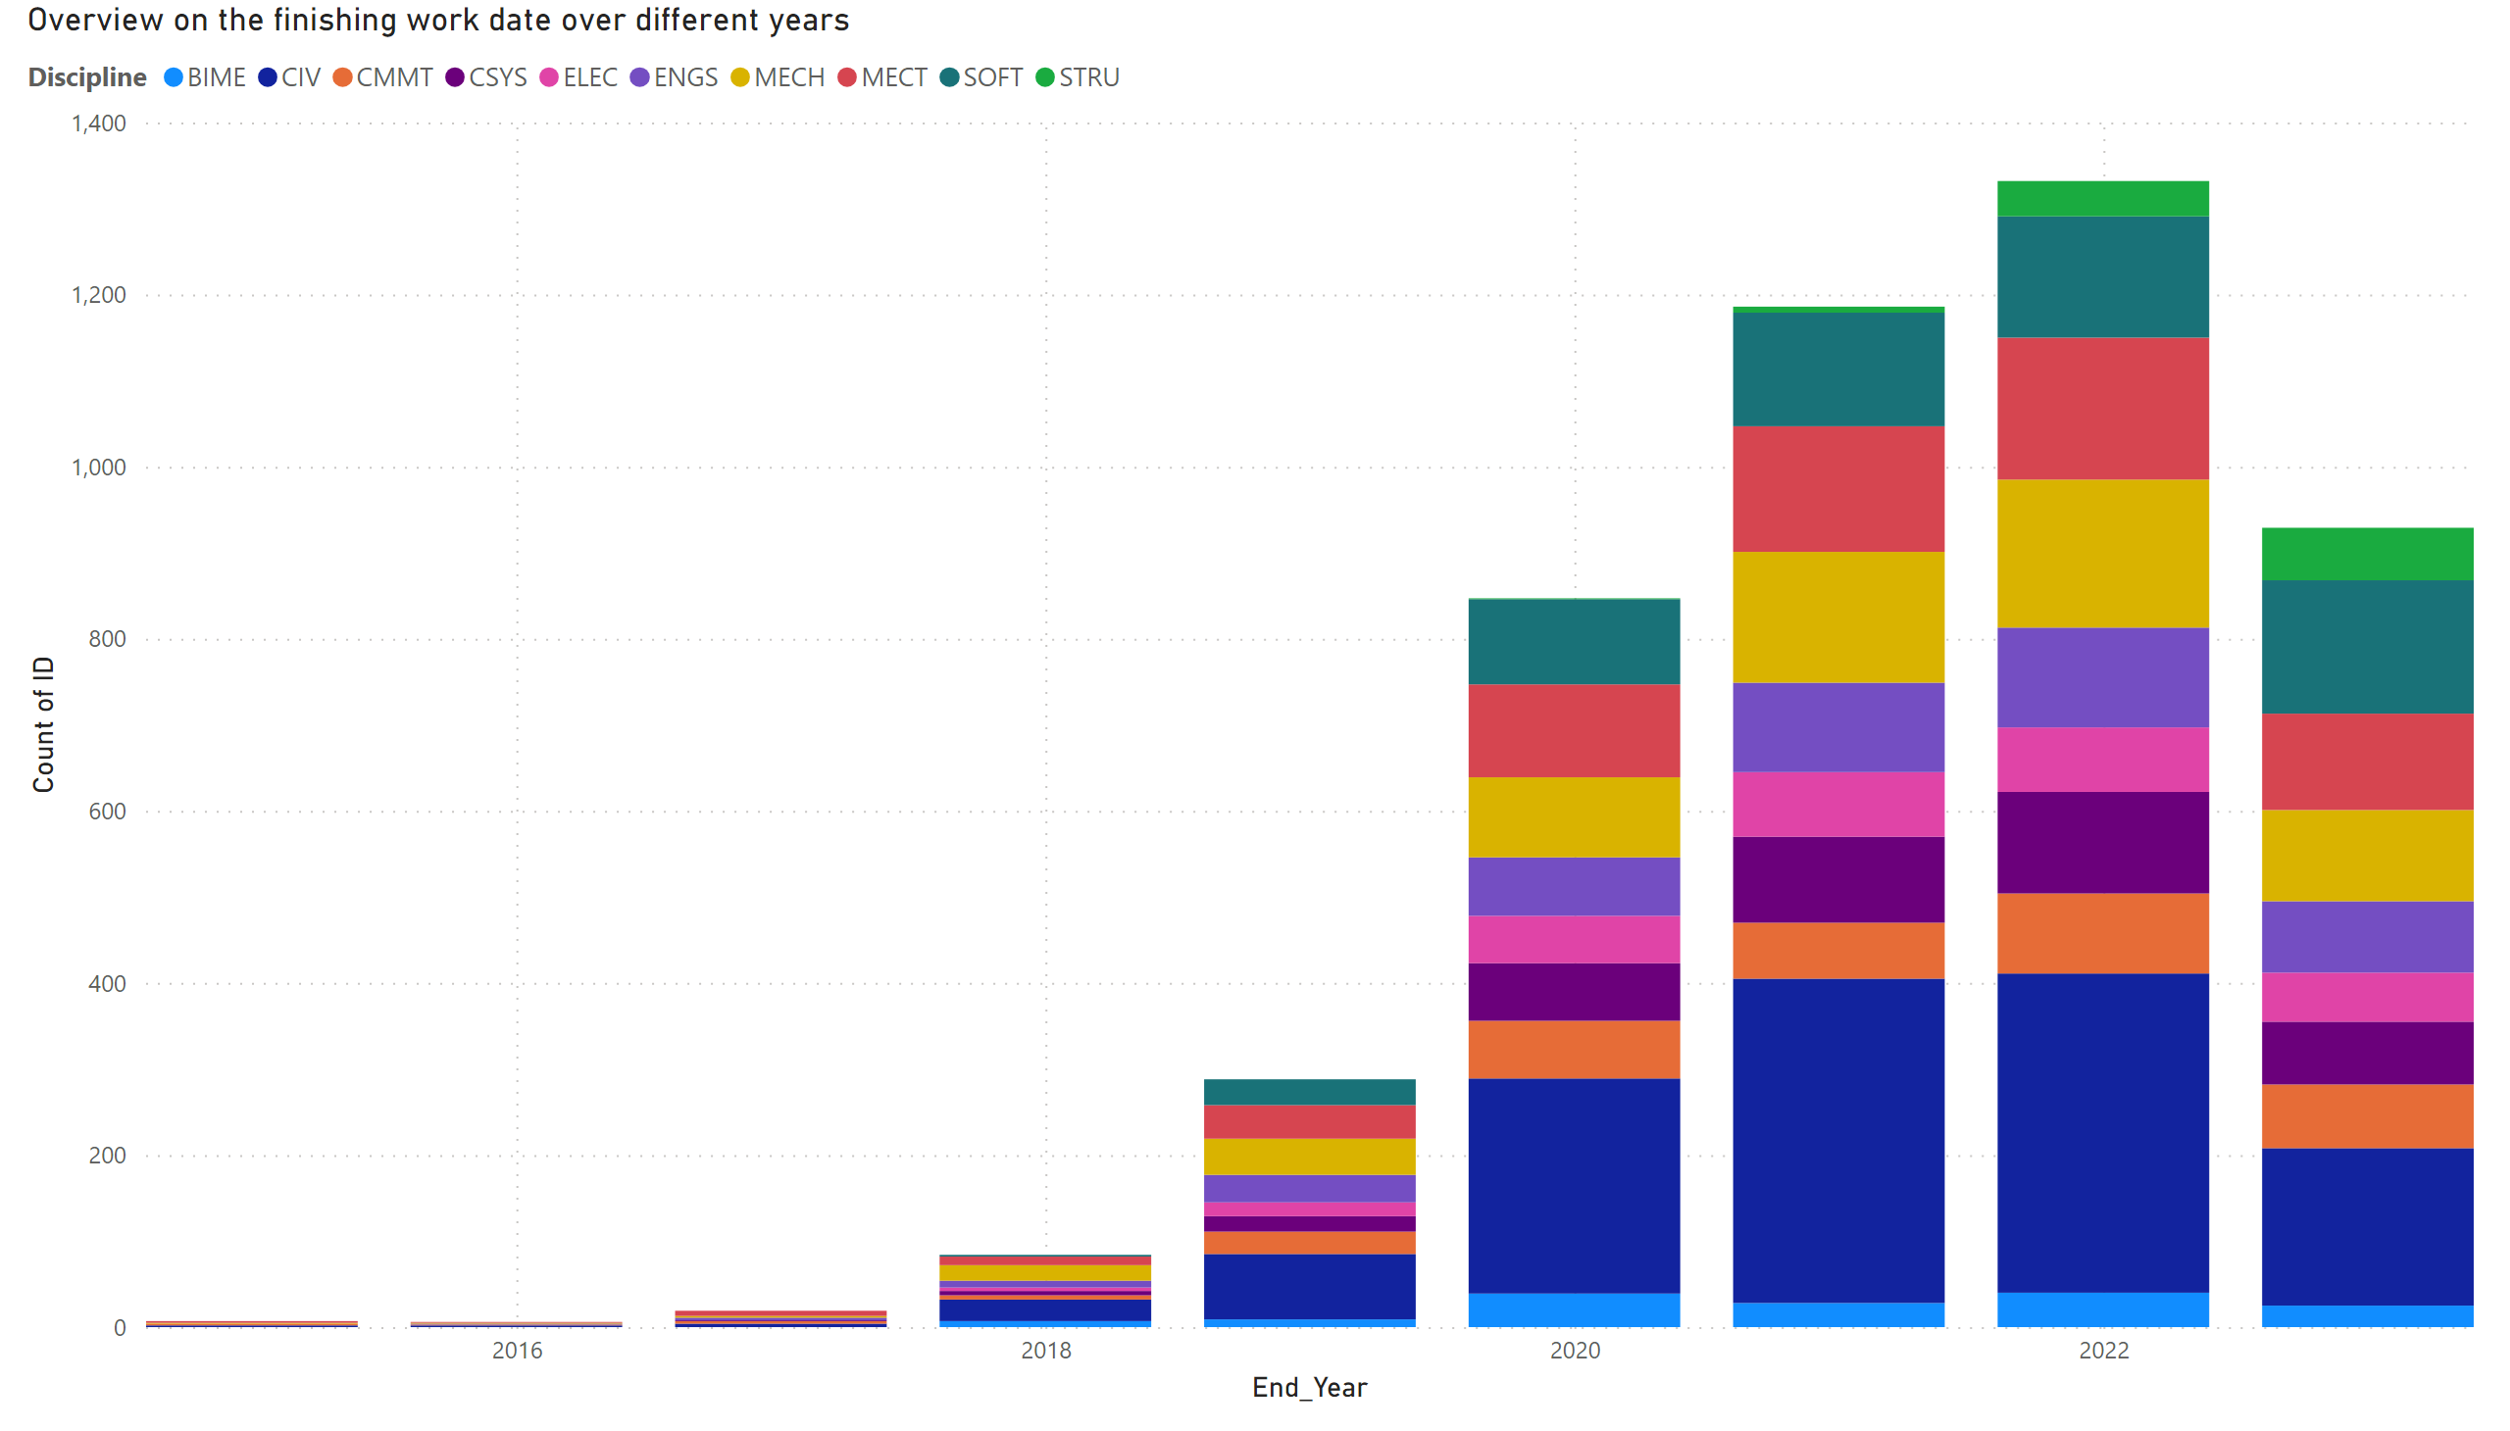
End_Work
Notes:
Overview on the finishing work date over different years
No alt text provided

