Slide 1



Juan Jesús Ávila Mota
Examen Semana02
Academia Java Xideral
Noviembre 2022

Slide 2

Dependency Inversion (DI)

Slide 3






An employee has to be assigned to a branch of X company but the employee should not be assigned his own branch, an Injector is charge of this action

Slide 4
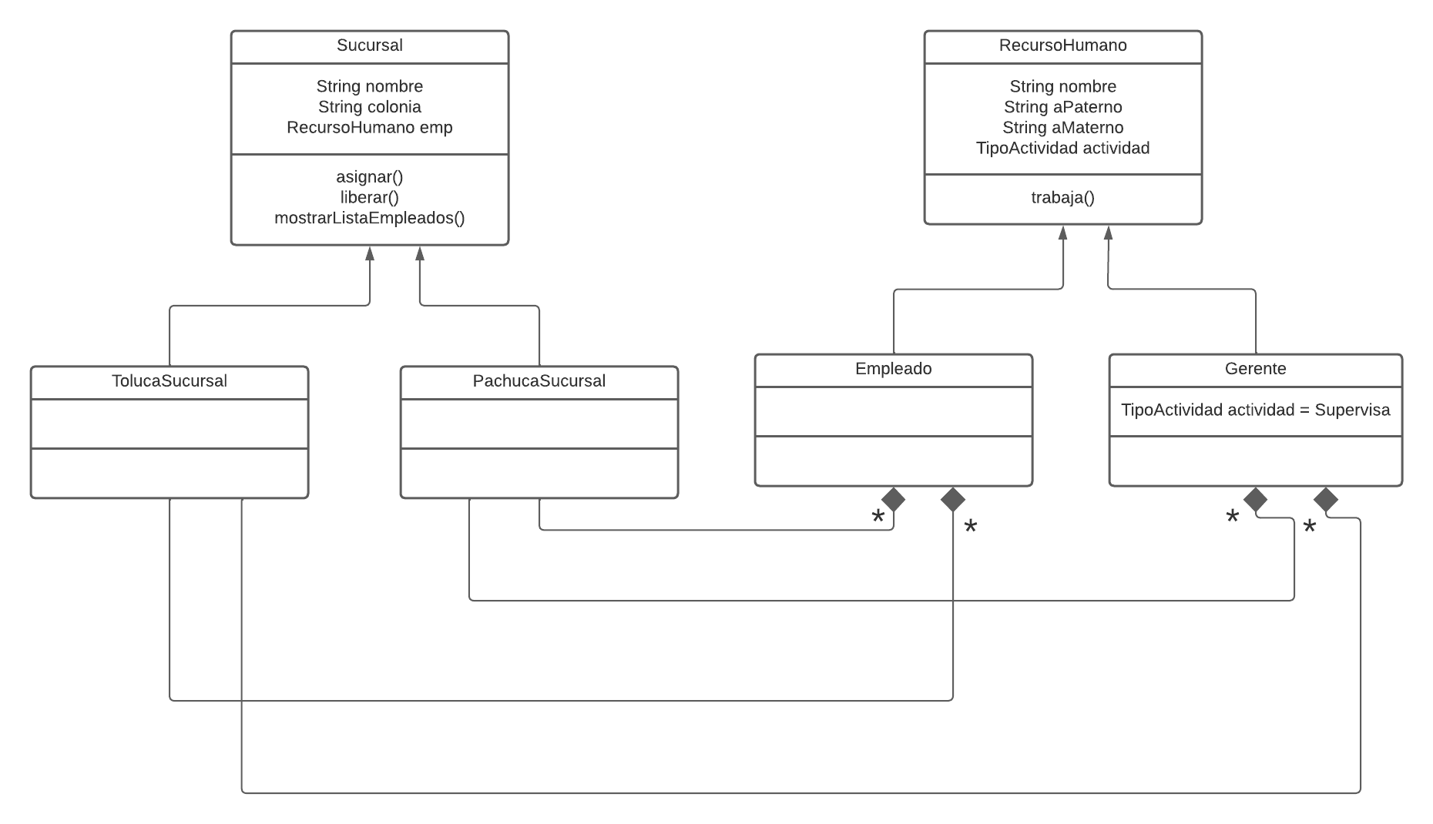

Slide 5
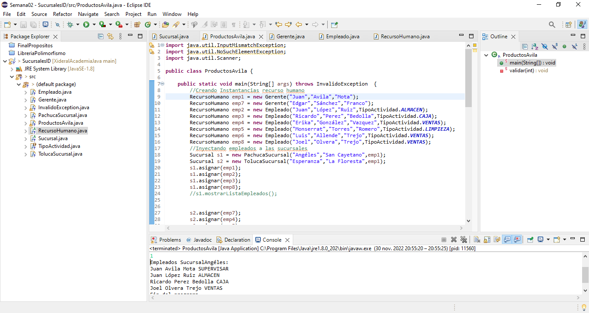
https://github.com/mota1299/XideralAcademiaJava/tree/main/Ex%C3%A1menes/Semana02/SucursalesID/src

Slide 6
MVC

Slide 7






Response:
Json
Xml
Txt
Pdf
Excel
Html
etc
Request
Response
HTTP
get
put
post
delete
Etc.
The architecture of this model requires a request by the user through the browser to HTTP, using one of its protocols, this will be sent to the server that contains Java which communicates directly with the MVC and the database.

Slide 8

Controller
invoke
Build HTML, CSS, JS and remove Java code
Process and send
Model
View
send
requests
response

Slide 9
Presentation Layer
Businnes Logic Layer
Data Access Layer
In this model, the business logic must be present in another layer, due to the fact that the MVC should not have this logic in its controller, it should only delegate responsibilities, in addition to the fact that a presentation like this allows better maintenance and easier migration to another SMDB since only tables are found in the DB

Slide 10
Types of Exceptions

Slide 11
Throwable
Exception
Error
RunTimeException
Other Exceptions
UnChecked
Checked

Slide 12
The exceptions have Throwable as a superclass, There are three types of exceptions, The errors are exceptions for which it is not possible to do something, for example, a damage to the hard disk, The RunTimeException, UnChecked, the compiler does not force to do something with them, no it is necessary to catch them, contrary to Checked Exceptions, which compulsorily forces us to treat them either with a catch or throw them to the superior method, having as limit the JVM

Slide 13
Purposes of final

Slide 14
Final Primitive, is a constant
Final Class, can’t apply inheritance
Final method, can’t overwrite
Final Object, Cant´t Change the reference

Slide 15
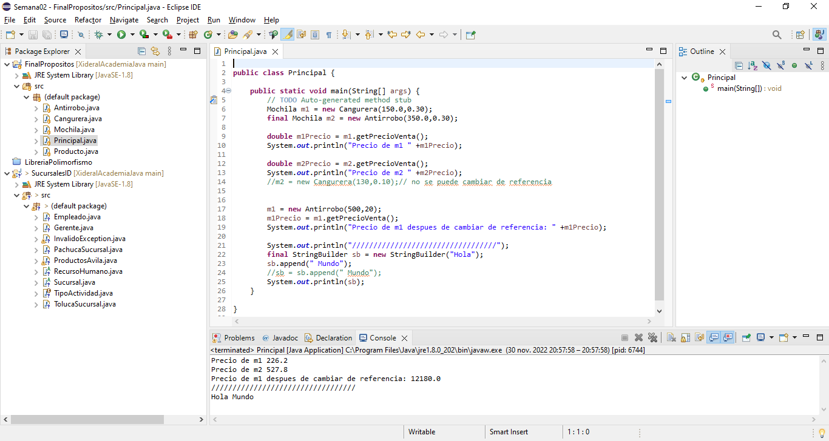
https://github.com/mota1299/XideralAcademiaJava/tree/main/Ex%C3%A1menes/Semana02/FinalPropositos/src

Slide 16
Multicatch and Try with resources

Slide 17
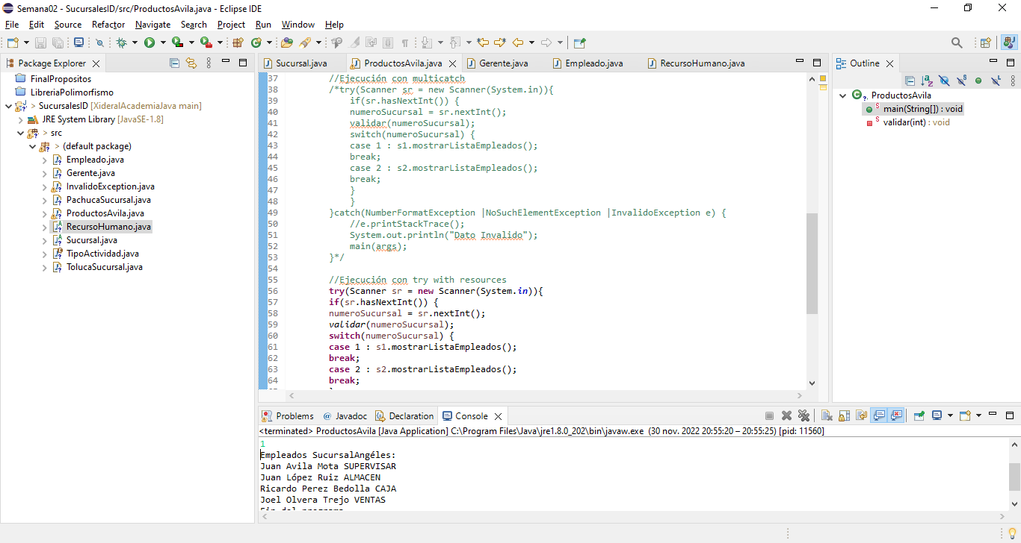
https://github.com/mota1299/XideralAcademiaJava/tree/main/Ex%C3%A1menes/Semana02/SucursalesID/src

Slide 18
Asynchronous vs Synchronous

Slide 19
SYNCHRONOUS
ASYNCHRONOUS
Process 1
Process 1
Process 2
Process 2
Process 3
Process 3
Process 4
Synchronous
The execution is sequential, it returns when the operation has been completed in its entirety, the processes go one by one
Processes do not depend on other processes to start or finish, they can be working simultaneously and interact with each other.
Process 4

Slide 20
Functional Lambdas

Slide 21
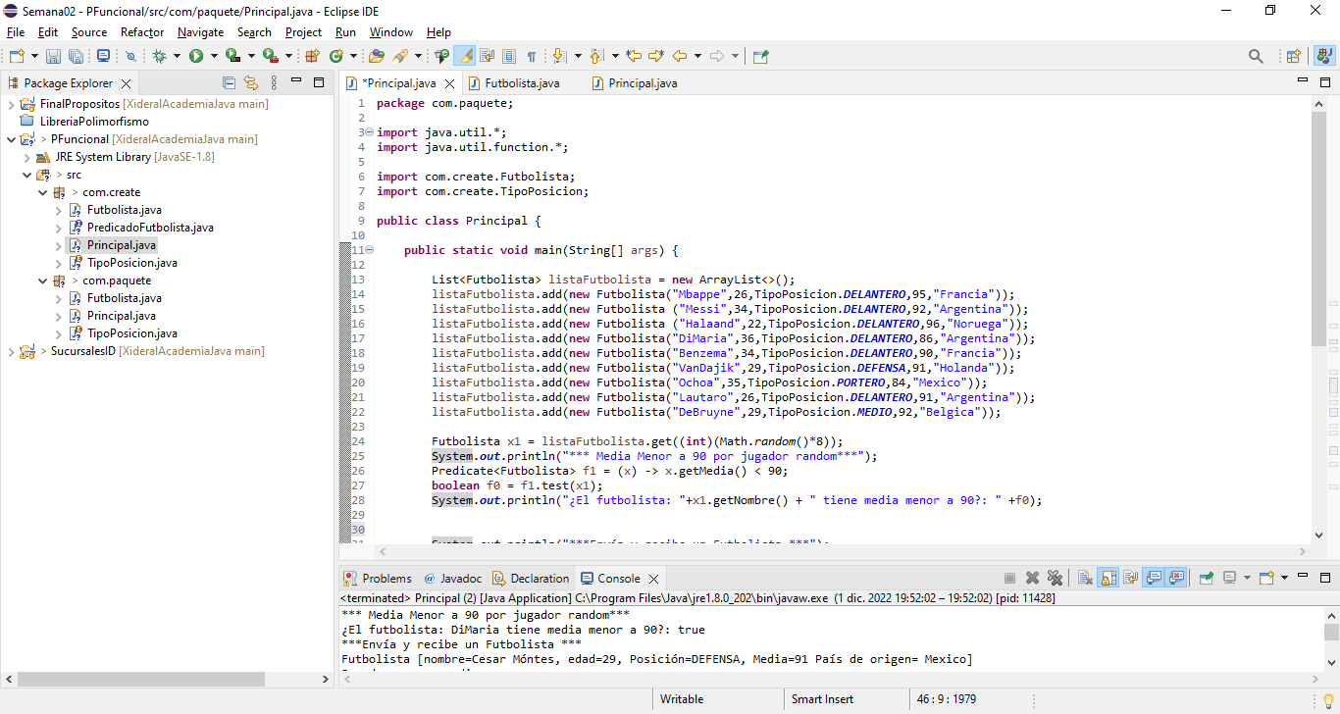
https://github.com/mota1299/XideralAcademiaJava/tree/main/Ex%C3%A1menes/Semana02/PFuncional/src/com

