Slide 1



Juan Jesús Ávila Mota
Examen Semana02
Academia Java Xideral
Noviembre 2022

Slide 2

Dependency Inversion (DI)

Slide 3







Slide 4
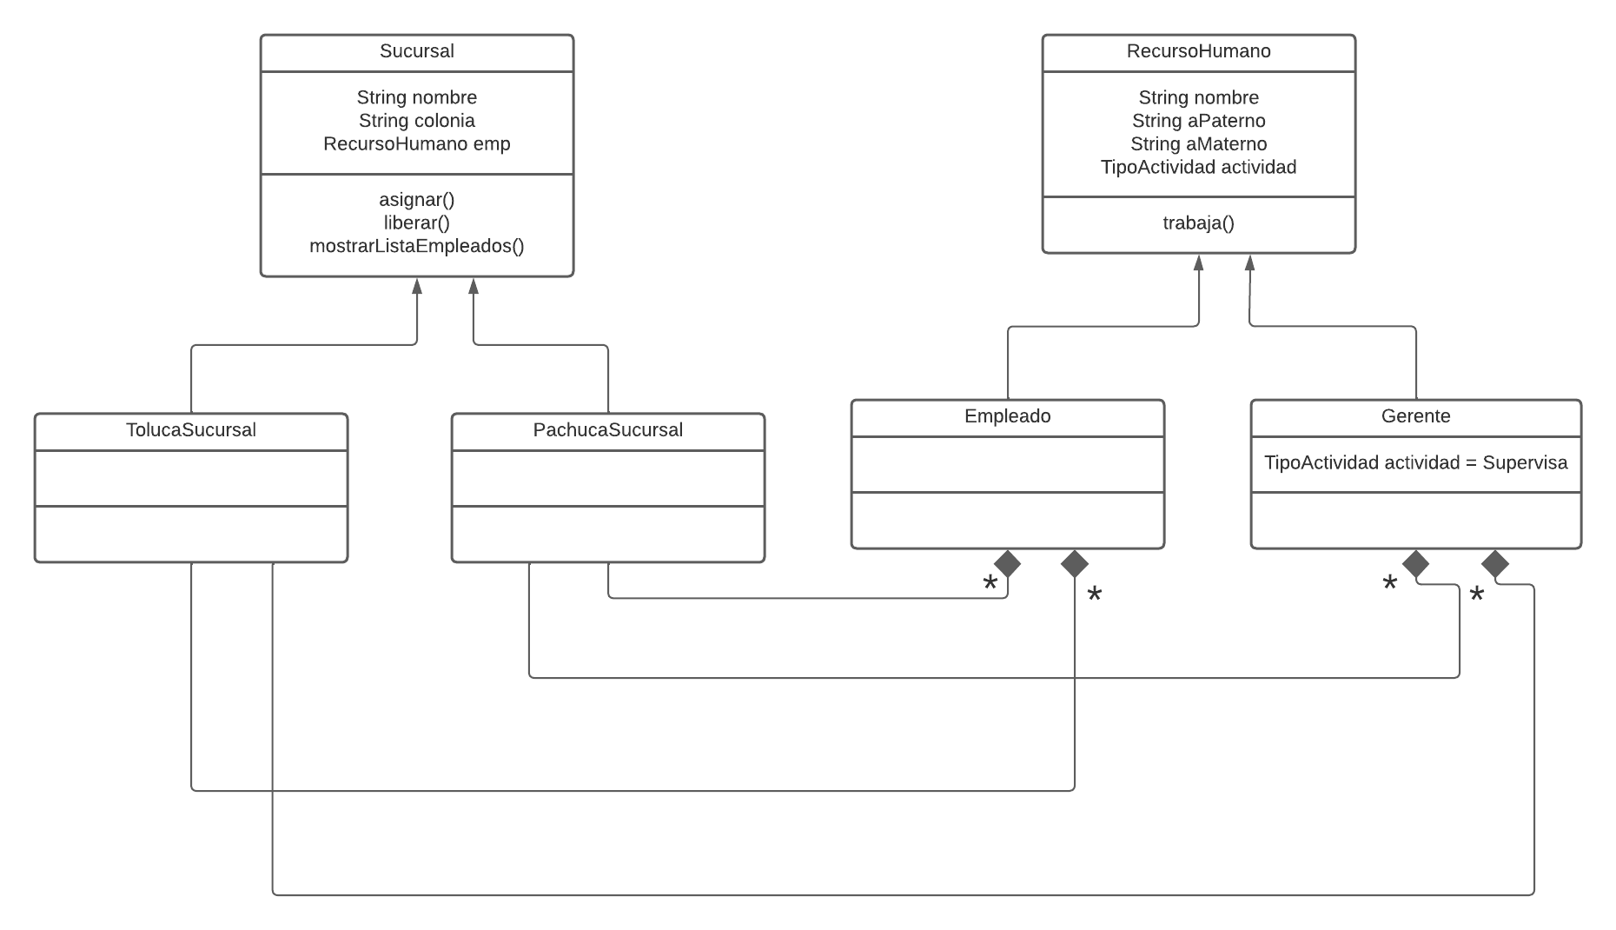

Slide 5
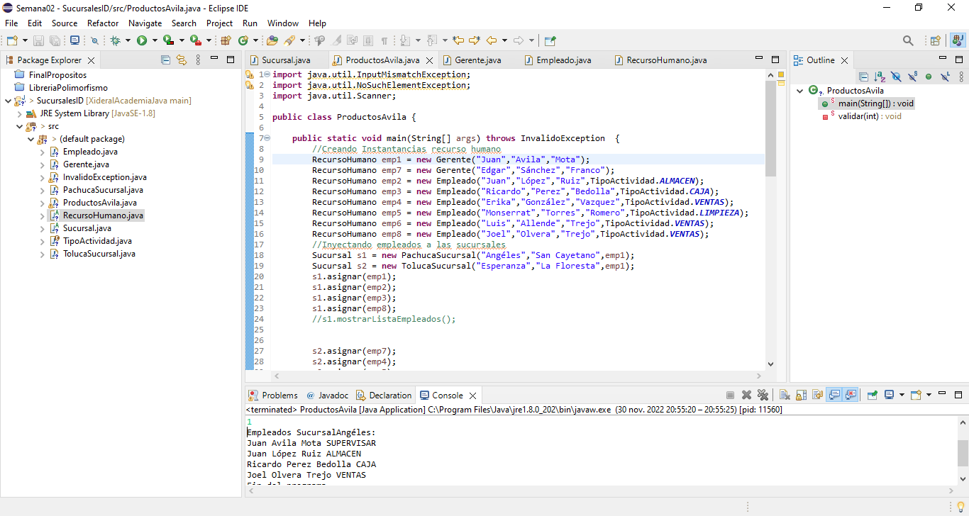

Slide 6
MVC

Slide 7






Response:
Json
Xml
Txt
Pdf
Excel
Html
etc
Request
Response
HTTP
get
put
post
delete
Etc.

Slide 8

Controller
invoke
Build HTML, CSS, JS and remove Java code
Process and send
Model
View
send
requests
response

Slide 9
Presentation Layer
Businnes Logic Layer
Data Access Layer

Slide 10
Types of Exceptions

Slide 11
Throwable
Exception
Error
RunTimeException
Other Exceptions
UnChecked
Checked

Slide 12
Purposes of final

Slide 13
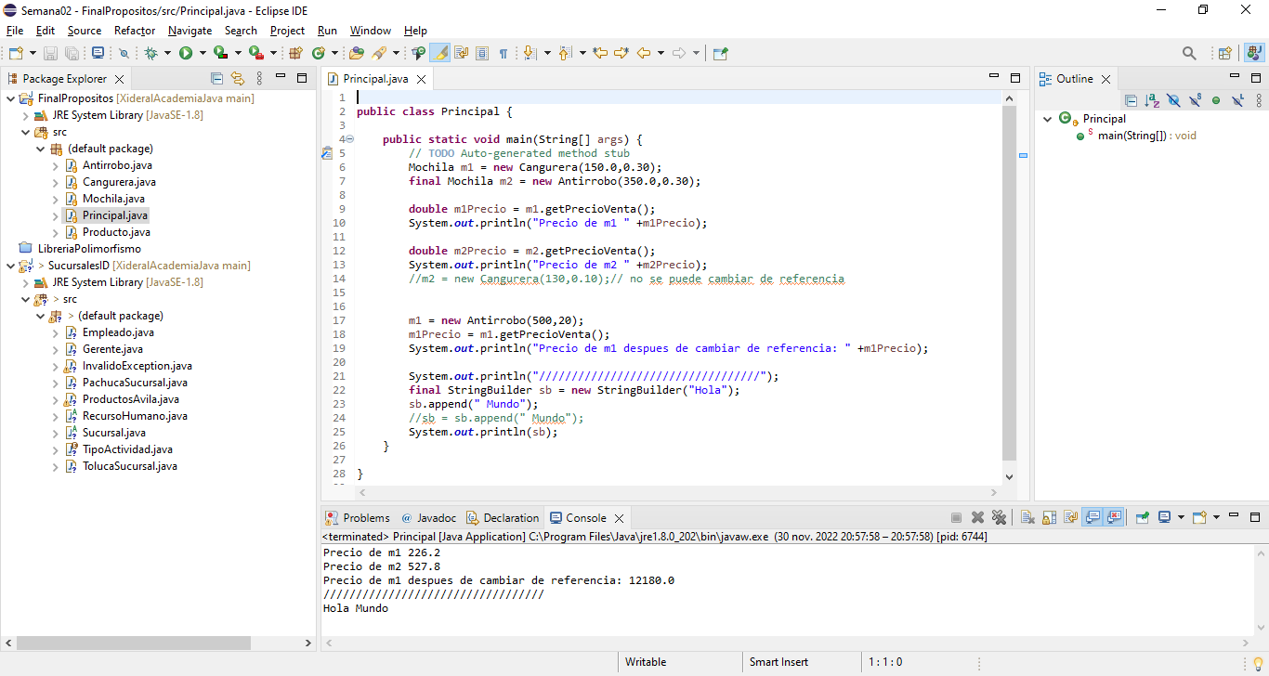

Slide 14
Multicatch and Try with resources

Slide 15
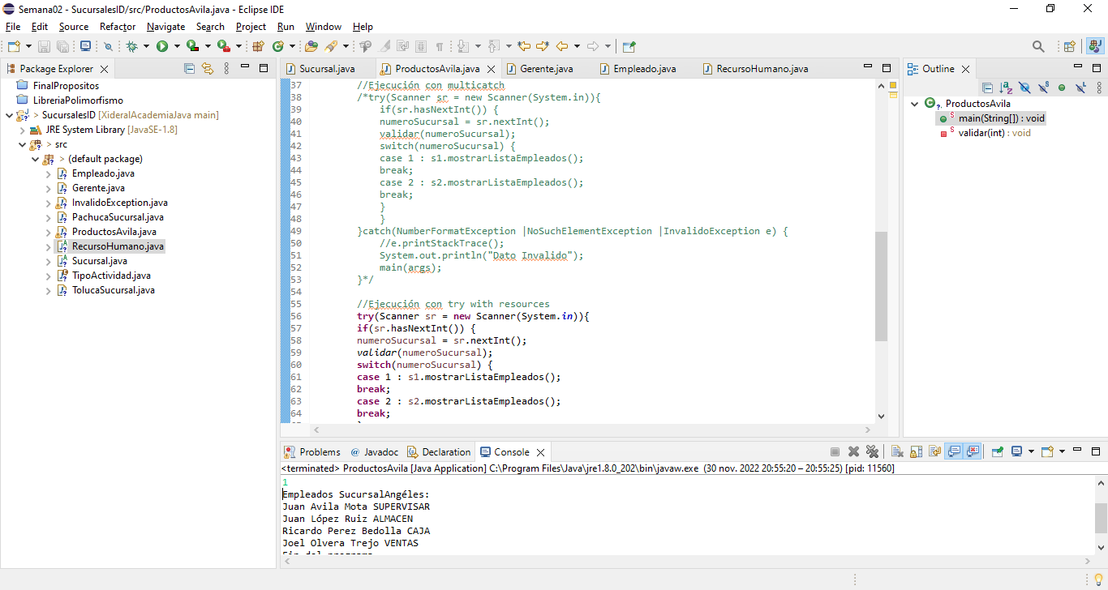

Slide 16
Asynchronous vs Synchronous

Slide 17
SYNCHRONOUS
ASYNCHRONOUS
Process 1
Process 1
Process 2
Process 2
Process 3
Process 3
Process 4
Process 4

Slide 18
Functional Lambdas

Slide 19
