Slide 1
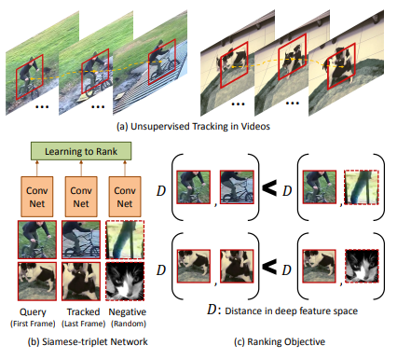
Unsupervised Learning of Visual Representations using Videos
1. What is the problem?
The research paper addresses the challenge of training Convolutional Neural Networks (CNNs) without relying on large amounts of labeled data.
The problem is how to effectively use unlabeled data, such as videos, to learn meaningful visual representations that can be used for tasks like object detection. The authors propose a method using a Siamese-triplet network to distinguish between similar and dissimilar images, thereby learning robust features from unlabeled data that can enhance performance in supervised tasks.
2.What have been done earlier?
So far, research has largely focused on using large labeled datasets to train CNNs effectively, but this approach is resource-intensive and not always feasible. To address this, various methods have been explored to leverage unlabeled data for training, including self-supervised and unsupervised learning techniques. These methods aim to learn useful representations from the data itself without the need for manual annotation. Specifically, the paper builds on the concept of Siamese networks and triplet loss to train models using pairs or triplets of images, which helps the network learn to distinguish between similar and dissimilar images, even without labels. This approach has shown promise in improving the performance of CNNs in tasks such as object detection and recognition when labeled data is scarce.

Slide 2
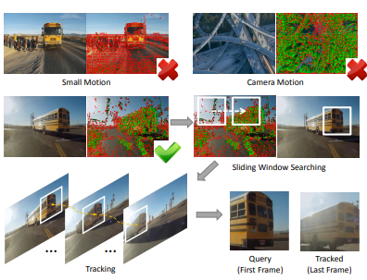
3.What are the remaining challenges ?What novel solution proposed by authors to solve the problem?
Remaining Challenges:
Data Scarcity: Despite advancements, the scarcity of labeled data remains a significant challenge. Training CNNs without a large amount of annotated data often results in suboptimal performance.
Generalization: Ensuring that models generalize well to unseen data, especially when trained on limited or noisy datasets, is still difficult.
Computational Complexity: Training models with self-supervised or unsupervised learning techniques can be computationally expensive, requiring significant resources.
Novel Solution Proposed by the Authors:
The authors propose a novel approach that leverages a modified version of Siamese networks combined with an innovative loss function tailored for unsupervised learning. Their method introduces a new mechanism for generating image pairs, which ensures that the CNN learns to distinguish subtle differences between images more effectively, even without labeled data. This approach reduces the reliance on large annotated datasets while improving the model's ability to generalize to new, unseen images, making the training process more efficient and accessible.

