Slide 1
licence PLATE RECOGNITION USING YOLO-V8
Submitted By:
MOTASIM

Slide 2
PROBLEM STATEMENT
To detect and recognize the number plate / licence plate of the vehicle from the captured video or the camera feed and store the recognized plates number in the database.

Slide 3
TASK STATUS
GOALS | STATUS
Plate Detection | Complete
Plate Recognition | Complete
User Interface | Complete
Live Results | Complete
Store Results in Database | Complete
Download as CSV | Complete

Slide 4
ACCOMPLISHED TASKS
The web-app can perform the following tasks:
Detect and recognized the number plates from the uploaded video clip or live feed.
Shows the live results as a list on the app interface.
Save the results in the database, which can be downloaded as .csv file after the complete model execution.

Slide 5
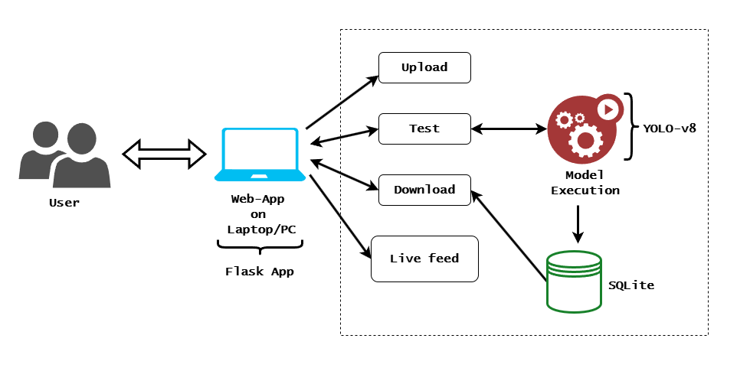
SYSTEM ARCHITECTURE

Slide 6
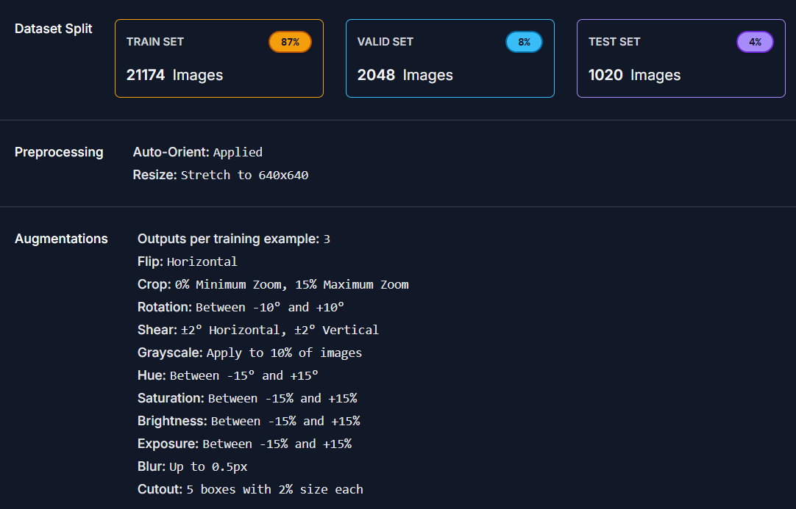
Dataset description

Slide 7
MODEL SETTINGS
Parameter | Value
Model | yolov8n.pt
Image Size | 640
Batch Size | 16
Epochs | 20
Optimizer | SGD
Dropout | 0.0
Learning Rate | 0.01
IOU | 0.7 (for NMS)

Slide 8
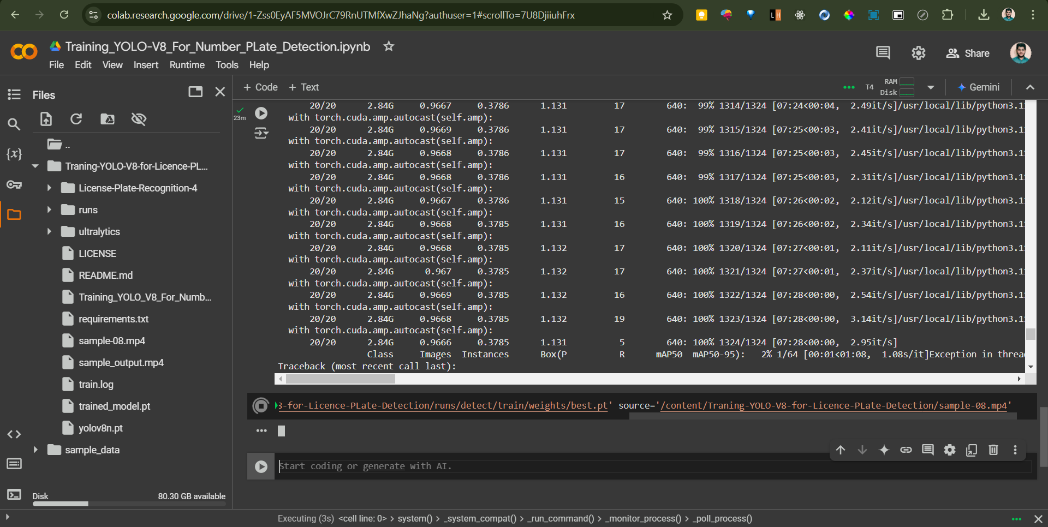
TRAINING Process

Slide 9
Training results
After Training
Class | All
Images | 2046
Instances | 2132
Box-Precision | 0.974
Box-Recall | 0.963
mAP50 | 0.983
mAP50-90 | 0.701

Slide 10
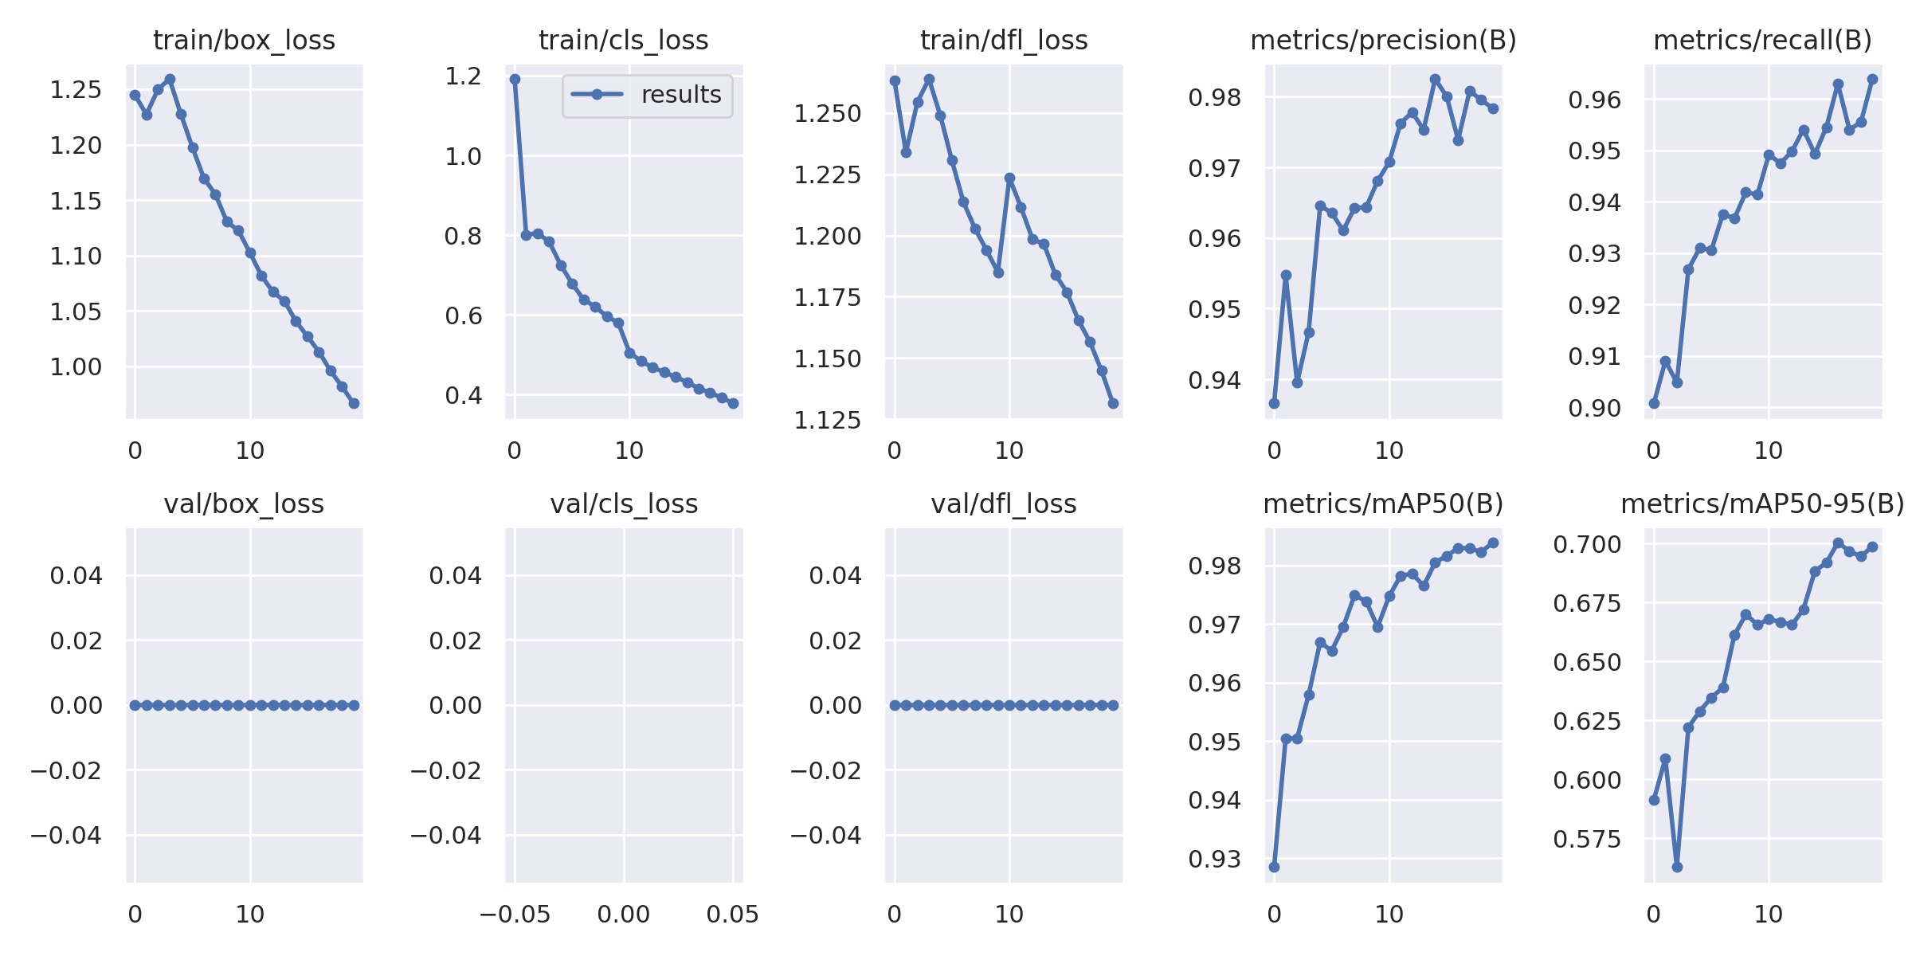
Training graphs

Slide 11
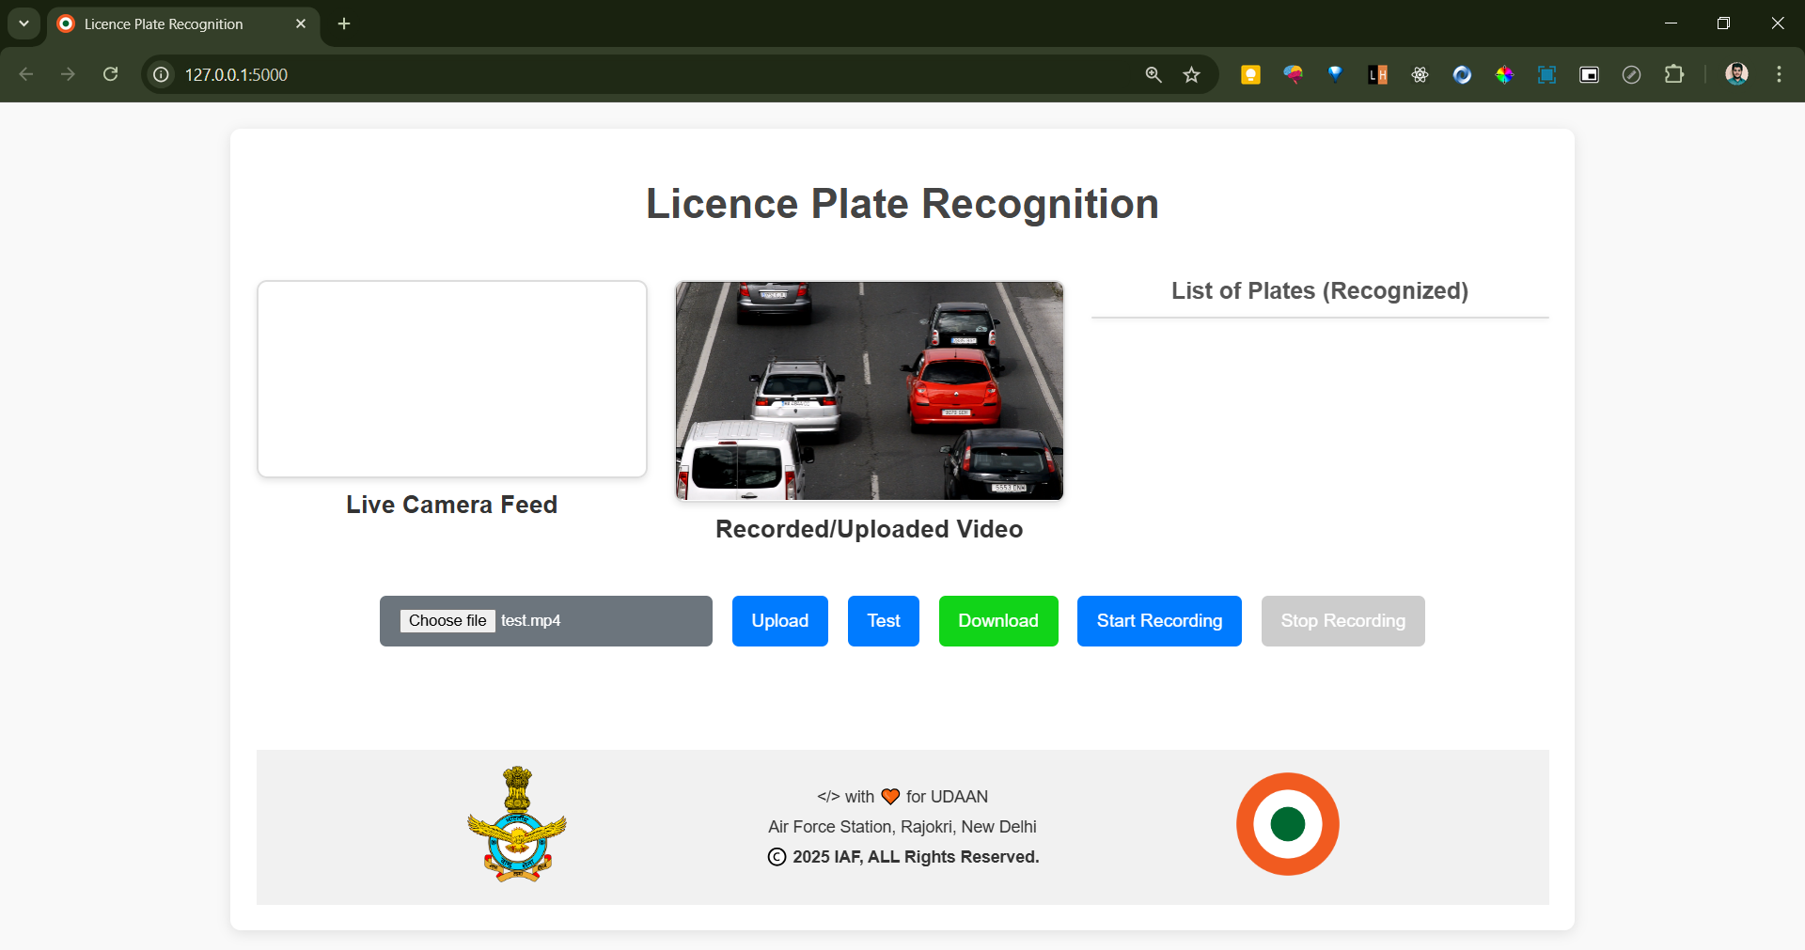
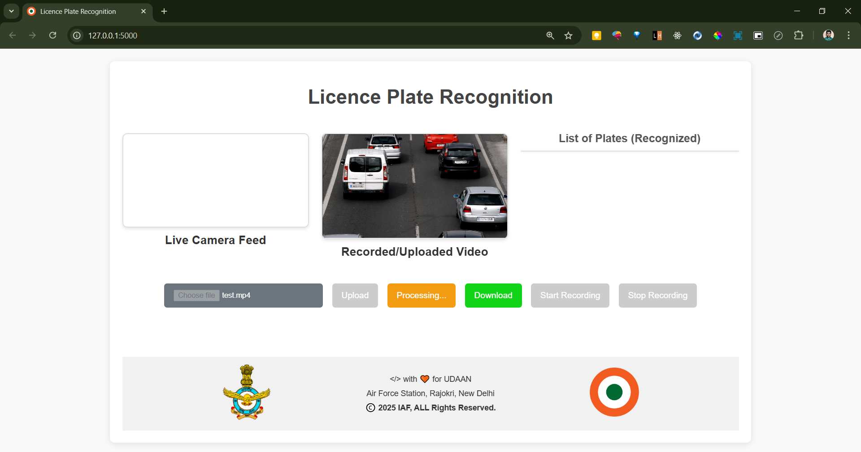
Running SCREENSHOTS
(a) On uploading video clip
(b) After Click on ‘Test’ button

Slide 12
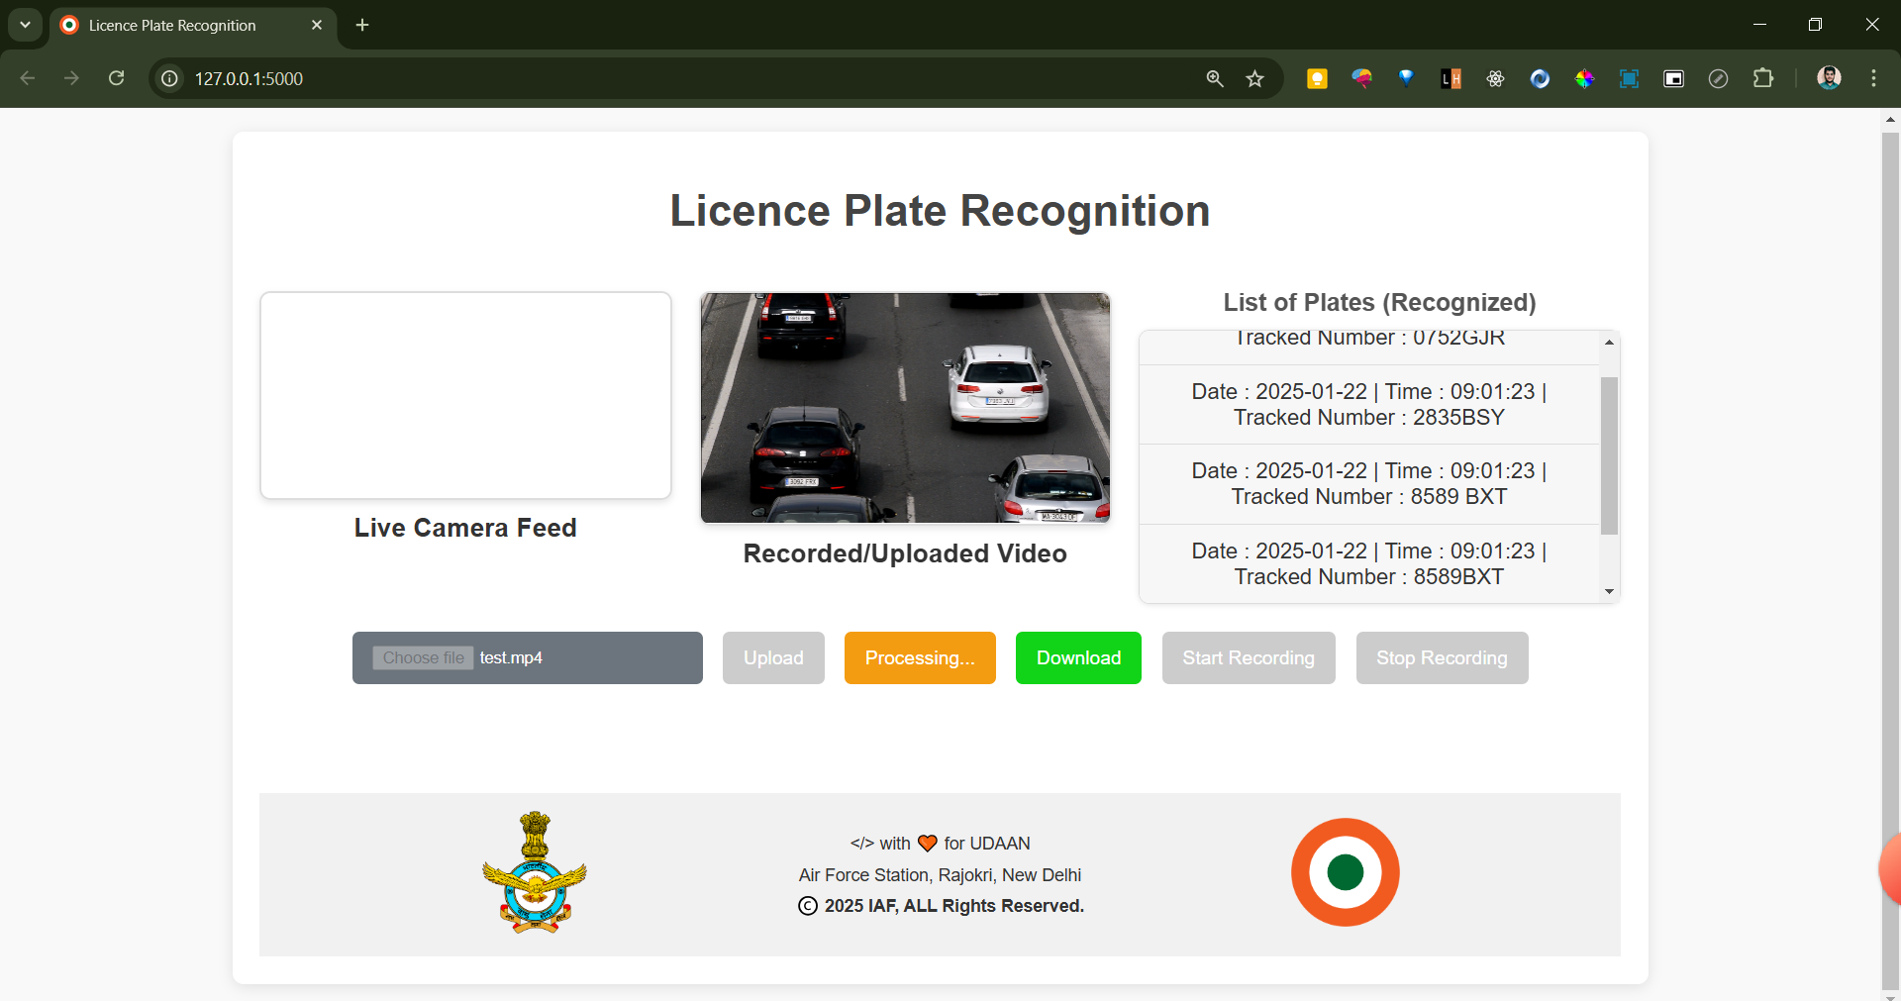
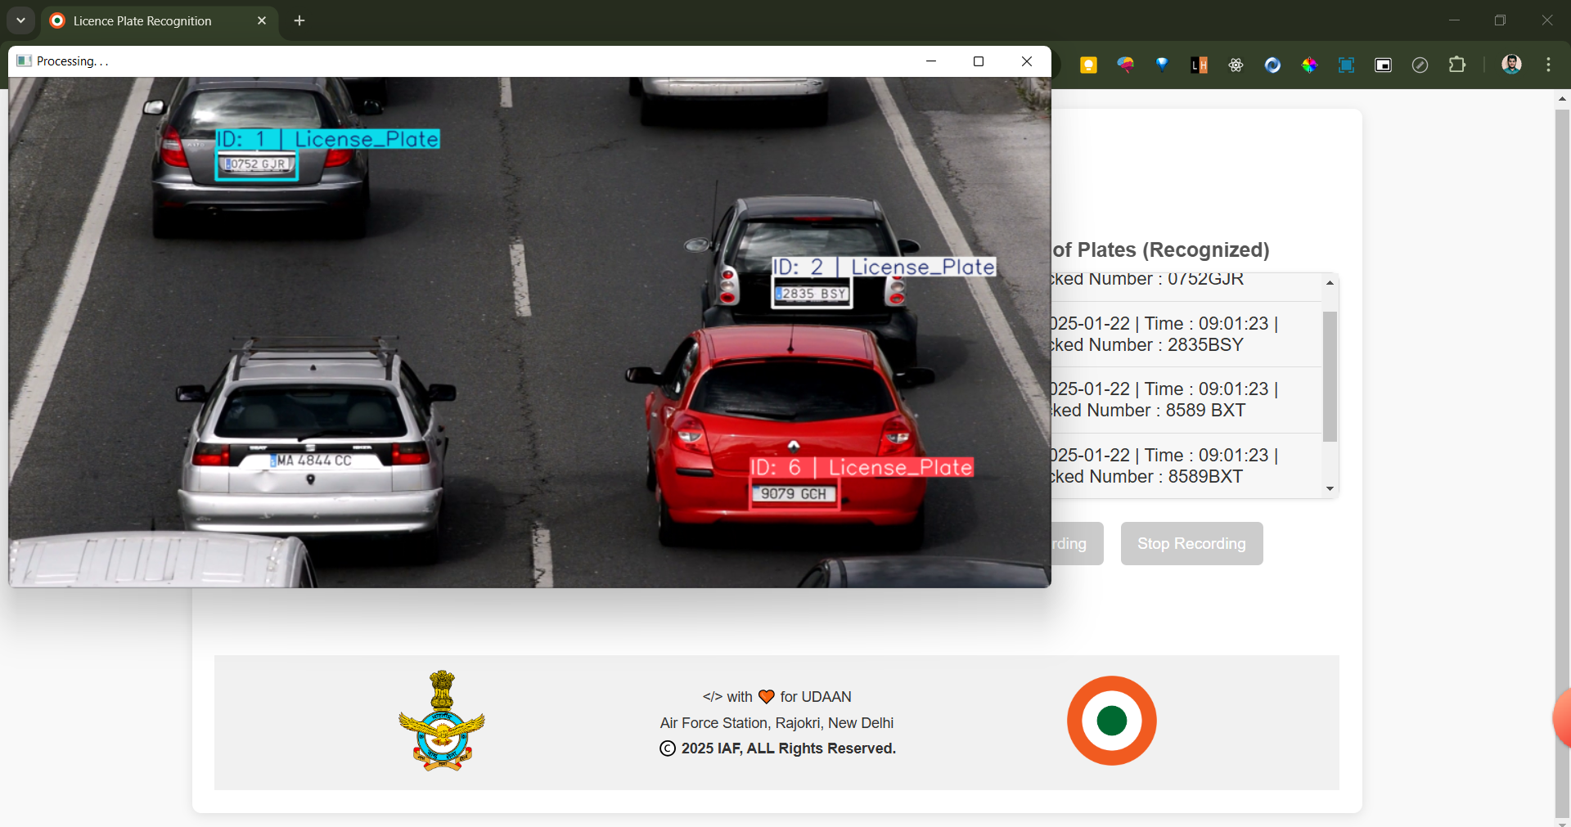
Running SCREENSHOTS
(c) Model started extracting number plates
(d) Showing individual frame processing.

Slide 13
FUTURE SCOPE
The project can have application in numerous areas.
Identifying the type of vehicle by color of number plate (white, yellow or green).
Identifying the state to where the vehicle belongs.
Monitoring vehicle presence.
Searching specific vehicle in a busy lane.
Etc...

Slide 14
Challenges
The major challenges in accomplishing the desired tasks are as follows:
Selection of appropriate dataset.
Train the model on the larger dataset, it requires the GPUs for fasten the training process, but the GPU access is limited over the Kaggle and Google-Colab.
…Thankyou

