Slide 1



Al-Azhar University - Gaza Faculty of Economics & Administrative Sciences Department of Accounting
The relationship of the quality of accounting information in improving management decision-making
Submitted by: Younes eyed sheikh ail 20191485 Shaaban Tariq Naser 20191375 Abd al-Rahman Muhammad eqtifan 20174582
Supervised by: Dr. Ahmed Abd-al-Fatah Al-Afifi May 2023

Slide 2
Introduction
Accounting information has become an important part of the administration's work and a basic resource on which it relies to support its administrative decisions. Accounting information also has a significant and important role in the administrative decision-making process in companies, so that the administration cannot overlook this important role.
The need for information production increases as a means that derives its importance and necessity from its contribution to the decision-making process. The accounting system is considered one of the most important information producing systems .
Information is data prepared in a manner that allows an opinion to be based on it or a decision to be taken according to it. The financial statements are considered a basic source of accounting information useful for making decisions .

Slide 3


Slide 4
The characteristics that make this information must be identified and defined Useful in decision-making, and the following shows some of These characteristics:
A- Convenience: It means the existence of a close relationship between the information derived from financial accounting and the purposes for which it was prepared.
B- The information's reliability, accuracy, and the ability to trust or rely on it.
C- information, its comparability, timeliness, and completeness .

Slide 5
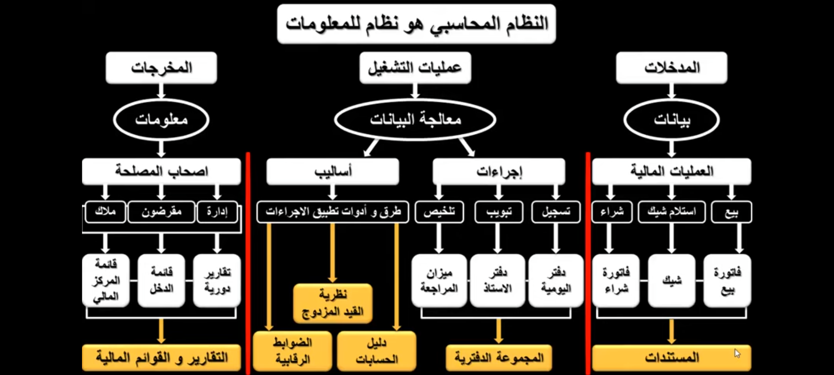

Slide 6
Examples of administrative decision-making for users of accounting information are as follows
Decisions taken by management related to the exercise of various administrative functions. For example: a business manager may decide to invest in marketing to attract new customers. This decision could involve analyzing the costs, benefits, and risks involved with each possible course of action and choosing the best course of action for the organization.
Decisions related to investing money in a specific enterprise .
For example: a long term capital decision would be to buy machinery for production. This is important as it affects the long term earnings of the firm. Short term investment is related to levels of cash, inventories, etc. These decisions affect day to day working of the business.

Slide 7


Slide 8
The problem of the study
The researcher believes that the success of these efforts depends on the abundance of accounting information. that can be relied upon to complete the tasks and achieve the goals, which are the study problem .
the main question : is: What is the role of accounting information in making administrative decisions in public shareholding companies in Palestine?
From this main question, the following sub-questions branch out: 1. Are the financial statements relied upon to obtain accounting information when making administrative decisions? 2. Are the required characteristics available in the accounting information that is relied upon in the administrative decision-making process in the public shareholding companies in Palestine?
3. Are the accounting information used by the managers when they take their management decisions in the public shareholding companies in Palestine? 4. Is the accounting information available to managers sufficient to make administrative decisions in companies?

Slide 9
Study Objectives
Determine the relationship between accounting information and the administrative decision-making process .
Recognizing the quality and efficiency of accounting information in the process of making administrative decisions in joint stock companies .
A study of the characteristics and requirements that must be taken into account in appropriate accounting information to meet the administrative needs of public shareholding companies in Palestine.
Identifying the adequacy of the accounting information available to managers in order to make administrative decisions .
Determining the extent to which management in public shareholding companies uses accounting information in the decision-making process .
Presenting recommendations that may contribute to improving the management decision-making process in joint stock companies and raising their value.

Slide 10
The importance of the study
The importance of these studies can be summarized in several points:
Contribute to evaluating the role of accounting information in administrative making decisions.
Highlighting the vital and important role that information accounting plays in making administrative decisions.
Achieving benefit for the owners of joint-stock companies and the decision makers in them, which contribute to increasing the level of benefit achieved from the use of accounting information in making administrative decisions.
The lack of previous studies on the subject of the research, especially the Palestinian business environment.

Slide 11

THE HYPOTHESES
.
First Hypotheses : Accounting information is used by managers when making their management decisions in public shareholding companies in Palestine.
Second Hypotheses : The accounting information available to managers is sufficient to make administrative decisions in public shareholding companies in Palestine.

Slide 12
variables
1- Independent variable: The quality of accounting information
Definition: The quality of accounting information refers to the extent to which financial and nonfinancial data generated through accounting processes are reliable, relevant, accurate, and timely.
Explanation: The independent variable in this research is the quality of accounting In the research titled "The relationship of the quality of accounting information in improving management decision-making," the dependent variable is "management decision-making,“ and the independent variable is "the quality of accounting information.“ information. It represents the factor that is hypothesized to have an impact on the dependent variable, which is management decision-making. The research aims to investigate how improvements in the quality of accounting information can enhance the accuracy, reliability, and relevance of financial data available to managers, thereby influencing their decision-making processes positively . 2- Dependent variable: Management decision-making Definition: Management decision-making refers to the process through which managers analyze information, evaluate alternatives, and make choices to achieve organizational goals and objectives .
Explanation: In this research, management decision-making is the outcome or the variable that is being influenced or affected by the independent variable, which is the quality of accounting information. The study aims to examine how variations in the quality of accounting information can impact the effectiveness and quality of management decision-making within organizations .

Slide 13
The study community and sample
the study community: The study population consists of most of the public shareholding companies in Palestine ”Gaza strip”.
In the following table are the characteristics of the sample table shows that the real sample represents most of the sectors Palestinian economy, as it contains companies representing four economic sectors, And that most of the sectors are the industrial and commercial sectors. The sample includes companies whose age ranges from (6-20 years). On the other hand, the sample reflects the reality of the size of the joint-stock companies in terms of the number of workers, which is not less than it also shows that most of the public shareholding companies are listed on the Palestine Stock Exchange. In our opinion, a sample with these specifications can reflect, to a large extent, the status of the Palestinian public shareholding companies.

Slide 14
Distribution according to the age of the company |  |  | Distribution according to the number of employees
Company life | Number over | percentile | The number of workers is | number | percent of 0
Less than 5 years | 7 | 17.5 | less than 10 | 0
From 6-10 years | 9 | 22.5 | 50-11 of | 16 | 40
From 11-20 years | 16 | 40 | 100-51 of | 9 | 22.5
More than 20 years | 8 | 20 | More than 100 | 15 | 37.5
in all | 40 | 100 | the total | 40 | 100
Distribution according to type of activity |  |  | Distribution according to the Palestine Stock Exchange
company's industrial | number | percentage | listing in the market | number | percentage
activity | 16 | 40 | yes | 21 | 52.5
commercial | 13 | 32.5 | no | 19 | 47.5
service | 8 | 20
other | 3 | 7.5
the total | 40 | 100 | the total | 40 | 100

Slide 15
Table (12) General information about the study sample
The previous table shows that most of the respondents to the questionnaire are holders of bachelor's degrees. Accounting is one of the specializations of accounting and its related sciences, most of them hold positions related to administrative staff, and most of them have experience in their field of work.

Slide 16
Results
Accounting information has an important and vital role when making administrative decisions in public shareholding companies.
Management in public shareholding companies relies on accounting information derived from the financial statements in making administrative decisions.
The administration relies in its decision-making and performance of administrative functions on information accounting by 90%
The statement of cash flows occupies the first place in importance in obtaining accounting information, followed by the statement of financial position, then the statement of income, then the list of changes in equity.
Public shareholding companies rely on an external auditor to audit their accounts, which gives more objectivity to accounting information.
Accounting information is permanently available in joint-stock companies for use in making administrative decisions.

Slide 17
The required characteristics are available in the accounting information that is relied upon in making administrative decisions by the management in public shareholding companies.
The public shareholding companies use the computerized system in their accounting system, which speeds up the process of communicating and submitting information, accounting reports and feedback information to the decision makers in the companies.
Public shareholding companies use a specialized cadre of accountants who have knowledge of accounting rules and standards and the ability to prepare financial statements that contain accounting information characterized by credibility and accuracy.
Accounting information in public shareholding companies is characterized by objectivity, impartiality, credibility, and a high degree of clarity and confidence.
Public shareholding companies are obligated to publish detailed explanatory information attached to the financial statements, and this enhances the possibility of obtaining clearer accounting information for use in making administrative decisions.
The joint-stock companies prepare special financial reports other than the basic financial statements and reports, and this also enhances the possibility of obtaining additional accounting information.

Slide 18
Recommendations
The need for public shareholding companies to use planning or discretionary budgets due to their importance as a tool to assist management in its mission to make administrative decisions.
The need to expand the use of accounting information in planning processes of all kinds and to draw up future policies for the company.
That the joint-stock companies increase the knowledge and knowledge of the accounting staff who work in the financial department with it, especially with regard to international accounting standards, because of their great importance that helps them in upgrading their scientific and knowledge level in the field of accounting, and this would increase the objectivity and accuracy of preparing financial statements and reports, and thus obtaining It has distinct accounting information with its required characteristics.
We recommend that joint-stock companies make comparisons of their financial statements with other companies constantly, because this gives an assessment of the company's situation and then works to improve that situation from an administrative and financial point of view.
The need for shareholding companies to use computers to save and store accounting data, to obtain accounting information in order to provide accuracy and speed in delivering this information to decision makers in companies.

Slide 19
The need for senior management in joint-stock companies to support the accounting departments and departments and provide them with the competencies and expertise necessary to carry out accounting work and submit reports and periodic follow-up lists to facilitate the management’s access to information on an up-to-date basis and to identify any deviations.
Preparing and qualifying administrative decision-makers in the field of financial analysis and holding courses in the field of decision-making so that they can deal with administrative situations that require difficult decisions, which contributes to increasing the ability of decision-makers to deal effectively with accounting information.
The necessity of identifying the nature of the information needed by each administrative category and taking into account the different categories that use the information and the multiplicity of their needs, as well as providing the necessary information for decision-making models in\ order to raise the efficiency and effectiveness of accounting information.

Slide 20
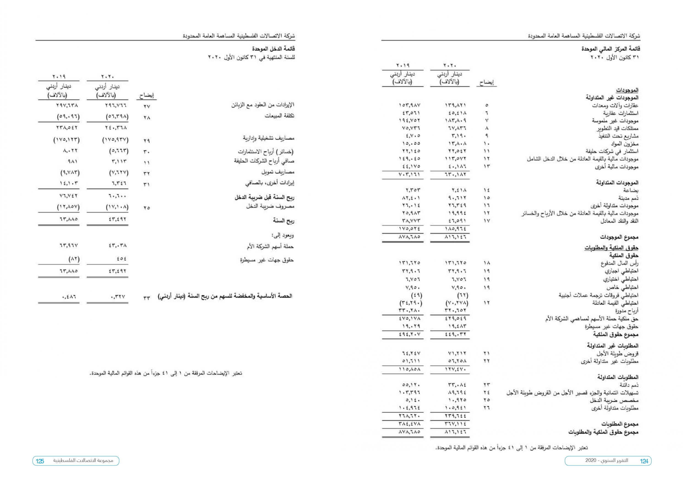

Slide 21
Thank you all

