Slide 1
Regression

Slide 2
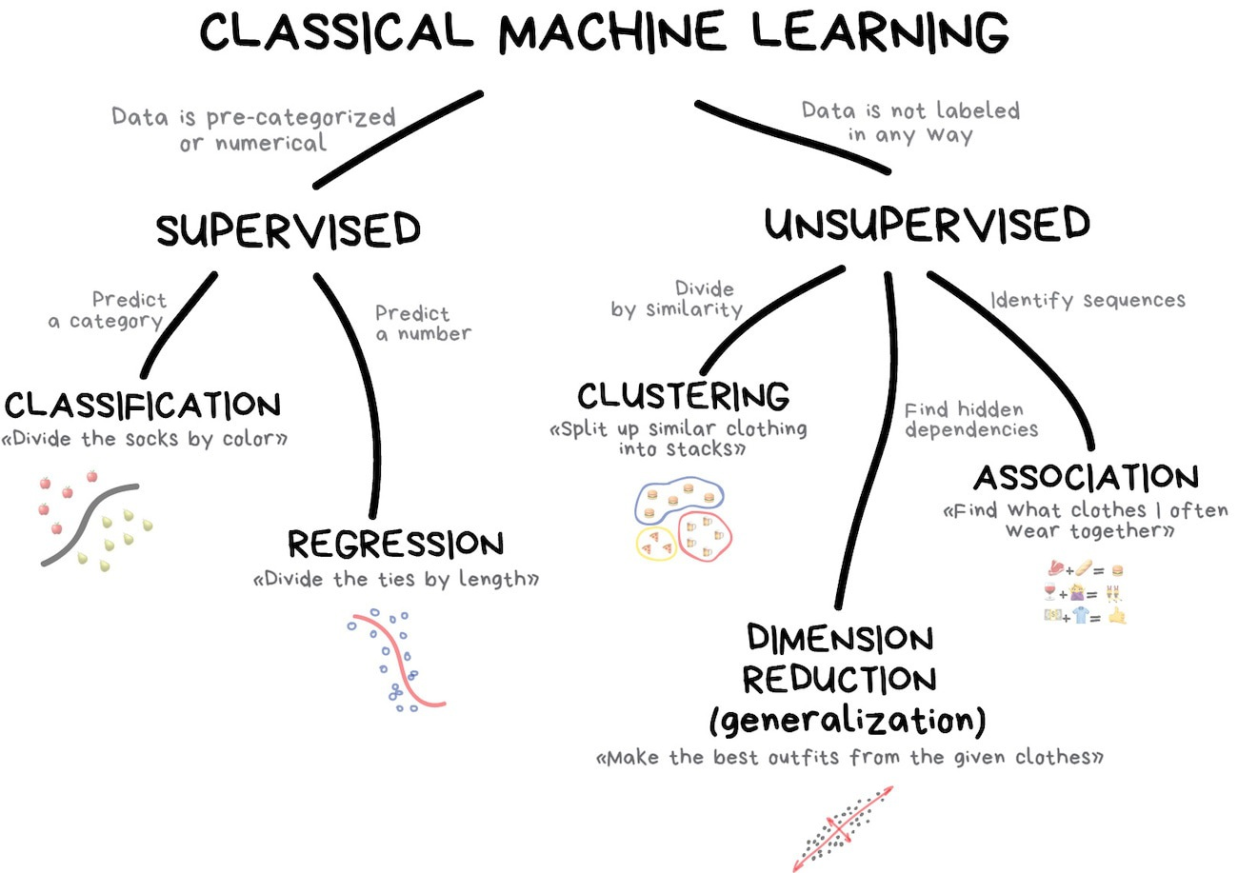

Slide 3
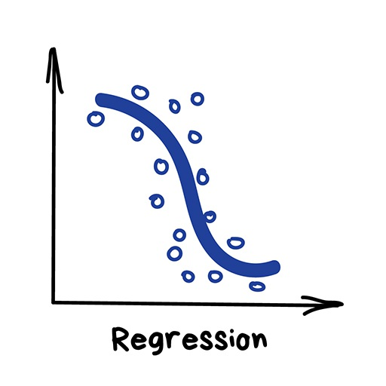

Regression
"Draw a line through these dots”
Today this is used for:
Stock price forecasts
Demand and sales volume analysis
Medical diagnosis
Any number-time correlations
House price prediction
Flight price prediction
…

Slide 4






Motivation
One of the most widely used techniques
Easy to interpret
Efficient to solve

Slide 5
A Simple Linear Regression Model
It models the relationship between X and Y as a straight line.
We have seen this earlier as a least squares line.
Values of X are assumed fixed, i.e. not random.
The only randomness in the model comes from ε, the error term.

Slide 6
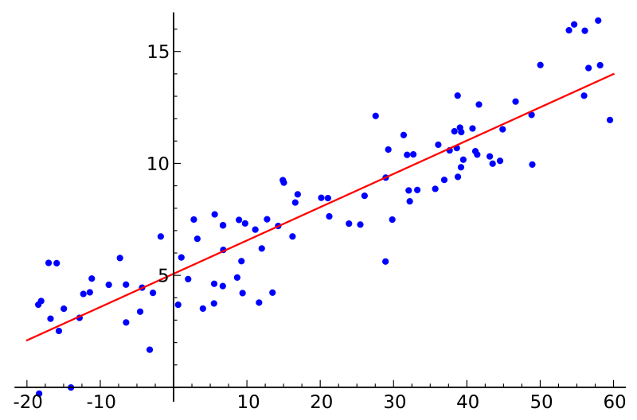
Simple Linear Regression
Y
X
Response
Variable
Covariate
Linear Model:
Slope
Intercept (bias)

Slide 7
Y
X

Slide 8
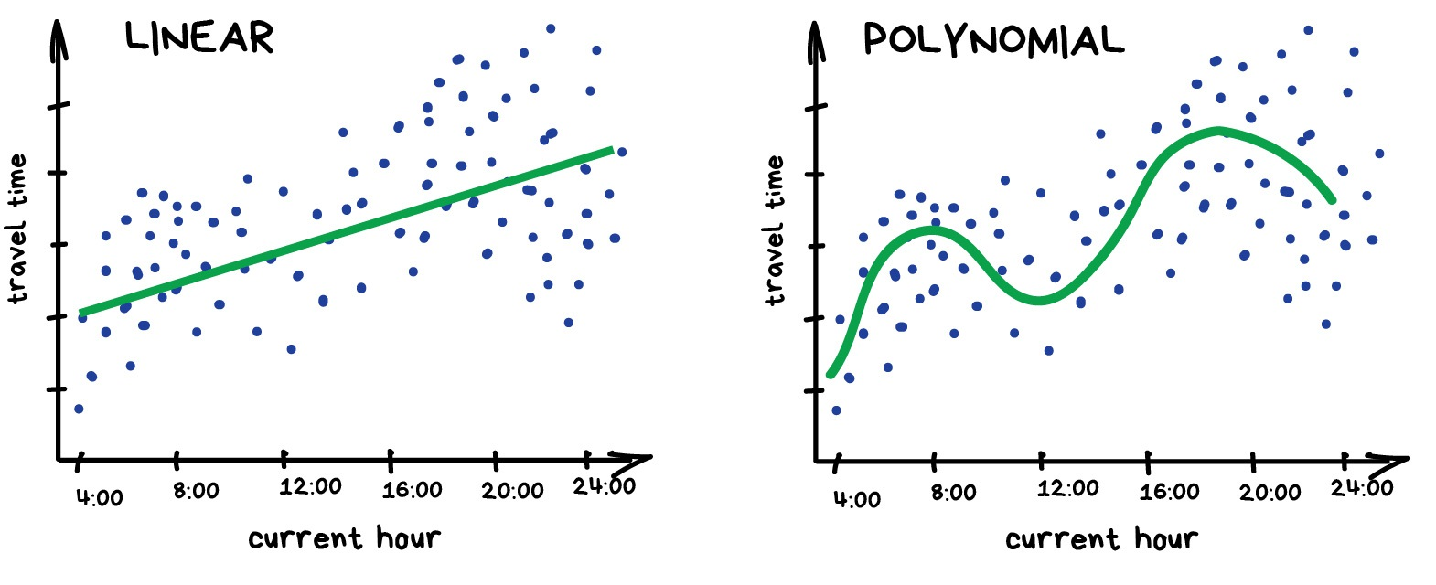




Regression

Slide 9
Regression
Everyone who works with finance and analysis loves regression.
It's even built-in to Excel. And it's super smooth inside — the machine simply tries to draw a line that indicates average correlation.

Slide 10
Regression Analysis…
Our objective is to analyze the relationship between interval variables;
Regression analysis is used to predict the value of one variable (the dependent variable) on the basis of other variables (the independent variables).
Dependent variable: denoted Y
Independent variables: denoted X₁, X₂, …, X_{k}

Slide 11
Regression Analysis…
If we are interested only in determining whether a relationship exists, we may employ correlation analysis.
Regression analysis with two-variables is sometimes called simple linear regression.
Mathematical equations describing their relationships are also called models
2 types: deterministic or probabilistic.

Slide 12
Model Types…
Deterministic Model: an equation or set of equations that allow us to fully determine the value of the dependent variable from the values of the independent variables.
Contrast this with…
Probabilistic Model: a method used to capture the randomness that is part of a real-life process.
E.g. do all houses of the same size (measured in square feet) sell for exactly the same price?

Slide 13
A Model…
To create a probabilistic model, we start with a deterministic model that approximates the relationship we want to model and add a random term that measures the error of the deterministic component.
Deterministic Model:
The cost of building a new house is about $75 per square foot and most lots sell for about $25,000.
Hence the approximate selling price (y) would be:
y = $25,000 + (75$/ft²) * x
(where x is the size of the house in square feet)

Slide 14
Regression Analysis…
Our objective is to analyze the relationship between interval variables;
Regression analysis is used to predict the value of one variable (the dependent variable) on the basis of other variables (the independent variables).
Dependent variable: denoted Y
Independent variables: denoted X₁, X₂, …, X_{k}

Slide 15
A Model…
A model of the relationship between house size (independent variable) and house price (dependent variable) would be:
House
Price:
Y
Building a house costs about
$75 per square foot.
House Price = 25000 + 75 * Size
Most lots sell
for $25,000
House size: X
In this model, the price of the house is completely determined by the size.

Slide 16




A Model…
In real life however, the cost of houses will vary, even among for houses of the same size:
Lower vs. Higher
Variability
House
Price:
Y
25K$
House Price = 25,000 + 75*Size +
x
House size: X

Slide 17
Random Term…
We now represent the price of a house as a function of its size in this Probabilistic Model:
y = 25,000 + 75x + ,
where (Greek letter epsilon) is the random term (a.k.a. error variable).
It is the difference between the actual selling price and the estimated price based on the size of the house (model based price) .
Its value will vary from house sale to house sale, even if the square footage (i.e. x) remains the same.

Slide 18

Simple Linear Regression Model…
Generally, a straight-line model with one independent variable is called a simple linear regression model.
dependent
variable
independent
variable
y-intercept
slope of the line
error term

Slide 19


Simple Linear Regression Model…
Note that both and are population parameters which are usually unknown and hence estimated from the data.
y
rise
run
=slope (=rise/run)
=y-intercept
x

Slide 20
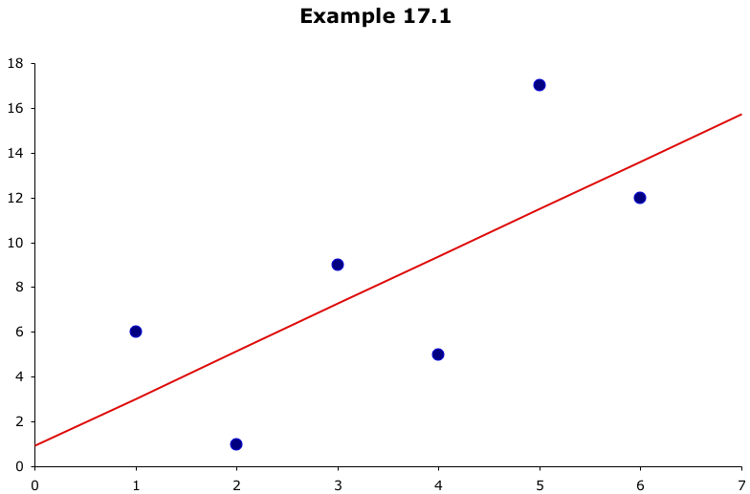
Which line has the best “fit” to the data?
?
?
?

Slide 21



Estimating the Coefficients…
In much the same way we based estimates of on , we estimate from b₀ and from b₁, the y-intercept and slope (respectively) of the least squares or regression line given by:
(Recall: this is an application of the least squares method and it produces a straight line that minimizes the sum of the squared differences between the points and the line)

Slide 22
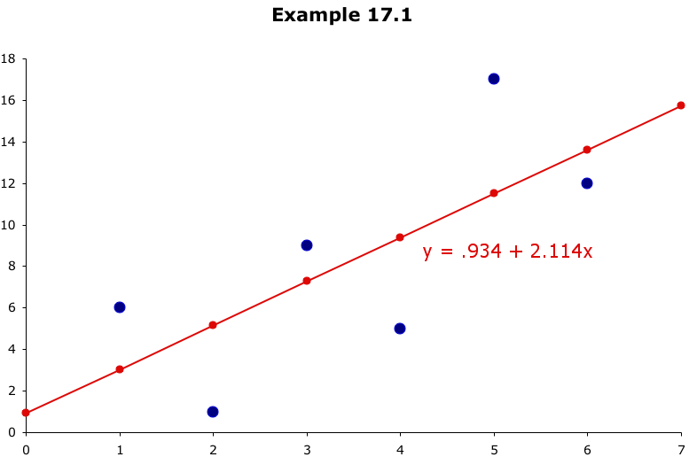
Least Squares Line…
these differences are called residuals
This line minimizes the sum of the squared differences
between the points and the line…
…but where did the line equation come from?
How did we get .934 for a y-intercept and 2.114 for slope??

Slide 23



Mathematical Optimization Routine

Slide 24


Slide 26
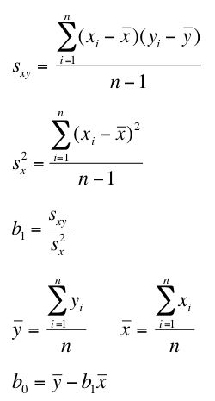



Least Squares Line…
The coefficients b₁ and b₀ for the least squares line…
…are calculated as:

Slide 27
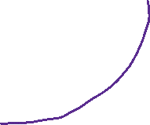
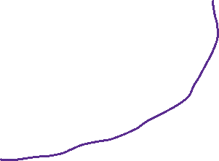

Least Squares Line…
Statistics
Recall…
Data
Information
Data Points:
x | y
1 | 6
2 | 1
3 | 9
4 | 5
5 | 17
6 | 12
y = .934 + 2.114x

Slide 28
Excel
Insert – Scatter
Right click on data point – add trend line (linear)
Tick on add equation and add R^2
x | y
1 | 6
2 | 1
3 | 9
4 | 5
5 | 17
6 | 12

Slide 29
Least Square Line …
Exercise : Decide which of these equations fits the given data best.
MJT = Mean January Temperature
LAT = Latitude
A: MJT’ = 100 -1.8 (LAT)
B: MJT’ = 108 - 2.1 (LAT)
C: MJT’ = 115 – 2.5 (LAT)
City | MJT | LAT
Boise | 22 | 43.7
Philly | 24 | 40.9
Milwaukee | 13 | 43.3

Slide 30
Model Comparison
Model predictions:
Lat (x) | A (y’) | B (y’) | C (y’) | MJT (y)
43.7 | 21.34 | 16.23 | 5.75 | 22
40.9 | 26.38 | 22.11 | 12.75 | 24
43.3 | 22.06 | 17.07 | 6.75 | 13
 | MJT-MJT_A | MJT-MJT_B | MJT-MJT_C
 | 0.66 | 5.77 | 16.25
 | -2.38 | 1.89 | 11.25
 | -9.06 | -4.07 | 6.25
Sum: | -10.78 | 3.59 | 33.75
 | (MJT-MJT_A)^2 | (MJT-MJT_B)^2 | (MJT-MJT_C)^2
 | 0.4356 | 33.2929 | 264.0625
 | 5.6644 | 3.5721 | 126.5625
 | 82.0836 | 16.5649 | 39.0625
Sum^2: | 88.1836 | 53.4299 | 429.6875

Slide 32
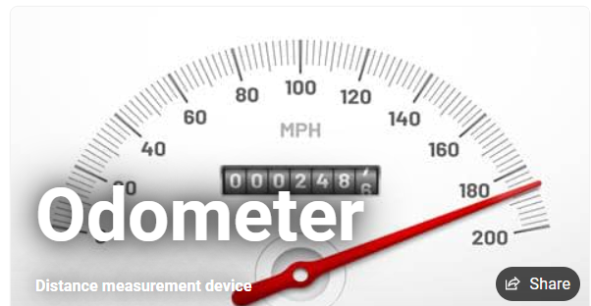
Example
A used car dealer recorded the price (in $1,000’s) and odometer reading (also in 1,000s) of 100 three-year old Ford Taurus cars in similar condition with the same options.
Can we use data to find a regression line?

Slide 33
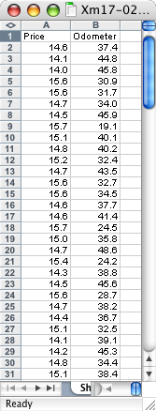
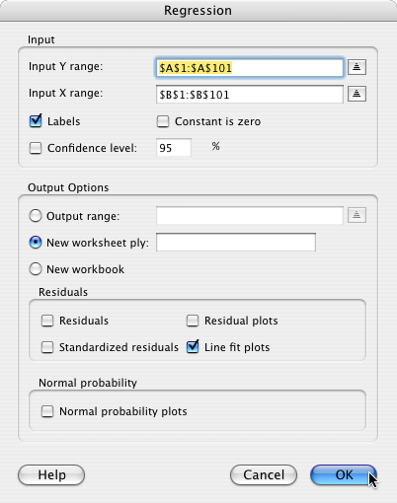
Example
COMPUTE
Tools >
Data Analysis… >
Regression
Y range (price)
X range (odometer)
OK
Check this if you want a scatter plot of the data…

Slide 34
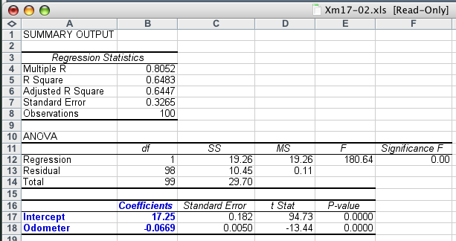

Example
Lots of good statistics calculated for us, but for now, all we’re interested in is this…

Slide 35
Example
As you might expect with used cars…
The slope coefficient, b₁, is –0.0669, that is, each additional mile on the odometer decreases the price by $0.0669 or 6.69¢
The intercept, b₀, is 17,250. One interpretation would be that when x = 0 (no miles on the car) the selling price is $17,250.
However, we have no data for cars with less than 19,100 miles on them so this isn’t a correct assessment.

Slide 36
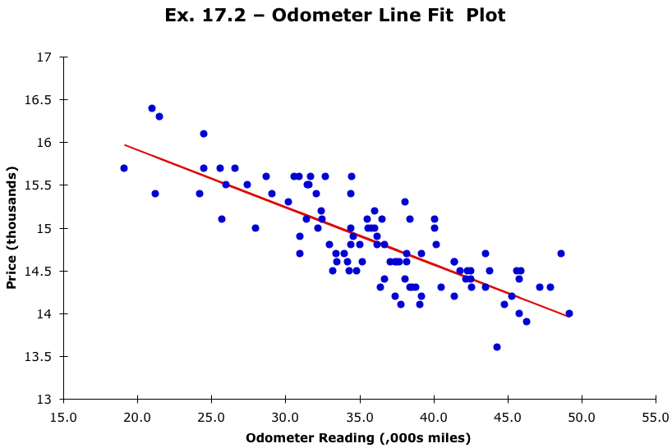
Example
Selecting “line fit plots” on the Regression dialog box, will produce a scatter plot of the data and the regression line…

Slide 37
Polynomial Regression
If your data points clearly will not fit a linear regression (a straight line through all data points), it might be ideal for polynomial regression.
Polynomial regression, like linear regression, uses the relationship between the variables x and y to find the best way to draw a line through the data points.

Slide 38
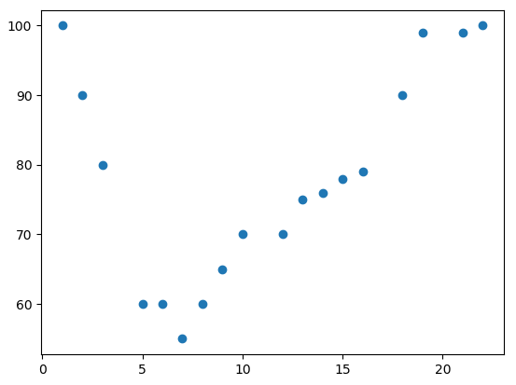
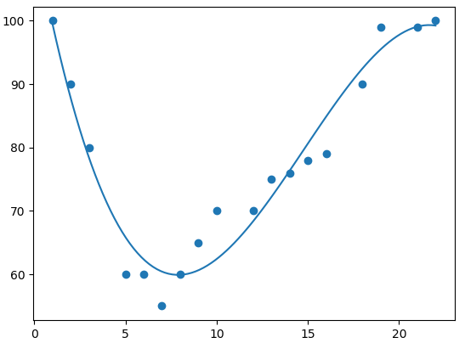
Polynomial Regression

Slide 40
Logistic Regression
Classification Algorithm (not regression)
The nature of the dependent variables differentiates regression and classification problems
Regression problems have continuous and usually unbounded outputs. An example is when you’re estimating the salary as a function of experience and education level.
Classification problems have discrete and finite outputs called classes or categories

Slide 41
There are two main types of classification problems:
Binary or binomial classification: exactly two classes to choose between (usually 0 and 1, true and false, or positive and negative
Multiclass or multinomial classification: three or more classes of the outputs to choose from
If there’s only one input variable, then it’s usually denoted with 𝑥.
For more than one input, you’ll commonly see the vector notation 𝐱 = (𝑥₁, …, 𝑥ᵣ), where 𝑟 is the number of the predictors (or independent features). T
The output variable is often denoted with 𝑦 and takes the values 0 or 1.

Slide 42
Logistic Regression Overview
Logistic regression is a fundamental classification technique.
It belongs to the group of linear classifiers and is somewhat similar to polynomial and linear regression.
Logistic regression is fast and relatively uncomplicated, and it’s convenient for you to interpret the results.
Although it’s essentially a method for binary classification, it can also be applied to multiclass problems

Slide 43
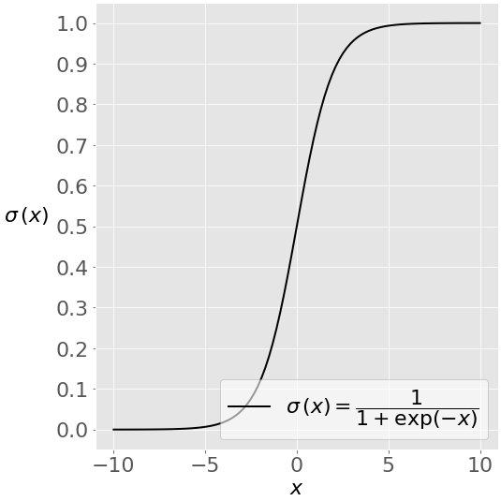
Math Prerequisites
You’ll need an understanding of the sigmoid function and the natural logarithm function to understand what logistic regression is and how it works.
This image shows the sigmoid function (or S-shaped curve) of some variable 𝑥
The sigmoid function has values very close to either 0 or 1 across most of its domain. This fact makes it suitable for application in classification methods.
As 𝑥 approaches zero, the natural logarithm of 𝑥 drops towards negative infinity. When 𝑥 = 1, log(𝑥) is 0.

Slide 44
Methodology
Logistic regression is a linear classifier,
Use a linear function 𝑓(𝐱) = 𝑏₀ + 𝑏₁𝑥₁ + ⋯ + 𝑏ᵣ𝑥ᵣ, also called the logit.
The variables 𝑏₀, 𝑏₁, …, 𝑏ᵣ are the estimators of the regression coefficients, which are also called the predicted weights or just coefficients.
The logistic regression function 𝑝(𝐱) is the sigmoid function of 𝑓(𝐱): 𝑝(𝐱) = 1 / (1 + exp(−𝑓(𝐱)). The value close to either 0 or 1.
The function 𝑝(𝐱) is often interpreted as the predicted probability that the output for a given 𝐱 is equal to 1. Therefore, 1 − 𝑝(𝑥) is the probability that the output is 0.

Slide 45
Methodology
Logistic regression determines the best predicted weights 𝑏₀, 𝑏₁, …, 𝑏ᵣ such that the function 𝑝(𝐱) is as close as possible to all actual responses 𝑦ᵢ, 𝑖 = 1, …, 𝑛, where 𝑛 is the number of observations.
The process of calculating the best weights using available observations is called model training or fitting.
To get the best weights, you usually maximize the log-likelihood function (LLF) for all observations 𝑖 = 1, …, 𝑛.
This method is called the maximum likelihood estimation and is represented by the equation LLF = Σᵢ(𝑦ᵢ log(𝑝(𝐱ᵢ)) + (1 − 𝑦ᵢ) log(1 − 𝑝(𝐱ᵢ))).

Slide 46
the best weights
There are several mathematical approaches that will calculate the best weights that correspond to the maximum LLF
Once you determine the best weights that define the function 𝑝(𝐱), you can get the predicted outputs 𝑝(𝐱ᵢ) for any given input 𝐱ᵢ.
For each observation 𝑖 = 1, …, 𝑛, the predicted output is 1 if 𝑝(𝐱ᵢ) > 0.5 and 0 otherwise.
The threshold doesn’t have to be 0.5, but it usually is. You might define a lower or higher value if that’s more convenient for your situation.

Slide 47
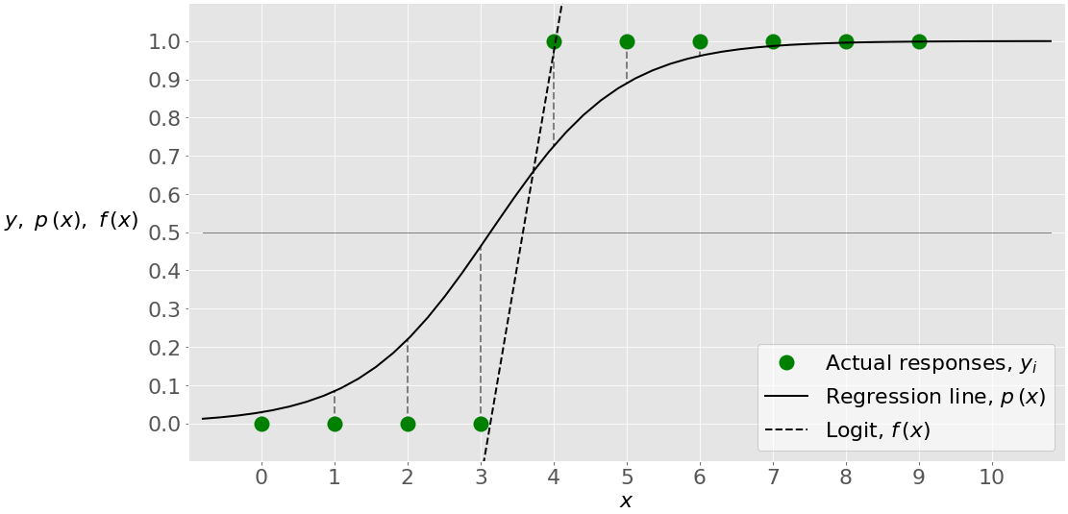
Single-Variate Logistic Regression
Single-variate logistic regression is the most straightforward case of logistic regression. There is only one independent variable (or feature), which is 𝐱 = 𝑥. This figure illustrates single-variate logistic regression:

Slide 48
you have a given set of input-output (or 𝑥-𝑦) pairs, represented by green circles.
These are your observations. Remember that 𝑦 can only be 0 or 1.
For example, the leftmost green circle has the input 𝑥 = 0 and the actual output 𝑦 = 0. The rightmost observation has 𝑥 = 9 and 𝑦 = 1.

Slide 49
Logistic regression finds the weights 𝑏₀ and 𝑏₁ that correspond to the maximum LLF. These weights define the logit 𝑓(𝑥) = 𝑏₀ + 𝑏₁𝑥, which is the dashed black line.

Slide 50
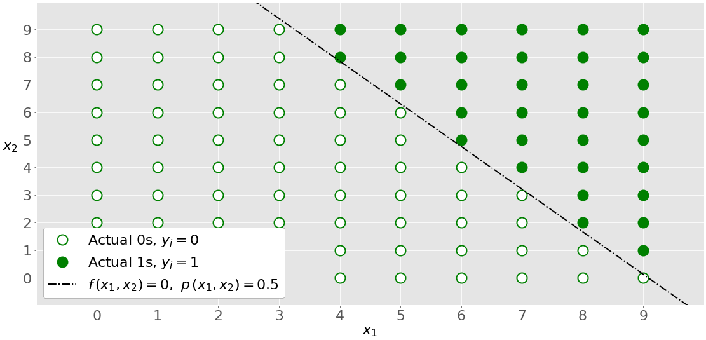
Multi-Variate Logistic Regression
Multi-variate logistic regression has more than one input variable. This figure shows the classification with two independent variables, 𝑥₁ and 𝑥₂

Slide 51
Multi-Variate Logistic Regression
The graph is different from the single-variate graph because both axes represent the inputs. The outputs also differ in color. The white circles show the observations classified as zeros, while the green circles are those classified as ones.
Logistic regression determines the weights 𝑏₀, 𝑏₁, and 𝑏₂ that maximize the LLF. Once you have 𝑏₀, 𝑏₁, and 𝑏₂, you can get:
The logit 𝑓(𝑥₁, 𝑥₂) = 𝑏₀ + 𝑏₁𝑥₁ + 𝑏₂𝑥₂
The probabilities 𝑝(𝑥₁, 𝑥₂) = 1 / (1 + exp(−𝑓(𝑥₁, 𝑥₂)))
The dash-dotted black line linearly separates the two classes. This line corresponds to 𝑝(𝑥₁, 𝑥₂) = 0.5 and 𝑓(𝑥₁, 𝑥₂) = 0.

Slide 52
Regularization
Overfitting is one of the most serious kinds of problems related to machine learning. It occurs when a model learns the training data too well.
The model then learns not only the relationships among data but also the noise in the dataset.
Overfitted models tend to have good performance with the data used to fit them (the training data), but they behave poorly with unseen data (or test data, which is data not used to fit the model)

Slide 53
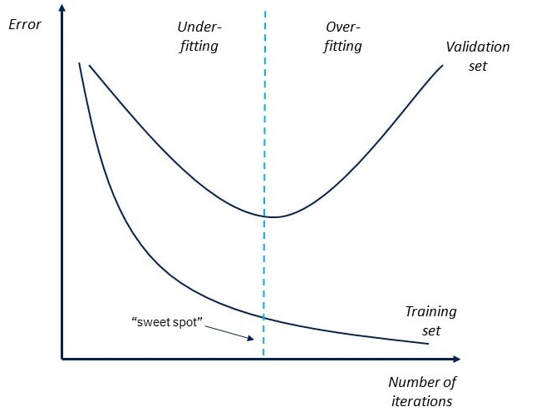
Overfitting and underfitting

Slide 54
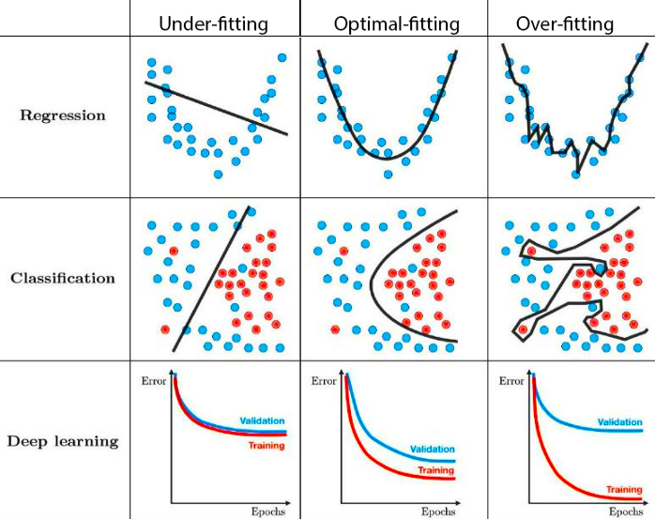

Slide 55
Regularization
Overfitting usually occurs with complex models.
Regularization normally tries to reduce or penalize the complexity of the model. Regularization techniques applied with logistic regression mostly tend to penalize large coefficients 𝑏₀, 𝑏₁, …, 𝑏ᵣ:
L1 regularization penalizes the LLF with the scaled sum of the absolute values of the weights: |𝑏₀|+|𝑏₁|+⋯+|𝑏ᵣ|.
L2 regularization penalizes the LLF with the scaled sum of the squares of the weights: 𝑏₀²+𝑏₁²+⋯+𝑏ᵣ².
Elastic-net regularization is a linear combination of L1 and L2 regularization.
L1 + L2 or 0.3 * L1 + 0.7 * L2
Regularization can significantly improve model performance on unseen data.

