Slide 1
ML code Life-cycle

Slide 2
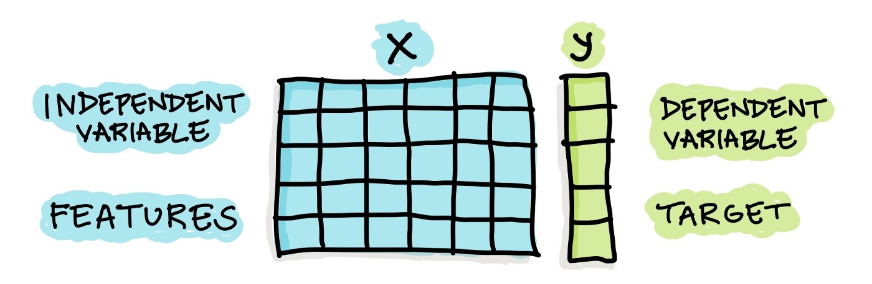

Slide 3
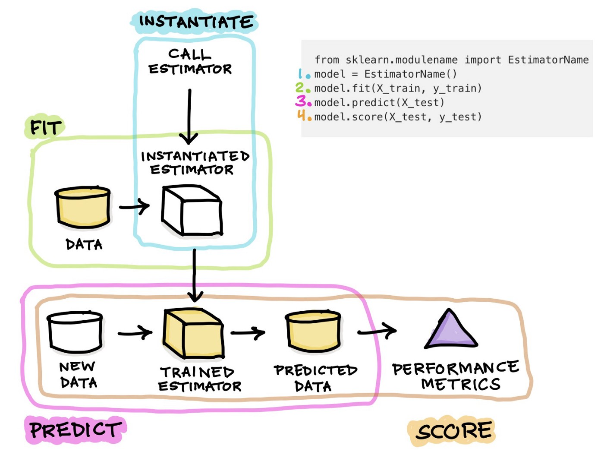
SKLearn

Slide 4
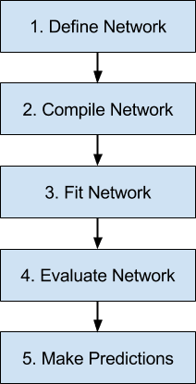
Tensorflow
Define Network.
Compile Network.
Fit Network.
Evaluate Network.
Make Predictions.

Slide 5
Step 1. Define Network
model = Sequential()
model.add(Dense(5, input_dim=2))
model.add(Activation('relu’))
model.add(Dense(1))
model.add(Activation('sigmoid'))

Slide 6
Step 2. Compile Network
model.compile(optimizer='sgd', loss='mse', metrics=['accuracy'])

Slide 7
Step 3. Fit Network
history = model.fit(X, y, batch_size=10, epochs=100)

Slide 8
Step 4. Evaluate Network
loss, accuracy = model.evaluate(X, y)

Slide 9
Step 5. Make Predictions
predictions = model.predict(x)

