Slide 1


Python Objects
Charles Severance
Python for Everybody
www.py4e.com
Notes:
Note from Chuck. If you are using these materials, you can remove the UM logo and replace it with your own, but please retain the CC-BY logo on the first page as well as the acknowledgement page(s) at the end.

Slide 2
Warning
This lecture is very much about definitions and mechanics for objects
This lecture is a lot more about “how it works” and less about “how you use it”
You won’t get the entire picture until this is all looked at in the context of a real problem
So please suspend disbelief and learn technique for the next 40 or so slides…

Slide 3
Lets Start with Programs

Slide 4

Europe floor? 0
US floor 1
inp = input('Europe floor?')
usf = int(inp) + 1
print('US floor', usf)
Input
Process
Output

Slide 5
Object Oriented
A program is made up of many cooperating objects
Instead of being the “whole program” - each object is a little “island” within the program and cooperatively working with other objects
A program is made up of one or more objects working together - objects make use of each other’s capabilities

Slide 6
Object
An Object is a bit of self-contained Code and Data
A key aspect of the Object approach is to break the problem into smaller understandable parts (divide and conquer)
Objects have boundaries that allow us to ignore un-needed detail
We have been using objects all along: String Objects, Integer Objects, Dictionary Objects, List Objects...

Slide 7

Input
Dictionary
Object
Object
String
Objects get created and used
Output

Slide 8
Input
Code/Data
Code/Data
Code/Data
Code/Data
Objects are bits of code and data
Output

Slide 9
Input
Code/Data
Code/Data
Code/Data
Code/Data
Objects hide detail - they allow us to ignore the detail of the “rest of the program”.
Output

Slide 10
Input
Code/Data
Code/Data
Code/Data
Code/Data
Objects hide detail - they allow the “rest of the program” to ignore the detail about “us”.
Output

Slide 11
We are using objects!!

Slide 12
String:
data: characters
code: isupper, islower, split, ....
List:
data: elements: numbers, letters, words, .....
code: append, count, sort, reverse, pop,
Dictionary:
data: key, value
code: items, popitem, update, keys, values, get ...
tuple: is like list but immutable
data: elements: numbers, letters, words, ..... code: count, index
l1 = list()
l1.append(3)

Slide 13

Definitions
Class - a template
Method or Message - A defined capability of a class
Field or attribute- A bit of data in a class
Object or Instance - A particular instance of a class

Slide 14
Terminologies
Class : template قالب
Object / instance
Data / fields / attributes / properties
Code / Method / function / message / behavior / capabilities

Slide 15
Terminology: Class
Defines the abstract characteristics of a thing (object), including the thing's characteristics (its attributes, fields or properties) and the thing's behaviors (the things it can do, or methods, operations or features). One might say that a class is a blueprint or factory that describes the nature of something. For example, the class Dog would consist of traits shared by all dogs, such as breed and fur color (characteristics), and the ability to bark and sit (behaviors).
http://en.wikipedia.org/wiki/Object-oriented_programming

Slide 16
Terminology: Instance
One can have an instance of a class or a particular object. The instance is the actual object created at runtime. In programmer jargon, the Lassie object is an instance of the Dog class. The set of values of the attributes of a particular object is called its state. The object consists of state and the behavior that's defined in the object's class.
Object and Instance are often used interchangeably.
http://en.wikipedia.org/wiki/Object-oriented_programming

Slide 17
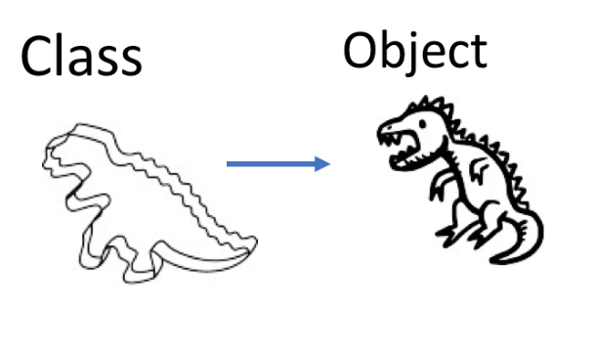
Class and Object

Slide 18
Class and instances ☺

Slide 19
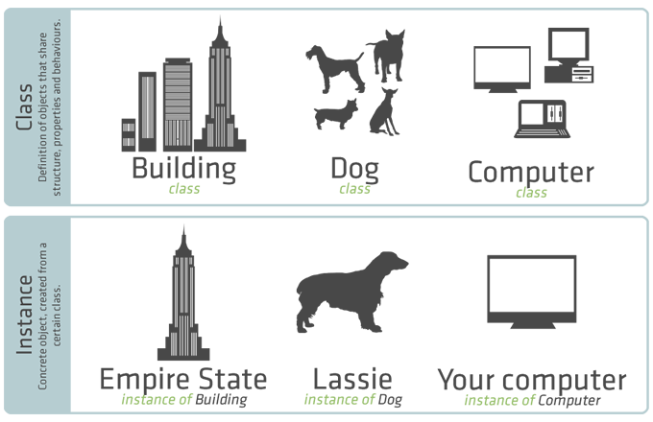
Classes and instances

Slide 20
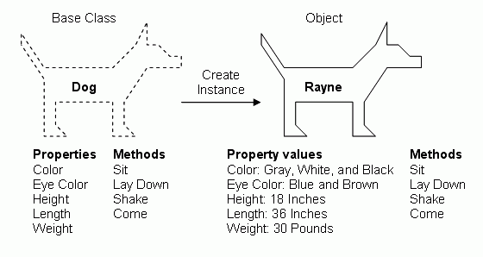
Class and instance

Slide 21
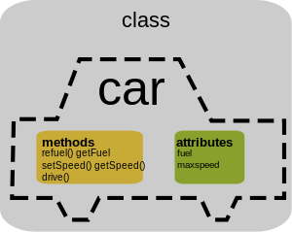
Car Class
Instances:
BMW, KIA, Mustang, Porsche, Ferrari,
Mercedes, Mazda, Citroën, …

Slide 22
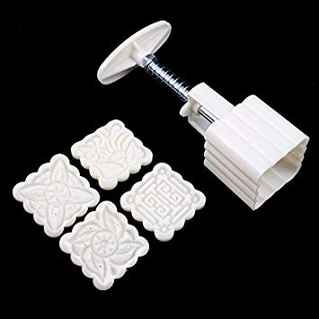
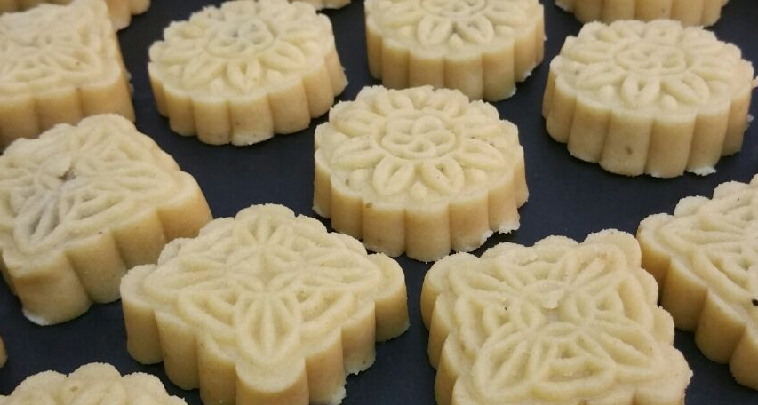
Class and instances ☺

Slide 23
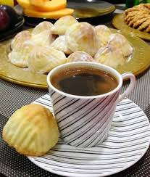
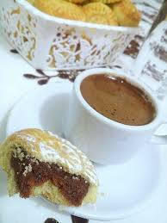

Objects interacting with each others ☺

Slide 24
Classes and Instances
Class Student:
Data:
id, name, dept, ........
Code:
Study()
eat()
walk()
speak()
sleep()
.....
Instances:
instance1:
120181122, 'Ahmed', 'MM', ......
instance2:
120183344, 'Mohammed’, ‘SDev', ......

Slide 25
Terminology: Method
An object's abilities. In language, methods are verbs. Lassie, being a Dog, has the ability to bark. So bark() is one of Lassie's methods. She may have other methods as well, for example sit() or eat() or walk() or save_timmy(). Within the program, using a method usually affects only one particular object; all Dogs can bark, but you need only one particular dog to do the barking
Method and Message are often used interchangeably.
http://en.wikipedia.org/wiki/Object-oriented_programming

Slide 26
Some Python Objects
>>> dir(x)
[ … 'capitalize', 'casefold', 'center', 'count', 'encode', 'endswith', 'expandtabs', 'find', 'format', … 'lower', 'lstrip', 'maketrans', 'partition', 'replace', 'rfind', 'rindex', 'rjust', 'rpartition', 'rsplit', 'rstrip', 'split', 'splitlines', 'startswith', 'strip', 'swapcase', 'title', 'translate', 'upper', 'zfill']
>>> dir(y)
[… 'append', 'clear', 'copy', 'count', 'extend', 'index', 'insert', 'pop', 'remove', 'reverse', 'sort']
>>> dir(z)
[…, 'clear', 'copy', 'fromkeys', 'get', 'items', 'keys', 'pop', 'popitem', 'setdefault', 'update', 'values']
>>> x = 'abc'
>>> type(x)
<class 'str'>
>>> type(2.5)
<class 'float'>
>>> type(2)
<class 'int'>
>>> y = list()
>>> type(y)
<class 'list'>
>>> z = dict()
>>> type(z)
<class 'dict'>

Slide 27
A Sample Class

Slide 28
This is the template for making PartyAnimal objects
class is a reserved word
class PartyAnimal:
x = 0
def party(self) :
self.x = self.x + 1
print("So far",self.x)
an = PartyAnimal()
an.party()
an.party()
an.party()
Each PartyAnimal object has a bit of data
Each PartyAnimal object has a bit of code
Construct a PartyAnimal object and store in an
Tell the an object to run the party() code within it
PartyAnimal.party(an)

Slide 29
class PartyAnimal:
x = 0
def party(self) :
self.x = self.x + 1
print("So far",self.x)
an = PartyAnimal()
an.party()
an.party()
an.party()
$ python party1.py

Slide 30
class PartyAnimal:
x = 0
def party(self) :
self.x = self.x + 1
print("So far",self.x)
an = PartyAnimal()
an.party()
an.party()
an.party()
$ python party1.py
an
x
0
party()

Slide 31
class PartyAnimal:
x = 0
def party(self) :
self.x = self.x + 1
print("So far",self.x)
an = PartyAnimal()
an.party()
an.party()
an.party()
$ python party1.py
So far 1
So far 2
So far 3
an self
x
party()
PartyAnimal.party(an)

Slide 32
Playing with dir() and type()

Slide 33
A Nerdy Way to Find Capabilities
The dir() command lists capabilities
Ignore the ones with underscores - these are used by Python itself
The rest are real operations that the object can perform
It is like type() - it tells us something *about* a variable
>>> y = list()
>>> type(y)
<class 'list'>
>>> dir(x)
['__add__', '__class__', '__contains__', '__delattr__', '__delitem__', '__delslice__', '__doc__', … '__setitem__', '__setslice__', '__str__', 'append', 'clear', 'copy', 'count', 'extend', 'index', 'insert', 'pop', 'remove', 'reverse', 'sort']
>>>

Slide 34
class PartyAnimal:
x = 0
def party(self) :
self.x = self.x + 1
print("So far",self.x)
an = PartyAnimal()
print("Type", type(an))
print("Dir ", dir(an))
We can use dir() to find the “capabilities” of our newly created class.
$ python party3.py
Type <class '__main__.PartyAnimal'>
Dir ['__class__', ... 'party', 'x']

Slide 35
Try dir() with a String
>>> x = 'Hello there'
>>> dir(x)
['__add__', '__class__', '__contains__', '__delattr__', '__doc__', '__eq__', '__ge__', '__getattribute__', '__getitem__', '__getnewargs__', '__getslice__', '__gt__', '__hash__', '__init__', '__le__', '__len__', '__lt__', '__repr__', '__rmod__', '__rmul__', '__setattr__', '__str__', 'capitalize', 'center', 'count', 'decode', 'encode', 'endswith', 'expandtabs', 'find', 'index', 'isalnum', 'isalpha', 'isdigit', 'islower', 'isspace', 'istitle', 'isupper', 'join', 'ljust', 'lower', 'lstrip', 'partition', 'replace', 'rfind', 'rindex', 'rjust', 'rpartition', 'rsplit', 'rstrip', 'split', 'splitlines', 'startswith', 'strip', 'swapcase', 'title', 'translate', 'upper', 'zfill']

Slide 36
Object Lifecycle
http://en.wikipedia.org/wiki/Constructor_(computer_science)

Slide 37
Object Lifecycle
Objects are created, used, and discarded
We have special blocks of code (methods) that get called
- At the moment of creation (constructor)
- At the moment of destruction (destructor)
Constructors are used a lot
Destructors are seldom used

Slide 38
Constructor
The primary purpose of the constructor is to set up some instance variables to have the proper initial values when the object is created

Slide 39
class PartyAnimal:
x = 0
def __init__(self):
print('I am constructed')
def party(self) :
self.x = self.x + 1
print('So far',self.x)
def __del__(self):
print('I am destructed', self.x)
an = PartyAnimal()
an.party()
an.party()
an = 42
print('an contains',an)
$ python party4.py
I am constructed
So far 1
So far 2
I am destructed 2
an contains 42
The constructor and destructor are optional. The constructor is typically used to set up variables. The destructor is seldom used.

Slide 40
Constructor
In object oriented programming, a constructor in a class is a special block of statements called when an object is created
http://en.wikipedia.org/wiki/Constructor_(computer_science)

Slide 41
Many Instances
We can create lots of objects - the class is the template for the object
We can store each distinct object in its own variable
We call this having multiple instances of the same class
Each instance has its own copy of the instance variables

Slide 42
class PartyAnimal:
x = 0
name = ""
def __init__(self, z):
self.name = z
print(self.name,"constructed")
def party(self) :
self.x = self.x + 1
print(self.name,"party count",self.x)
s = PartyAnimal("Sally")
j = PartyAnimal("Jim")
s.party()
j.party()
s.party()
Constructors can have additional parameters. These can be used to set up instance variables for the particular instance of the class (i.e., for the particular object).
party5.py

Slide 43
class PartyAnimal:
x = 0
name = ""
def __init__(self, z):
self.name = z
print(self.name,"constructed")
def party(self) :
self.x = self.x + 1
print(self.name,"party count",self.x)
s = PartyAnimal("Sally")
j = PartyAnimal("Jim")
s.party()
j.party()
s.party()

Slide 44
class PartyAnimal:
x = 0
name = ""
def __init__(self, z):
self.name = z
print(self.name,"constructed")
def party(self) :
self.x = self.x + 1
print(self.name,"party count",self.x)
s = PartyAnimal("Sally")
j = PartyAnimal("Jim")
s.party()
j.party()
s.party()
s
x: 0
name:

Slide 45
class PartyAnimal:
x = 0
name = ""
def __init__(self, z):
self.name = z
print(self.name,"constructed")
def party(self) :
self.x = self.x + 1
print(self.name,"party count",self.x)
s = PartyAnimal("Sally")
j = PartyAnimal("Jim")
s.party()
j.party()
s.party()
s
x: 0
name: Sally
j
x: 0
We have two independent instances
name: Jim

Slide 46
class PartyAnimal:
x = 0
name = ""
def __init__(self, z):
self.name = z
print(self.name,"constructed")
def party(self) :
self.x = self.x + 1
print(self.name,"party count",self.x)
s = PartyAnimal("Sally")
j = PartyAnimal("Jim")
s.party()
j.party()
s.party()
Sally constructed
Jim constructed
Sally party count 1
Jim party count 1
Sally party count 2

Slide 47
Inheritance
http://www.ibiblio.org/g2swap/byteofpython/read/inheritance.html

Slide 48
Inheritance
When we make a new class - we can reuse an existing class and inherit all the capabilities of an existing class and then add our own little bit to make our new class
Another form of store and reuse
Write once - reuse many times
The new class (child) has all the capabilities of the old class (parent) - and then some more

Slide 49
Terminology: Inheritance
‘Subclasses’ are more specialized versions of a class, which inherit attributes and behaviors from their parent classes, and can introduce their own.
http://en.wikipedia.org/wiki/Object-oriented_programming

Slide 50
class PartyAnimal:
x = 0
name = ""
def __init__(self, nam):
self.name = nam
print(self.name,"constructed")
def party(self) :
self.x = self.x + 1
print(self.name,"party count",self.x)
class FootballFan(PartyAnimal):
points = 0
def touchdown(self):
self.points = self.points + 7
self.party()
print(self.name,"points",self.points)
s = PartyAnimal("Sally")
s.party()
j = FootballFan("Jim")
j.party()
j.touchdown()
FootballFan is a class which extends PartyAnimal. It has all the capabilities of PartyAnimal and more.

Slide 51
class PartyAnimal:
x = 0
name = ""
def __init__(self, nam):
self.name = nam
print(self.name,"constructed")
def party(self) :
self.x = self.x + 1
print(self.name,"party count",self.x)
class FootballFan(PartyAnimal):
points = 0
def touchdown(self):
self.points = self.points + 7
self.party()
print(self.name,"points",self.points)
s = PartyAnimal("Sally")
s.party()
j = FootballFan("Jim")
j.party()
j.touchdown()
s
x:
name: Sally

Slide 52
class PartyAnimal:
x = 0
name = ""
def __init__(self, nam):
self.name = nam
print(self.name,"constructed")
def party(self) :
self.x = self.x + 1
print(self.name,"party count",self.x)
class FootballFan(PartyAnimal):
points = 0
def touchdown(self):
self.points = self.points + 7
self.party()
print(self.name,"points",self.points)
s = PartyAnimal("Sally")
s.party()
j = FootballFan("Jim")
j.party()
j.touchdown()
j
x:
name: Jim
points:

Slide 53
Definitions
Class - a template
Attribute – A variable within a class
Method - A function within a class
Object - A particular instance of a class
Constructor – Code that runs when an object is created
Inheritance - The ability to extend a class to make a new class.

Slide 54
Summary
Object Oriented programming is a very structured approach to code reuse
We can group data and functionality together and create many independent instances of a class

Slide 55
Acknowledgements / Contributions
Thes slide are Copyright 2010- Charles R. Severance (www.dr-chuck.com) of the University of Michigan School of Information and made available under a Creative Commons Attribution 4.0 License. Please maintain this last slide in all copies of the document to comply with the attribution requirements of the license. If you make a change, feel free to add your name and organization to the list of contributors on this page as you republish the materials.
Initial Development: Charles Severance, University of Michigan School of Information
… Insert new Contributors here
...

Slide 56
Additional Source Information
Snowman Cookie Cutter" by Didriks is licensed under CC BY https://www.flickr.com/photos/dinnerseries/23570475099
Photo from the television program Lassie. Lassie watches as Jeff (Tommy Rettig) works on his bike is Public Domain https://en.wikipedia.org/wiki/Lassie#/media/File:Lassie_and_Tommy_Rettig_1956.JPG

