Slide 1
Intelligent Agents
CHAPTER 2
Stuart Russell and Peter Norvig, Artificial Intelligence: A Modern Approach, Global Edition 3/E

Slide 2
Outline
‹#›
Agents and environments
Rationality
PEAS (Performance measure, Environment, Actuators, Sensors)
Environment types
Agent types
Artificial Intelligence a modern approach

Slide 3
Agents
‹#›
An agent is anything that can be viewed as perceiving its environment through sensors and acting upon that environment through actuators
Human agent:
eyes, ears, and other organs for sensors;
hands, legs, mouth, and other body parts for actuators
Robotic agent:
cameras and infrared range finders for sensors
various motors for actuators
Artificial Intelligence a modern approach

Slide 4
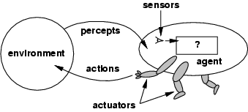
Agents and environments
‹#›
The agent function maps from percept histories to actions:
[f: P* → A]
The agent program runs on the physical architecture to produce f
agent = architecture + program
Artificial Intelligence a modern approach

Slide 5
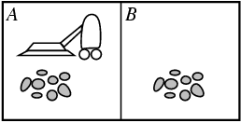
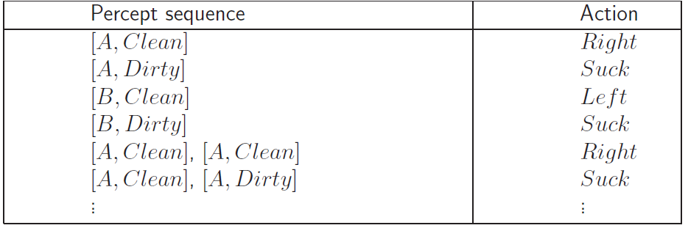
Vacuum-cleaner world
‹#›
Demos: http://aima.cs.berkeley.edu/demos.html
Percepts: location and contents, e.g., [A,Dirty]
Actions: Left, Right, Suck, NoOp
Agent’s function -> look-up table
For many agents this is a very large table
Artificial Intelligence a modern approach

Slide 6
Rational agents
‹#›
Rationality
Performance measuring success
Agents prior knowledge of environment
Actions that agent can perform
Agent’s percept sequence to date
Rational Agent: For each possible percept sequence, a rational agent should select an action that is expected to maximize its performance measure, given the evidence provided by the percept sequence and whatever built-in knowledge the agent has.
Artificial Intelligence a modern approach

Slide 7
Examples of Rational Choice
‹#›
Consider the simplified map of Romania below. Numbers correspond to travel times. Consider the following choices.
1. To go from Rimnicu Vilcea to Craivo:
a. RV – Pitesti – Craiova, or
b. RV- Craiova?
2. To go from Oradea to Craiova:
a. Go via Arad-Sibiu-…, or
b. Go via Sibui, or
c. Go via Arad-Timisoara-….?
Artificial Intelligence a modern approach

Slide 8
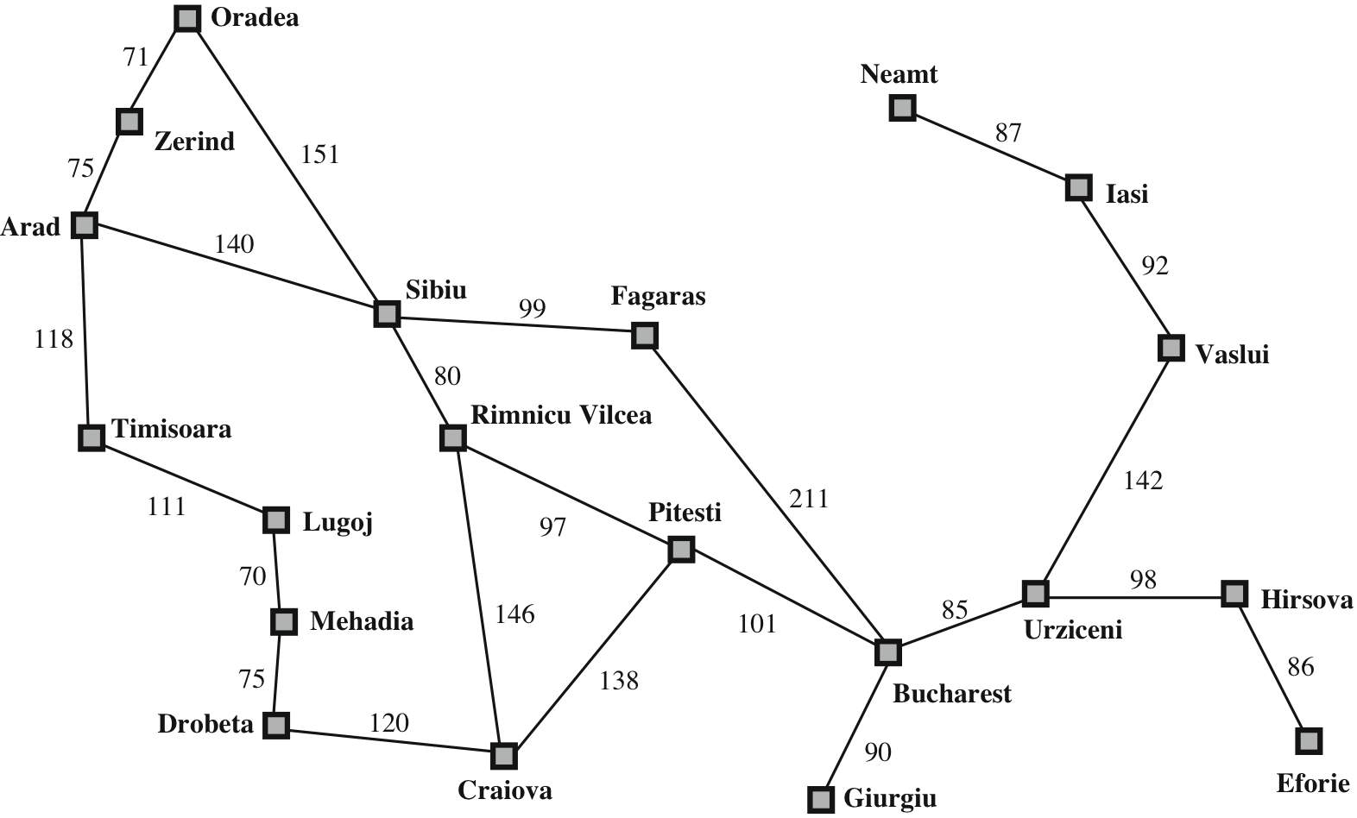

Slide 9
Rationality
‹#›
Rational is different from omniscience
Percepts may not supply all relevant information
E.g., in card game, don’t know cards of others.
Rational is different from being perfect
Rationality maximizes expected outcome while perfection maximizes actual outcome.
Artificial Intelligence a modern approach

Slide 10
Autonomy in Agents
The autonomy of an agent is the extent to which its
behaviour is determined by its own experience,
rather than knowledge of designer.
Extremes
No autonomy – ignores environment/data
Complete autonomy – must act randomly/no program
Example: baby learning to crawl
Ideal: design agents to have some autonomy
Possibly become more autonomous with experience

Slide 11
PEAS
‹#›
PEAS: Performance measure, Environment, Actuators, Sensors
Must first specify the setting for intelligent agent design
Examples:
Automated Taxi Driver
Part-picking robot
Interactive English tutor
Artificial Intelligence a modern approach

Slide 12
PEAS for automated taxi driver
Performance measure: Safe, fast, legal, comfortable trip, maximize profits
Environment: Roads, other traffic, pedestrians, customers
Actuators: Steering wheel, accelerator, brake, signal, horn
Sensors: Cameras, sonar, speedometer, GPS, odometer, engine sensors, keyboard

Slide 13
PEAS Part-picking robot
‹#›
Agent: Part-picking robot
Performance measure: Percentage of parts in correct bins
Environment: Conveyor belt with parts, bins
Actuators: Jointed arm and hand
Sensors: Camera, joint angle sensors
Artificial Intelligence a modern approach

Slide 14
PEAS: Interactive English tutor
‹#›
Agent: Interactive English tutor
Performance measure: Maximize student's score on test
Environment: Set of students
Actuators: Screen display (exercises, suggestions, corrections)
Sensors: Keyboard, microphone
Artificial Intelligence a modern approach

Slide 15
Environment types
‹#›
Fully observable (vs. partially observable)
Deterministic (vs. stochastic)
Episodic (vs. sequential)
Static (vs. dynamic)
Discrete (vs. continuous)
Single agent (vs. multiagent):
Artificial Intelligence a modern approach

Slide 16
Fully observable (vs. partially observable)
‹#›
Is everything an agent requires to choose its actions available to it via its sensors? Perfect or Full information.
If so, the environment is fully accessible
If not, parts of the environment are inaccessible
Agent must make informed guesses about world.
In decision theory: perfect information vs. imperfect information.
Cross Word
Poker
Backgammon
Taxi driver
Part picking robot
Image analysis
Fully
Partially
Partially
Partially
Fully
Fully
Artificial Intelligence a modern approach

Slide 17
Deterministic (vs. stochastic)
‹#›
Does the change in world state
Depend only on current state and agent’s action?
Non-deterministic environments
Have aspects beyond the control of the agent
Utility functions have to guess at changes in world
Cross Word
Cross Word
Poker
Poker
Backgammon
Backgammon
Taxi driver
Taxi driver
Part picking robot
Part
Image analysis
Image analysis
Deterministic
Stochastic
Stochastic
Stochastic
Stochastic
Deterministic
Artificial Intelligence a modern approach
Notes:
‹#›

Slide 18
Episodic (vs. sequential):
‹#›
Is the choice of current action
Dependent on previous actions?
If not, then the environment is episodic
In non-episodic environments:
Agent has to plan ahead:
Current choice will affect future actions
Cross Word
Poker
Backgammon
Taxi driver
Part picking robot
Image analysis
Sequential
Sequential
Sequential
Sequential
Episodic
Episodic
Artificial Intelligence a modern approach

Slide 19
Static (vs. dynamic):
‹#›
Static environments don’t change
While the agent is deliberating over what to do
Dynamic environments do change
So agent should/could consult the world when choosing actions
Alternatively: anticipate the change during deliberation OR make decision very fast
Semidynamic: If the environment itself does not change with the passage of time but the agent's performance score does.
Cross Word
Poker
Backgammon
Taxi driver
Part picking robot
Image analysis
Static
Static
Static
Dynamic
Dynamic
Semi
Another example: off-line route planning vs. on-board navigation system
Artificial Intelligence a modern approach

Slide 20
Discrete (vs. continuous)
‹#›
A limited number of distinct, clearly defined percepts and actions vs. a range of values (continuous)
Cross Word
Poker
Backgammon
Taxi driver
Part picking robot
Image analysis
Discrete
Discrete
Discrete
Conti
Conti
Conti
Artificial Intelligence a modern approach

Slide 21
Single agent (vs. multiagent):
‹#›
An agent operating by itself in an environment or there are many agents working together
Cross Word
Poker
Backgammon
Taxi driver
Part picking robot
Image analysis
Single
Multi
Multi
Multi
Single
Single
Artificial Intelligence a modern approach

Slide 22
Summary.
Observable
Deterministic
Episodic
Static
Discrete
Agents
Cross Word
Fully
Deterministic
Sequential
Static
Discrete
Single
Poker
Fully
Stochastic
Sequential
Static
Discrete
Multi
Backgammon
Partially
Stochastic
Sequential
Static
Discrete
Multi
Taxi driver
Partially
Multi
Stochastic
Sequential
Dynamic
Conti
Part picking robot
Partially
Stochastic
Episodic
Dynamic
Conti
Single
Image analysis
Fully
Deterministic
Episodic
Semi
Conti
Single
Artificial Intelligence a modern approach
Notes:
Only 2 locations
‹#›

Slide 23
Choice under (Un)certainty
‹#›
Fully Observable
yes
no
Deterministic
no
yes
Certainty: Search
Uncertainty
Artificial Intelligence a modern approach

Slide 24
Agent types
‹#›
Four basic types in order of increasing generality:
Simple reflex agents
Reflex agents with state/model
Goal-based agents
Utility-based agents
All these can be turned into learning agents
Artificial Intelligence a modern approach

Slide 25
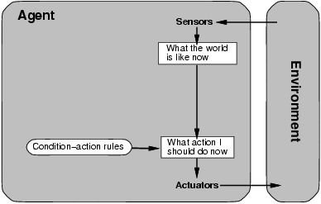
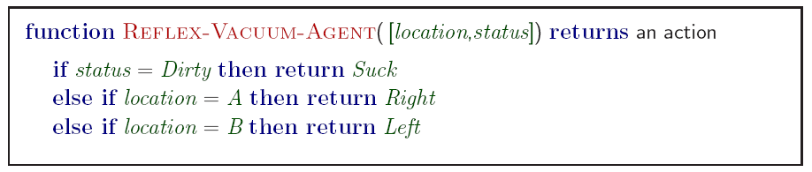
Simple reflex agents
‹#›
Artificial Intelligence a modern approach

Slide 26
Simple reflex agents
‹#›
Simple but very limited intelligence.
Action does not depend on percept history, only on current percept.
Therefore no memory requirements.
Infinite loops
Suppose vacuum cleaner does not observe location. What do you do given location = clean? Left of A or right on B -> infinite loop.
Fly buzzing around window or light.
Possible Solution: Randomize action.
Thermostat.
Chess – openings, endings
Lookup table (not a good idea in general)
35¹⁰⁰ entries required for the entire game
Artificial Intelligence a modern approach

Slide 27
States: Beyond Reflexes
‹#›
Recall the agent function that maps from percept histories to actions:
[f: P* -> A]
An agent program can implement an agent function by maintaining an internal state.
The internal state can contain information about the state of the external environment.
The state depends on the history of percepts and on the history of actions taken:
[f: P*, A*-> S -> A] where S is the set of states.
If each internal state includes all information relevant to information making, the state space is Markovian.
Artificial Intelligence a modern approach

Slide 28
States and Memory: Game Theory
‹#›
If each state includes the information about the percepts and actions that led to it, the state space has perfect recall.
Perfect Information = Perfect Recall + Full Observability + Deterministic Actions.
Artificial Intelligence a modern approach

Slide 29
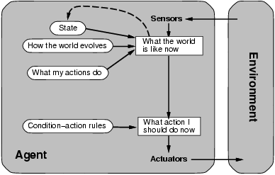
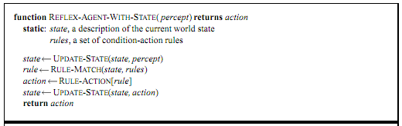
Model-based reflex agents
‹#›
Know how world evolves
Overtaking car gets closer from behind
How agents actions affect the world
Wheel turned clockwise takes you right
Model base agents update their state
Artificial Intelligence a modern approach

Slide 30
Goal-based agents
‹#›
knowing state and environment? Enough?
Taxi can go left, right, straight
Have a goal
A destination to get to
Uses knowledge about a goal to guide its actions
E.g., Search, planning
Artificial Intelligence a modern approach

Slide 31
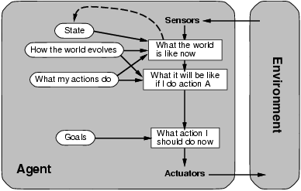
Goal-based agents
‹#›
Reflex agent breaks when it sees brake lights. Goal based agent reasons
Brake light -> car in front is stopping -> I should stop -> I should use brake
Artificial Intelligence a modern approach

Slide 32
Utility-based agents
‹#›
Goals are not always enough
Many action sequences get taxi to destination
Consider other things. How fast, how safe…..
A utility function maps a state onto a real number which describes the associated degree of “happiness”, “goodness”, “success”.
Where does the utility measure come from?
Economics: money.
Biology: number of offspring.
Your life?
Artificial Intelligence a modern approach
Notes:
How many environment types are there in total?
‹#›

Slide 33
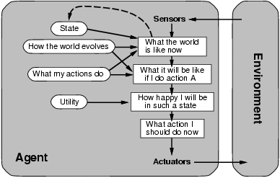
Utility-based agents
‹#›
Artificial Intelligence a modern approach

Slide 34
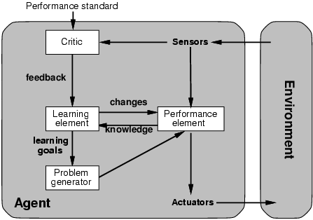
Learning agents
‹#›
Performance element is what was previously the whole agent
Input sensor
Output action
Learning element
Modifies performance element.
Artificial Intelligence a modern approach

Slide 35
Learning agents
‹#›
Critic: how the agent is doing
Input: checkmate?
Fixed
Problem generator
Tries to solve the problem differently instead of optimizing.
Suggests exploring new actions -> new problems.
Artificial Intelligence a modern approach

Slide 36
Learning agents(Taxi driver)
‹#›
Performance element
How it currently drives
Taxi driver Makes quick left turn across 3 lanes
Critics observe shocking language by passenger and other drivers and informs bad action
Learning element tries to modify performance elements for future
Problem generator suggests experiment out something called Brakes on different Road conditions
Exploration vs. Exploitation
Learning experience can be costly in the short run
shocking language from other drivers
Less tip
Fewer passengers
Artificial Intelligence a modern approach

Slide 37
The Big Picture: AI for Model-Based Agents
‹#›
Planning
Decision Theory
Game Theory
Action
Reinforcement Learning
Knowledge
Learning
Logic
Probability
Heuristics
Inference
Machine Learning
Statistics
Artificial Intelligence a modern approach

Slide 38
The Picture for Reflex-Based Agents
‹#›
Action
Reinforcement Learning
Learning
Studied in AI, Cybernetics, Control Theory, Biology, Psychology.
Artificial Intelligence a modern approach

Slide 39
Summary
‹#›
Agents can be described by their PEAS.
Environments can be described by several key properties
A rational agent maximizes the performance measure for their PEAS.
The performance measure depends on the agent function.
The agent program implements the agent function.
3 main architectures for agent programs.
Artificial Intelligence a modern approach

