Slide 1
Adversarial Search and Game-Playing
CHAPTER 6
Stuart Russell and Peter Norvig, Artificial Intelligence: A Modern Approach, Global Edition 3/E

Slide 2
Environment Type Discussed In this Lecture
Fully Observable
yes
Multi-agent
yes
Sequential
yes
no
Discrete
no
yes
Discrete
yes
Game Tree Search
Game Matrices
Continuous Action Games
Notes:
Discuss discrete variables a little bit.

Slide 3
Adversarial Search
Examine the problems that arise when we try to plan ahead in a world where other agents are planning against us.
A good example is in board games.

Slide 4
Typical AI assumptions
Two agents whose actions alternate
Utility values for each agent are the opposite of the other
creates the adversarial situation
Fully observable environments

Slide 5
Search vs. Games
Search – no adversary
Solution is (heuristic) method for finding goal
Heuristic techniques can find optimal solution
Evaluation function: estimate of cost from start to goal through given node
Examples: path planning, scheduling activities
Games – adversary
Solution is strategy (strategy specifies move for every possible opponent reply) “unpredictable opponent”
Optimality depends on opponent.
Time limits force an approximate solution
Evaluation function: evaluate “goodness” of game position
Examples: chess, checkers, Othello, backgammon

Slide 6
Types of Games
 | deterministic | Chance moves
Perfect information | Chess, checkers, go, othello | Backgammon, monopoly
Imperfect information (Initial Chance Moves) | Bridge, Skat, blind tic tac to | Poker, scrabble, blackjack
https://playtictactoe.org/
https://cardgames.io/backgammon/
Notes:
If Nature is not a player, then poker etc. involve chance moves like drawing cards, tiles. The other card games involve no more chance. Play with class.

Slide 7
Game Setup
Two players: MAX and MIN
MAX moves first and they take turns until the game is over
Winner gets award, loser gets penalty.
Games as search:
Initial state: e.g. board configuration of chess
Successor function: list of (move,state) pairs specifying legal moves.
Terminal test: Is the game finished?
Utility function: Gives numerical value of terminal states. E.g. win (+1), lose (-1) and draw (0) in tic-tac-toe or chess
Notes:
Explain these conventions carefully. Maybe contrast with general game trees.

Slide 8
Size of search trees
b = branching factor
d = number of moves by both players
Search tree is O(b^{d})
Chess
b ~ 35
d ~100
- search tree is ~ 10 ¹⁵⁴ (!!)
- completely impractical to search this
Game-playing emphasizes being able to make optimal decisions in a finite amount of time

Slide 9
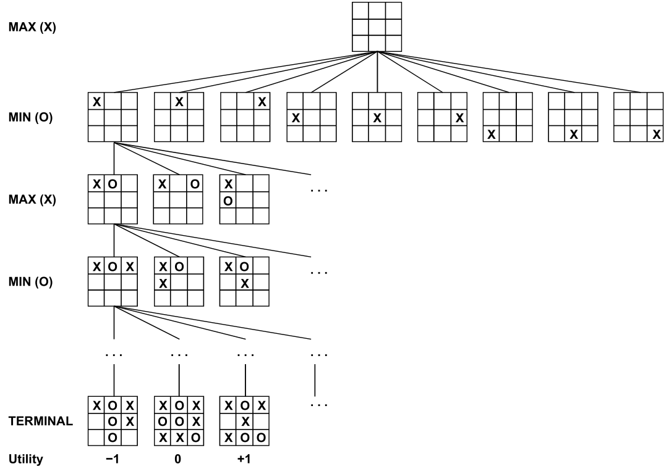
Partial Game Tree for Tic-Tac-Toe

Slide 10
Minimax strategy: Look ahead and reason backwards
Find the optimal strategy for MAX assuming an infallible MIN opponent
Need to compute this all the down the tree
Assumption: Both players play optimally!
Given a game tree, the optimal strategy can be determined by using the minimax value of each node.

Slide 11
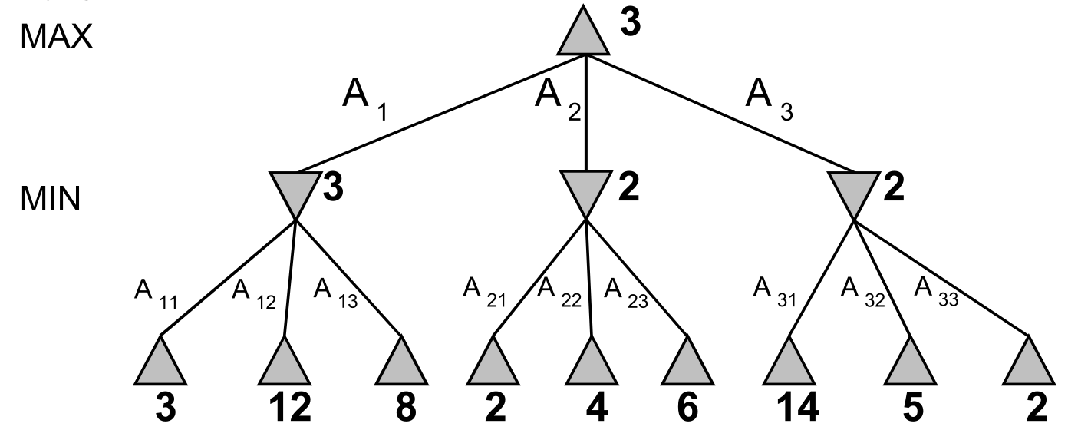
MinMax

Slide 12
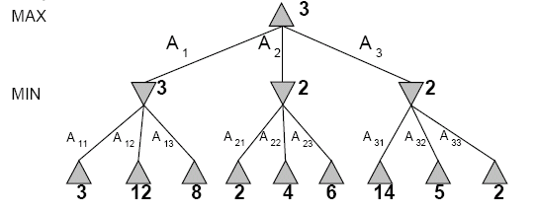
Two-Ply Game Tree
Notes:
Chocolate playing: max gets x number of chocolates, min has to give up x number of chocolates.

Slide 13
Two-Ply Game Tree

Slide 14
Two-Ply Game Tree
Notes:
Ply = 2 half moves

Slide 15
Two-Ply Game Tree
Minimax maximizes the utility for the worst-case outcome for max
The minimax decision

Slide 16
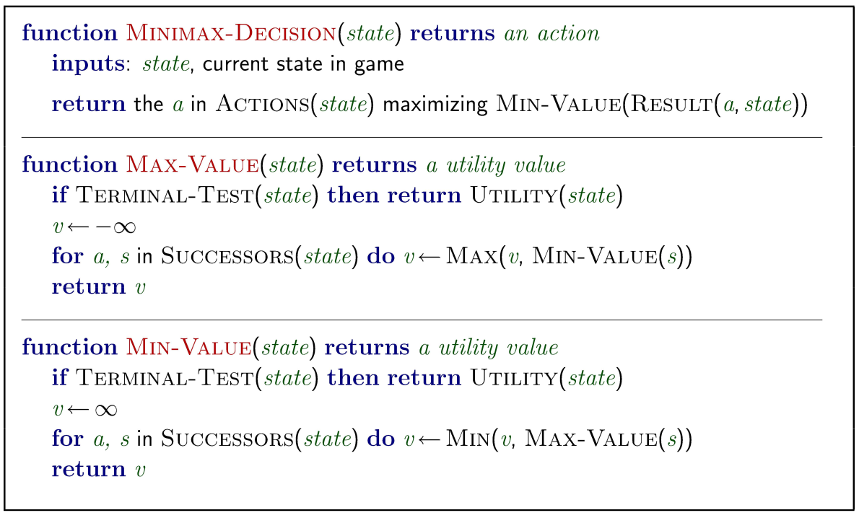
Minmax Algorithm

Slide 17
Minmax Algorithm Steps
Step 1: First, generate the entire game tree starting with the current position of the game all the way upto the terminal states.
Let us understand the defined terminology in terms
The initial state is the first layer that defines that the board is blank it’s MAX’s turn to play.
Successor function lists all the possible successor moves. It is defined for all the layers in the tree.
Terminal State is the last layer of the tree that shows the final state, i.e whether the player MAX wins, loses, or ties with the opponent.
Utilities in this case for the terminal states are 1, 0, and -1 as discussed earlier, and they can be used to determine the utilities of the other nodes as well.

Slide 18
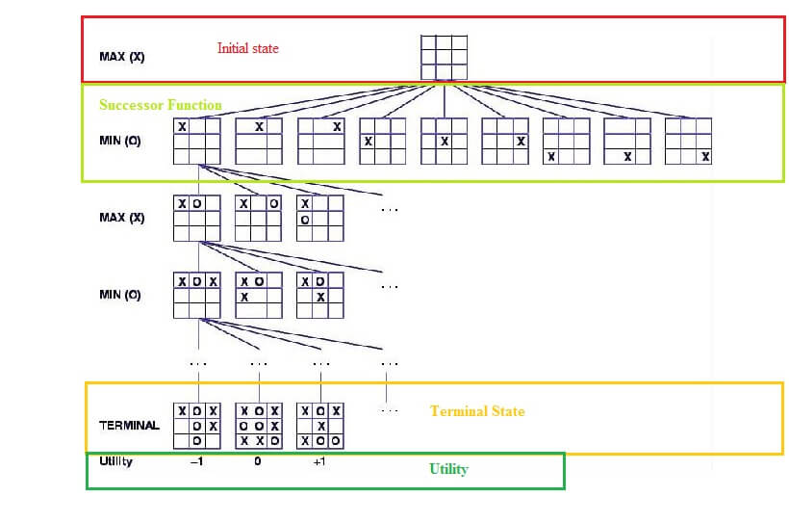
step 1: terminologies for tic tac to

Slide 19
Minmax Algorithm Steps
Step 2: Apply the utility function to get the utility values for all the terminal states.
Step 3: Determine the utilities of the higher nodes with the help of the utilities of the terminal nodes.
Calculate the utility for the left node(red) of the layer above the terminal.
Since it is the move of the player MIN, we will choose the minimum of all the utilities. For this case, we have to evaluate MIN{3, 5, 10}, which we know is certainly 3. So the utility for the red node is 3.

Slide 20
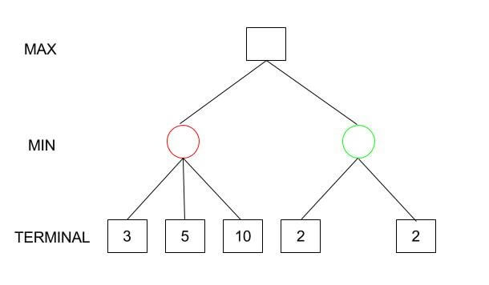
Steps 2, 3

Slide 21
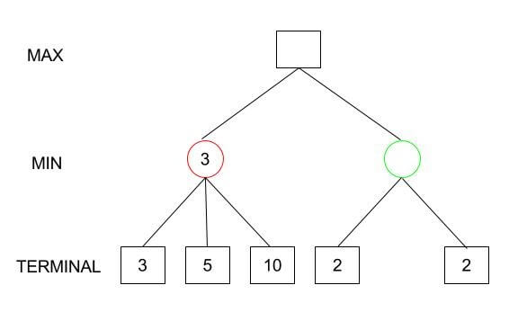
Step 2, 3

Slide 22
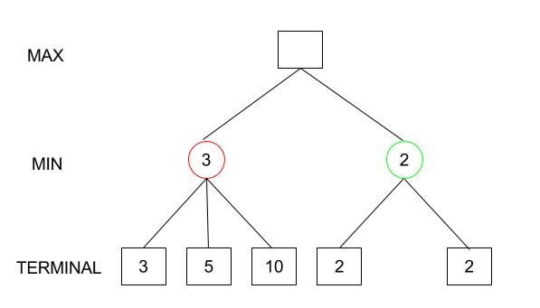
Step 2, 3

Slide 23
Minmax Algorithm Steps
Step 4: Calculate the utility values with the help of leaves considering one layer at a time until the root of the tree.
Step 5: Eventually, all the backed-up values reach to the root of the tree, i.e., the topmost point. At that point, MAX has to choose the highest value.

Slide 24
Minmax Algorithm Steps
In our example, we only have 3 layers so we immediately reached to the root but in actual games, there will be many more layers and nodes. So we have to evaluate MAX{3,2} which is 3.
Therefore, the best opening move for MAX is the left node(or the red one). This move is called the minimax decision as it maximizes the utility following the assumption that the opponent is also playing optimally to minimize it.
To summarize: Minimax Decision = MAX{MIN{3,5,10},MIN{2,2}} = MAX{3,2} = 3

Slide 25
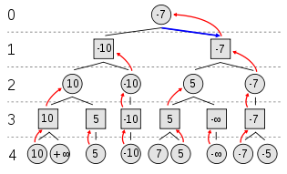
Example of Algorithm Execution
max(min(max(min(10, +inf)), max(min())), min(max(min()), max(min())))
MAX to move
Notes:
Can have negative values too

Slide 26
Properties of minmax
Complete? Yes, if the tree is finite
Optimal? Yes
Time complexity? O(b^m)
Space Complexity O(bm)

Slide 27
Minimax Algorithm
Complete depth-first exploration of the game tree
Assumptions:
Max depth = d, b legal moves at each point
E.g., Chess: d ~ 100, b ~35
do we need to explore every path?
Criterion | Minimax
Time | O(b^{d})
Space | O(bd)
☹
☺

Slide 28
Practical problem with minimax search
Number of game states is exponential in the number of moves.
Solution: Do not examine every node
=> pruning
Remove branches that do not influence final decision
Revisit example …

Slide 29
Minmax optimization
Game trees are, in general, very time consuming to build, and it’s only for simple games that it can be generated in a short time.
If there are b legal moves, i.e., b nodes at each point and the maximum depth of the tree is m, the time complexity of the minimax algorithm is of the order bm(O(bm)).
It is viable to find the actual minimax decision without even looking at every node of the game tree.
Hence, we eliminate nodes from the tree without analyzing, and this process is called pruning.

Slide 30
Alpha-beta pruning
If we apply alpha-beta pruning to a standard minimax algorithm, it returns the same move as the standard one, but it removes (prunes) all the nodes that are possibly not affecting the final decision.

Slide 31
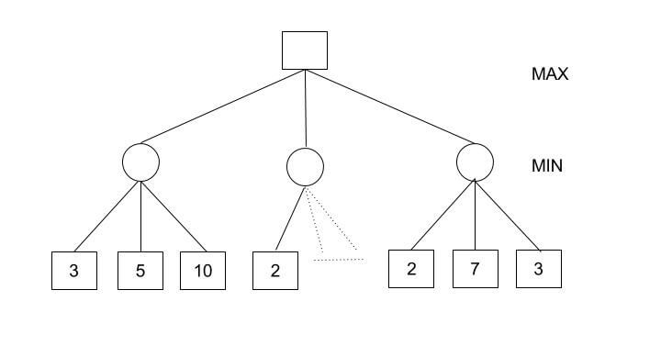
Alpha-beta pruning
Consider the following tree
Minimax Decision = MAX{MIN{3,5,10}, MIN{2,a,b}, MIN{2,7,3}} = MAX{3,c,2} = 3

Slide 32
Alpha-beta pruning
MIN{2,a,b} would certainly be less than or equal to 2, i.e., c<=2 and hence MAX{3,c,2} has to be 3.
We could have reached a conclusion without looking at those nodes. And this is where alpha-beta pruning comes into the picture.

Slide 33
A few definitions
Alpha: It is the best choice so far for the player MAX. We want to get the highest possible value here.
Beta: It is the best choice so far for MIN, and it has to be the lowest possible value.
Note: Each node has to keep track of its alpha and beta values. Alpha can be updated only when it’s MAX’s turn and, similarly, beta can be updated only when it’s MIN’s chance.

Slide 34
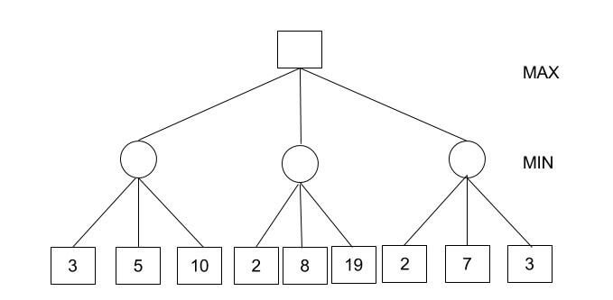
Alpha-beta pruning algorithm steps
1 - Initialize alpha = -infinity and beta = infinity as the worst possible cases. The condition to prune a node is when alpha becomes greater than or equal to beta.
alpha >= beta

Slide 35
Alpha-beta pruning algorithm steps
2- Start with assigning the initial values of alpha and beta to root and since alpha is less than beta we don’t prune it.
3 - Carry these values of alpha and beta to the child node on the left. And now from the utility value of the terminal state, we will update the values of alpha and be, so we don’t have to update the value of beta. Again, we don’t prune because the condition remains the same. Similarly, the third child node also. And then backtracking to the root we set alpha=3 because that is the minimum value that alpha can have.

Slide 36
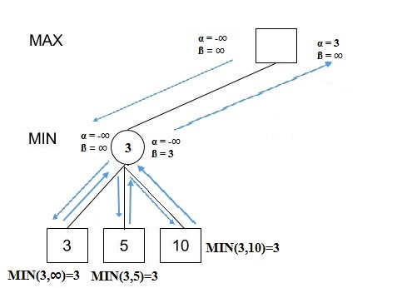
Alpha-beta pruning algorithm steps

Slide 37
Alpha-beta pruning algorithm steps
4 - Now, alpha=3 and beta=infinity at the root. So, we don’t prune. Carrying this to the center node, and calculating MIN{2, infinity}, we get alpha=3 and beta=2.
5 - Prune the second and third child nodes because alpha is now greater than beta.
6 - Alpha at the root remains 3 because it is greater than 2. Carrying this to the rightmost child node, evaluate MIN{infinity,2}=2. Update beta to 2 and alpha remains 3.

Slide 38
Alpha-beta pruning algorithm steps
7 - Prune the second and third child nodes because alpha is now greater than beta.
8 - Hence, we get 3, 2, 2 at the left, center, and right MIN nodes, respectively. And calculating MAX{3,2,2}, we get 3. Therefore, without even looking at four leaves we could correctly find the minimax decision.

Slide 39
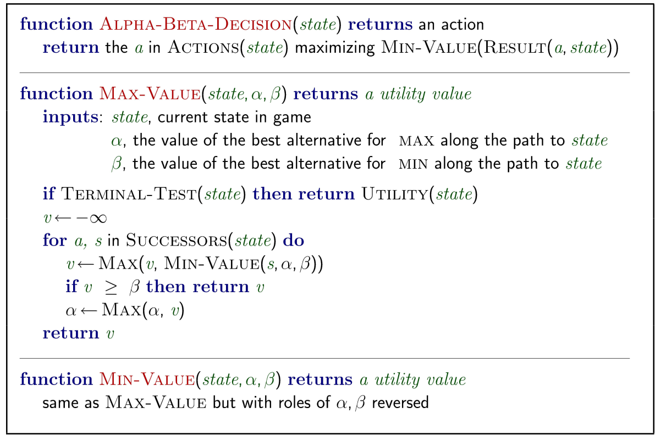
Alpha-beta pruning algorithm steps

Slide 40
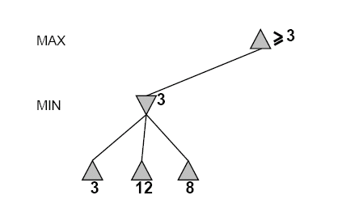
Alpha-Beta Example
Do DF-search until first leaf
Range of possible values
[-∞,+∞]
[-∞, +∞]

Slide 41
Alpha-Beta Example (continued)
[-∞,+∞]
[-∞,3]

Slide 42
Alpha-Beta Example (continued)
[-∞,+∞]
[-∞,3]

Slide 43
Alpha-Beta Example (continued)
[3,+∞]
[3,3]

Slide 44
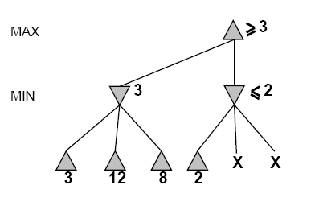
Alpha-Beta Example (continued)
[3,+∞]
This node is worse
for MAX
[3,3]
[-∞,2]

Slide 45
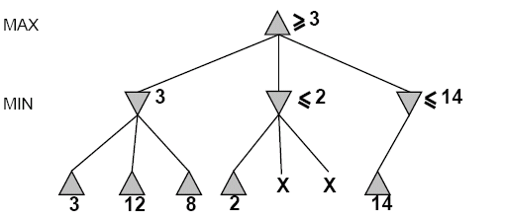
Alpha-Beta Example (continued)
[3,14]
,
[3,3]
[-∞,2]
[-∞,14]

Slide 46
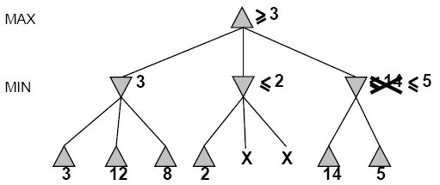

Alpha-Beta Example (continued)
[3,5]
,
[3,3]
[−∞,2]
[-∞,5]

Slide 47
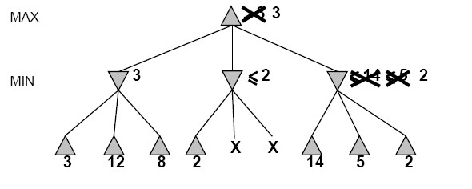
Alpha-Beta Example (continued)
[3,3]
[3,3]
[−∞,2]
[2,2]

Slide 48
Alpha-Beta Example (continued)
[3,3]
[3,3]
[-∞,2]
[2,2]

Slide 49
Example
-which nodes can be pruned?
MAX
MIN
MAX
3
5
6
4
1
2
7
8
Notes:
Nothing actually.

Slide 50
Final Comments about Alpha-Beta Pruning
Pruning does not affect final results
Entire subtrees can be pruned.
Good move ordering improves effectiveness of pruning
Repeated states are again possible.
Store them in memory = transposition table

Slide 51
Static (Heuristic) Evaluation Functions
An Evaluation Function:
estimates how good the current board configuration is for a player.
Typically, one figures how good it is for the player, and how good it is for the opponent, and subtracts the opponents score from the players
Othello: Number of white pieces - Number of black pieces
Chess: Value of all white pieces - Value of all black pieces
Typical values from -infinity (loss) to +infinity (win) or [-1, +1].
If the board evaluation is X for a player, it’s -X for the opponent.
Many clever ideas about how to use the evaluation function.
e.g. null move heuristic: let opponent move twice.
Example:
Evaluating chess boards,
Checkers
Tic-tac-toe

Slide 52
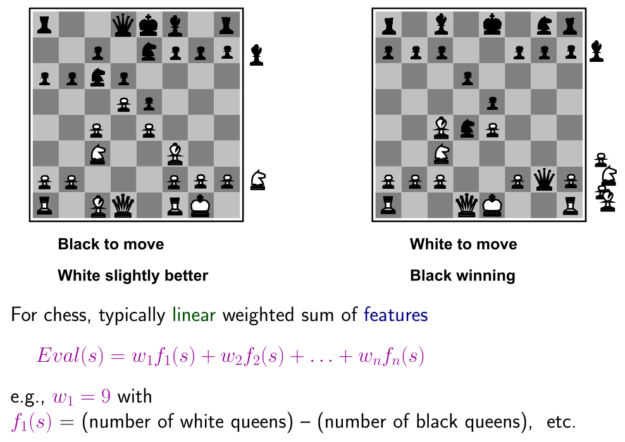
Evaluation functions

