Slide 1
Natural Language Processing
An Introduction

Slide 2
Outline
What is NLP?
Why NLP is hard?
Applications

Slide 3
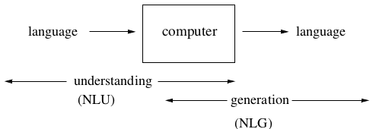
What is Natural Language Processing?
computers using natural language as input and/or output

Slide 4
NLP tasks
Machine Translation (MT)
Information Extraction (IE)
Text Summarization
Dialogue Systems
Tagging (POS, NER)
Speech Recognition

Slide 5
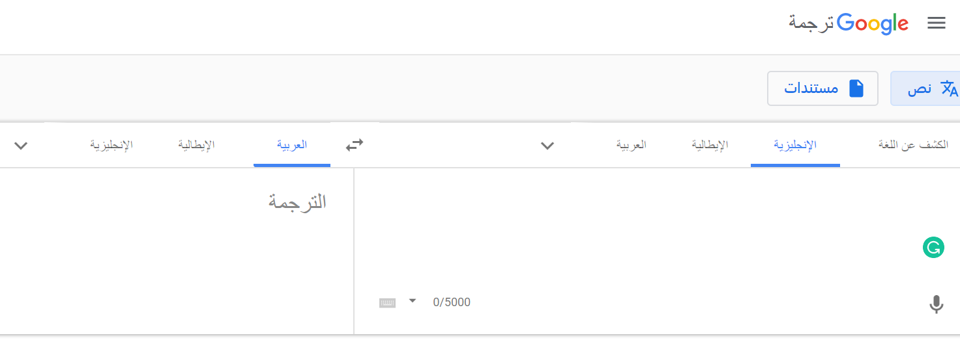

Machine Translation (MT)
A sub-field of computational linguistics that investigates the use of software to translate text or speech from one language to another. (Wikipedia)
Statistical Machine Translation (SMT)
Neural Machine Translation (NMT)

Slide 6
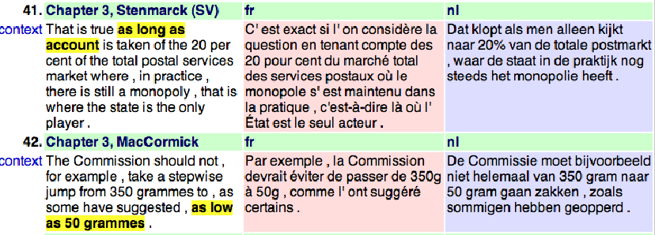
Parallel coprus

Slide 7

Information Extraction (IE)
Information extraction (IE) is the task of automatically extracting structured information from unstructured documents. (Wikipedia)

Slide 8
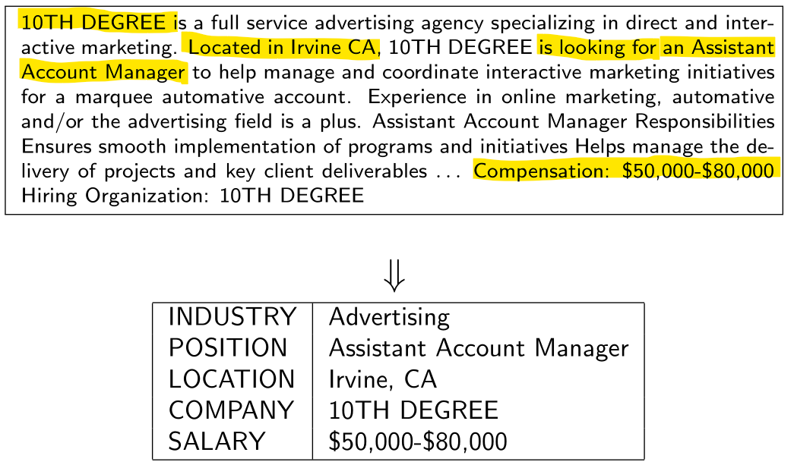
Information Extraction Example

Slide 9
Information Extraction
Goal: Map a document collection to structured database
Motivation:
Complex searches (“Find me all the jobs in advertising paying at least $50,000 in Boston”)
Statistical queries (“How has the number of jobs in accounting changed over the years?”)

Slide 10
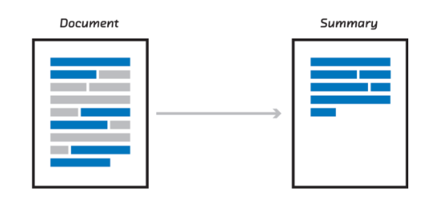
Text Summarization

Slide 11
Dialogue Systems
User: I need a flight from Boston to Washington, arriving by 10 pm.
System: What day are you flying on?
User: Tomorrow
System: Returns a list of flights

Slide 12
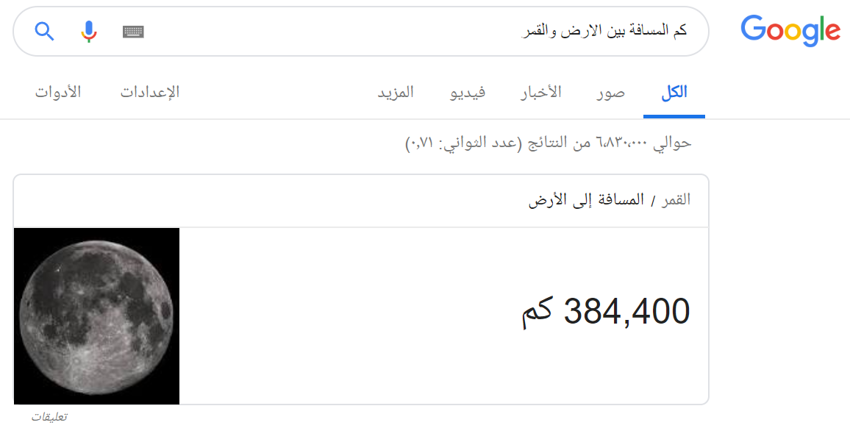

Slide 13
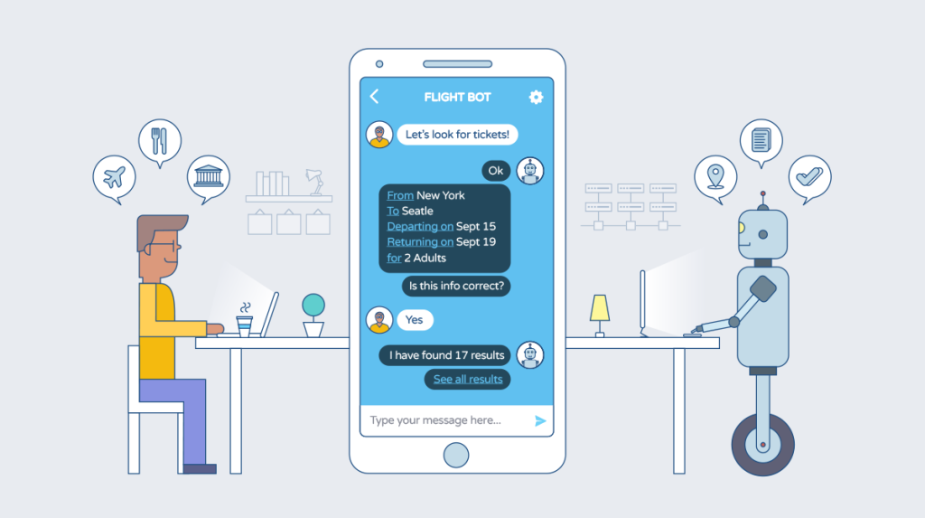
Chatbots (text understanding and generation)
is a computer program which conducts a conversation via auditory or textual methods

Slide 14
NLU / NLG
Seq2seq
LSTM
GRU

Slide 15
Tagging
Example 1: Part-of-speech tagging
Profits/N soared/V at/P Boeing/N Co./N ,/, easily/ADV topping/V forecasts/N on/P Wall/N Street/N ./.
Example 2: Named Entity Recognition
Profits/NA soared/NA at/NA Boeing/SC Co./CC ,/NA easily/NA topping/NA forecasts/NA on/NA Wall/SL Street/CL ./.

Slide 16
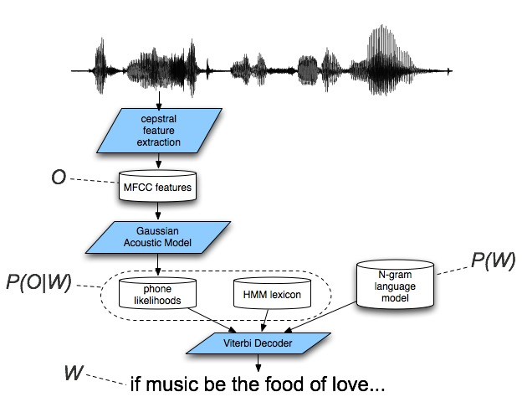
Speech Recognition

Slide 17
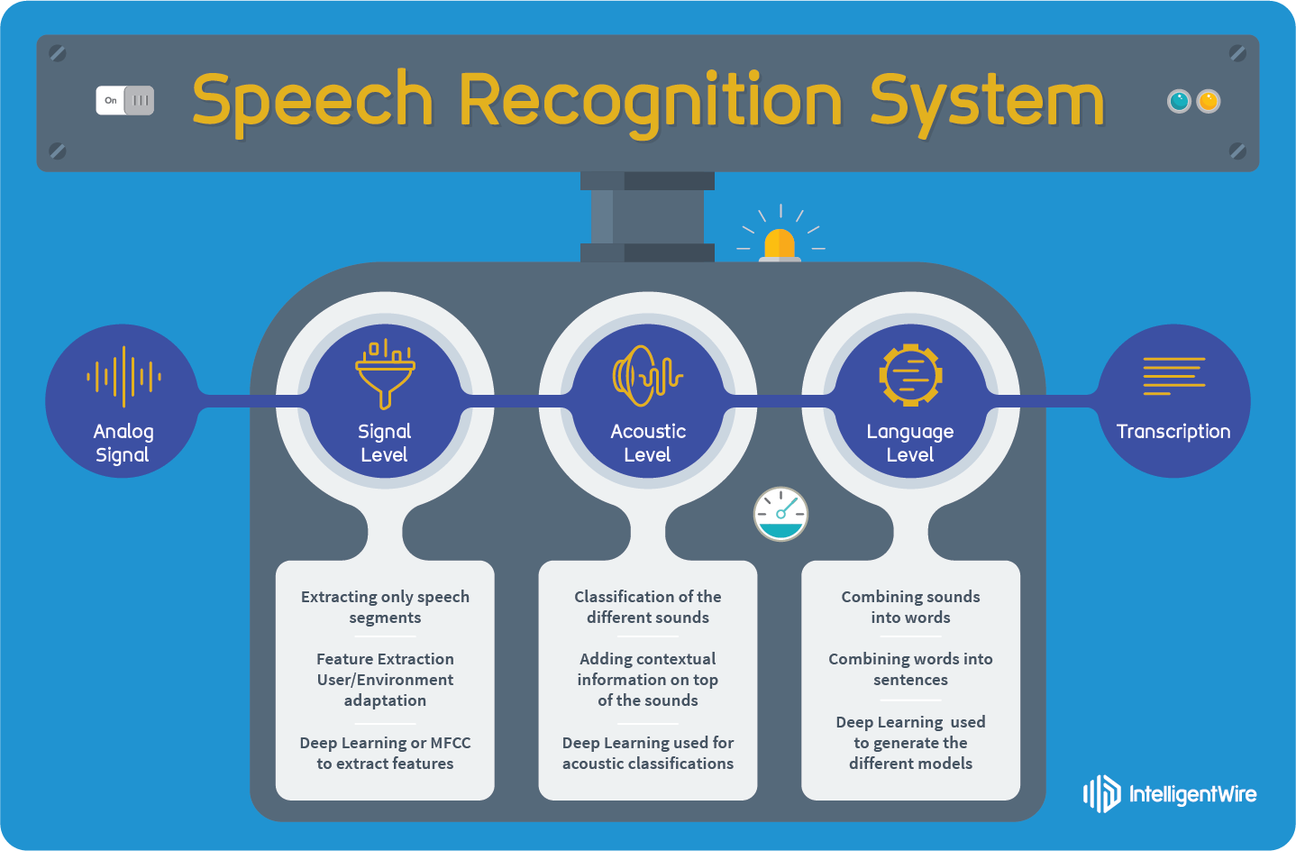
Speech Recognition

Slide 18
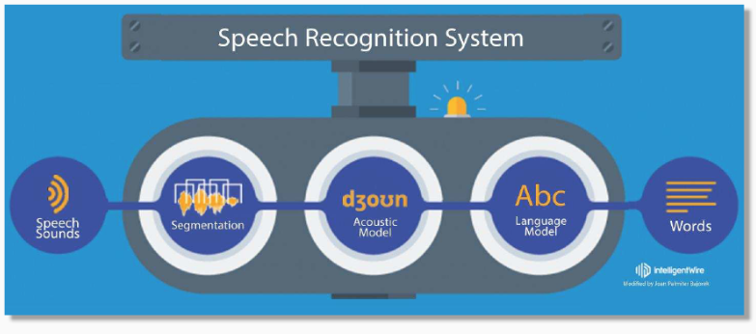
Example

Slide 19

Why is NLP Hard?

Slide 20
Ambiguity
“At last, a computer that understands you like your mother”
1. (*) It understands you as well as your mother understands you
2. It understands (that) you like your mother
3. It understands you as well as it understands your mother
1 and 3: Does this mean well, or poorly?

Slide 21
Ambiguity At the acoustic level (speech recognition)
I’m eight or duck
Eye maid; her duck
I maid her duck
I’m aid her duck
I’m ate her duck
I’m ate or duck

Slide 22
Ambiguity at the semantic (meaning) level
Two definitions of “mother”
I a woman who has given birth to a child
I a stringy slimy substance consisting of yeast cells and bacteria; is added to cider or wine to produce vinegar
This is an instance of word sense ambiguity

Slide 23
More Word Sense Ambiguity semantic (meaning) level
I They put money in the bank = = buried in mud?
I saw her duck with a telescope

Slide 24

Book
Jurafsky and Martin:
Speech and Language Processing
https://web.stanford.edu/~jurafsky/slp3/

Slide 25
NLP Libraries in Python
NLTK (Classical NLP)
Spacy (Classical NLP)
Textblob (Classical NLP)
TensorFlow (Deep learning, supported by Google)
Chainer (Deep learning, is led by Japanese venture company in partnership with IBM, Intel, Microsoft, and Nvidia)
Google tools https://ai.google/tools/
Facebook tools https://ai.facebook.com/tools/

Slide 26
Thanks ☺

