Slide 1
Assembly Language
Lecture 1: Introduction
Motaz K. Saad
Spring 2009

Slide 2
Introduction
Computer Architecture includes the design of:
  Instruction Set Architecture (programmer's view)
  Machine Organization (logic designer’s view).

Slide 3
Computer Design
Programmer’s View | Logic Designer’s View
Instruction Set Design | Machine Organization
Machine Language | Machine Implementations
Computer Interface | Hardware Components
Compiler/System View | Logic Designer’s View

Slide 4
Computer Architecture Design
Application
Software
Operating
System
Compiler
Instruction Set
Architecture
Instr. Set Proc.
I/O system
Datapath & Control
Digital Design
Hardware
Circuit Design

Slide 5
Architectures
  x86 (including Intel IA-32)
  HP/Compaq Alpha AXP
  Sun SPARC
  Sun UltraSPARC
  Motorola 68000
  PowerPC
  PowerPC64
  ARM
  Hitachi SuperH
  IBM S/390 and zSeries
  MIPS
  HP PA-RISC
  Intel IA-64
  AMD x86-64
  H8/300
  V850 and CRIS.

Slide 6
Below Your Program
High-level
language
program in C
void swap(int v[ ], int k)
{
int temp;
temp = v[k];
v[k] = v[k+1];
v[k+1] = temp;
}
swap:
muli $2, $5, 4
add $2, $4, $2
lw $15, 0($2)
lw $16, 4($2)
sw $16, 0($2)
sw $15, 4($2)
jr $31
Compiler
Assembler
Assembly
language
Program
(for MIPS)
00000000101000010000000000011000
00000000100011100001100000100001
10001100011000100000000000000000
10001100111100100000000000000100
10101100111100100000000000000000
10101100011000100000000000000100
00000011111000000000000000001000
Binary
machine
language
program
(for MIPS)

Slide 7
Try it out !
#include <stdio.h>
int main() {
  printf("Hello World!\n");
  return 0;
}
gcc –S file.c
Compile only; do not assemble or link

Slide 8
gcc – S hello.c
.file "cprog.c"
.section .rodata
.LC0:
.string "Hello World!"
.text
.globl main
.type main, @function
main:
leal 4(%esp), %ecx
andl $-16, %esp
pushl -4(%ecx)
pushl %ebp
movl %esp, %ebp
pushl %ecx
subl $4, %esp
movl $.LC0, (%esp)
call puts
movl $0, %eax
addl $4, %esp
popl %ecx
popl %ebp
leal -4(%ecx), %esp
ret
.size main, .-main
.ident "GCC: (GNU) 4.1.0 (SUSE Linux)"
.section .note.GNU-stack,"",@progbits

Slide 9
Trying it out on different architectures!
#include <stdio.h>
void swap(int v[ ], int k);
void print_vector(int v[ ]);
int main(int argc, char *argv[ ])
{
int v[]={1,3,5,7,9,-1};
print_vector(v);
swap(v,2);
print_vector(v);
}
void swap(int v[], int k)
{
int temp;
temp = v[k];
v[k] = v[k+1];
v[k+1] = temp;
}
void print_vector(int v[])
{
int i;
for(i=0 ; v[i]>0 ; i++)
printf("\t%d ",v[i]);
printf("\n");
}

Slide 10
$ gcc -S swap.c
[on a MIPS R12K machine]
swap:
# vars= 8, regs= 2/0, args= 0, extra= 8
.frame $fp,24,$31
.mask 0x50000000,-4
.fmask 0x00000000,0
.set noreorder
.cpload $25
.set reorder
subu $sp,$sp,24
.cprestore 0
sw $fp,20($sp)
sw $28,16($sp)
move $fp,$sp
sw $4,24($fp)
sw $5,28($fp)
lw $2,28($fp)
move $3,$2
sll $2,$3,2
lw $3,24($fp)
addu $2,$2,$3
lw $3,0($2)
sw $3,8($fp)
lw $2,28($fp)
move $3,$2
sll $2,$3,2
lw $3,24($fp)
addu $2,$2,$3
lw $3,28($fp)
move $4,$3
sll $3,$4,2
lw $4,24($fp)
addu $3,$3,$4
addu $4,$3,4 # page 1
lw $3,0($4)
sw $3,0($2)
lw $2,28($fp)
move $3,$2
sll $2,$3,2
lw $3,24($fp)
addu $2,$2,$3
addu $3,$2,4
lw $2,8($fp)
sw $2,0($3) # page 2

Slide 11
$ gcc -O3 -S swap.c
[on a MIPS R12K machine]
swap:
# vars= 0, regs= 0/0, args= 0, extra= 0
.frame $sp,0,$31
.mask 0x00000000,0
.fmask 0x00000000,0
.set noreorder
.cpload $25
.set reorder
sll $5,$5,2
addu $5,$5,$4
lw $2,4($5)
lw $3,0($5)
sw $2,0($5)
.set noreorder
.set nomacro
j $31
sw $3,4($5)
.set macro
.set reorder
.end swap
.rdata
.align 2

Slide 12
$ gcc -S swap.c
[on a Pentium III machine]
swap: pushl %ebp
movl %esp, %ebp
subl $4, %esp
movl 12(%ebp), %eax
imull $4, %eax, %edx
movl 8(%ebp), %eax
movl (%eax,%edx), %eax
movl %eax, -4(%ebp)
movl 12(%ebp), %eax
imull $4, %eax, %ecx
movl 8(%ebp), %edx
movl 12(%ebp), %eax
imull $4, %eax, %eax
addl 8(%ebp), %eax
addl $4, %eax
movl (%eax), %eax
movl %eax, (%edx,%ecx)
movl 12(%ebp), %eax
imull $4, %eax, %eax
addl 8(%ebp), %eax
leal 4(%eax), %edx
movl -4(%ebp), %eax
movl %eax, (%edx)
leave
ret
$ gcc -O3 -S swap.c
[on a Pentium III machine]
swap:
pushl %ebp
movl %esp, %ebp
movl 8(%ebp), %edx
pushl %ebx
movl 12(%ebp), %eax
movl (%edx,%eax,4), %ebx
movl 4(%edx,%eax,4), %ecx
movl %ecx, (%edx,%eax,4)
movl %ebx, 4(%edx,%eax,4)
movl (%esp), %ebx
leave
ret

Slide 13
swap:
.prologue 2, 2
.vframe r2
mov r2 = r12 ;;
.body
st8 [r2] = r32
mov r14 = r2 ;;
adds r14 = 8, r2 ;;
st4 [r14] = r33
mov r14 = r2
adds r16 = 12, r2 ;;
mov r14 = r2 ;;
adds r14 = 8, r2 ;;
ld4 r14 = [r14] ;;
sxt4 r15 = r14
addl r14 = 4, r0 ;;
setf.sig f6 = r15
setf.sig f7 = r14 ;;
xma.l f6 = f6, f7, f0 ;;
getf.sig r15 = f6
ld8 r14 = [r2] ;;
add r14 = r15, r14 ;;
ld4 r14 = [r14] ;;
st4 [r16] = r14
mov r14 = r2 ;;
adds r14 = 8, r2 ;;
ld4 r14 = [r14] ;;
sxt4 r15 = r14
addl r14 = 4, r0 ;;
setf.sig f6 = r15
setf.sig f7 = r14 ;;
xma.l f6 = f6, f7, f0 ;;
getf.sig r15 = f6
ld8 r14 = [r2] ;;
add r16 = r15, r14
mov r14 = r2 ;; #page 1
adds r14 = 8, r2 ;;
$ gcc -S swap.c
[on an Itanium I machine]
ld4 r14 = [r14] ;;
sxt4 r15 = r14
addl r14 = 4, r0 ;;
setf.sig f6 = r15
setf.sig f7 = r14 ;;
xma.l f6 = f6, f7, f0 ;;
getf.sig r15 = f6
ld8 r14 = [r2] ;;
add r14 = r15, r14 ;;
adds r14 = 4, r14 ;;
ld4 r14 = [r14] ;;
st4 [r16] = r14
mov r14 = r2 ;;
adds r14 = 8, r2 ;;
ld4 r14 = [r14] ;;
sxt4 r15 = r14
addl r14 = 4, r0 ;;
setf.sig f6 = r15
setf.sig f7 = r14 ;;
xma.l f6 = f6, f7, f0 ;;
getf.sig r15 = f6
ld8 r14 = [r2] ;;
add r14 = r15, r14 ;;
adds r15 = 4, r14
mov r14 = r2 ;;
adds r14 = 12, r2 ;;
ld4 r14 = [r14] ;;
st4 [r15] = r14
.restore sp
mov r12 = r2
br.ret.sptk.many b0
.endp swap#
.section .rodata
.align 8 # page 2

Slide 14
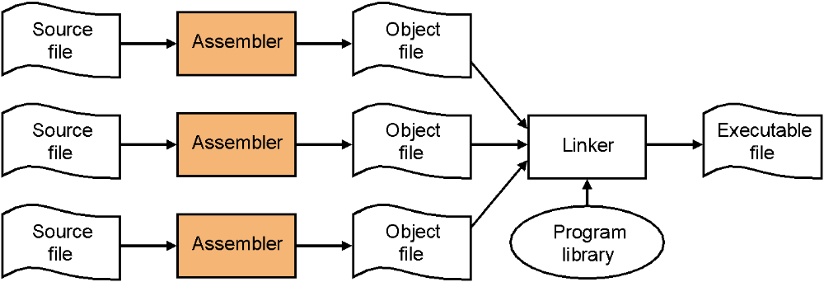
Converting Source into Executable Files

Slide 15
A More Complete Story
Source
file
Assembler
file
Object
file
Program
library
Compiler
Assembler
Source
file
Compiler
Assembler
file
Assembler
Object
file
Linker
Executable
file
Source
file
Compiler
Assembler
file
Assembler
Object
file
Program
library

Slide 16
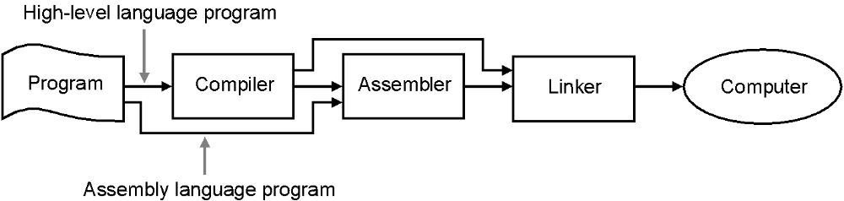
Converting Source into Executable Files

Slide 17
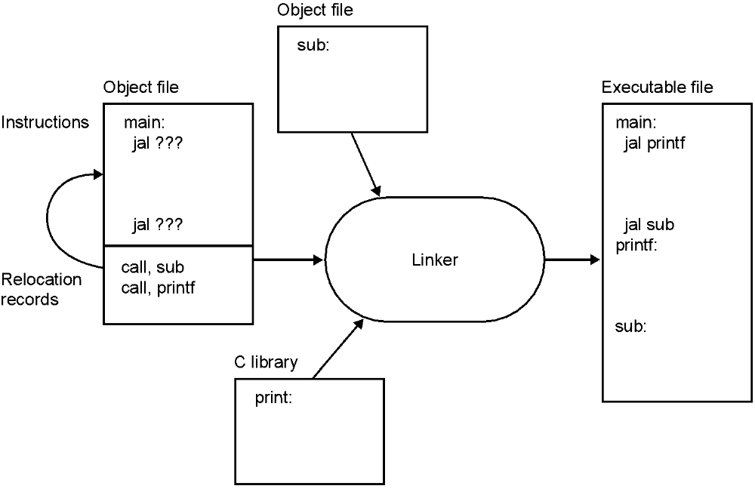
The Linker

Slide 18
When to use Assembly Language?
  When you don’t have the tools to program in higher level:
    New embedded processors
    Compilers that check deadlines for real time system do not exist yet
  When the tools fail:
    Compilers still generate sub-optimal code
  When you are building the tools:
    Compiler designer/builders must know assembly well

Slide 19
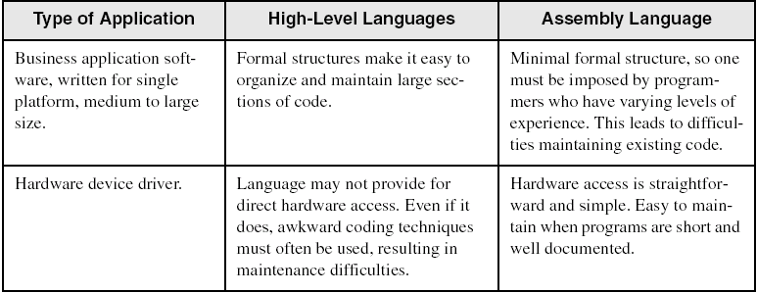
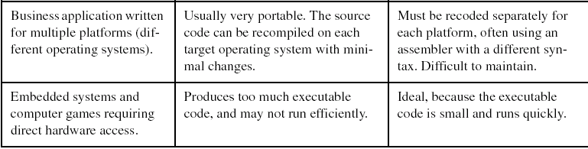
Comparing Assembly Language to High-Level Languages

Slide 20
Specific Machine Levels

