Slide 1
Assembly Language
Lecture 2:
Instruction Addressing and Execution
Motaz K. Saad
Spring 2009

Slide 2
Lesson plan
Review some concepts in the first week
First assembly program with EMU8086
Related concepts with the first program:
  Loading program
  Boot process
  Handling the stack

Slide 3
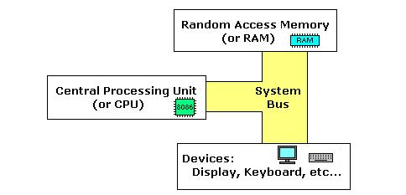
Recalling main concepts

Slide 4
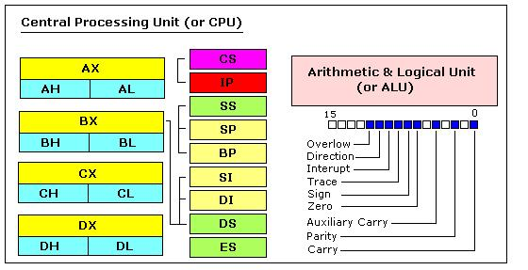
Recalling main concepts

Slide 5
Recalling main concepts
Segment: special areas defined to contain CODE, DATA and STACK
Paragraph boundary: location evenly divisible by 16 or 10H
Stack Segment
SS
DS
Data Segment
CS
Code Segment
Segment
Registers

Slide 6
Types of programs
*.COM and *.EXE files
  *.COM: consists of one segment containing code, data and stack
  *.exe: separate code, data and stack segments
  COM is small, (small utility program or can be a resident program).
  We will focus on EXE program in this course.
Notes:
COM is small, (small utility program or can be a resident program). We will focus on EXE program in this course.

Slide 7
.MODEL SMALL,
.STACK
.DATA
MESSAGE DB "HELLO EVERYBODY! I AM LEARNING ASSEMBLY LANGUAGE!","$"
.CODE
MAIN PROC
MOV AX, @DATA
MOV DS,AX
MOV AH,09
LEA DX,MESSAGE
INT 21H
MOV AX,4C00H
INT 21H
MAIN ENDP
END MAIN
Assembly directive to define memory model to use in the program
Notes:
There are several types of memory: Memory model TINY, SMALL, COMPACT, MEDIUM, LARGE, HUGE, or FLAT. Determines size of code and data pointers. This field is required. The model does, however, control segment defaults and determine whether data and code are near or far by default, as indicated in the following table. The model does not control the type of instructions that we can use.

Slide 8
Memory Model
There are several types of memory: Memory model TINY, SMALL, COMPACT, MEDIUM, LARGE, HUGE, or FLAT.
Determines size of code and data pointers. This field is required.
The model does, however, control segment defaults and determine whether data and code are near or far by default, as indicated in the following table.
The model does not control the type of instructions that we can use.

Slide 9
Real and Protected mode
 | Real Mode | 16-bit Protected Mode | 32-bit Protected Mode
Segment base address | 20-bit | 24-bit | 32-bit
Segment size (limit) | 16-bit, 64K bytes (fixed) | 16-bit, 1-64K bytes | 20-bit, 1-1M bytes or 4K-4G bytes
Segment protection | no | yes | yes

Slide 10
Protected mode
Is a type of memory utilization, available on Intel 80286 and later
Support:
  protection: each program is protected from interference from other programs.
  extended memory : Enables a single program to access more than 640K of memory.
  virtual memory : Expands the address space to over 1GB.
  Multitasking

Slide 11
.model small
.STACK
.DATA
MESSAGE DB "HELLO EVERYBODY! I AM LEARNING ASSEMBLY LANGUAGE!","$"
.CODE
MAIN PROC
MOV AX, @DATA
MOV DS,AX
MOV AH,09
LEA DX,MESSAGE
INT 21H
MOV AX,4C00H
INT 21H
MAIN ENDP
END MAIN
Assembly directive to define stack to use in the program

Slide 12
STACK
The word is from data structure
Last In, First Out (LIFO) mechanism
STACK in OS has three main functions:
  Contains return address
  Data
  Content of present registers
Notes:
Queue

Slide 13
STACK
PUSH
  Decrease SP by 2 and store a value there
POP
  Return a value from stack and increase SP by 2

Slide 14
Lesson plan
Review loading an *.exe file
Concept of execution of instructions
Practice:
  Execution of instructions

Slide 15
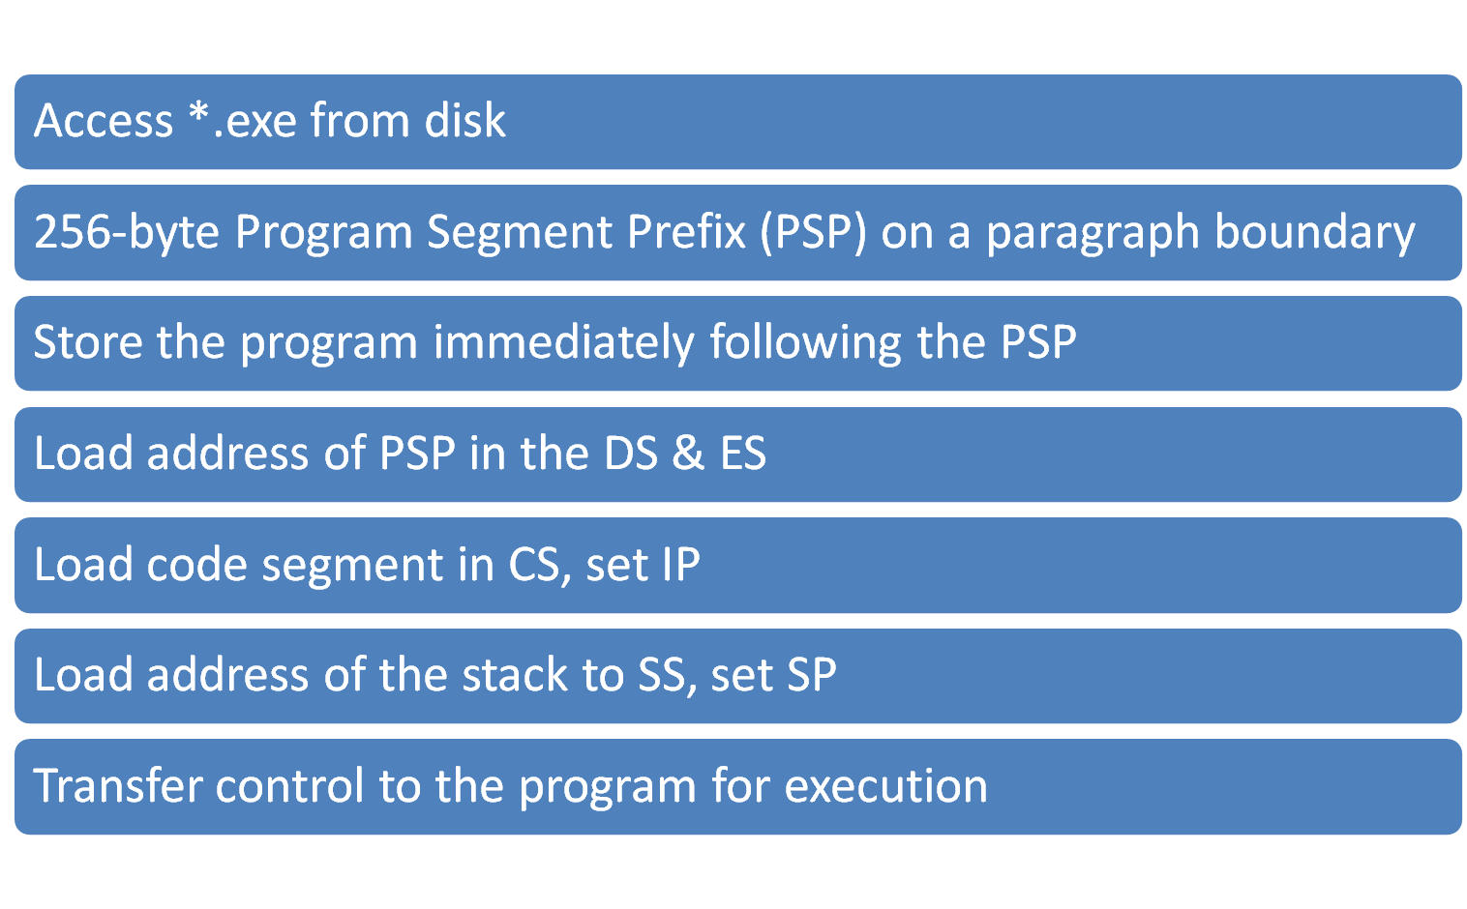
Loading *.exe file

Slide 16
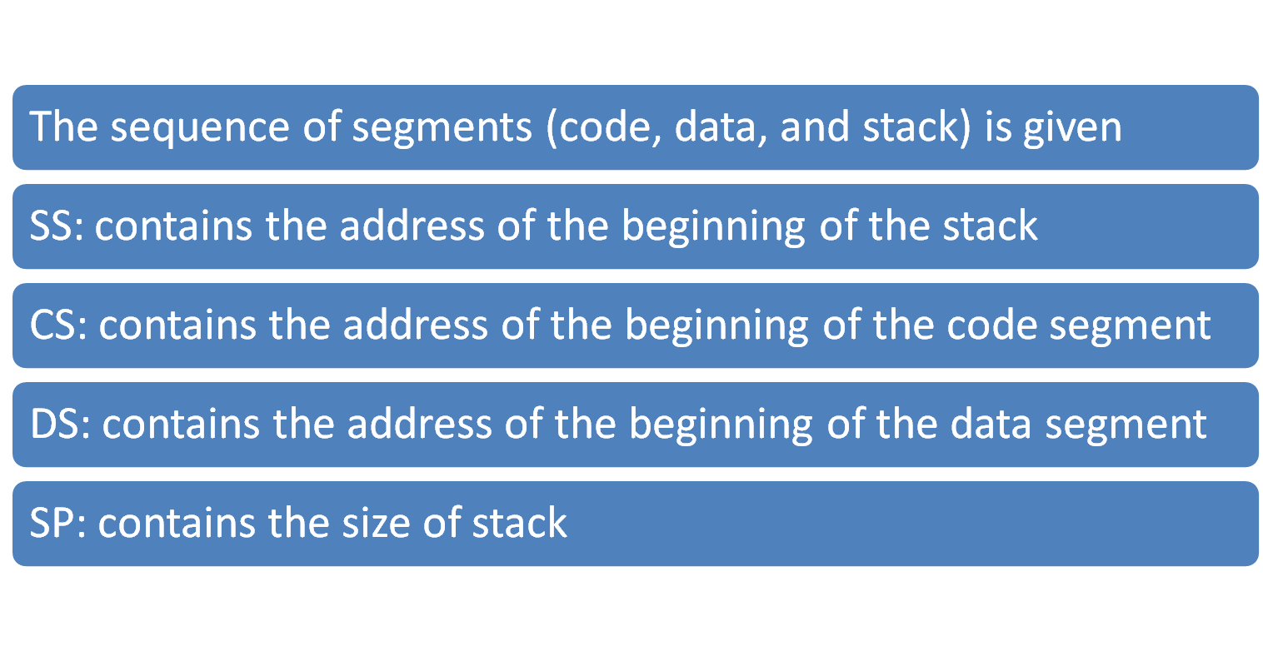
Loading *.exe file

Slide 17
Instruction Execution and Addressing
Executing an instruction include
  Fetch the next instruction, put to a queue (QUEUE: FIFO)
  Decode the instruction
  Execute the instruction

Slide 18
Instruction Execution and Addressing
Instruction address =
Code Segment address (CS) * 10h + Instruction Offset (IP)
Data address =
  Data Segment address (DS) * 10h + Data Offset

Slide 19
26AE
IP
0044
CS
Instruction address = ???????
SI
003F
DS
25BD
Data address=??????

Slide 20
26AE
IP
0044
CS
Instruction address = 26AE0
+ 0044
_______________________
26B24
SI
003F
DS
25BD
Data address = 25BD0
+ 003F
_______________________
25C0F

Slide 21
Example
CS
4AF0
IP
0013
DS
04B1
CS segment address: 4AF00H
IP offset: 0013H
________________________
+
Instruction address:
4AF13H

Slide 22
Example
CS
4AF0
IP
0013
DS
04B1
A01200
Decode instruction:
4AF13H
AO: MOV [0012] to AL
Memory

Slide 23
Example
CS
4AF0
IP
0013
DS
04B1
A01200
DS segment address:04B10H
IP offset: 0012H
________________________
+
04B03H
Data address:
04B22H
Memory

Slide 24
Example
CS
4AF0
IP
0013
DS
04B1
A01200
1B
Data address:
04B22
AX
AX
04B03H
| 1B
AH
AL
04B22H
Memory

Slide 25
Booting process
What is booting?
The process of starting or restarting a computer
warm boot
Process of restarting a computer that is already powered on
Also called a warm start
cold boot
Process of turning on a computer after it has been powered off completely
Notes:
Interest part: father of Ctrl-Alt-Del: david Bradley, long time employee of IBM, who also has a Ph.D in EE from Purdue in Indiana

Slide 26
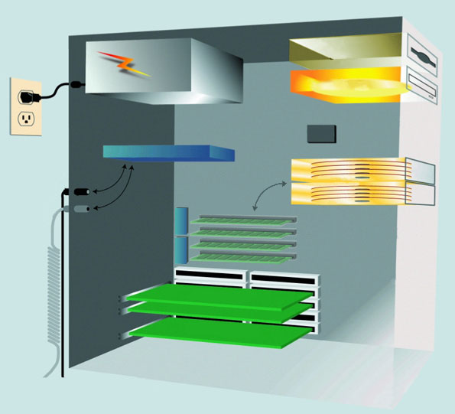
Booting process
How does a personal computer boot up?
floppy disk drive
CD-ROM drive
CMOS
processor
hard disk
(RAM) memory modules
BIOS
Step 6
expansion cards
Notes:
How does a personal computer boot up?
Step 1: The power supply sends a signal to components in the system unit.
Step 2: The processor looks for the BIOS (Basic Input/Output system)
Step 3: The BIOS performs the POST, which checks components such as the mouse, keyboard connectors, and expansion cards. (Power On Self Test)
Step 4: The results of the POST are compared with data in the CMOS chip. (battery power)
Step 5: The BIOS looks for the system files in drive A (floppy disk drive) and then drive C (hard disk).
Step 6: The boot program loads the kernel of the operating system into RAM from storage (hard disk).
The operating system in memory takes control of the computer.
Step 7: The operating system loads configuration information and displays the desktop on the screen.
The operating system executes programs in the StartUp folder
Registry - Several files that contain the system configuration information
Registry is constantly accessed during the computer's operation
StartUp folder - Contains a list of programs that open automatically when you boot the computer

Slide 27
How does a personal computer boot up?
Step 1: The power supply sends a signal to components in the system unit.
Step 2: The processor looks for the BIOS (Basic Input/Output system)

Slide 28
How does a personal computer boot up?
Step 3: The BIOS performs the POST, which checks components such as the mouse, keyboard connectors, and expansion cards. (Power On Self Test)
Step 4: The results of the POST are compared with data in the CMOS chip. (battery power)
Step 5: The BIOS looks for the system files in drive A (floppy disk drive) and then drive C (hard disk).

Slide 29
How does a personal computer boot up?
Step 6: The boot program loads the kernel of the operating system into RAM from storage (hard disk).
  The operating system in memory takes control of the computer.
Step 7: The operating system loads configuration information and displays the desktop on the screen.

Slide 30
How does a personal computer boot up?
The operating system executes programs in the StartUp folder
  Registry - Several files that contain the system configuration information
    Registry is constantly accessed during the computer's operation
  StartUp folder - Contains a list of programs that open automatically when you boot the computer

Slide 31
BIOS Boot process
FFFF0H
BIOS routine
Check ports
Initialize
devices
Interrupt
Vector
Table
BIOS Data
Areas
Access
the bootstrap
loader
Notes:
Internally, processor enters the reset state, clear all memory location to zero, perform a parity check of a memory, set CS to FFFFH, IP to zero. The first address to execute is FFFF0H (entry point of BIOS in ROM)
Identify & Initialized devices.
Established the tables: IVT (Interrupt Vector Table) and BIOS data area (status of attached devices)
-Determine if the disk containing the system file is available.

Slide 32
BIOS Boot process
Internally, processor enters the reset state, clear all memory location to zero, perform a parity check of a memory, set CS to FFFFH, IP to zero. The first address to execute is FFFF0H (entry point of BIOS in ROM)
Identify & Initialized devices.
Established the tables: IVT (Interrupt Vector Table) and BIOS data area (status of attached devices)
Determine if the disk containing the system file is available.

