Slide 1
Assembly Language
Lecture 5:
Conditional Processing and Flow Control
Motaz K. Saad
Spring 2009

Slide 2
Overview
Boolean and Comparison Instructions
Conditional Jumps
Conditional Loop Instructions
Conditional Structures
Application: Finite-State Machines
Decision Directives

Slide 3
Status Flags - Review
The Zero flag is set when the result of an operation equals zero.
The Carry flag is set when an instruction generates a result that is too large for the destination operand.
The Sign flag is set if the destination operand is negative, and it is clear if the destination operand is positive.
The Overflow flag is set when an instruction generates an invalid signed result.

Slide 4


AND Instruction
Performs a Boolean AND operation between each pair of matching bits in two operands
Syntax:
    AND destination, source
  (same operand types as MOV)
AND

Slide 5


OR Instruction
Performs a Boolean OR operation between each pair of matching bits in two operands
Syntax:
    OR destination, source
OR

Slide 6

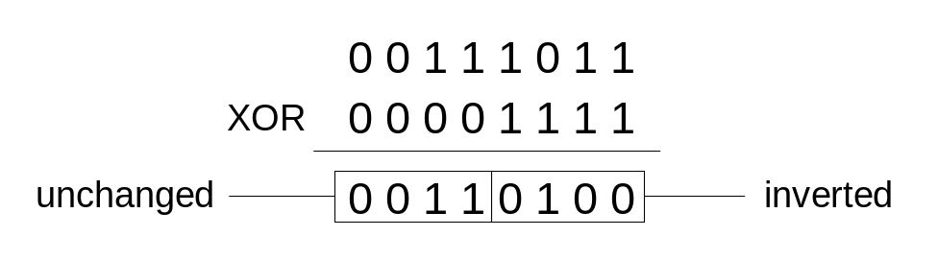
XOR Instruction
Performs a Boolean exclusive-OR operation between each pair of matching bits in two operands
Syntax:
    XOR destination, source
XOR
XOR is a useful way to toggle (invert) the bits in an operand.

Slide 7

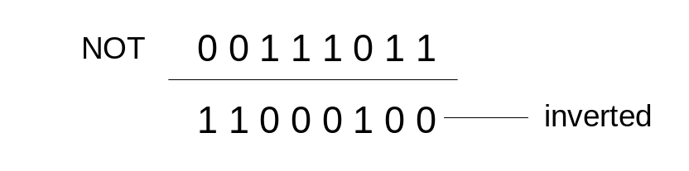
NOT Instruction
Performs a Boolean NOT operation on a single destination operand
Syntax:
    NOT destination
NOT

Slide 8
TEST Instruction
Performs a nondestructive AND operation between each pair of matching bits in two operands
No operands are modified, but the Zero flag is affected.
Example: jump to a label if either bit 0 or bit 1 in AL is set.
test al,00000011b
jnz ValueFound
Example: jump to a label if neither bit 0 nor bit 1 in AL is set.
test al,00000011b
jz ValueNotFound

Slide 9
CMP Instruction (1 of 3)
Compares the destination operand to the source operand
  Nondestructive subtraction of source from destination (destination operand is not changed)
Syntax: CMP destination, source
Example: destination == source
mov al,5
cmp al,5 ; Zero flag set
Example: destination < source
mov al,4
cmp al,5 ; Carry flag set

Slide 10
CMP Instruction (2 of 3)
Example: destination > source
mov al,6
cmp al,5 ; ZF = 0, CF = 0
(both the Zero and Carry flags are clear)

Slide 11
CMP Instruction (3 of 3)
The comparisons shown here are performed with signed integers.
Example: destination > source
mov al,5
cmp al,-2 ; Sign flag == Overflow flag
Example: destination < source
mov al,-1
cmp al,5 ; Sign flag != Overflow flag

Slide 12
Conditional Jumps
Jumps Based On . . .
  Specific flags
  Equality
  Unsigned comparisons
  Signed Comparisons
Applications

Slide 13
Jcond Instruction
A conditional jump instruction branches to a label when specific register or flag conditions are met
Examples:
  JB, JC jump to a label if the Carry flag is set
  JE, JZ jump to a label if the Zero flag is set
  JS jumps to a label if the Sign flag is set
  JNE, JNZ jump to a label if the Zero flag is clear
  JcxZ jumps to a label if cx equals 0

Slide 14
Jcond Ranges
Prior to the 386:
  jump must be within –128 to +127 bytes from current location counter
IA-32 processors:
  32-bit offset permits jump anywhere in memory

Slide 15
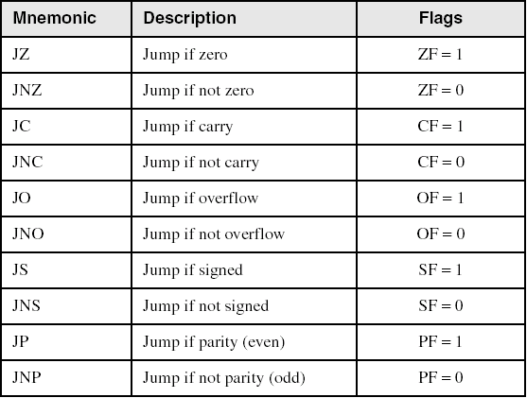
Jumps Based on Specific Flags

Slide 16
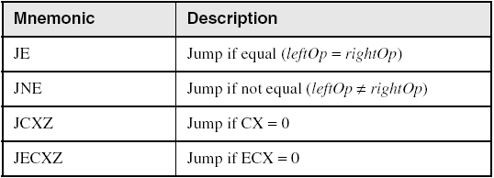
Jumps Based on Equality

Slide 17
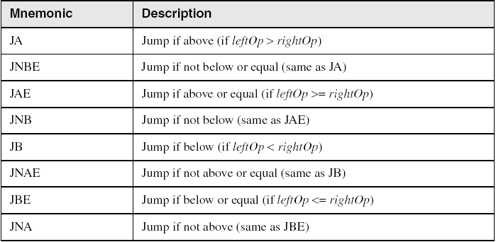
Jumps Based on Unsigned Comparisons

Slide 18
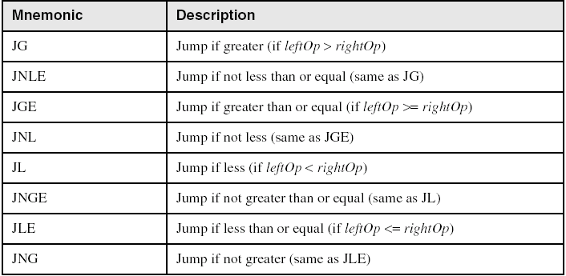
Jumps Based on Signed Comparisons

Slide 19
Conditional Structures
Block-Structured IF Statements
Compound Expressions with AND
Compound Expressions with OR
WHILE Loops
Switch Selection

Slide 20
Your turn . . .
Implement the following pseudo code in assembly language. All values are unsigned:
If( bx <= cx )
{
ax = 5;
dx = 6;
}
  Cmp bx,cx
  ja next
  Mov ax,5
  Mov dx,6
next:

Slide 21
Block-Structured IF Statements
Assembly language programmers can easily translate logical statements written in C++/Java into assembly language. For example:
if( op1 == op2 )
X = 1;
else
X = 2;
  mov ax,op1
  cmp ax,op2
  jne L1
  mov X,1
  jmp L2
L1: mov X,2
L2:

Slide 22
Your turn . . .
Implement the following pseudo code in assembly language
if( var1 <= var2 )
var3 = 10;
else
{
var3 = 6;
var4 = 7;
}
  mov ax,var1
  cmp ax,var2
  jle L1
  mov var3,6
  mov var4,7
  jmp L2
L1: mov var3,10
L2:

Slide 23
Compound Expression with AND (1 of 3)
When implementing the logical AND operator, consider that HLLs use short-circuit evaluation
In the following example, if the first expression is false, the second expression is skipped:
if (al > bl) AND (bl > cl)
X = 1;

Slide 24
Compound Expression with AND (2 of 3)
if (al > bl) AND (bl > cl)
X = 1;
This is one possible implementation . . .
cmp al,bl ; first expression...
ja L1
jmp next
L1:
cmp bl,cl ; second expression...
ja L2
jmp next
L2: ; both are true
mov X,1 ; set X to 1
next:

Slide 25
Compound Expression with AND (3 of 3)
if (al > bl) AND (bl > cl)
X = 1;
But the following implementation uses 29% less code by reversing the first relational operator. We allow the program to "fall through" to the second expression:
cmp al,bl ; first expression...
jbe next ; quit if false
cmp bl,cl ; second expression...
jbe next ; quit if false
mov X,1 ; both are true
next:

Slide 26
Your turn . . .
Implement the following pseudo code in assembly language. All values are unsigned:
if( bx <= cx
&& cx > dx )
{
ax = 5;
dx = 6;
}
  cmp bx,cx
  ja next
  cmp cx,dx
  jbe next
  mov ax,5
  mov dx,6
next:

Slide 27
Compound Expression with OR (1 of 2)
When implementing the logical OR operator, consider that HLLs use short-circuit evaluation
In the following example, if the first expression is true, the second expression is skipped:
if (al > bl) OR (bl > cl)
X = 1;

Slide 28
Compound Expression with OR (1 of 2)
if (al > bl) OR (bl > cl)
X = 1;
We can use "fall-through" logic to keep the code as short as possible:
cmp al,bl ; is AL > BL?
ja L1 ; yes
cmp bl,cl ; no: is BL > CL?
jbe next ; no: skip next statement
L1: mov X,1 ; set X to 1
next:

Slide 29
Switch Selection
CMP BL, 30H ; compare input digit and 0
JL @NEGATIVE ; jump to label @NEGATIVE if digit<0
JZ @ZERO ; jump to label @ZERO if digit=0
JG @POSITIVE ; jump to label @POSITIVE if digit>0
@NEGATIVE: ; jump label
MOV DL, 'N‘
JMP @DISPLAY ; jump to label @DISPLAY
@ZERO: ; jump label
MOV DL, 'Z‘
JMP @DISPLAY ; jump to label @DISPLAY
@POSITIVE: ; jump label
MOV DL, 'P‘
JMP @DISPLAY ; jump to label @DISPLAY
@DISPLAY: ; jump label
MOV AH, 2 ; print the character
INT 21H

Slide 30
WHILE Loops
A WHILE loop is really an IF statement followed by the body of the loop, followed by an unconditional jump to the top of the loop. Consider the following example:
while( ax < bx)
ax = ax + 1;
This is a possible implementation:
top: cmp ax,bx ; check loop condition
jae next ; false? exit loop
inc ax ; body of loop
jmp top ; repeat the loop
next:

Slide 31
Your turn . . .
Implement the following loop
while( bx <= val1)
{
bx = bx + 5;
val1 = val1 - 1
}
top: cmp bx,val1 ; check loop condition
ja next ; false? exit loop
add bx,5 ; body of loop
dec val1
jmp top ; repeat the loop
next:

Slide 32
Decision Directive
Using the .IF Directive
Runtime Expressions
Relational and Logical Operators
MASM-Generated Code
.REPEAT Directive
.WHILE Directive

Slide 33
Runtime Expressions
.IF, .ELSE, .ELSEIF, and .ENDIF can be used to evaluate runtime expressions and create block-structured IF statements.
Examples:
.IF ax > bx
mov dx,1
.ELSE
mov dx,2
.ENDIF
.IF ax > bx && ax > cx
mov dx,1
.ELSE
mov dx,2
.ENDIF
MASM generates "hidden" code for you, consisting of code labels, CMP and conditional jump instructions.

Slide 34
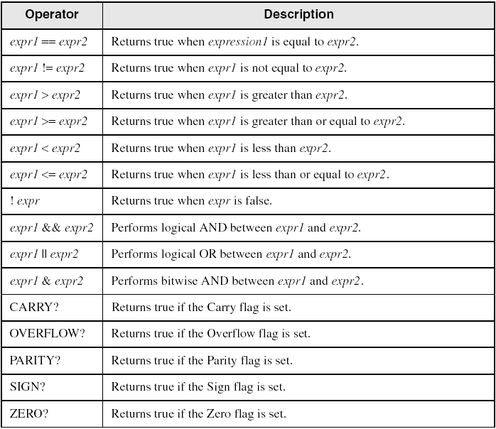
Relational and Logical Operators

Slide 35
MASM-Generated Code
.data
val1 DWORD 5
result DWORD ?
.code
mov ax,6
.IF ax > val1
mov result,1
.ENDIF
Generated code:
mov ax,6
cmp ax,val1
jbe @C0001
mov result,1
@C0001:
MASM automatically generates an unsigned jump (JBE) because val1 is unsigned.

Slide 36
MASM-Generated Code
.data
val1 SDWORD 5
result SDWORD ?
.code
mov ax,6
.IF ax > val1
mov result,1
.ENDIF
Generated code:
mov ax,6
cmp ax,val1
jle @C0001
mov result,1
@C0001:
MASM automatically generates a signed jump (JLE) because val1 is signed.

Slide 37
MASM-Generated Code
.data
result DWORD ?
.code
mov bx,5
mov ax,6
.IF ax > bx
mov result,1
.ENDIF
Generated code:
mov bx,5
mov ax,6
cmp ax,bx
jbe @C0001
mov result,1
@C0001:
MASM automatically generates an unsigned jump (JBE) when both operands are registers . . .

Slide 38
MASM-Generated Code
.data
result SDWORD ?
.code
mov bx,5
mov ax,6
.IF SDWORD PTR ax > bx
mov result,1
.ENDIF
Generated code:
mov bx,5
mov ax,6
cmp ax,bx
jle @C0001
mov result,1
@C0001:
. . . unless you prefix one of the register operands with the SDWORD PTR operator. Then a signed jump is generated.

Slide 39
.REPEAT Directive
Executes the loop body before testing the loop condition associated with the .UNTIL directive.
Example:
; Display integers 1 – 10:
mov ax,0
.REPEAT
inc ax
call WriteDec
call Crlf
.UNTIL ax == 10

Slide 40
.WHILE Directive
Tests the loop condition before executing the loop body The .ENDW directive marks the end of the loop.
Example:
; Display integers 1 – 10:
mov ax,0
.WHILE ax < 10
inc ax
call WriteDec
call Crlf
.ENDW

