Slide 1
Assembly Language
Lecture 6:
32 Bit Assembly Programming
Motaz K. Saad
Spring 2009

Slide 2
IA-32 Processor Architecture
Modes of operation
Basic execution environment
Floating-point unit
Intel Microprocessor history

Slide 3
Modes of Operation
Protected mode
  native mode (Windows, Linux)
Real-address mode
  native MS-DOS
Virtual-8086 mode
  hybrid of Protected
  each program has its own 8086 computer

Slide 4
Basic Execution Environment
Addressable memory
General-purpose registers
Index and base registers
Specialized register uses
Status flags
Floating-point, MMX, XMM registers

Slide 5
Addressable Memory
Protected mode
  4 GB
  32-bit address
Real-address and Virtual-8086 modes
  1 MB space
  20-bit address

Slide 6

General-Purpose Registers
Named storage locations inside the CPU, optimized for speed.

Slide 7


Accessing Parts of Registers
Use 8-bit name, 16-bit name, or 32-bit name
Applies to EAX, EBX, ECX, and EDX

Slide 8

Index and Base Registers
Some registers have only a 16-bit name for their lower half:

Slide 9
Some Specialized Register Uses (1 of 2)
General-Purpose
  EAX – accumulator
  ECX – loop counter
  ESP – stack pointer
  ESI, EDI – index registers
  EBP – extended frame pointer (stack)
Segment
  CS – code segment
  DS – data segment
  SS – stack segment
  ES, FS, GS - additional segments

Slide 10
Some Specialized Register Uses (2 of 2)
EIP – instruction pointer
EFLAGS
  status and control flags
  each flag is a single binary bit

Slide 11

Floating-Point, MMX, XMM Registers
Eight 80-bit floating-point data registers
  ST(0), ST(1), . . . , ST(7)
  arranged in a stack
  used for all floating-point arithmetic
Eight 64-bit MMX registers
Eight 128-bit XMM registers for single-instruction multiple-data (SIMD) operations

Slide 12
Floating-Point Binary Representation
IEEE Floating-Point Binary Reals
The Exponent
Normalized Binary Floating-Point Numbers
Creating the IEEE Representation
Converting Decimal Fractions to Binary Reals

Slide 13
IEEE Floating-Point Binary Reals
Types
  Single Precision
    32 bits: 1 bit for the sign, 8 bits for the exponent, and 23 bits for the fractional part of the significand.
  Double Precision
    64 bits: 1 bit for the sign, 11 bits for the exponent, and 52 bits for the fractional part of the significand.
  Double Extended Precision
    80 bits: 1 bit for the sign, 16 bits for the exponent, and 63 bits for the fractional part of the significand.

Slide 14
Single-Precision Format
Approximate normalized range: 2–¹²⁶ to 2¹²⁷.
Also called a short real.

Slide 15
Components of a Single-Precision Real
Sign
  1 = negative, 0 = positive
Significand
  decimal digits to the left & right of decimal point
  weighted positional notation
  Example:
    123.154 = (1 x 10²) + (2 x 10¹) + (3 x 10⁰) + (1 x 10^{–1})
    + (5 x 10^{–2}) + (4 x 10^{–3})
Exponent
  unsigned integer
  integer bias (127 for single precision)

Slide 16
Intel Microprocessor History
Intel 8086, 80286
IA-32 processor family
P6 processor family
CISC and RISC

Slide 17
Early Intel Microprocessors
Intel 8080
  64K addressable RAM
  8-bit registers
  CP/M operating system
  S-100 BUS architecture
  8-inch floppy disks!
Intel 8086/8088
  IBM-PC Used 8088
  1 MB addressable RAM
  16-bit registers
  16-bit data bus (8-bit for 8088)
  separate floating-point unit (8087)

Slide 18
The IBM-AT
Intel 80286
  16 MB addressable RAM
  Protected memory
  several times faster than 8086
  introduced IDE bus architecture
  80287 floating point unit

Slide 19
Intel IA-32 Family
Intel386
  4 GB addressable RAM, 32-bit registers, paging (virtual memory)
Intel486
  instruction pipelining
Pentium
  superscalar, 32-bit address bus, 64-bit internal data path

Slide 20
Intel P6 Family
Pentium Pro
  advanced optimization techniques in microcode
Pentium II
  MMX (multimedia) instruction set
Pentium III
  SIMD (streaming extensions) instructions
Pentium 4 and Xeon
  Intel NetBurst micro-architecture, tuned for multimedia

Slide 21
CISC and RISC
CISC – complex instruction set
  large instruction set
  high-level operations
  requires microcode interpreter
  examples: Intel 80x86 family
RISC – reduced instruction set
  simple, atomic instructions
  small instruction set
  directly executed by hardware
  examples:
    ARM (Advanced RISC Machines)
    DEC Alpha (now Compaq)

Slide 22
Components of an IA-32 Microcomputer
Motherboard
Video output
Memory
Input-output ports

Slide 23
Motherboard
CPU socket
External cache memory slots
Main memory slots
BIOS chips
Sound synthesizer chip (optional)
Video controller chip (optional)
IDE, parallel, serial, USB, video, keyboard, joystick, network, and mouse connectors
PCI bus connectors (expansion cards)

Slide 24
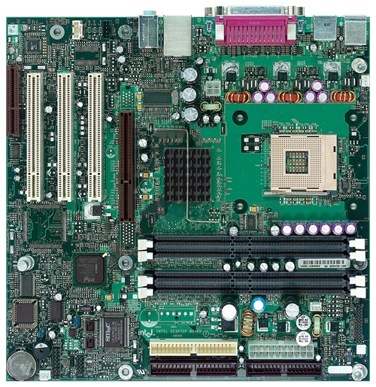
Intel D850MD Motherboard
mouse, keyboard, parallel, serial, and USB connectors
Video
Audio chip
PCI slots
memory controller hub
Pentium 4 socket
AGP slot
dynamic RAM
Firmware hub
I/O Controller
Speaker
Power connector
Battery
Diskette connector
IDE drive connectors
Source: Intel® Desktop Board D850MD/D850MV Technical Product Specification

Slide 25
Memory
ROM
  read-only memory
EPROM
  erasable programmable read-only memory
Dynamic RAM (DRAM)
  inexpensive; must be refreshed constantly
Static RAM (SRAM)
  expensive; used for cache memory; no refresh required
Video RAM (VRAM)
  dual ported; optimized for constant video refresh
CMOS RAM
  complimentary metal-oxide semiconductor
  system setup information

Slide 26
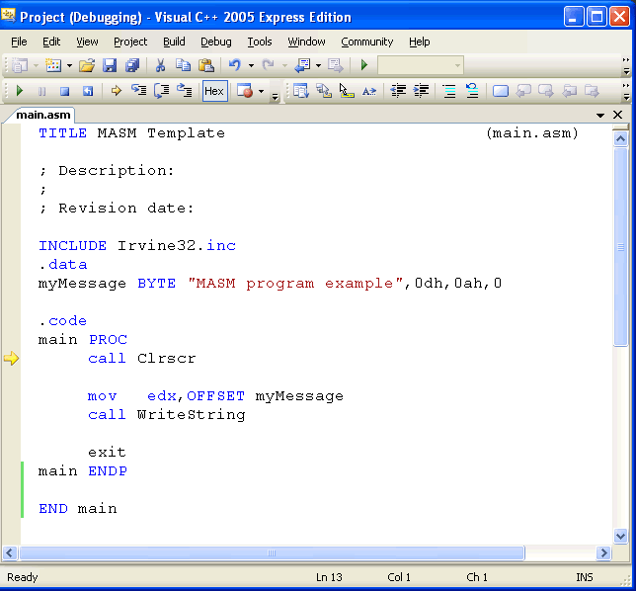
Required steps for 32 bit assembly programming
Visual C++ .NET
  Steps at http://kipirvine.com/asm/gettingStarted

Slide 27
Required steps for 32 bit assembly programming
MASM32
  Steps at http://www.masm32.com

