Slide 1


An Introduction to Machine Translation
Anoop Kunchukuttan
Microsoft AI and Research
Center for Indian Language Technology
Indian Institute of Technology Bombay
Ninth IIIT-H Advanced Summer School on NLP, 27th June 2018

Slide 2
Agenda
What is Machine Translation & why is it interesting?
Machine Translation Paradigms
Word Alignment
Phrase-based SMT
Extensions to Phrase-based SMT
Addressing Word-order Divergence
Addressing Morphological Divergence
Handling Named Entities
Syntax-based SMT
Machine Translation Evaluation
Summary
Statistical Machine Translation

Slide 3
Agenda
What is Machine Translation & why is it interesting?
Machine Translation Paradigms
Word Alignment
Phrase-based SMT
Extensions to Phrase-based SMT
Addressing Word-order Divergence
Addressing Morphological Divergence
Handling Named Entities
Syntax-based SMT
Machine Translation Evaluation
Summary

Slide 4




What is Machine Translation?
Automatic conversion of text/speech from one natural language to another
Be the change you want to see in the world
वह परिवर्तन बनो जो संसार में देखना चाहते हो

Slide 5
Machine Translation Usecases
Government
Administrative requirements
Education
Security
Enterprise
Product manuals
Customer support
Social
Travel (signboards, food)
Entertainment (books, movies, videos)
Translation under the hood
Cross-lingual Search
Cross-lingual Summarization
Building multilingual dictionaries
Any multilingual NLP system will involve some kind of machine translation at some level

Slide 6
Why should you study Machine Translation?
One of the most challenging problems in Natural Language Processing
Pushes the boundaries of NLP
Involves analysis as well as synthesis
Involves all layers of NLP: morphology, syntax, semantics, pragmatics, discourse
Theory and techniques in MT are applicable to a wide range of other problems like transliteration, speech recognition and synthesis

Slide 7
Why is Machine Translation interesting?
Language Divergence ➔ the great diversity among languages of the world
The central problem of MT is to bridge this language divergence

Slide 8
Language Divergence
Word order: SOV (Hindi), SVO (English), VSO, OSV
E: Germany won the last World Cup
H: जर्मनी ने पिछला विश्व कप जीता था
Free (Hindi) vs rigid (English) word order
पिछला विश्व कप जर्मनी ने जीता था (correct)
The last World Cup Germany won (grammatically incorrect)
The last World Cup won Germany (meaning changes)
S
V
O
S
O
V

Slide 9
Language Divergence
Analytic vs Polysynthetic languages
Analytic (Chinese) → very few morphemes per word, no inflections
Polysynthetic (Finnish)→ many morphemes per word, no inflections
English: Even if it does not rain
Malayalam: മഴ പെയ്യുതിലെങ്ങിലും
(rain_noun shower_verb+not+even_if+then_also)
Inflectional systems [infixing (Arabic), fusional (Hindi), agglutinative (Marathi)]
Arabic
k-t-b: root word
katabtu: I wrote
kattabtu: I had (something) written
kitaab: book
kotub: books
Hindi
Jaaunga (1st per, singular, masculine)
Jaaoge (2nd per)
Jaayega (3rd per, singular, masculine)
Jaayenge (3rd per, plural)
Marathi
कपाटावरील: कपाट + वर + ईल
(the one over the cupboard)
दारावरील: दार + वर + ईल
(the one over the door)
दारामागील: दार + मागे + ईल
(the one behind the door)

Slide 10
Language Divergence
Different ways of expressing same concept
water → पानी, जल, नीर
Language registers
Formal: आप बैठिये Informal: तू बैठ
Standard : मुझे डोसा चाहिए Dakhini: मेरे को डोसा होना

Slide 11
Language Divergence
Case marking systems
Categorical divergence
Null Subject Divergence
Pleonastic Divergence
… and much more

Slide 12
Why is Machine Translation difficult?
Ambiguity
Same word, multiple meanings: मंत्री (minister or chess piece)
Same meaning, multiple words: जल, पानी, नीर (water)
Word Order
Underlying deeper syntactic structure
Phrase structure grammar?
Computationally intensive
Morphological Richness
Identifying basic units of words

Slide 13
Agenda
What is Machine Translation & why is it interesting?
Machine Translation Paradigms
Word Alignment
Phrase-based SMT
Extensions to Phrase-based SMT
Addressing Word-order Divergence
Addressing Morphological Divergence
Handling Named Entities
Syntax-based SMT
Machine Translation Evaluation
Summary

Slide 14
Approaches to build MT systems
Knowledge based, Rule-based MT
Data-driven, Machine Learning based MT
Transfer-based
Interlingua based
Example-based
Statistical
Neural

Slide 15
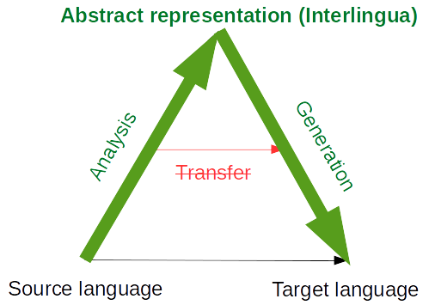
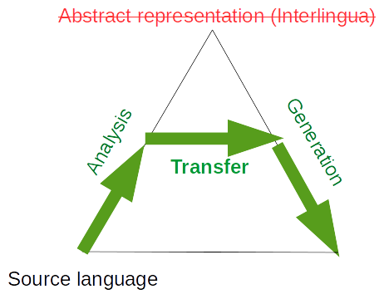
Rule-based MT
Rules are written by linguistic experts to analyze the source, generate an intermediate representation, and generate the target sentence
Depending on the depth of analysis: interlingua or transfer-based MT
Interlingua based MT
Transfer based MT
Deep analysis, complete disambiguation and language independent representation
Partial analysis, partial disambiguation and a bridge intermediate representation

Slide 16
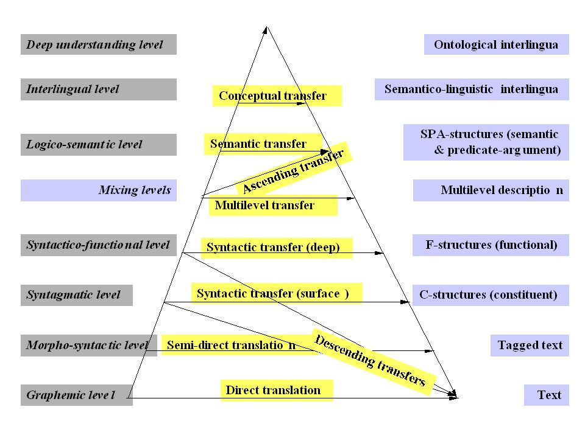
Vauquois Triangle
Translation approaches can be classified by the depth of linguistic analysis they perform

Slide 17
Problems with rule-based MT
Required linguistic expertise to develop systems
Maintenance of system is difficult
Difficult to handle ambiguity
Scaling to a large number of language pairs is not easy

Slide 18
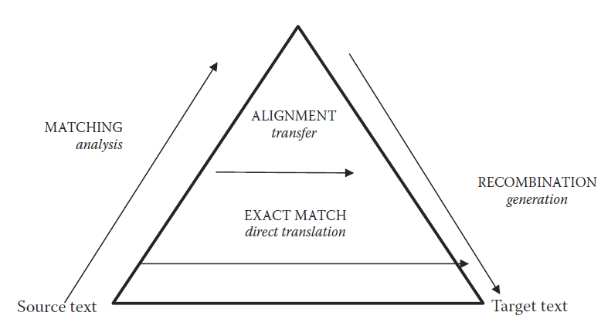
Example-based MT
Translation by analogy ⇒ match parts of sentences to known translations and then combine
Input: He buys a book on international politics
Phrase fragment matching: (data-driven)
he buys
a book
international politics
Translation of segments: (data-driven)
वह खरीदता है
एक किताब
अंतर राष्ट्रीय राजनीति
Recombination: (human crafted rules/templates)
वह अंतर राष्ट्रीय राजनीति पर एक किताब खरीदता है
Partly rule-based, partly data-driven.
Good methods for matching and large corpora did not exist when proposed

Slide 19
Approaches to build MT systems
Knowledge based, Rule-based MT
Data-driven, Machine Learning based MT
Tomorrow!
Transfer-based
Interlingua based
Example-based
Statistical
Neural

Slide 20
Statistical Machine Translation
A Probabilistic Formalism

Slide 21

Let’s formalize the translation process
We will model translation using a probabilistic model. Why?
We would like to have a measure of confidence for the translations we learn
We would like to model uncertainty in translation
E: target language e: source language sentence
F: source language f : target language sentence
How do we model this quantity?
Best translation
Model: a simplified and idealized understanding of a physical process
We must first explain the process of translation

Slide 22
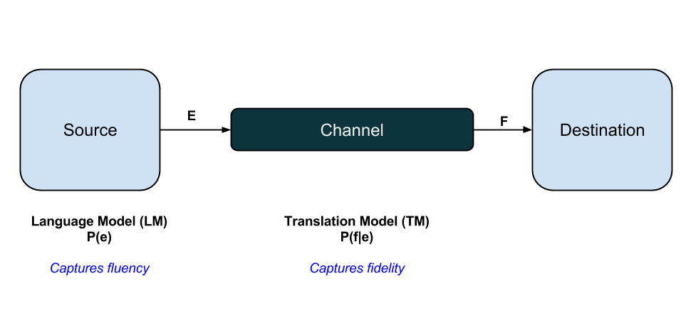

A very general framework for many NLP problems
We explain translation using the Noisy Channel Model
Generate target sentence
Channel corrupts the target
Source sentence is a corruption of the target sentence
Translation is the process of recovering the original signal given the corrupted signal
Why use this counter-intuitive way of explaining translation?
Makes it easier to mathematically represent translation and learn probabilities
Fidelity and Fluency can be modelled separately

Slide 23
We have already seen how to learn n-gram language models
Let’s see how to learn the translation model → $P(f|e)$
To learn sentence translation probabilities,
→ we first need to learn word-level translation probabilities
That is the task of word alignment

Slide 24
Agenda
What is Machine Translation & why is it interesting?
Machine Translation Paradigms
Word Alignment
Phrase-based SMT
Extensions to Phrase-based SMT
Addressing Word-order Divergence
Addressing Morphological Divergence
Handling Named Entities
Syntax-based SMT
Machine Translation Evaluation
Summary

Slide 25
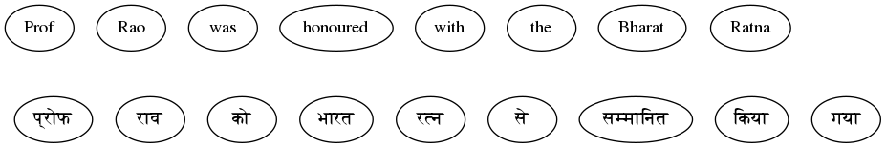
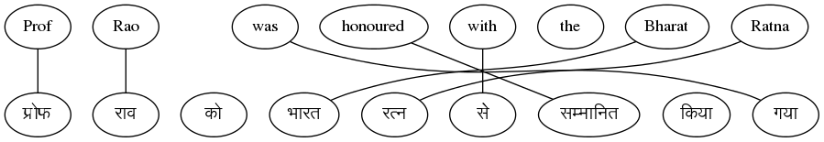
Given a parallel sentence pair, find word level correspondences
This set of links for a sentence pair is called an ‘ALIGNMENT’

Slide 26
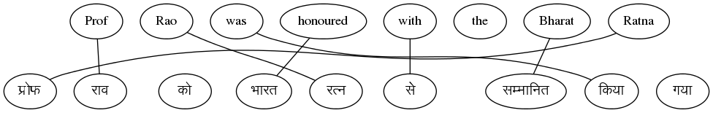
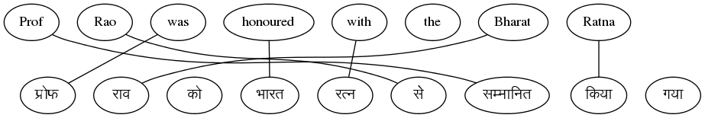
But there are multiple possible alignments
Sentence 1
With one sentence pair, we cannot find the correct alignment

Slide 27
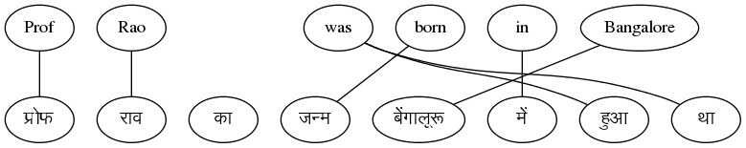
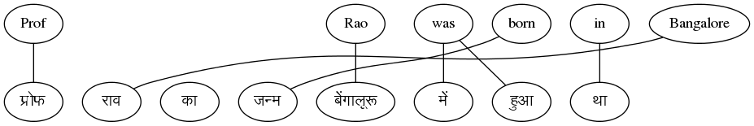
Can we find alignments if we have multiple sentence pairs?
Sentence 2
Yes, let’s see how to do that …

Slide 28
Parallel Corpus
A boy is sitting in the kitchen | एक लडका रसोई मे़ बैठा है
A boy is playing tennis | एक लडका टेनिस खेल रहा है
A boy is sitting on a round table | एक लडका एक गोल मेज पर बैठा है
Some men are watching tennis | कुछ आदमी टेनिस देख रहे है
A girl is holding a black book | एक लडकी ने एक काली किताब पकडी है
Two men are watching a movie | दो आदमी चलचित्र देख रहे है
A woman is reading a book | एक औरत एक किताब पढ रही है
A woman is sitting in a red car | एक औरत एक काले कार मे बैठी है

Slide 29
Parallel Corpus
A boy is sitting in the kitchen | एक लडका रसोई मे़ बैठा है
A boy is playing tennis | एक लडका टेनिस खेल रहा है
A boy is sitting on a round table | एक लडका एक गोल मेज पर बैठा है
Some men are watching tennis | कुछ आदमी टेनिस देख रहे है
A girl is holding a black book | एक लडकी ने एक काली किताब पकडी है
Two men are watching a movie | दो आदमी चलचित्र देख रहे है
A woman is reading a book | एक औरत एक किताब पढ रही है
A woman is sitting in a red car | एक औरत एक काले कार मे बैठा है
Key Idea
Co-occurrence of translated words
Words which occur together in the parallel sentence are likely to be translations (higher P(f|e))

Slide 30
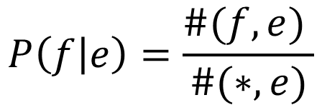
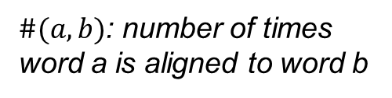
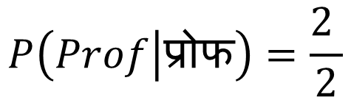
If we knew the alignments, we could compute P(f|e)
Sentence 1
Sentence 2
$$P\left(f | e\right)=\frac{\#(f,e) }{\#(∗,e)}$$
$$P\left(Prof | प्रोफ\right)=\frac{2 }{2}$$
$\#(a,b)$: number of times word a is aligned to word b

Slide 31
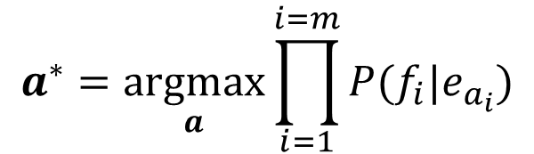
But, we can find the best alignment only if we know the word translation probabilities
The best alignment is the one that maximizes the sentence translation probability
$$a^{∗}=\underset{a}{argmax}{\prod_{i=1}^{i=m}{P(f_{i}|e_{a_{i}})}}$$
$P(f,a|e)=P(a)\prod_{i=1}^{i=m}{P\left(f_{i} | e_{a_{i}}\right)}$
This is a chicken and egg problem! How do we solve this?

Slide 32
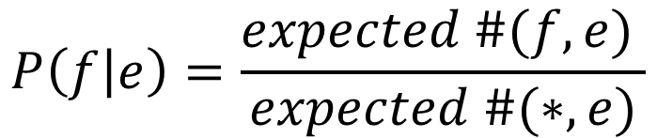
We can solve this problem using a two-step, iterative process
Start with random values for word translation probabilities
Step 1: Estimate alignment probabilities using word translation probabilities
Step 2: Re-estimate word translation probabilities
- We don’t know the best alignment
- So, we consider all alignments while estimating word translation probabilities
- Instead of taking only the best alignment, we consider all alignments and weigh the word alignments with the alignment probabilities
$$P\left(f | e\right)=\frac{expected \#(f,e) }{expected \#(∗,e)}$$
Repeat Steps (1) and (2) till the parameters converge

Slide 33
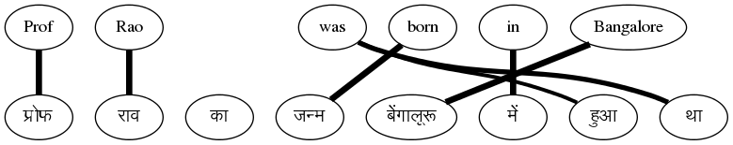
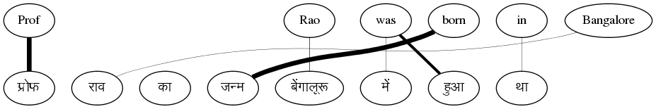
At the end of the process …
Sentence 2

Slide 34
Is the algorithm guaranteed to converge?
That’s the nice part → it is guaranteed to converge
This is an example of the well known Expectation-Maximization Algorithm
However, the problem is highly non-convex
Will lead to local minima
Good modelling assumptions necessary to ensure a good solution

Slide 35
IBM Models
IBM came up with a series of increasingly complex models
Called Models 1 to 5
Differed in assumptions about alignment probability distributions
Simper models are used to initialize the more complex models
This pipelined training helped ensure better solutions

Slide 36
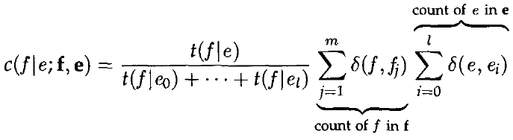
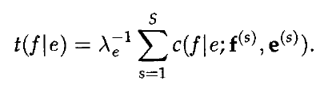

IBM Model 1
Assumption: All alignments are equally likely
E-step computes expected counts
M-step uses expected counts
to compute translation
probabilities
(normalization factor)

Slide 37
Summary
EM provides a semi-supervised method for learning word alignments and word translation probabilities
Word translation probabilities can be used to extract a bilingual dictionary
Avoids the new for word-aligned corpora
If a few word-aligned sentences are available, discriminative alignment methods can improve upon the EM-based solution
Arbitrary features can be incorporated
Morphological information
Character level edit distance

Slide 38
Agenda
What is Machine Translation & why is it interesting?
Machine Translation Paradigms
Word Alignment
Phrase-based SMT
Extensions to Phrase-based SMT
Addressing Word-order Divergence
Addressing Morphological Divergence
Handling Named Entities
Syntax-based SMT
Machine Translation Evaluation
Summary

Slide 39
What is PB-SMT?
Why stop at learning word correspondences?
KEY IDEA ➔ Use “Phrase” (Sequence of Words) as the basic translation unit
Note: the term ‘phrase’ is not used in a linguistic sense
The Prime Minister of India | भारत के प्रधान मंत्री bhArata ke pradhAna maMtrI India of Prime Minister
is running fast | तेज भाग रहा है teja bhAg rahA hai fast run -continuous is
honoured with | से सम्मानित किया se sammanita kiyA with honoured did
Rahul lost the match | राहुल मुकाबला हार गया rAhula mukAbalA hAra gayA Rahul match lost

Slide 40
Parallel Corpus
A boy is sitting in the kitchen | एक लडका रसोई मे़ बैठा है
A boy is playing tennis | एक लडका टेनिस खेल रहा है
A boy is sitting on a round table | एक लडका एक गोल मेज पर बैठा है
Some men are watching tennis | कुछ आदमी टेनिस देख रहे है
A girl is holding a black book | एक लडकी ने एक काली किताब पकडी है
Two men are watching a movie | दो आदमी चलचित्र देख रहे है
A woman is reading a book | एक औरत एक किताब पढ रही है
A woman is sitting in a red car | एक औरत एक काले कार मे बैठा है

Slide 41
Benefits of PB-SMT
Local Reordering → Intra-phrase re-ordering can be memorized
The Prime Minister of India | भारत के प्रधान मंत्री bhaarat ke pradhaan maMtrI India of Prime Minister
Sense disambiguation based on local context → Neighbouring words help make the choice
heads towards Pune | पुणे की ओर जा रहे है pune ki or jaa rahe hai Pune towards go –continuous is
heads the committee | समिति की अध्यक्षता करते है Samiti kii adhyakshata karte hai committee of leading -verbalizer is

Slide 42
Benefits of PB-SMT (2)
Handling institutionalized expressions
Institutionalized expressions, idioms can be learnt as a single unit
Improved Fluency
The phrases can be arbitrarily long (even entire sentences)
hung assembly | त्रिशंकु विधानसभा trishanku vidhaansabha
Home Minister | गृह मंत्री gruh mantrii
Exit poll | चुनाव बाद सर्वेक्षण chunav baad sarvekshana

Slide 43
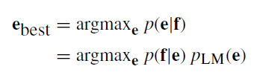

Mathematical Model
Let’s revisit the decision rule for SMT model
Let’s revisit the translation model p(f|e)
Source sentence can be segmented in I phrases
Then, p(f|e) can be decomposed as:
Distortion probability
Phrase Translation Probability
start_{i} :start position in f of i^{th} phrase of e
end_{i} :end position in f of i^{th} phrase of e

Slide 44
Learning The Phrase Translation Model
Involves Structure + Parameter Learning:
Learn the Phrase Table: the central data structure in PB-SMT
Learn the Phrase Translation Probabilities
The Prime Minister of India | भारत के प्रधान मंत्री
is running fast | तेज भाग रहा है
the boy with the telescope | दूरबीन से लड़के को
Rahul lost the match | राहुल मुकाबला हार गया
Prime Minister of India | भारत के प्रधान मंत्री India of Prime Minister | 0.75
Prime Minister of India | भारत के भूतपूर्व प्रधान मंत्री India of former Prime Minister | 0.02
Prime Minister of India | प्रधान मंत्री Prime Minister | 0.23

Slide 45
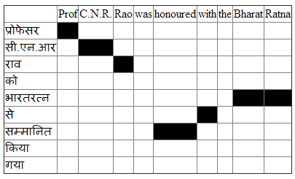
Learning Phrase Tables from Word Alignments
Start with word alignments
Word Alignment : reliable input for phrase table learning
high accuracy reported for many language pairs
Central Idea: A consecutive sequence of aligned words constitutes a “phrase pair”
Which phrase pairs to include in the phrase table?

Slide 46
Extracting Phrase Pairs

Slide 47
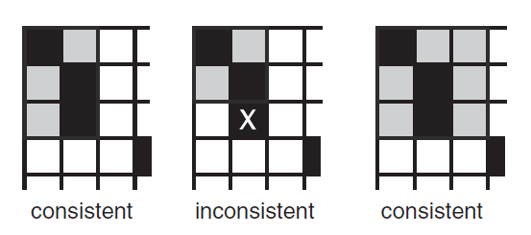


Phrase Pairs “consistent” with word alignment
Source: SMT, Phillip Koehn

Slide 48
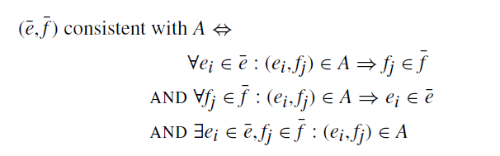
Phrase Pairs “consistent” with word alignment

Slide 49
Examples
26 phrase pairs can be extracted from this table
Professor CNR | प्रोफेसर सी.एन.आर
Professor CNR Rao | प्रोफेसर सी.एन.आर राव
Professor CNR Rao was | प्रोफेसर सी.एन.आर राव
Professor CNR Rao was | प्रोफेसर सी.एन.आर राव को
honoured with the Bharat Ratna | भारतरत्न से सम्मानित
honoured with the Bharat Ratna | भारतरत्न से सम्मानित किया
honoured with the Bharat Ratna | भारतरत्न से सम्मानित किया गया
honoured with the Bharat Ratna | को भारतरत्न से सम्मानित किया गया

Slide 50

Computing Phrase Translation Probabilities
Estimated from the relative frequency:
Prime Minister of India | भारत के प्रधान मंत्री India of Prime Minister | 0.75
Prime Minister of India | भारत के भूतपूर्व प्रधान मंत्री India of former Prime Minister | 0.02
Prime Minister of India | प्रधान मंत्री Prime Minister | 0.23

Slide 51


Generative vs. Discriminative models in ML
Generative Model
Discriminative Model
Maximum Entropy based model, incorporating arbitrary features
h_{i} - features functions, λ_{i} are feature weights
No need to model source, reduces parameter space
Arbitrary features can better capture translation process
Why exponential function form? –maximizing entropy w.r.t data constraints
Noisy channel model of translation from sentence f to sentence e.
Task is to recover e from noisy f.
P(f|e): Translation model, addresses adequacy
P(e): Language model, addresses fluency
Joint modeling of entire parameter space
The generative story is too simplistic, not reflective of translation process

Slide 52


Discriminative Training of PB-SMT
Directly model the posterior probability p(e|f)
Use the Maximum Entropy framework
h_{i}(f,e) are feature functions , λ_{i}’s are feature weights
Benefits:
Can add arbitrary features to score the translations
Can assign different weight for each features
Assumptions of generative model may be incorrect
Notes:
P(\mathbf{e|f})=\exp\left( \sum_i \lambda_i h_i(f_1^I,e_1^J)\right)

Slide 53


Generative Model as a special case
Generative model
translation model
Feature function mappings
for corresponding discriminative
model
distortion model
language model
Notes:
h_1=\prod_{i=1}^{I}\phi(\bar{f_i},\bar{e_i}) \;\;\; , \;\;\; \lambda_1=1

Slide 54

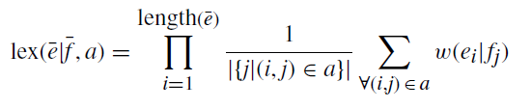
More features for PB-SMT
Inverse phrase translation probability ( )
Lexical Weighting
a: alignment between words in phrase pair (ē, f)
w(x|y): word translation probability
Inverse Lexical Weighting
Same as above, in the other direction

Slide 55
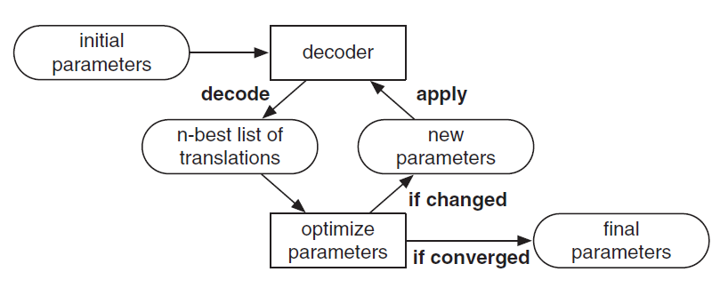
Tuning
Learning feature weights from data – λ_{i}
Minimum Error Rate Training (MERT)
Search for weights which minimize the translation error on a held-out set (tuning set)
Translation error metric : (1 – BLEU)
Source: SMT, Phillip Koehn

Slide 56
Typical SMT Pipeline
Parallel
Training Corpus
Word-aligned Corpus
Phrase-table
Parallel Tuning Corpus
Word Alignment
Phrase Extraction
Tuning
Model parameters
Distortion Modelling
Other Feature Extractors
Target
LM
Source sentence
Decoder
Target Language Monolingual Corpus
Language Modelling
Target sentence

Slide 57
Decoding
Searching for the best translations in the space of all translations

Slide 58
An Example of Translation
Ram ate rice with the spoon
राम ने
चम्मच से
चावल
खाये

Slide 59
Reality
We picked the phrase translation that made sense to us
The computer has less intuition
Phrase table may give many options to translate the input sentence
Ram ate rice with the spoon
राम
खाये
धान
के साथ
यह
चमचा
राम ने
खा लिया
चावल
से
वह
चम्मच
राम को
खा लिया है
एक
राम से
चम्मच
चम्मच से
चम्मच के साथ

Slide 60
What is the challenge in decoding?
The task of decoding in machine translation is to find the best scoring translation according to translation models
Hard problem, since there is a exponential number of choices, given a specific input sentence
Shown as an NP complete problem
Need to come up with heuristic search methods
No guarantee of finding the best translation

Slide 61
Search Space and Search Organization
Partial Hypothesis
Hypothesis Expansion
खा लिया
Final Hypothesis
राम ने
चम्मच से
चावल
चावल
खाये
चम्मच
Incremental construction
Each hypothesis is scored using the odel
Hypotheses are maintained in a priority queue
Limit to the reordering window for efficiency
Empty Hypothesis

Slide 62
Agenda
What is Machine Translation & why is it interesting?
Machine Translation Paradigms
Word Alignment
Phrase-based SMT
Extensions to Phrase-based SMT
Addressing Word-order Divergence
Addressing Morphological Divergence
Handling Named Entities
Syntax-based SMT
Machine Translation Evaluation
Summary

Slide 63
We have looked at a basic phrase-based SMT system
This system can learn word and phrase translations from parallel corpora
But many important linguistic phenomena need to be handled
Divergent Word Order
Rich morphology
Named Entities and Out-of-Vocabulary words

Slide 64
Getting word order right
Phrase based MT is not good at learning word ordering
Solution: Let’s help PB-SMT with some preprocessing of the input
Change order of words in input sentence to match order of the words in the target language
Let’s take an example
Bahubali earned more than 1500 crore rupee sat the boxoffice

Slide 65
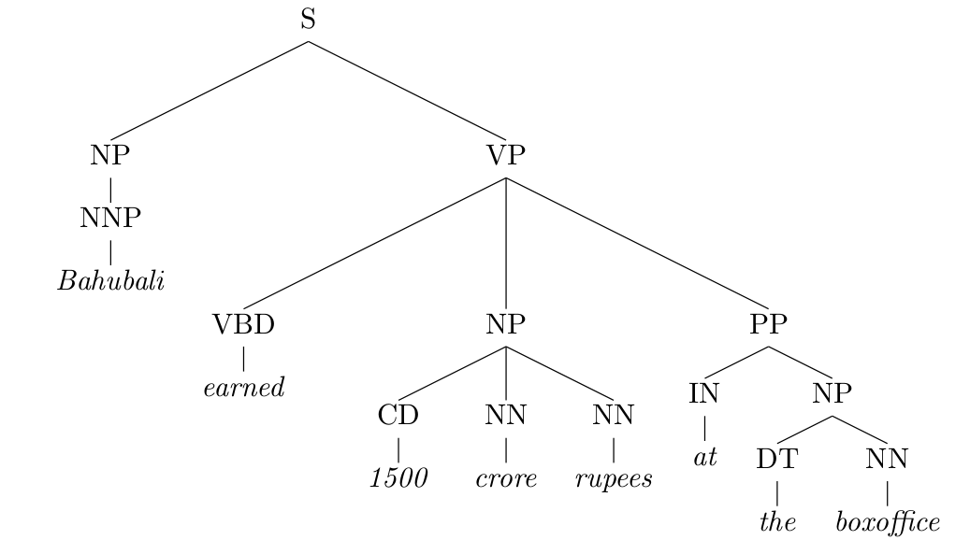
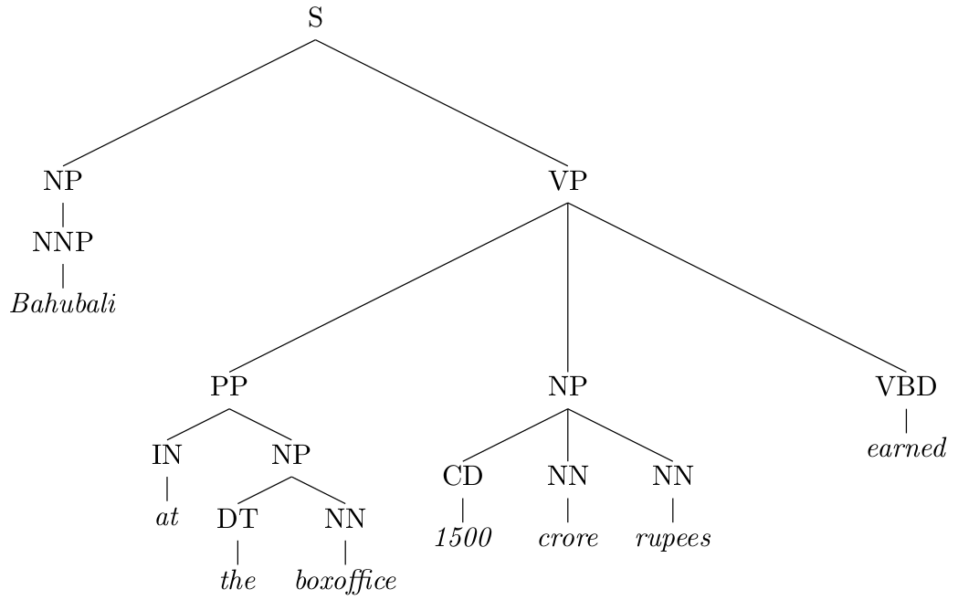
Parse the sentence to understand its syntactic structure
1
3
2
Apply rules to transform the tree
VP → VBD NP PP ⇒ VP → PP NP VBD
3
1
This rule captures
Subject-Verb-Object to Subject-Object-Verb divergence
2
5
4

Slide 66
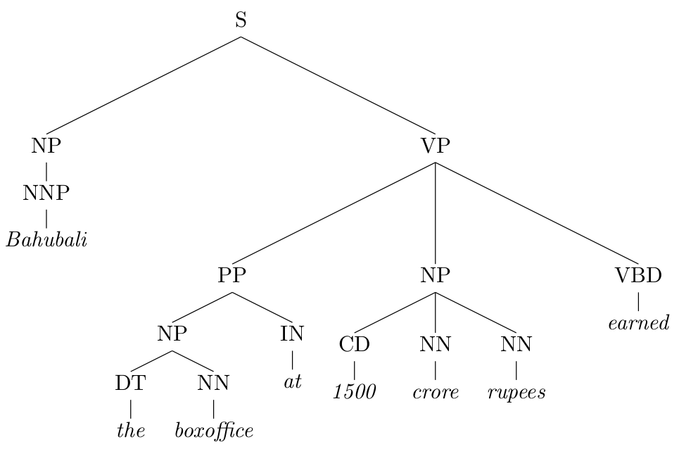
Prepositions in English become postpositions in Hindi
PP → IN NP ⇒ PP → NP IN
4
5
The new input to the machine translation system is
Bahubali the boxoffice at 1500 crore rupees earned
These rules can be written manually or learnt from parse trees
Now we can translate with little reordering
बाहुबली ने बॉक्सओफिस पर 1500 करोड रुपए कमाए

Slide 67
Better methods exist for generating the correct word order
Incorporate learning of reordering is built into the SMT system
Hierarchical PBSMT ⇒ Provision in the phrase table for limited & simple reordering rules
Syntax-based SMT ⇒ Another SMT paradigm, where the system learns mappings of “treelets” instead of mappings of phrases

Slide 68
We have looked at a basic phrase-based SMT system
This system can learn word and phrase translations from parallel corpora
But many important linguistic phenomena need to be handled
Divergent Word Order
Rich morphology
Named Entities and Out-of-Vocabulary words

Slide 69
Language is very productive, you can combine words to generate new words
Inflectional forms of the Marathi word घर
Hindi words with the suffix वाद
घर
घरात
घरावरती
घराखाली
घरामध्ये
घरामागे
घराचा
घरामागचा
घरासमोर
घरासमोरचा
घरांसमोर
house
in the house
on the house
below the house
in the house
behind the house
of the house
that which is behind the house
in front of the house
that which is in front of the house
in front of the houses
साम्यवाद
समाजवाद
पूंजीवाद
जातीवाद
साम्राज्यवाद
communism
socialism
capitalism
casteism
imperialism
The corpus should contains all variants to learn translations
This is infeasible!

Slide 70
Language is very productive, you can combine words to generate new words
Inflectional forms of the Marathi word घर
Hindi words with the suffix वाद
घर
घर ा त
घर ा वरती
घर ा खाली
घर ा मध्ये
घर ा मागे
घर ा चा
घर ा माग चा
घर ा समोर
घर ा समोर चा
घर ा ं समोर
house
in the house
on the house
below the house
in the house
behind the house
of the house
that which is behind the house
in front of the house
that which is in front of the house
in front of the houses
साम्य वाद
समाज वाद
पूंजी वाद
जाती वाद
साम्राज्य वाद
communism
socialism
capitalism
casteism
imperialism
Break the words into its component morphemes
Learn translations for the morphemes
Far more likely to find morphemes in the corpus

Slide 71
We have looked at a basic phrase-based SMT system
This system can learn word and phrase translations from parallel corpora
But many important linguistic phenomena need to be handled
Divergent Word Order
Rich morphology
Named Entities and Out-of-Vocabulary words

Slide 72
Some words not seen during train will be seen at test time
These are out-of-vocabulary (OOV) words
Names are one of the most important category of OOVs
⇒ There will always be names not seen during training
How do we translate names like Sachin Tendulkar to Hindi?
What we want to do is map the Roman characters to Devanagari to they sound the same when read → सचिन तेंदुलकर
➔ We call this process ‘transliteration’

Slide 73
How do we transliterate?
Convert a sequence of characters in one script to another script
s a c h i n → स च ि न
Isn’t that a translation problem → at the character level?
Albeit a simpler one,
Smaller vocabulary
No reordering
Shorter segments

Slide 74
Translation between Related Languages

Slide 75
Related Languages
Related by Genealogy
Related by Contact
Language Families
Dravidian, Indo-European, Turkic
(Jones, Rasmus, Verner, 18th & 19th centuries, Raymond ed. (2005))
Linguistic Areas
Indian Subcontinent, Standard Average European
(Trubetzkoy, 1923)
Related languages may not belong to the same language family!
Notes:
Greenberg, Joseph H. (ed.) (1963) Universals of Language. Cambridge, Mass.: MIT Press.

Slide 76
Key Similarities between related languages
भारताच्या स्वातंत्र्यदिनानिमित्त अमेरिकेतील लॉस एन्जल्स शहरात कार्यक्रम आयोजित करण्यात आला
bhAratAcyA svAta.ntryadinAnimitta ameriketIla lOsa enjalsa shaharAta kAryakrama Ayojita karaNyAta AlA
Marathi
भारता च्या स्वातंत्र्य दिना निमित्त अमेरिके तील लॉस एन्जल्स शहरा त कार्यक्रम आयोजित करण्यात आला
bhAratA cyA svAta.ntrya dinA nimitta amerike tIla lOsa enjalsa shaharA ta kAryakrama Ayojita karaNyAta AlA
Marathi segmented
भारत के स्वतंत्रता दिवस के अवसर पर अमरीका के लॉस एन्जल्स शहर में कार्यक्रम आयोजित किया गया
bhArata ke svata.ntratA divasa ke avasara para amarIkA ke losa enjalsa shahara me.n kAryakrama Ayojita kiyA gayA
Hindi
Lexical: share significant vocabulary (cognates & loanwords)
Morphological: correspondence between suffixes/post-positions
Syntactic: share the same basic word order
Notes:
Make the highlighted areas in square for better alignment

Slide 77
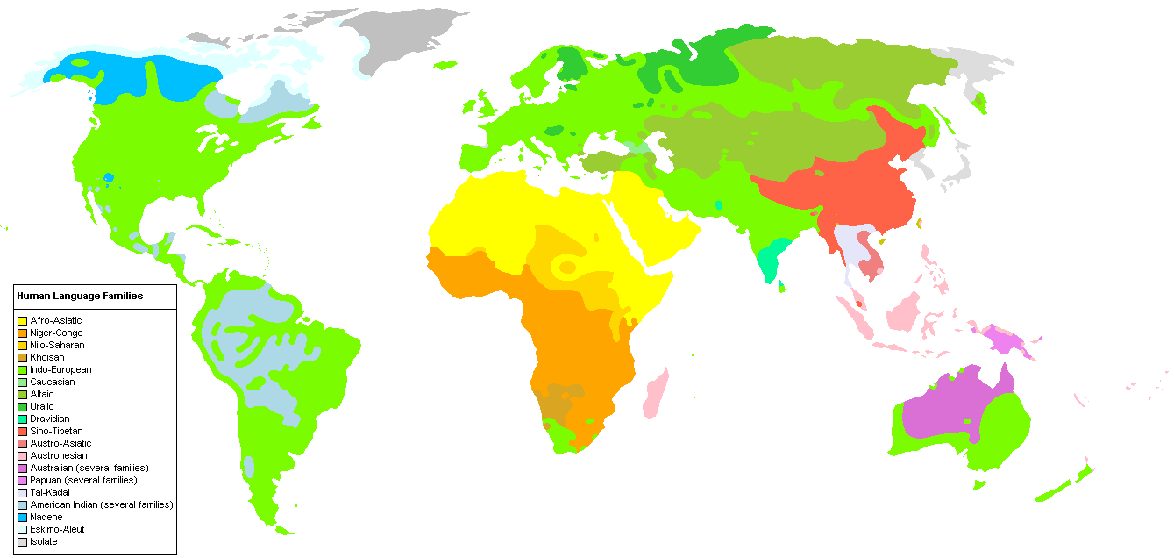
Balkans
Indian Subcontinent
Indian Subcontinent
Nigeria
South East Asia
Source: Wikipedia
These related languages are generally geographically contiguous
Notes:
Trubetzkoy,
Emenau, 1956

Slide 78
Naturally, lot of communication between such languages
(government, social, business needs)
Most translation requirements also involves related languages
Between related languages
Hindi-Malayalam
Marathi-Bengali
Czech-Slovak
Related languages ⇐⇒ Link languages
Kannada,Gujarati ⇒ English
English ⇒ Tamil,Telugu
We want to be able to handle a large number of such languages
e.g. 30+ languages with a speaker population of 1 million + in the Indian subcontinent

Slide 79
Lexically Similar Languages (Many words having similar form and meaning)
Cognates
Loan Words
Named Entities
Fixed Expressions/Idioms
a common etymological origin
do not change across languages
roTI (hi) | roTlA (pa) | bread
bhai (hi) | bhAU (mr) | brother
mu.mbaI (hi) | mu.mbaI (pa) | mu.mbaI (pa)
keral (hi) | k.eraLA (ml) | keraL (mr)
borrowed without translation
MWE with non-compositional semantics
matsya (sa) | matsyalu (te) | fish
pazha.m (ta) | phala (hi) | fruit
dAla me.n kuCha kAlA honA | (hi) | Something fishy
dALa mA kAIka kALu hovu | (gu)
Translation at subword level which exploits lexical similarity

Slide 80
What is a good unit of representation?
Let's take the word EDUCATION as an example
Character: E D U C A T I O N
ambiguity in character mappings
Character n-gram: ED UC AT IO N
Vocabulary size explodes for n>2
Orthographic Syllable
- Break at vowel boundaries
- Approximate syllable
E DU CA TIO N
Byte Pair Encoded Unit
- Identify most frequent character substrings as vocabulary
- Motivated from compression theory
EDU CA TION
Variable length
Small Vocabulary
More relevant units
Training objective?
What about sentence length?
Sentence Representation
मु म्ब ई _ म हा रा ष्ट्र _ की _ रा ज धा नी _ है _।
Notes:
दृ ष्टि को ण
द ् ृ ष ् ट ी क ो ण
द ृ ष ् ट ी क ो ण
दृष्टिकोण

Slide 81

Adapting SMT for subword-level translation
Tune at the word-level (Tiedemann, 2012)
Word-aligned Corpus
Phrase-table
Parallel Corpus
Word Alignment
Phrase Extraction
Tuning
Decode using cube-pruning & smaller beam size for improved performance (Kunchukuttan & Bhattacharyya, VarDial 2016)
Model parameters
Decoder
Target Monolingual Corpus
Language Modelling
Target
LM
Source sentence
Target sentence
Use higher order language models (Vilar et al., 2007)
रा जू _ , _ घ र _ के _बा ह र _ म त _ जा ओ _ .
राजू , घर के बाहर मत जाओ .

Slide 82
Agenda
What is Machine Translation & why is it interesting?
Machine Translation Paradigms
Word Alignment
Phrase-based SMT
Extensions to Phrase-based SMT
Addressing Word-order Divergence
Addressing Morphological Divergence
Handling Named Entities
Syntax-based SMT
Machine Translation Evaluation
Summary

Slide 83
Problems with Phrase Based models
Heavy reliance on lexicalization
Direct Translation method
No generalization
Lot of data is required
For similar sentences, sometimes reordering occurs, sometimes it does not
Correct reordering
Oracle bought Sun Microsystems in 2010
ओरेकल 2010 में सन माइक्रोसिस्टम्स को खरीदा
Incorrect Reordering
IBM approached Sun Microsystems in 2008
आईबीएम दरवाजा खटखटाया 2008 में सन माइक्रोसिस्टम्स का

Slide 84
Problems with Phrase Based models (2)
Learning is very local in nature
Local reordering, sense disambiguation learnt
Phenomena like word order divergence, recursive structure are non-local
Word order divergence (SVO-SOV) is not learnt
[The USA] [is not engaging] [in war] [with Iran]
[अमरीका] [संलग्न नहीं है] [युद्ध में] [ईरान के साथ]
Recursive structure: phrase boundaries are not maintained
[[It is necessary [that the person [who is travelling for the conference]] should get approval prior to his departure]]
यह सम्मेलन के लिए यात्रा कर रहा है, जो व्यक्ति पहले अपने प्रस्थान से अनुमोदन प्राप्त करना चाहिए कि आवश्यक है

Slide 85
Tree based models
Source and/or Target sentences are represented as trees
Translation as Tree-to-Tree Transduction
As opposed to string-to-string transduction in PB-SMT
Parsing as Decoding
Parsing of the source language sentence produces the target language sentences

Slide 86
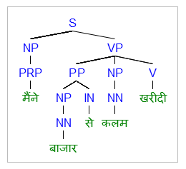
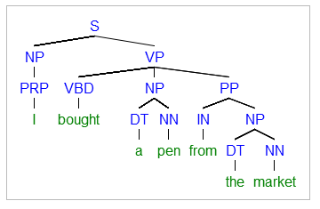
Example
Source Tree
Target Tree
Notes:
[S [NP [PRP I]] [VP [VBD bought] [NP [DT a] [NN pen]] [PP [IN from] [NP [DT the] [NN market]]]]]
[S [NP [PRP मैंने]] [VP [PP [NP [NN बाजार ]] [IN से ] ] [NP [NN कलम]] [V खरीदी ] ]

Slide 87
Why tree based model?
Natural language sentences have a tree-like structure
Syntax based Reordering
Source side tree: guides decoding by constraining the possible rules that can be applied
Target side tree ensures grammatically correct output

Slide 88
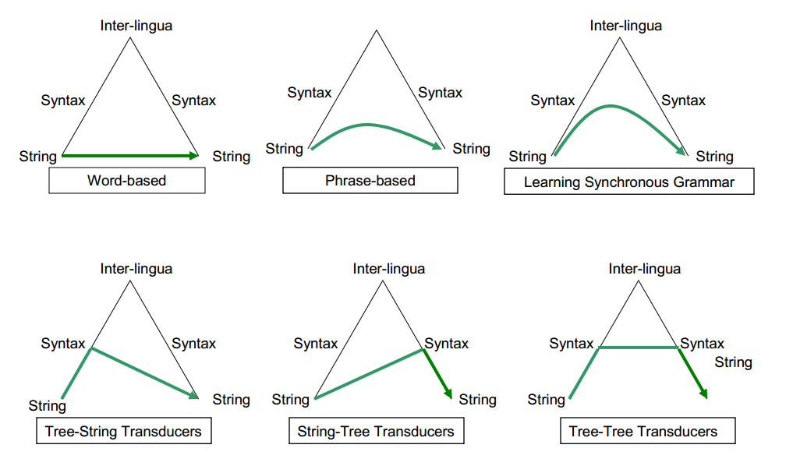
Different flavours of tree-based models
Slide from Amr Ahmed

Slide 89
Synchronous Context Free Grammar
Fundamental formal tool for Tree-based translation models
An enhanced Context Free Grammar for generating two related strings instead of one
Alternatively, SCFG defines a tree transducer

Slide 90
Definition
S → NP VP
VP → V
VP → V NP
VP → VP NP PP
NP → NN
NN → market
S → < NP₁ VP₂ , NP₁ VP₂ >
VP → < V₁ , V₁ >
VP → < V₁ NP₂ , NP₂ V₁ >
VP → < V₁ NP₂ PP₃ , PP₃ NP₂ V₁ >
NP → < NN₁ , NN₁ >
NN → < market , बाजार >
CFG
SCFG
Differences of SCFG from CFG:
2 components on the RHS of production rule
Same number of non-terminals
Non-terminals have one-one correspondence (index-linked)

Slide 91
Example
Source Tree
Target Tree
Notes:
[S [NP [PRP I]] [VP [VBD bought] [NP [DT a] [NN pen]] [PP [IN from] [NP [DT the] [NN market]]]]]
[S [NP [PRP मैंने]] [VP [PP [NP [NN बाजार ]] [IN से ] ] [NP [NN कलम]] [V खरीदी ] ]

Slide 92
Example SCFG for English-Hindi
S → < NP₁ VP₂ , NP₁ VP₂ >
VP → < V₁ , V₁ >
VP → < V₁ NP₂, NP₂ V₁ >
VP → < V₁ NP₂ PP₃ , PP₃ NP₂ V₁ >
NP → < NN₁ , NN₁ >
NP → < PRP₁ , PRP₁ >
PP → < IN₁ NP₂ , NP₂ IN₁ >
NN → < market , बाजार >
NN → < pen , कलम >
PRP → < I , मैंने >
V → < bought, खरीदी >
IN → < from , से >
DT → < the , ε >
DT → < a ,ε >
Notes:
[S [NP [PRP]] [VP [PP [NP [NN]] [IN] ] [NP [NN]] [V] ]

Slide 93
Derivation
Parsing as Decoding!
S
< NP₁ VP₂ , NP₁ VP₂ >
< NP₁ VP₂ , NP₁ VP₂ >
< PRP₃ VP₂ , PRP₃ VP₂ >
< I VP₂ , मैंने VP₂ >
< I V₃ NP₄ PP₅ , मैंने PP₅ NP₄ V₃ >
< I bought NP₄ PP₅ , मैंने PP₅ NP₄ खरीदी >
< I bought DT₆ NN₇ PP₅ , मैंने PP₅ DT₆ NN₇ खरीदी >
< I bought a NN₇ PP₅ , मैंने PP₅ NN₇ खरीदी >
< I bought a pen PP₅ , मैंने PP₅ कलम खरीदी >
< I bought a pen IN₈ NP₉ , मैंने NP₉ IN₈ कलम खरीदी >
< I bought a pen from NP₉ , मैंने NP₉ से कलम खरीदी >
< I bought a pen from DT₁₀ NN₁₁ , मैंने DT₁₀ NN₁₁ से कलम खरीदी >
< I bought a pen from the NN₁₁ , मैंने NN₁₁ से कलम खरीदी >
< I bought a pen from the market, मैंने बाजार से कलम खरीदी >

Slide 94
Reordering and Relabeling among Child Nodes
The only operations a SCFG allows is:
reordering among child nodes
Re-labelling of nodes
The condition is overly restrictive, hardly any pair of languages would follow such a grammar
Useful for representing non-linguistic formalisms like hierarchical model, Inverse Transduction Grammar
Other tree-based models like Tree Substitution Grammars are more powerful
VP → < V₁ NP₂ PP₃ , PP₃ NP₂ V₁ >
VP → < V₁ NP₂ PP₃ , PREPP₃ NP₂ V₁ >
PP/PREPP → < IN₁ NP₂ , NP₂ IN₂>

Slide 95
Hierarchical Phrase Based Models
Learns a SCFG purely from data
no source, target side parsers used
Learns an undifferentiated grammar
Grammar does not have notion of different types of non-terminals (eg. NP, VP, etc.)
Only one type of non-terminal, called X
Production rules are of the form
Useful in generalizing learning of reordering among phrases
X → <α X₁ β X ₂ γ X₃ , X ₂ α’ β’ X ₃ X ₁>

Slide 96


The SCFG for the Hierarchical Model
A rule is of the form:
where, ~ is one-one correspondence between non-terminals
In addition, there are “glue” rules for the initial state
X → < with X₁ , X ₁ के साथ >

Slide 97
Formal, Not Linguistic
"Formal", but not linguistic
The SCFG grammar does not correspond to any natural language
"non-linguistic" phrases (not words) as basic units
The HPBSMT model defines a formal SCFG model for reordering of these "phrases“ in PBMST
A custom designed engineering solution for a purpose

Slide 98
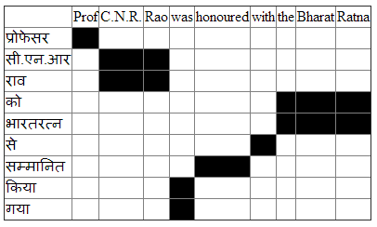
Example of rule generation
Extracted Phrase alignments
Extracted Rules
Phrase Pair | Extracted Rule
(was honoured, सम्मानित किया गया) | X → < was X₁ , X₁ किया गया >
(with the Bharat Ratna, भारतरत्न से) | X → < with X₁ , X₁ से >
(was honoured with the Bharat Ratna, भारतरत्न से सम्मानित किया गया) | X → < was X₁ with X₂, X₂ से X₁ किया गया >

Slide 99
Summary
Tree based models can better handle syntactic phenomena like reordering, recursion
Basic formalism: Synchronous Context Free Grammar
Decoding: Parsing on the source side
CYK Parsing
Integration of the language model presents challenge
Parsers required for learning syntax transfer
Without parsers, some weak learning is possible with hierarchical PBSMT

Slide 100
Agenda
What is Machine Translation & why is it interesting?
Machine Translation Paradigms
Word Alignment
Phrase-based SMT
Extensions to Phrase-based SMT
Addressing Word-order Divergence
Addressing Morphological Divergence
Handling Named Entities
Syntax-based SMT
Machine Translation Evaluation
Summary

Slide 101
Motivation
How do we judge a good translation?
Can a machine do this?
Why should a machine do this?
Because human evaluation is time-consuming and expensive!
Not suitable for rapid iteration of feature improvements

Slide 102
What is a good translation?
Evaluate the quality with respect to:
Adequacy: How good the output is in terms of preserving content of the source text
Fluency: How good the output is as a well-formed target language entity
For example, I am attending a lecture
मैं एक व्याख्यान बैठा हूँ
Main ek vyaakhyan baitha hoon
I a lecture sit (Present-first person)
I sit a lecture : Adequate but not fluent
मैं व्याख्यान हूँ
Main vyakhyan hoon
I lecture am
I am lecture: Fluent but not adequate.

Slide 103
Human Evaluation
Common techniques:
Assigning fluency and adequacy scores (Direct Assessment)
Ranking translated sentences relative to each other (Relative Ranking)

Slide 104
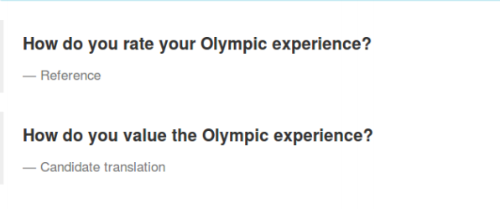
Direct Assessment
Average score over the entire test set
Gives a sense of the absolute translation quality
Evaluators use their own perception to rate
Often adequacy/fluency scores correlate: undesirable
Adequacy:
is the meaning translated correctly?
5 = All
4 = Most
3 = Much
2 = Little
1 = None
Fluency:
Is the sentence grammatically valid?
5 = Flawless
4 = Good
3 = Non-native
2 = Disfluent
1 = Incomprehensible

Slide 105
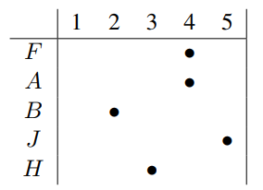
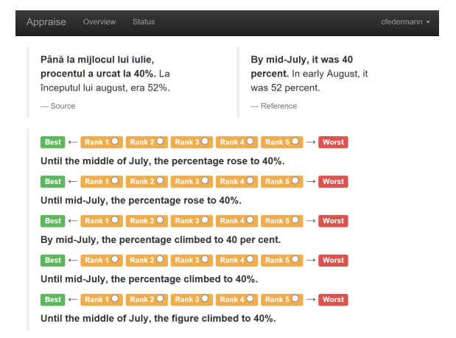
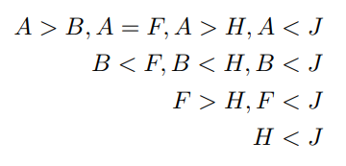
Ranking Translations

Slide 106
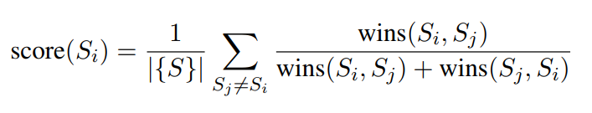
Wins(S_{i},S_{j}) = number of times system S_{i} is ranked better than system S_{j}
Can provide only relative quality judgments
Faster to collect data than judgments than Direct Assessment
Correlates well with direct assessment
Another popular adaptive algorithm: Trueskill

Slide 107
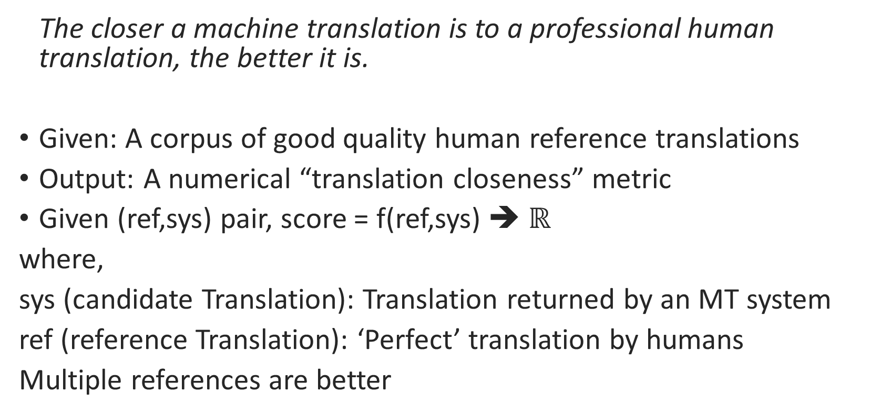
Automatic Evaluation
The closer a machine translation is to a professional human translation, the better it is.
Given: A corpus of good quality human reference translations
Output: A numerical “translation closeness” metric
Given (ref,sys) pair, score = f(ref,sys) ➔ $ℝ$
where,
sys (candidate Translation): Translation returned by an MT system
ref (reference Translation): ‘Perfect’ translation by humans
Multiple references are better

Slide 108
Some popular automatic evaluation metrics
BLEU (Bilingual Evaluation Understudy)
TER (Translation Edit Rate)
METEOR (Metric for Evaluation of Translation with Explicit Ordering)
How good is an automatic metric?
How well does it correlate with human judgment?

Slide 109
BLEU
Most popular MT evaluation metric
Requires only reference translations
No additional resources required
Precision-oriented measure
Difficult to interpret absolute values
Useful to compare two systems

Slide 110
Formulating BLEU (Step 1): Precision
I had lunch now.
Reference 1: मैने अभी खाना खाया
maine abhi khana khaya
I now food ate
I ate food now.
Reference 2 : मैने अभी भोजन किया
maine abhi bhojan kiyaa
I now meal did
I did meal now
Candidate 1: मैने अब खाना खाया
maine ab khana khaya matching unigrams: 3, I now food ate matching bigrams: 1
I ate food now
Candidate 2: मैने अभी लंच एट
maine abhi lunch ate. matching unigrams: 2,
I now lunch ate
I ate lunch(OOV) now(OOV) matching bigrams: 1
Unigram precision: Candidate 1: 3/4 =0.75, Candidate 2: 2/4 = 0.5
Bigram precision: Candidate 1: 0.33, Candidate 2 = 0.33

Slide 111
Precision: Not good enough
Reference: मुझ पर तेरा सुरूर छाया
mujh-par tera suroor chhaaya
me-on your spell cast
Your spell was cast on me
Candidate 1: मेरे तेरा सुरूर छाया matching unigram: 3
mere tera suroor chhaaya
my your spell cast
Your spell cast my
Candidate 2: तेरा तेरा तेरा सुरूर matching unigrams: 4
tera tera tera suroor
your your your spell
Unigram precision: Candidate 1: 3/4 = 0.75, Candidate 2: 4/4 = 1

Slide 112
Formulating BLEU (Step 2): Modified Precision
Clip the total count of each candidate word with its maximum reference count
Count_{clip}(n-gram) = min (count, max_ref_count)
Reference: मुझ पर तेरा सुरूर छाया
mujh-par tera suroor chhaaya
me-on your spell cast
Your spell was cast on me
Candidate 2: तेरा तेरा तेरा सुरूर
tera tera tera suroor
your your your spell
matching unigrams:
(तेरा : min(3, 1) = 1 ) (सुरूर : min (1, 1) = 1)
Modified unigram precision: 2/4 = 0.5

Slide 113
Recall for MT (1/2)
Candidates shorter than references
Reference: क्या ब्लू लंबे वाक्य की गुणवत्ता को समझ
पाएगा?
kya blue lambe vaakya ki guNvatta ko samajh paaega?
Will blue long sentence-of quality (case-marker) understandable(III-person-male-singular)?
Will blue be able to understand quality of long sentence?
Candidate: लंबे वाक्य
lambe vaakya
long sentence
long sentence
modified unigram precision: 2/2 = 1
modified bigram precision: 1/1 = 1

Slide 114
Recall for MT (2/2)
Candidates longer than references
Reference 1: मैने भोजन किया
maine bhojan kiyaa
I meal did
I had meal
Candidate 1: मैने खाना भोजन किया
maine khaana bhojan kiya
I food meal did
I had food meal
Modified unigram precision: 1
Reference 2: मैने खाना खाया
maine khaana khaaya
I food ate
I ate food
Candidate 2: मैने खाना खाया
maine khaana khaaya
I food ate
I ate food
Modified unigram precision: 1

Slide 115
Formulating BLEU (Step 3): Incorporating recall
Sentence length indicates ‘best match’
Brevity penalty (BP):
Multiplicative factor
Candidate translations that match reference translations in length must be ranked higher
Candidate 1: लंबे वाक्य
Candidate 2: क्या ब्लू लंबे वाक्य की गुणवत्ता समझ पाएगा?

Slide 116

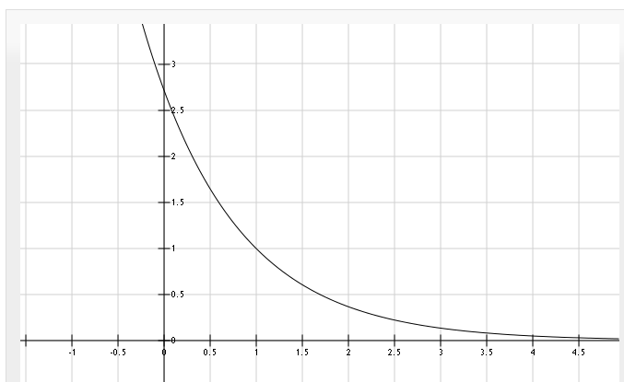
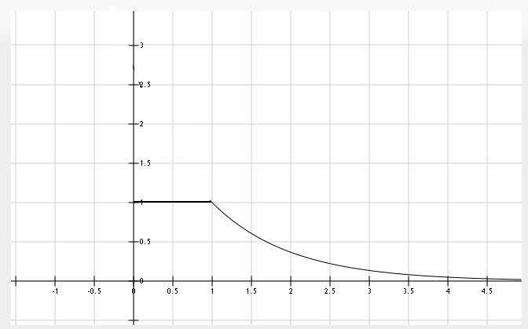
Formulating BLEU (Step 3): Brevity Penalty
r: Reference sentence length
c: Candidate sentence length
BP
e^(1-x)
BP = 1 for c > r.
x = ( r / c )
Formula from [2]
Graph drawn using www.fooplot.com

Slide 117
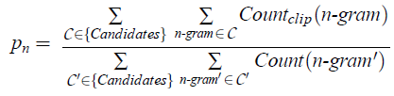
BP leaves out longer translations
Why?
Translations longer than reference are already penalized by modified precision
Formula from [2]

Slide 118


BLEU score
Recall -> Brevity Penalty
Precision -> Modified n-gram precision
Formula from [2]

Slide 119
METEOR: Criticisms of BLEU
Brevity penalty is not a good measure of recall
Higher order n-grams may not indicate grammatical correctness of a sentence
BLEU is often zero. Should a score be zero?

Slide 120
METEOR
Aims to do better than BLEU
Central idea: Have a good unigram matching strategy
Notes:
Satanjeev Banerjee and Alon Lavie, "METEOR: An Automatic Metric for MT Evaluation with Improved Correlation with Human Judgments", Proceedings of the ACL 2005 Workshop on Intrinsic and Extrinsic Evaluation Measures for MT and/or Summarization, 2005

Slide 121
Repeat with different matching strategies:
Incorporate stemmers
Consider synonyms, etc.
Candidate:
The intelligent and excited dude jumped
Reference:
The intelligent and excited boy jumped
The excited and intelligent guy pounced
Phase I
Find alignment between words
List all possible mappings based on matches
Phase II
Select best possible alignment
Select alignment with least number of ‘alignment crosses/overlaps’
METEOR: Process

Slide 122



METEOR: The score
Using unigram mappings, precision and recall are calculated. Then,
harmonic mean:
Penalty: Find ‘as many chunks’ that match
The bright boy sits on the black bench
The intelligent guy sat on the dark bench
More accurate -> Less #chunks, Less penalty
Less accurate -> More #chunks, more penalty

Slide 123
METEOR v/s BLEU
 | METEOR | BLEU
Handling incorrect words | Alignment chunks. Matching can be done using different techniques: Adaptable | N-gram mismatch
Handling incorrect word order | Chunks may be ordered in any manner. METEOR does not capture this. | N-gram mismatch
Handling recall | Idea of alignment incorporates missing word handling | Precision cannot detect ‘missing’ words. Hence, brevity penalty!

Slide 124
Agenda
What is Machine Translation & why is it interesting?
Machine Translation Paradigms
Word Alignment
Phrase-based SMT
Extensions to Phrase-based SMT
Addressing Word-order Divergence
Addressing Morphological Divergence
Handling Named Entities
Syntax-based SMT
Machine Translation Evaluation
Summary

Slide 125
Summary
Machine Translation is a challenging and exciting NLP problem
Machine Translation is important to build multilingual NLP systems
Rule-based systems provide principled linguistic approaches to build translation systems
Statistical MT systems provide ways to handling uncertaintly
Incorporating Neural Networks in SMT
Distributed Representations are a strength of neural network
Use NN-based LM and TM instead of discrete counterparts
SMT and NMT
SMT is useful when corpora available is limited
SMT is useful for translation of rare words

Slide 126
Thank you!
anoopk@cse.iitb.ac.in
https://www.cse.iitb.ac.in/~anoopk
The material in the presentation draws from an earlier tutorial I was part of. For a more comprehensive treatment of the material please refer to the tutorial on ‘Machine learning for Machine Translation’ at ICON 2013 conducted by Prof. Pushpak Bhattacharyya, Piyush Dungarwal, Shubham Gautam and me. You can find the tutorial slides here: https://www.cse.iitb.ac.in/~anoopk/publications/presentations/icon_2013_smt_tutorial_slides.pdf
Acknowledgments: Thanks to Prof. Pushpak Bhattacharyya, Aditya Joshi, Shubham Gautam and Kashyap Popat for some of the slides and diagrams
Notes:
Bilingual Mappings

