Slide 1
Statistical Machine Translation
Part III – Phrase-based SMT / Decoding
Alex Fraser
Institute for Natural Language Processing
University of Stuttgart
2010.05.12 Seminar: Statistical MT

Slide 2
Where we have been
We defined the overall problem and talked about evaluation
We have now covered word alignment
  IBM Model 1, true Expectation Maximization
  IBM Model 4, approximate Expectation Maximization
  Symmetrization Heuristics (such as Grow)
    Applied to two Model 4 alignments
    Results in final word alignment

Slide 3
Where we are going
We will define a high performance translation model
We will show how to solve the search problem for this model

Slide 4
Outline
Phrase-based translation
  Model
  Estimating parameters
Decoding

Slide 5
We could use IBM Model 4 in the direction p(f|e), together with a language model, p(e), to translate
    argmax P( e | f ) = argmax P( f | e ) P( e )
    e e

Slide 6
However, decoding using Model 4 doesn’t work well in practice
  One strong reason is the bad 1-to-N assumption
  Another problem would be defining the search algorithm
    If we add additional operations to allow the English words to vary, this will be very expensive
  Despite these problems, Model 4 decoding was briefly state of the art
We will now define a better model…

Slide 7
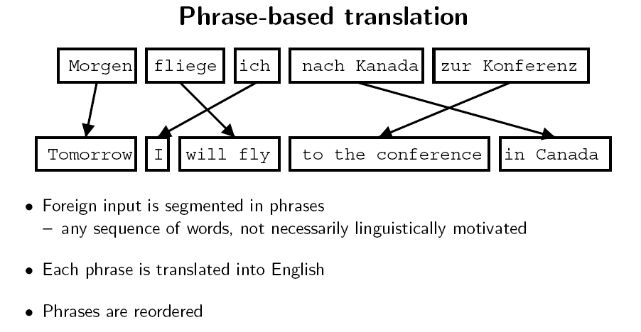
Slide from Koehn 2008

Slide 8
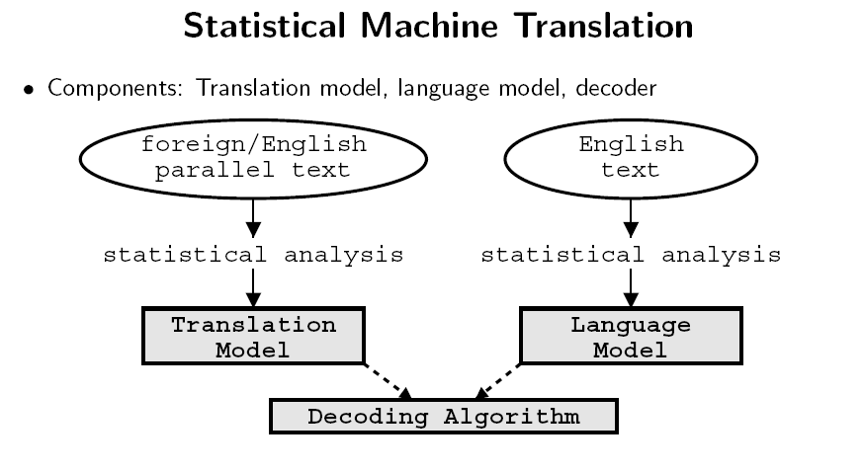
Slide from Koehn 2008

Slide 9
Language Model
Often a trigram language model is used for p(e)
  P(the man went home) = p(the | START) p(man | START the) p(went | the man) p(home | man went)
Language models work well for comparing the grammaticality of strings of the same length
  However, when comparing short strings with long strings they favor short strings
  For this reason, an important component of the language model is the length bonus
    This is a constant > 1 multiplied for each English word in the hypothesis
    It makes longer strings competitive with shorter strings

Slide 10
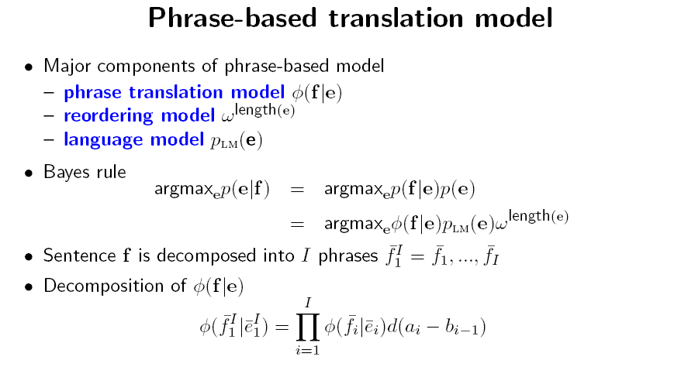
d
Modified from Koehn 2008

Slide 11
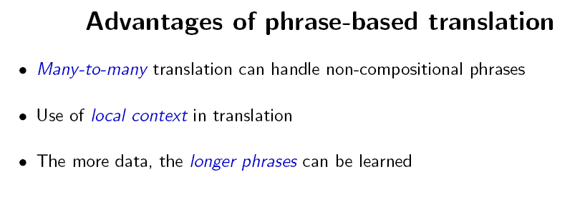
Slide from Koehn 2008

Slide 12
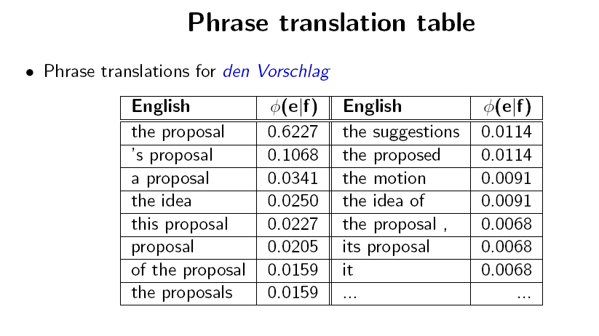
Slide from Koehn 2008

Slide 13
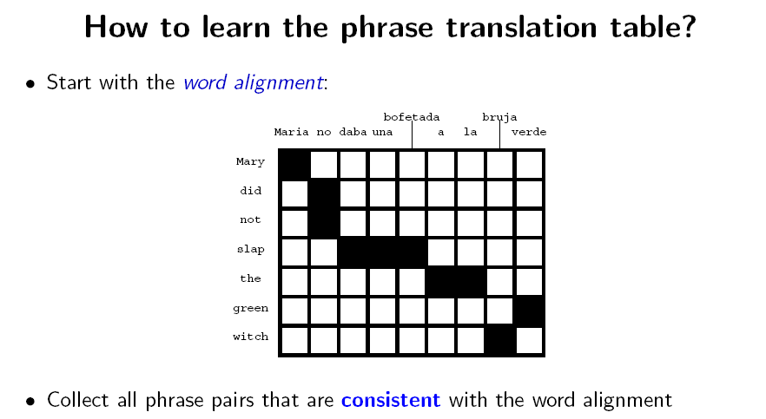
Slide from Koehn 2008

Slide 14
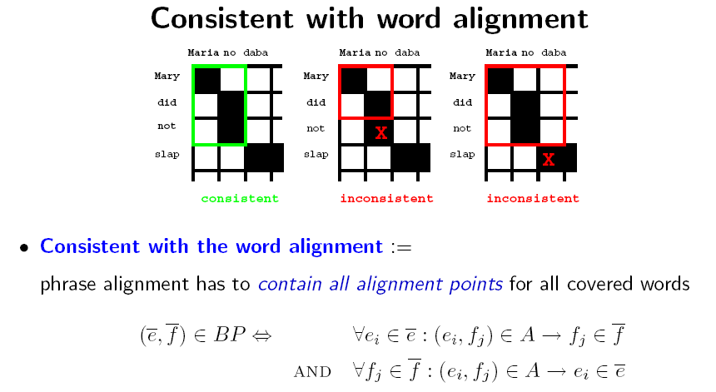
Slide from Koehn 2008

Slide 15
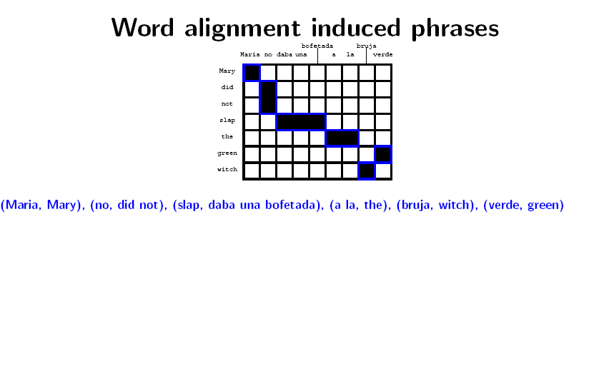
Slide from Koehn 2008

Slide 16
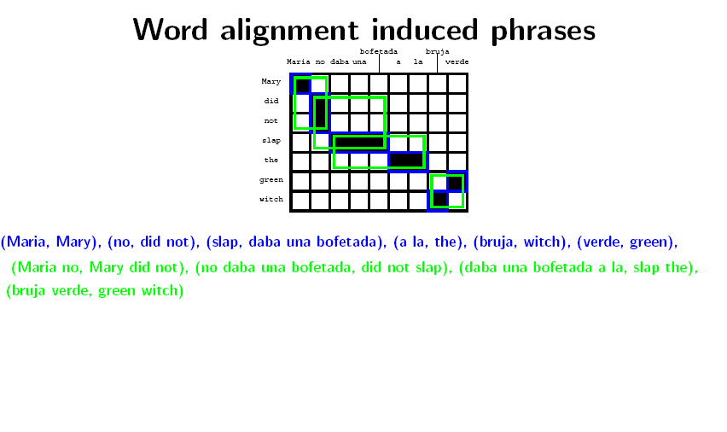
Slide from Koehn 2008

Slide 17
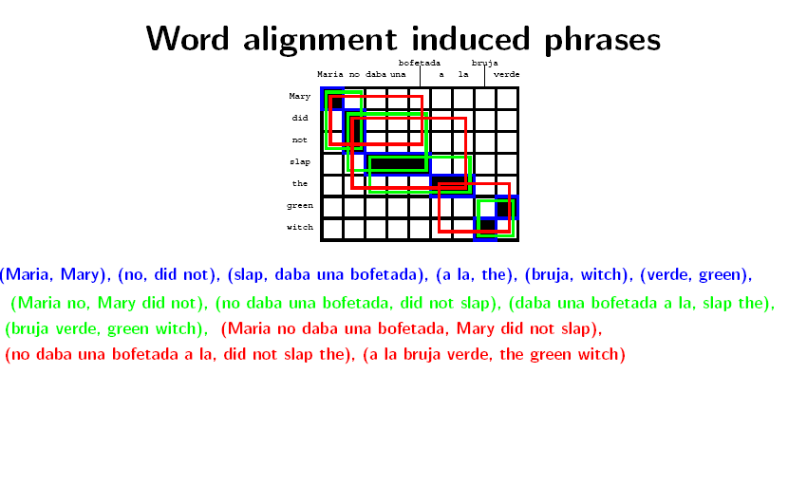
Slide from Koehn 2008

Slide 18
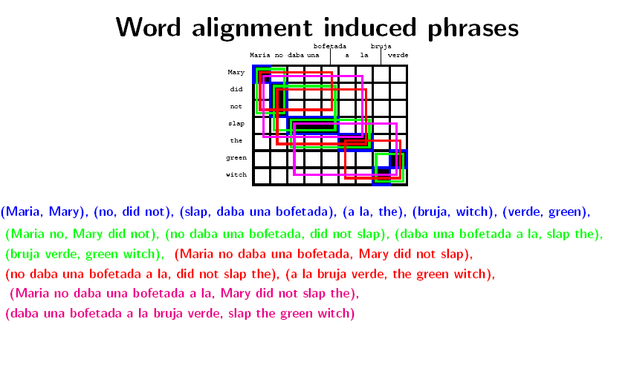
Slide from Koehn 2008

Slide 19
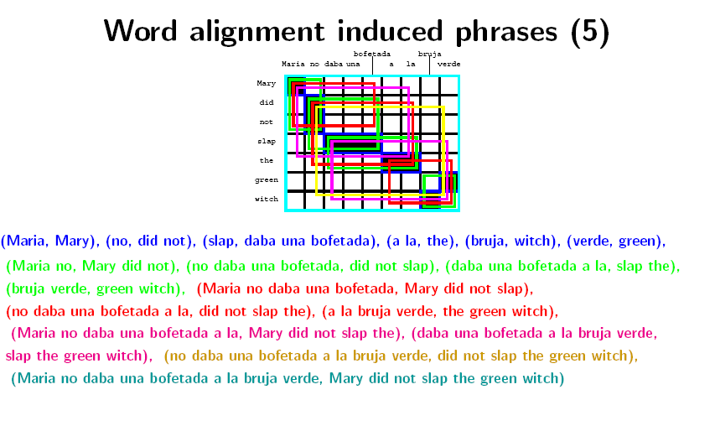
Slide from Koehn 2008

Slide 20
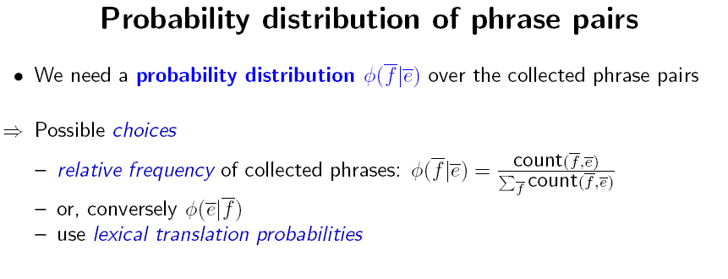
Slide from Koehn 2008

Slide 21
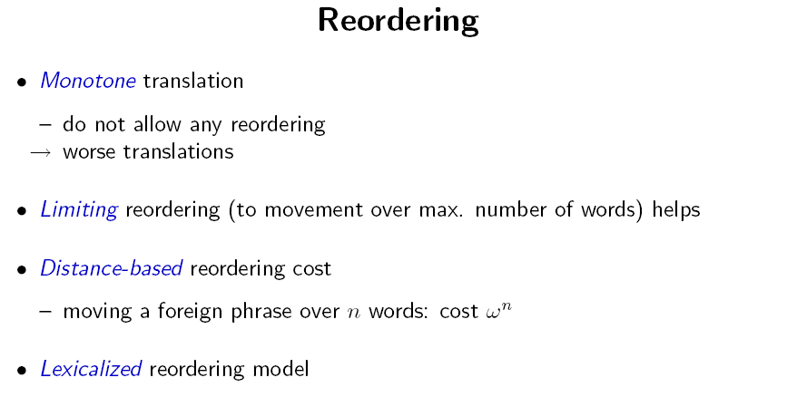
z^n
Slide from Koehn 2008

Slide 22
Outline
Phrase-based translation model
Decoding
  Basic phrase-based decoding
  Dealing with complexity
    Recombination
    Pruning
    Future cost estimation

Slide 23
Slide from Koehn 2008

Slide 24
Decoding
Goal: find the best target translation of a source sentence
Involves search
  Find maximum probability path in a dynamically generated search graph
Generate English string, from left to right, by covering parts of Foreign string
  Generating English string left to right allows scoring with the n-gram language model
Here is an example of one path

Slide 25
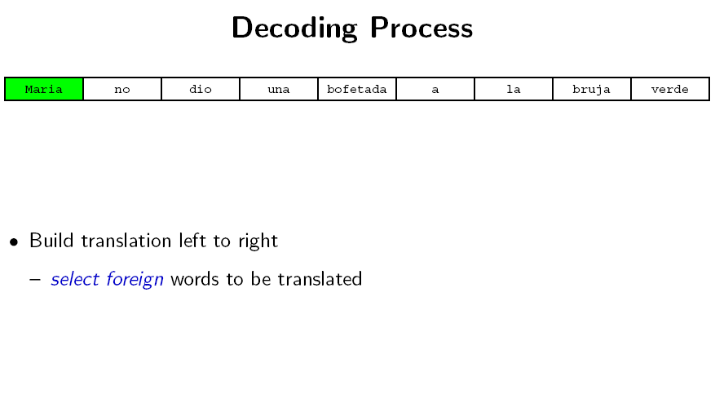
Slide from Koehn 2008

Slide 26
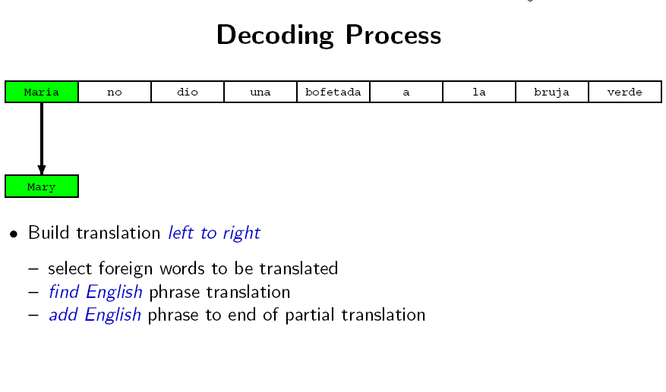
Slide from Koehn 2008

Slide 27
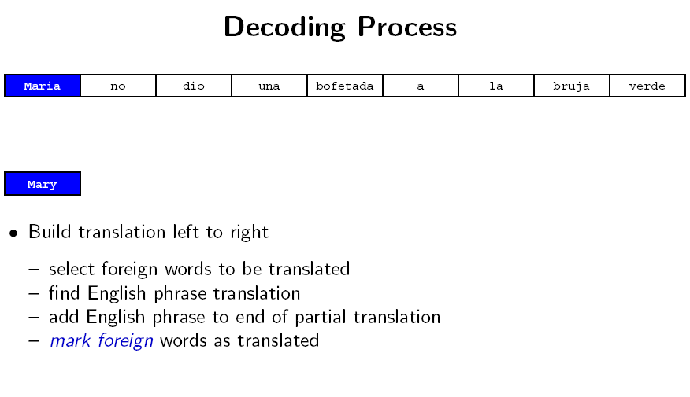
Slide from Koehn 2008

Slide 28
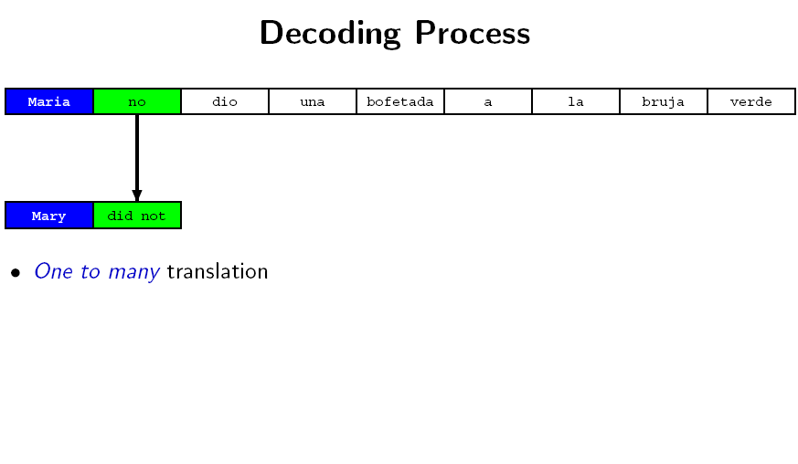
Slide from Koehn 2008

Slide 29
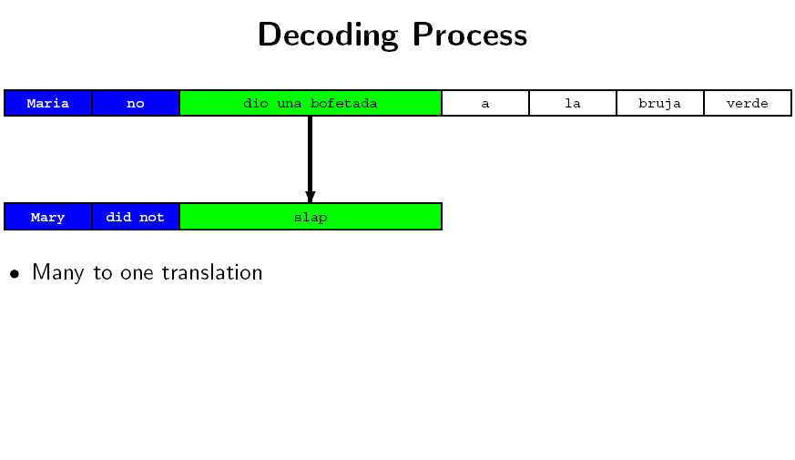
Slide from Koehn 2008

Slide 30
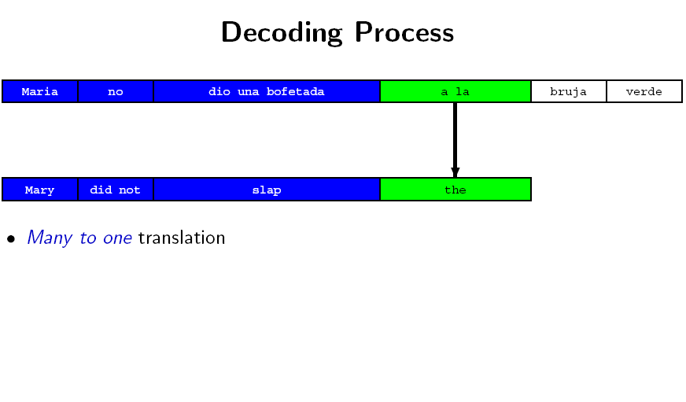
Slide from Koehn 2008

Slide 31
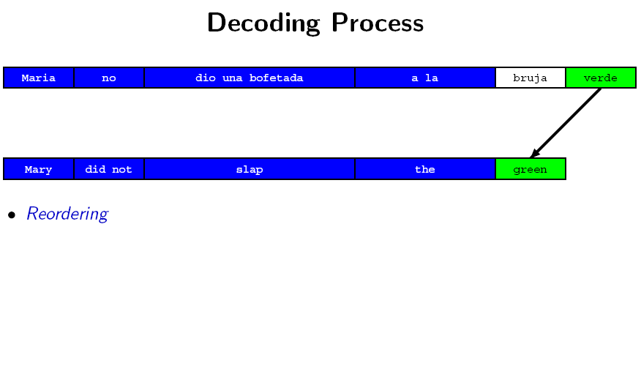
Slide from Koehn 2008

Slide 32
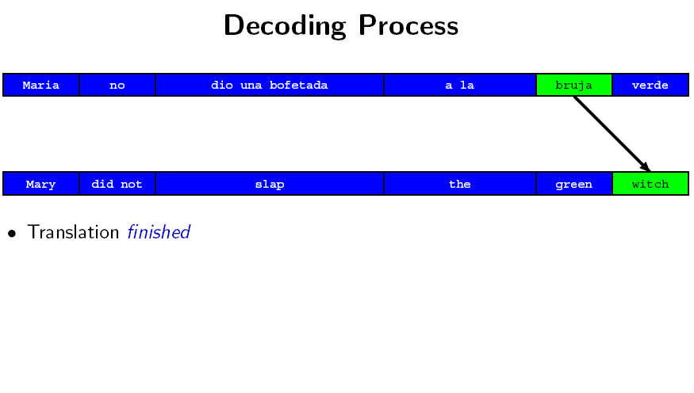
Slide from Koehn 2008

Slide 33
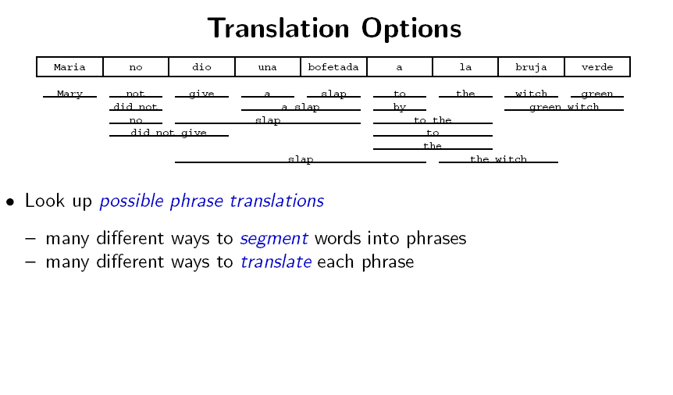
Slide from Koehn 2008

Slide 34
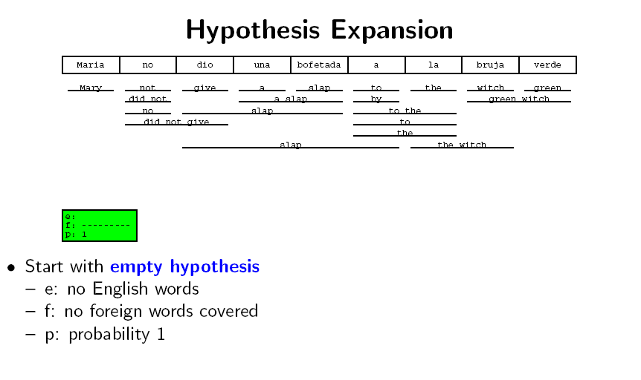
Slide from Koehn 2008

Slide 35
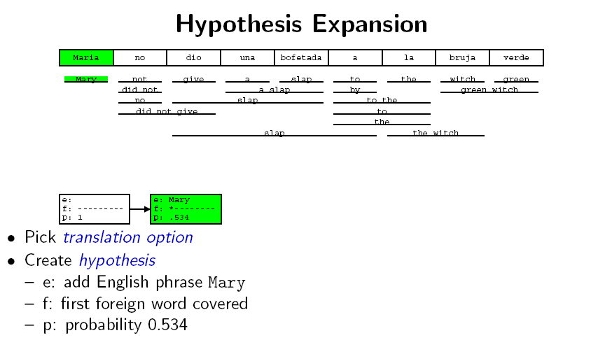
Slide from Koehn 2008

Slide 36
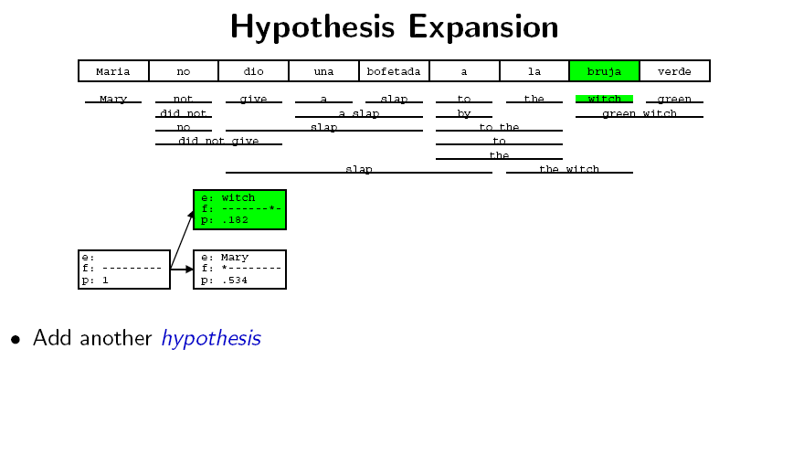
Slide from Koehn 2008

Slide 37
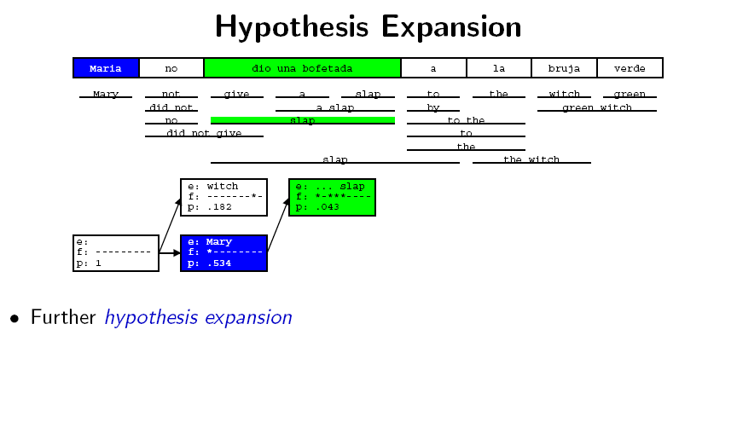
Slide from Koehn 2008

Slide 38
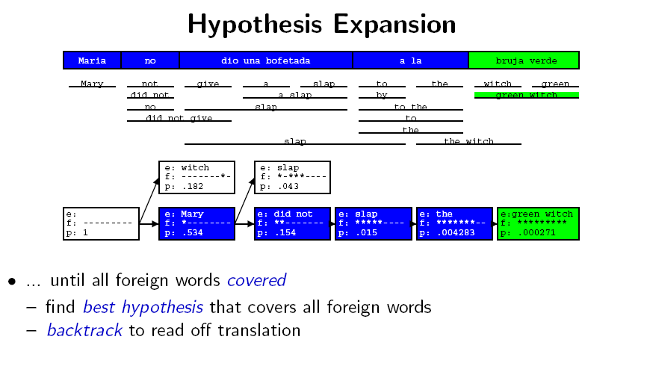
Slide from Koehn 2008

Slide 39
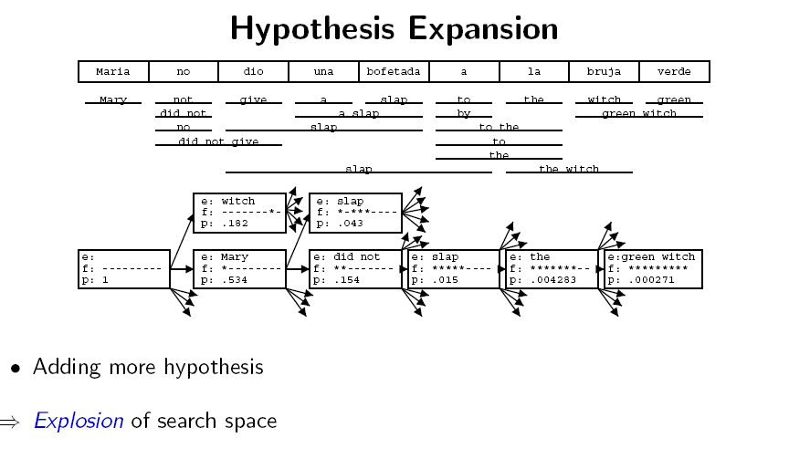
Slide from Koehn 2008

Slide 40
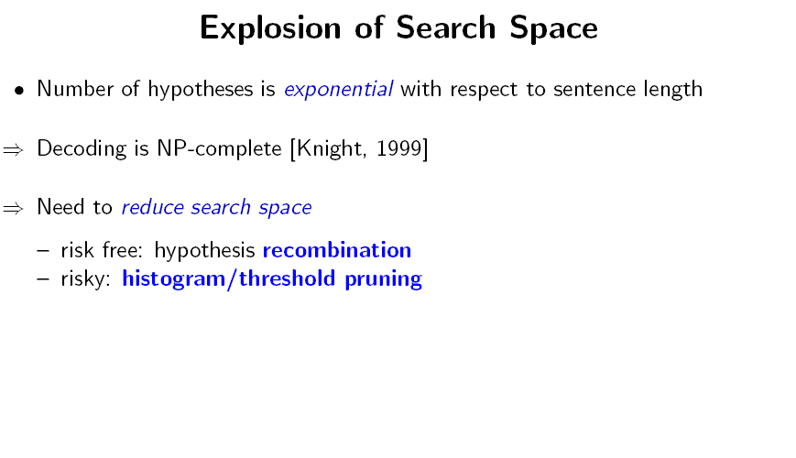
Slide from Koehn 2008

Slide 41
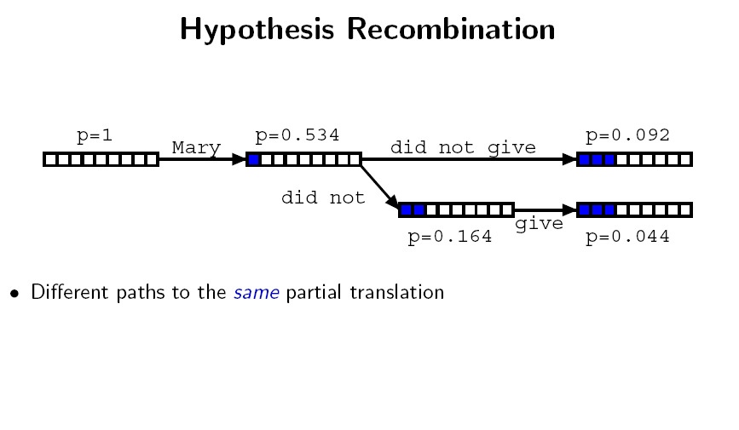
Slide from Koehn 2008

Slide 42
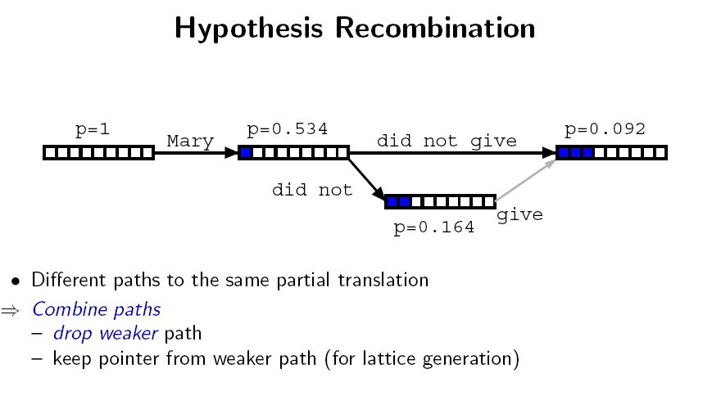
Slide from Koehn 2008

Slide 43
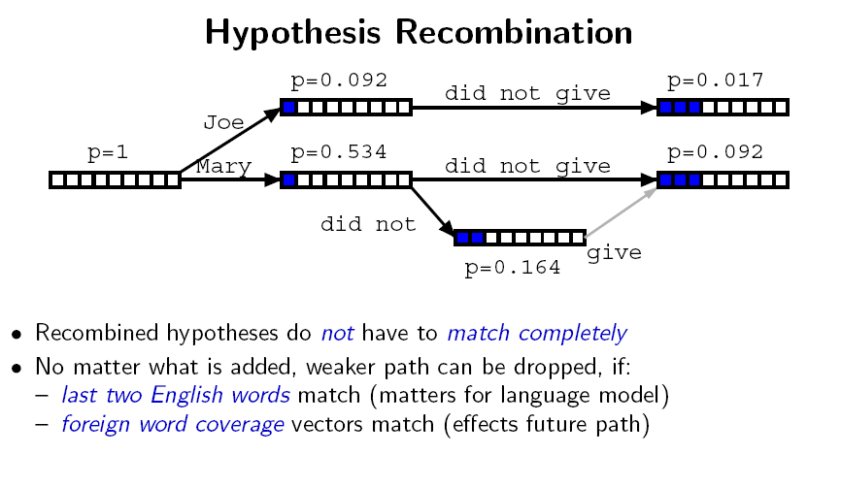
(possible future paths are the same)
Modified from Koehn 2008

Slide 44
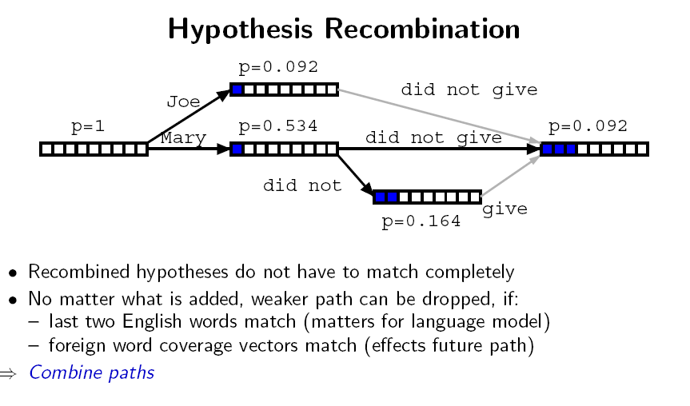
(possible future paths are the same)
Modified from Koehn 2008

Slide 45
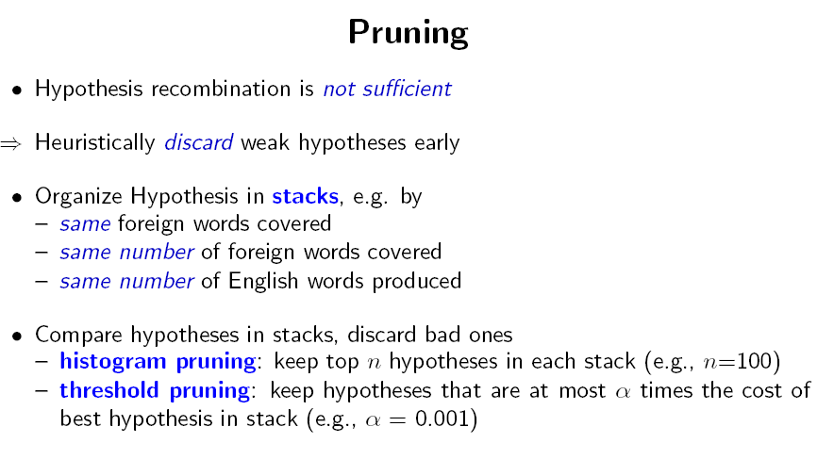
Slide from Koehn 2008

Slide 46
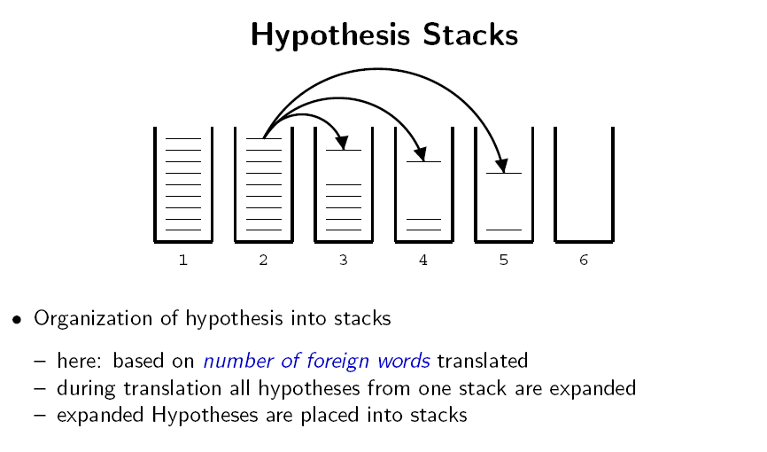
Slide from Koehn 2008

Slide 47
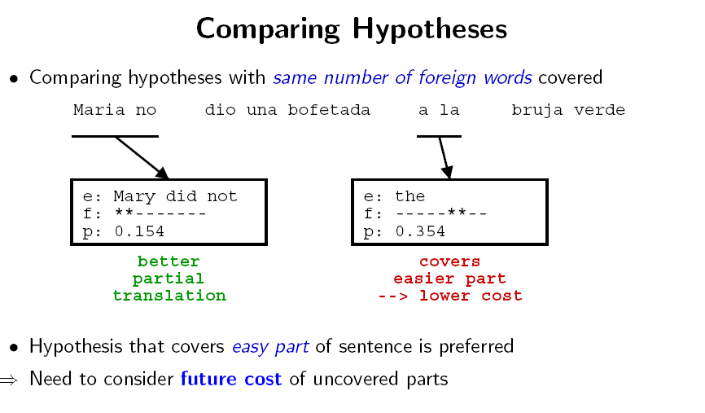
Slide from Koehn 2008

Slide 48
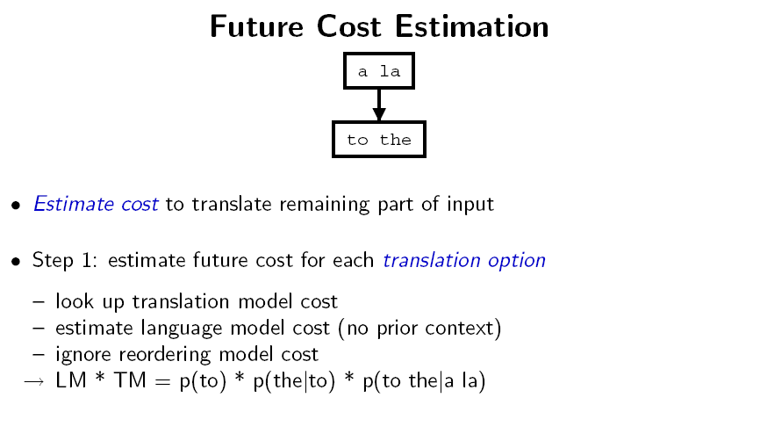
Slide from Koehn 2008

Slide 49
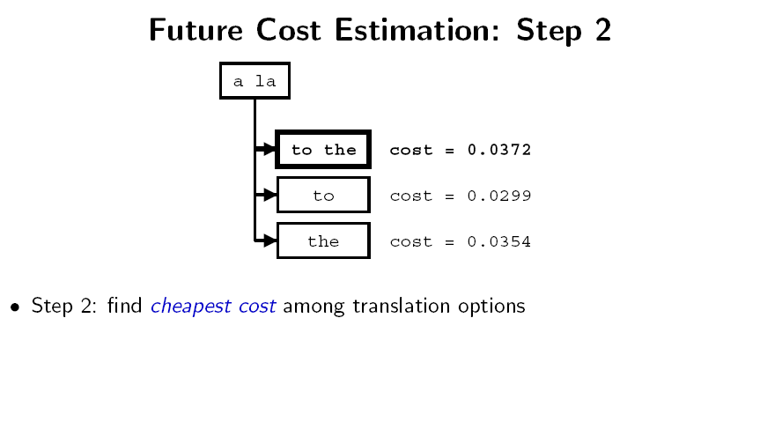
Slide from Koehn 2008

Slide 50
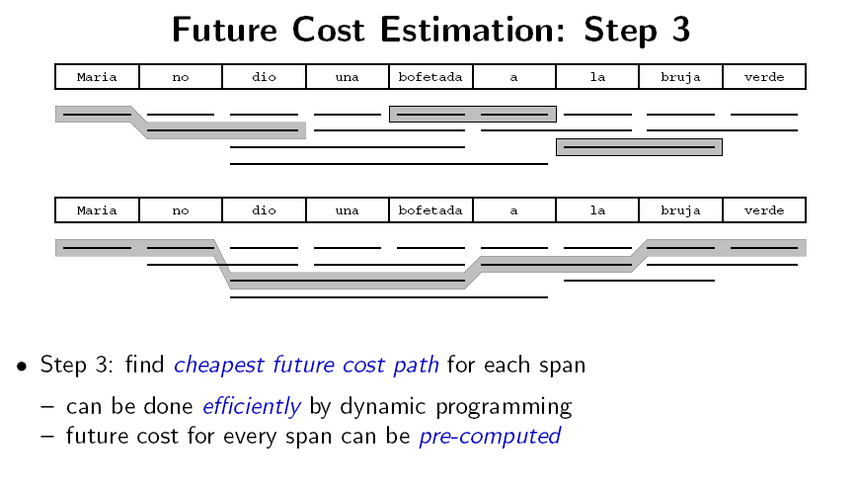
Slide from Koehn 2008

Slide 51
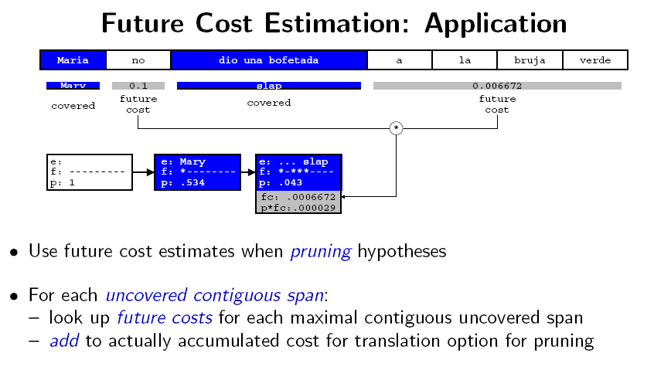
Slide from Koehn 2008

Slide 52
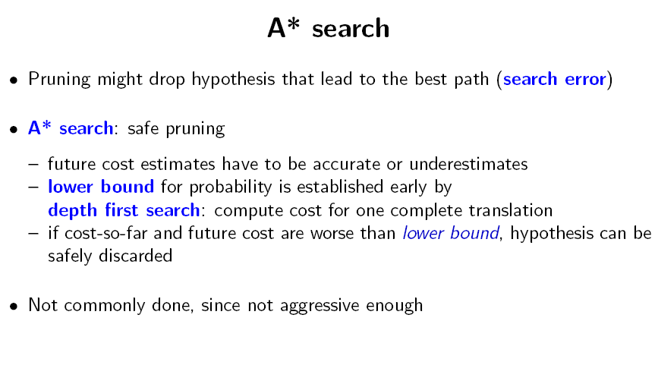
Slide from Koehn 2008

Slide 53
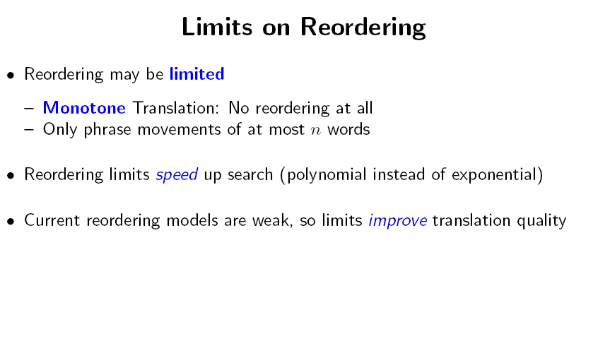
Slide from Koehn 2008

Slide 54
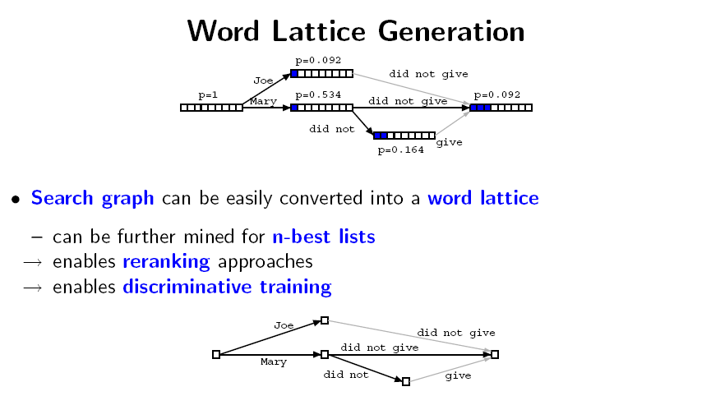
Slide from Koehn 2008

