Slide 1


An Improved Delegated Proof of Stake Consensus Algorithm

Slide 2


Slide 3
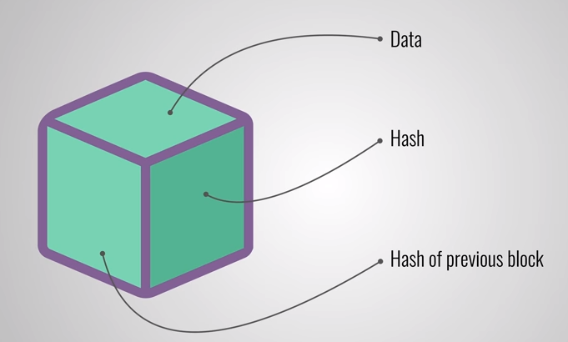

Slide 4
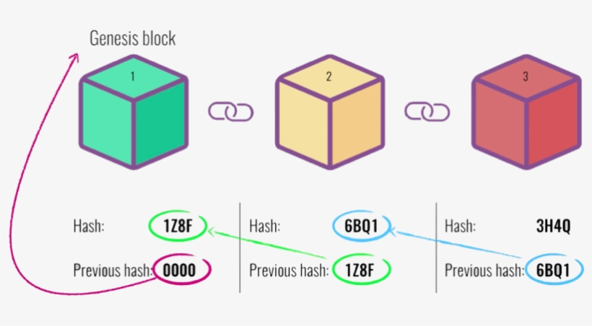

Slide 5


Slide 6


Slide 7
Proof of Work

Slide 8
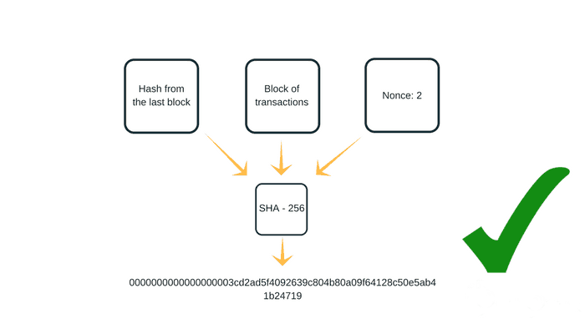

Slide 9
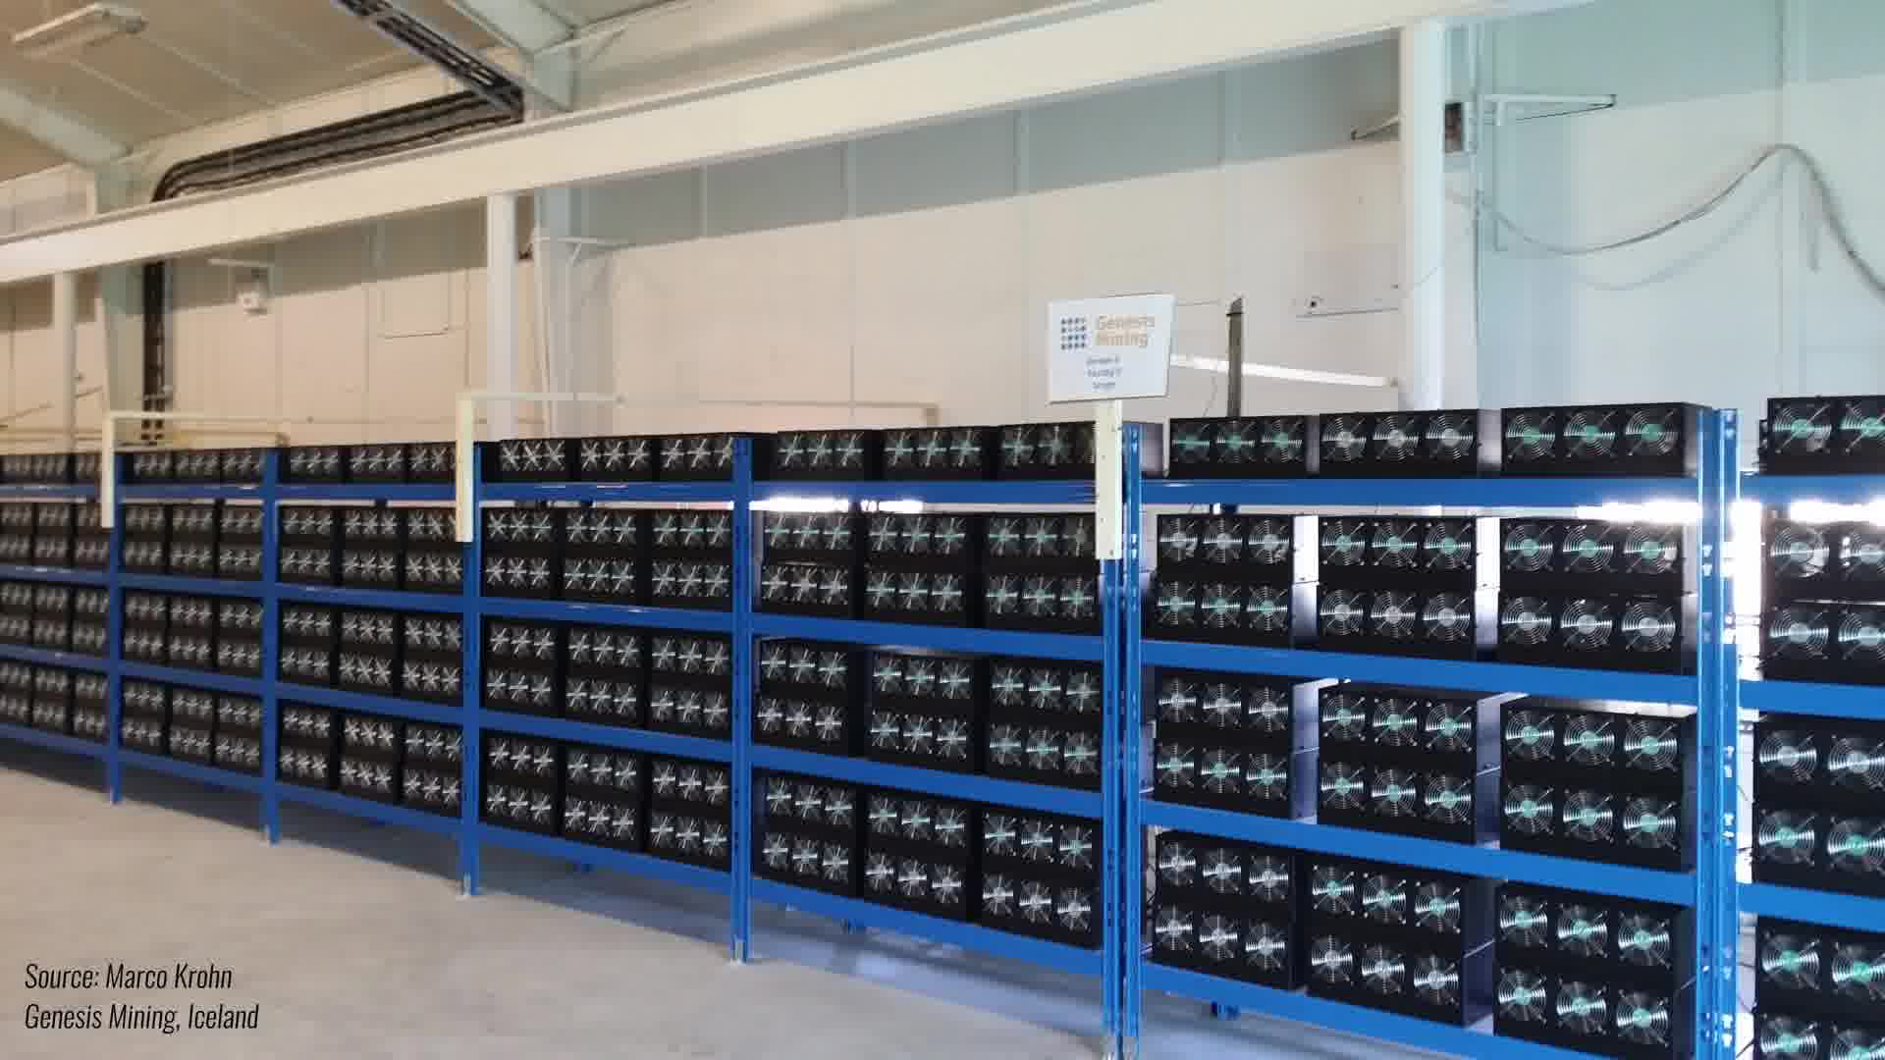

Slide 10
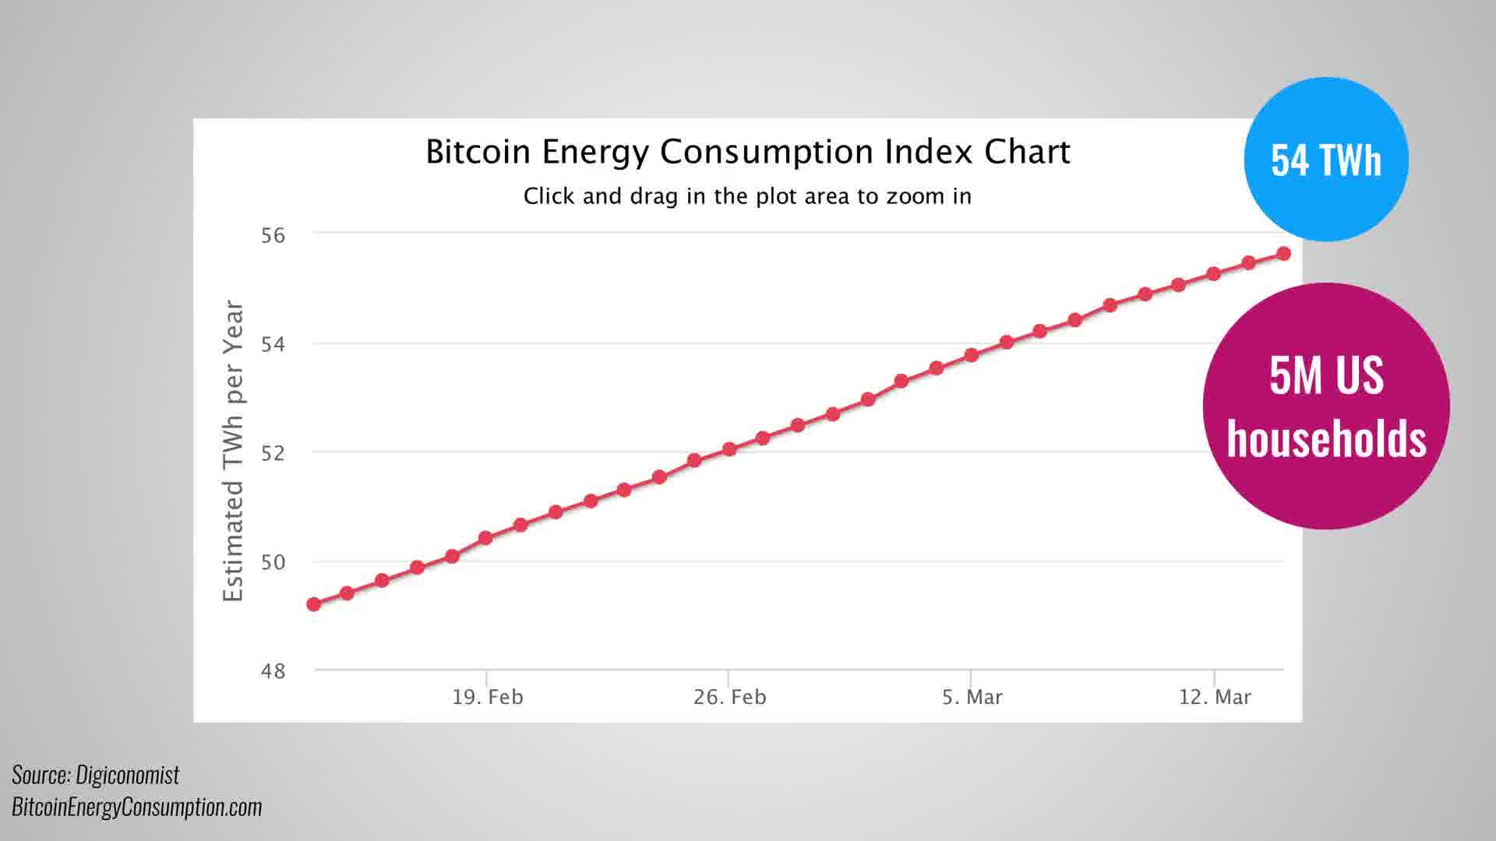

Slide 11


Slide 12


Slide 13
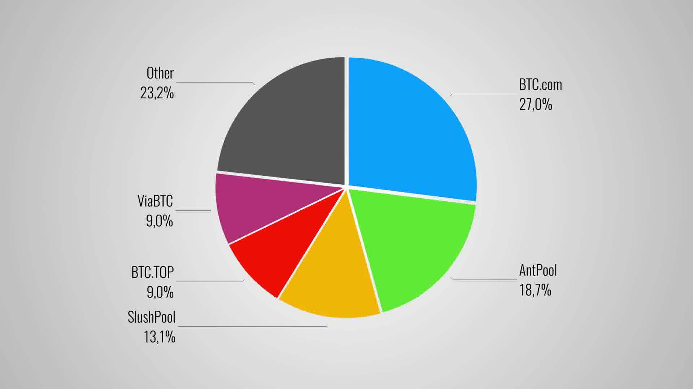

Slide 14


Slide 15
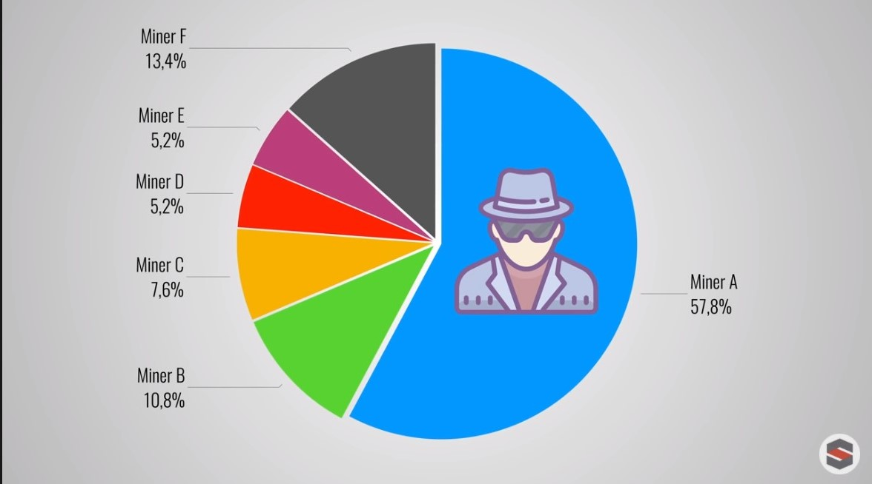

Slide 16
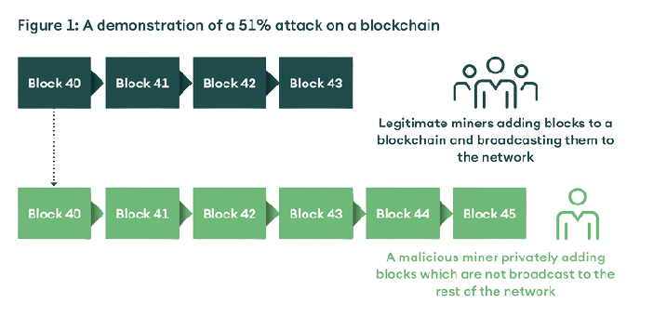

Slide 17


Slide 18
Proof of Stake

Slide 19


Slide 20
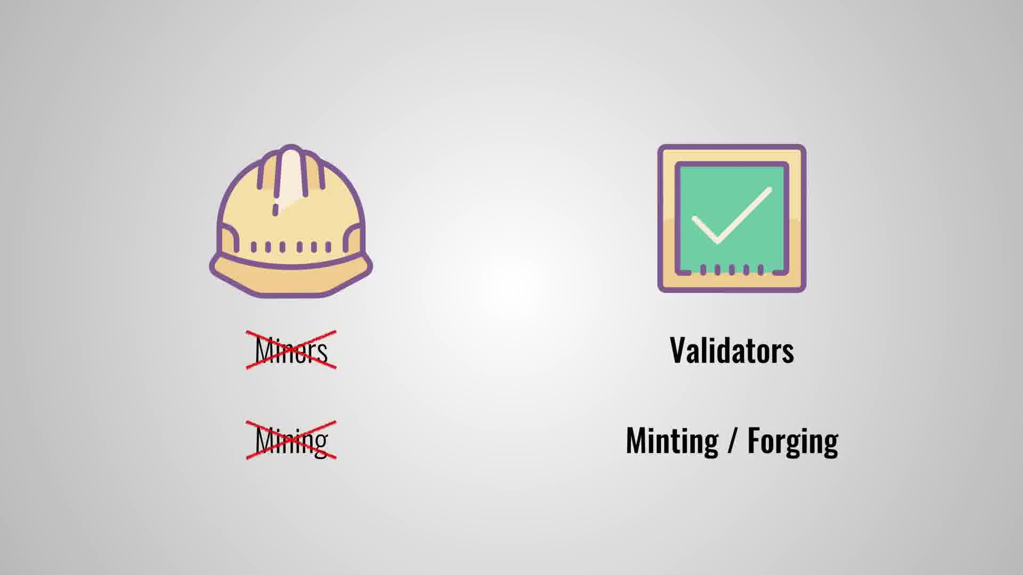

Slide 21
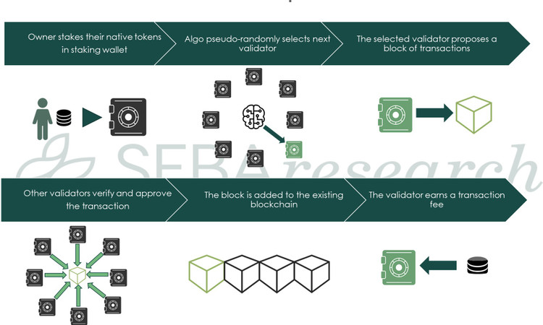

Slide 22
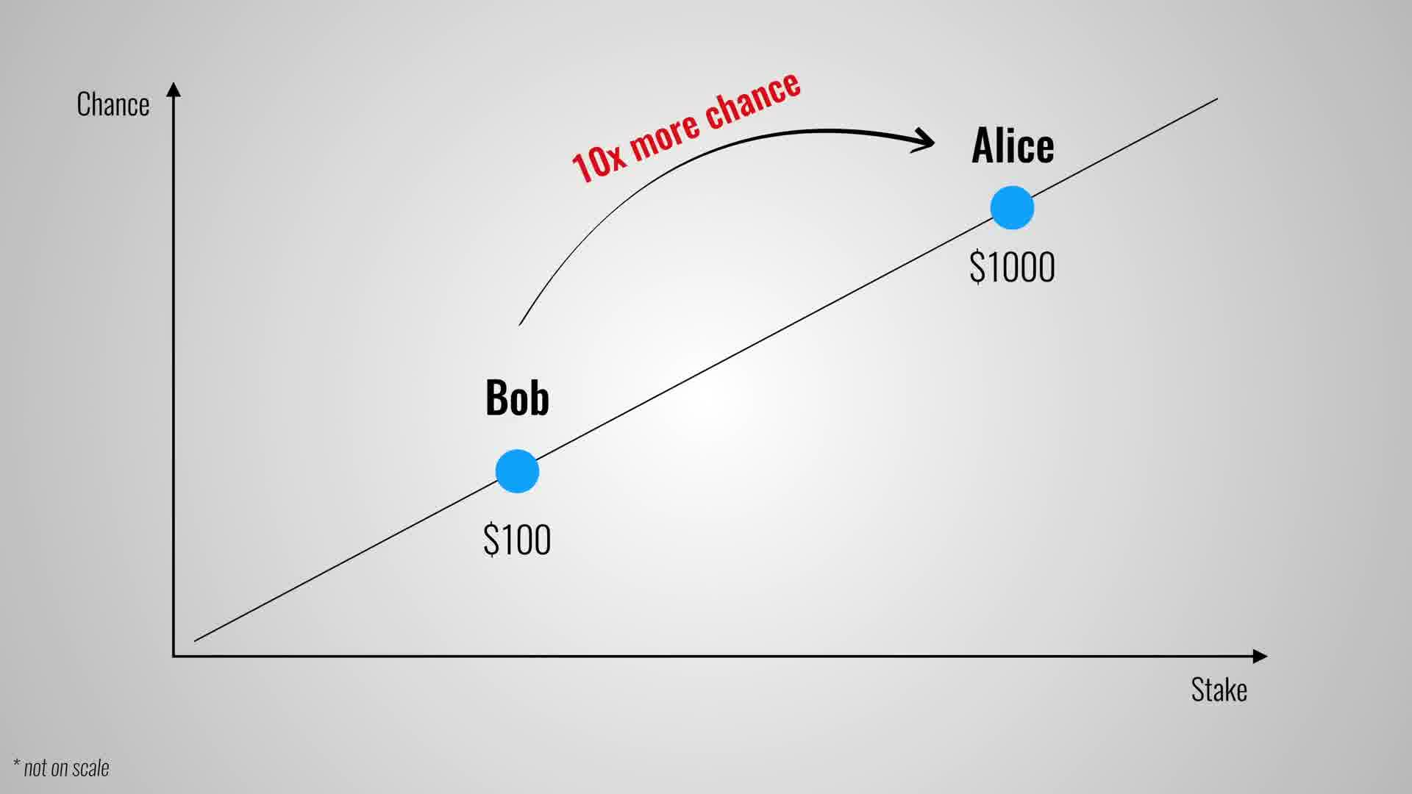

Slide 23


Slide 24


Slide 25


Slide 26


Slide 27


Slide 28


Slide 30
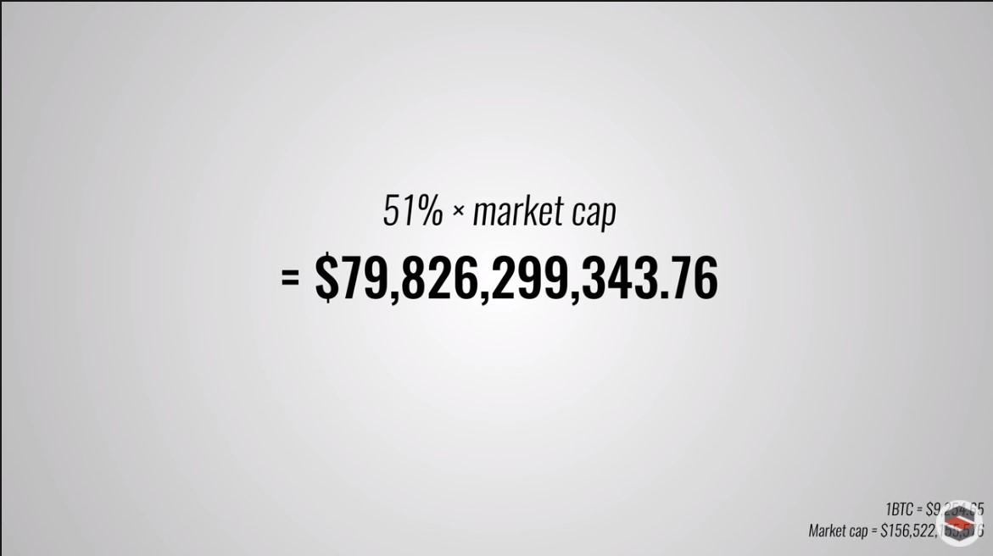

Slide 31
Proof of Stake Risk

Slide 32


Slide 33
Delegated Proof of Stake

Slide 34
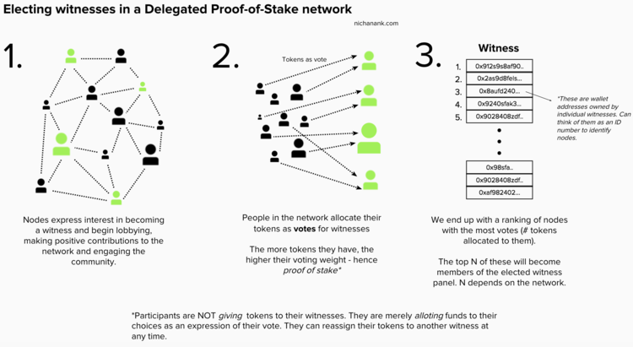

Slide 35


Slide 36
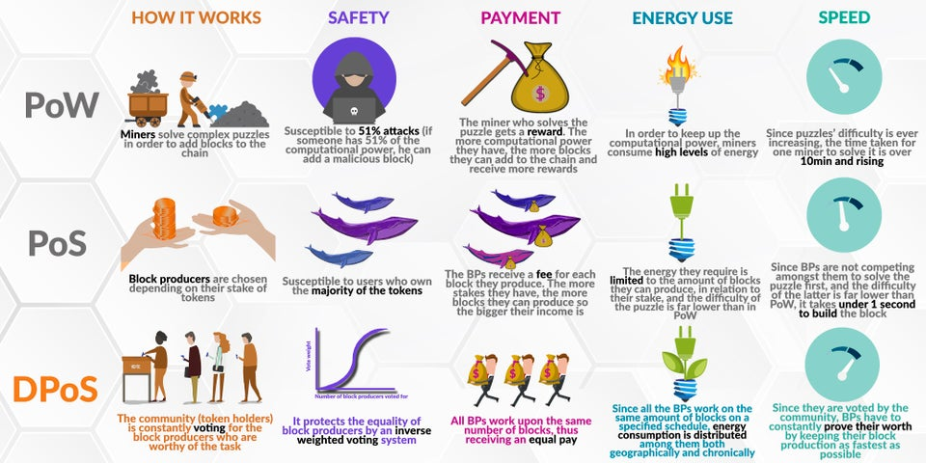

Slide 37
Reputation-DPoS

Slide 38
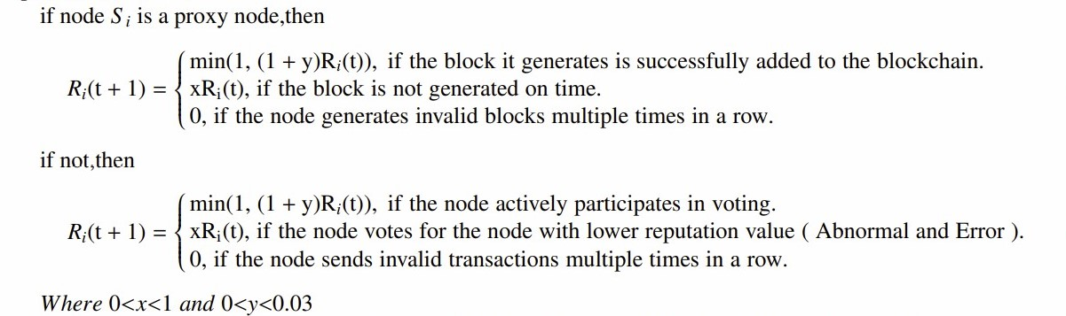
We use Ri(t) to represent the current reputation of the node S(i) in the blockchain after the t-th round of voting

Slide 39
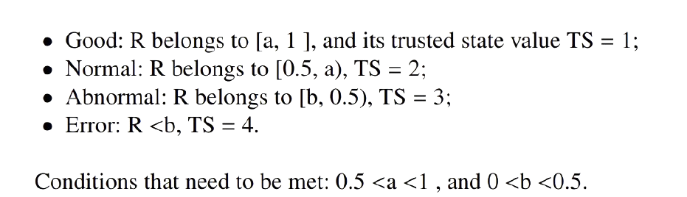
The trusted state of a node is determined by the reputation value R. We distinguish the following four trusted states:

Slide 40
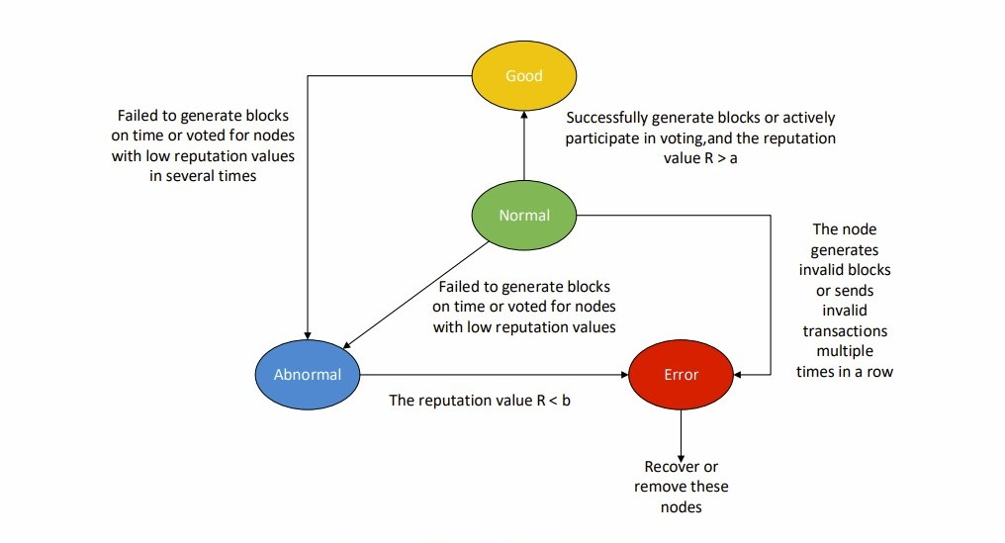

Slide 41
Incentive mechanism
if node I successfully generates a block, the node’s trusted state value TS is first obtained, and then the node is calculated to obtain the final transaction fee reward R. The value of R is equal to the original transaction fee reward F / TS
The increase of reputation value makes the node obtain a good trusted state and improves the probability of the node being elected as a consensus node.

Slide 42
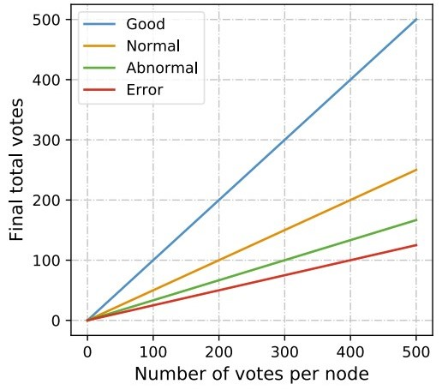
Selection of consensus nodes
At the beginning of each election cycle, the actual number of votes obtained by each node is calculated as follows:
S = V/ TS
TS represents the trusted state value of the node, and V represents the number of votes obtained by the node. Rank according to the value of S, and finally select a certain number of nodes with the highest ranking.

Slide 43
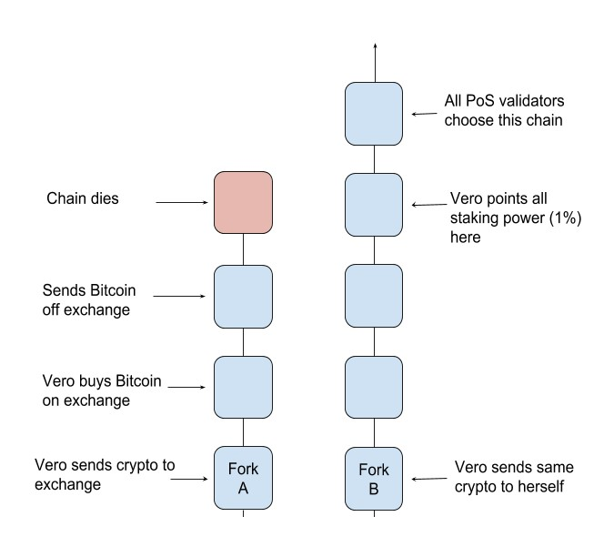
Nothing at stake

