Slide 1



Developing a Data Harvester in the Amazon Cloud for the Automated Assimilation of Florida’s Healthy Beaches Reports into the GCOOS Data Portal
Robert Currier, Mote Marine Laboratory
Dr. Barbara Kirkpatrick, TAMU/GCOOS

Slide 2

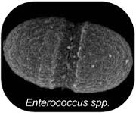
Overview
FL Department of Health monitors 34 coastal counties
E. coli/Enterroccus samples taken weekly
DOH data publicly available but no API
Original DOH website used standard HTML/CSS
Python “web scraping” app developed to harvest data
DOH outsourced website to commercial provider

Slide 3





We had no access to DOH staff or API for the data
In “Big Data” world of today this is becoming typical:
What we built broke when data format changed
This is the story of how we fixed the harvester

Slide 4

Original Data Harvester
Written in Python
Used the ‘urllib’ library for web scraping
Data stored in MySQL database
Harvester ran nightly out of cron
App walked through list of counties and built url:
http://esetappsdoh.doh.state.fl.us/irm00beachwater/beachresults.apx?county=’sarasota’
Data returned as Python text object
Text object fed to regular expression for matching

Slide 5
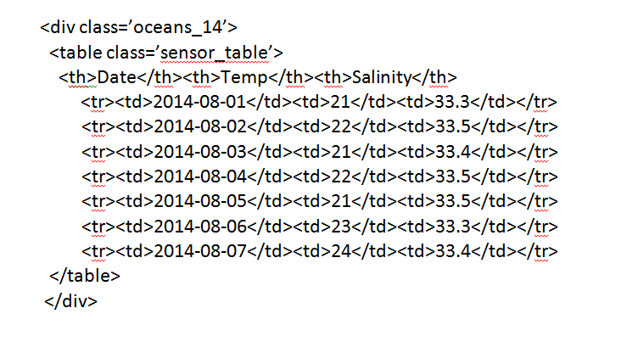
Original Data Format

Slide 6

And Then It Stopped Working…
FL DOH suddenly (to us) outsourced in early 2013
New website used proprietary JavaScript and Maps
Plain HTML no longer sent to the browser
Instead, custom JavaScript was loaded
The JavaScript used AJAX and DOM manipulation

Slide 7
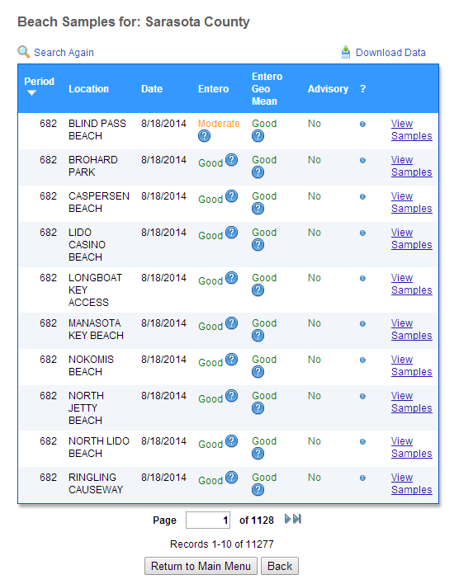
New Data Format

Slide 8

The Solution
Emulating a browser with Selenium
Portable software test framework for web applications
Can act like FireFox, Chrome and IE
Typically used for building automated tests
We repurposed and used as a virtual browser
As a browser Selenium can execute JavaScript

Slide 9
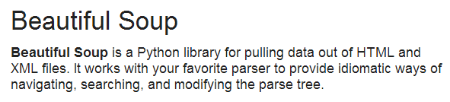

Soup’s On!
Selenium worked and we now had data available
But data was very unstructured and massively ugly
BeautifulSoup4 to the rescue…

Slide 10
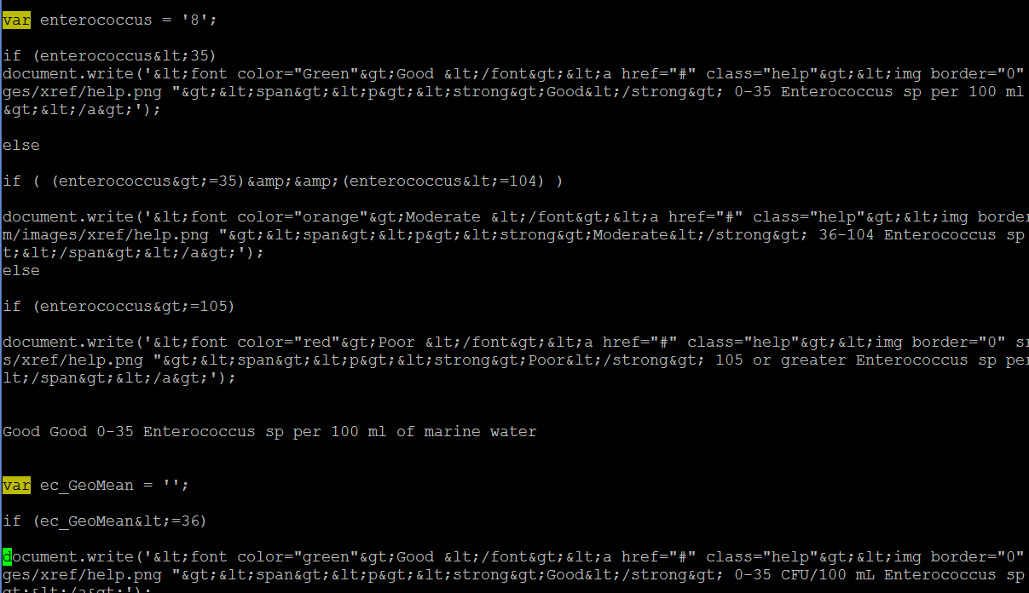
And The Soup Was Tasty!
BeautifulSoup4 gave us back our “structured” data
Some modification needed to data parsing code as…
Locations, variables and dates were not on same line

Slide 11
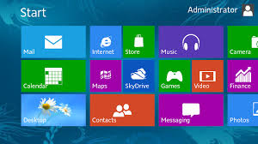
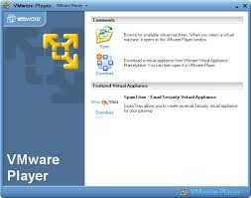

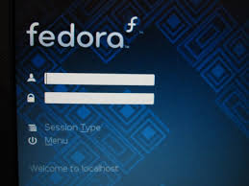
The New Code Worked Perfectly In Our Development Environment

Slide 12
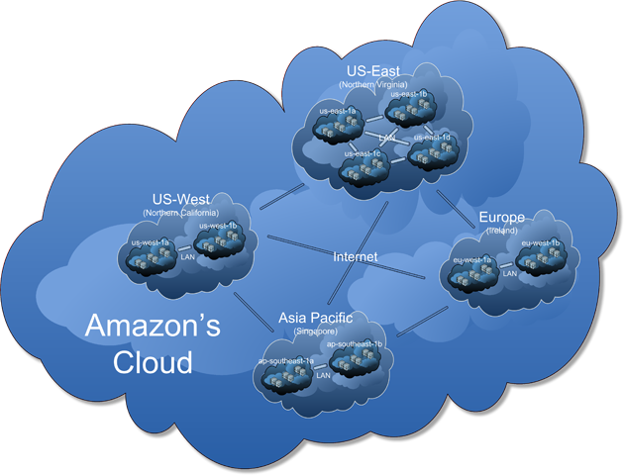
But Failed Spectacularly When We Deployed

Slide 13

What Happened?
Amazon EC-2 instances are “headless” servers
No display hardware
No graphics libraries (GTK+)
Since no graphics libraries, no browsers
Without a browser, we crash and burn

Slide 14

Adding A Virtual Head
http://joekiller.com provided us with a script that pulled the source and built GTK+ on our cloud server in under two hours. Thanks, Joe Lawson!
Unfortunately, the script bombed and didn’t build FireFox. We had to download the source and build by hand.
Now we had a working browser, but no monitor on which to display our output…

Slide 15

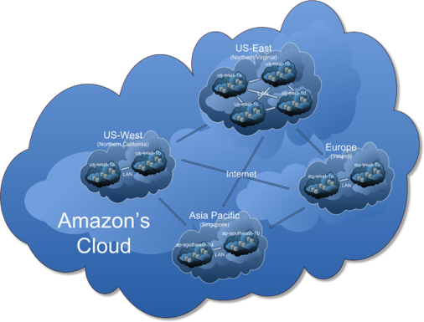
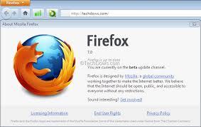
Getting A Head with XVFB
XVFB: The X virtual frame buffer
Performs all graphical operations in memory
Doesn’t show output
Primarily used for testing, but…
We repurposed, just like Selenium
+
=

Slide 16
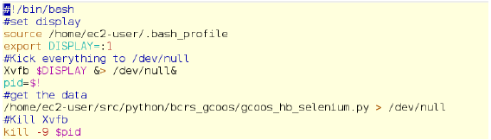
Automating The Process

Slide 17
Conclusions
Don’t be afraid to use untraditional data sources
But be prepared for your code to break
We live in a data rich environment
But most of the data is very messy/unstructured
So tread lightly, and don’t lose your head! ☺

Slide 18

Thanks To:
Mote Marine Laboratory
Gulf Coast Ocean Observing Systems
Texas A&M Department of Oceanography
All the Free and Open Source Software developers

Slide 19


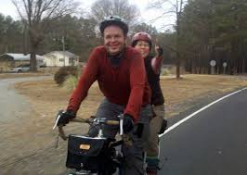
In Remembrance Of
Seth Vidal, creator of ‘yum’, friend and FOSS guru
Killed while biking on July 8th 2013 in Durham, NC

