Slide 1
Urban Traffic Twin
A calibrated digital twin of one Paris junction: signal control for every user
Bd de l'Hôpital × Bd Saint-Marcel, next to the Pitié-Salpêtrière hospital, Paris 13e
Cars · buses · an ambulance · pedestrians: fixed, actuated, rules and RL control compared on the same seeds
Motez Jerbi, mrvolcon1
v1 — provisional (before the field visit) · 2026-10-23
Simulated data · ASSUMED signal program · field visit 3-5 Nov 2026 not yet done
Notes:
Open with the four people of spec 1.1 stuck in the same morning peak. One real Paris junction, modelled and calibrated, four signal strategies compared fairly, and an app that tells each user what matters to them. Say early that every number is simulated and that the signal program is assumed until the field visit.

Slide 2
Four users, one junction, one question
Can adaptive signal control cut every user's delay without sacrificing one of them?
Student
Ambulance
Bus driver
Pedestrian
Will I make the exam? A travel time with an honest interval and a departure advice.
Clear the junction now: preemption of the signals on the way to the hospital gate.
Am I on schedule? Delay against the timetable, headway, priority.
Can I cross? A verdict for my walking speed, and a wait that stays bounded.
The answer is measured per user, on the same demand and the same seeds for every controller, with pre-registered statistics (spec 13.3).
Simulated data · ASSUMED signal program
2
Notes:
These are the personas of the spec. The fifth profile, the operator, compares the strategies. The equity question is the hard part: a controller can lower the average delay while one user group pays for it, so every result is broken down per user and checked for hidden degradation.

Slide 3
The site: Bd de l'Hôpital × Bd Saint-Marcel
Paris 13e, next to the Pitié-Salpêtrière hospital, sensor node 302
N Bd de l'Hôpital (Austerlitz)
Signalised junction
three general legs, two bus-only legs, four signalised crossings, one traffic light
Buses
lines 91, 24 and 57 with the Saint-Marcel - La Pitié stop
Ambulance
N to S towards the hospital main gate, one per run (seven in the ambulance probe)
Sensors
City of Paris permanent loops: hourly flow and occupancy, one per general approach
Simulated window
07:30-09:30, two hours of the school-term Tue-Thu peak
W Bd Saint-Marcel
NB bus road · hospital gate
S Bd de l'Hôpital (Place d'Italie)
Simulated data · ASSUMED signal program
3
Notes:
Chosen with the spec's weighted grid: the only candidate with usable sensors on its approaches, a hospital, three bus lines and busy crossings. The drawing is a schematic, not to scale. OSM has no crossing on the N arm.

Slide 4
From open sensor data to five user views
Six layers, each with a simpler fallback that already works
Data
Simulation
Control
Prediction
API
App
Paris permanent sensors, typical school-term days
SUMO network from OSM, demand calibrated per arm
S0 fixed · S1 actuated · S2 rules · S3 RL, one Safety Guard
ETA quantiles with a conformal 80 % interval
FastAPI on precomputed runs, one envelope, degraded modes
five profiles, replay, operator dashboard
Everything the app shows comes from the simulation, through the API, labelled 'données simulées' with the calibration date (ENF-05).
Simulated data · ASSUMED signal program
4
Notes:
Data, simulation, control, prediction, API, app. Every layer has a simpler fallback: rules if RL fails, the reference table if the ETA model is missing, degraded answers if a run is missing. Nothing is a live city feed.

Slide 5
Twin vs reality: flows PASS, timing not yet measured
Spec 13.4 asks for three checks before any comparison; one is done
A-02 flows
GEH < 5
Signal timing
Queues
6/6
10/10
41
6
inbound arm × slot rows within ±15 % of the sensors
distinct counts
rows NOT_MEASURED until the field visit
rows NOT_MEASURED until the field visit
What is ASSUMED
The signal program (cycle and greens), turn shares, lane use, bus headways and dwell, pedestrian flows. The inbound flow check is close to circular: the demand is built from the same sensors. The field visit (3-5 Nov 2026) measures the program and the queues; every result is provisional until then.
Simulated data · ASSUMED signal program
5
Notes:
Be explicit: A-02 passes, but it mostly shows that the network carries the demand in the right time slots. The independent checks are the signal timing and the queues, which wait for the field visit. If the measured program differs, Parts 3 to 8 are rerun and the report gets a version 2.

Slide 6
Four controllers behind one Safety Guard
Same demand, same seeds; the guard filters every stage request of every controller
S0
S1
S2
S3
Fixed time
Actuated
Rules
Reinforcement learning
the ASSUMED provisional program
SUMO-style gap logic: extend a green while vehicles arrive
ambulance preemption, bus priority, box clearing, pedestrian protection
a DQN policy choosing stay or advance every few seconds
Safety Guard (EF-11)
Clearance never cut · min green · strict stage order · max green · anti-starvation · and last, the pedestrian shield: no crossing waits past the 90 s bound. Every run audits the phases it showed.
Simulated data · ASSUMED signal program
6
Notes:
S2 is the rules controller of Part 4; S3 is the RL policy selected in Part 7. The guard and the preemption keep priority over every controller, RL included. The shield is what makes S2's longer greens safe for pedestrians.

Slide 7
Rules cut the delay per person by 23 % against fixed time
Mean delay per person (all users, occupancy-weighted), seeds 1-10, paired, same demand
-23 %
S2 vs S0: 63.6 s → 48.9 s per person
A-06 PASS: S3 on seeds 1-10
S3 vs S1 (actuated): all/person_delay_mean 57.1 → 46.0 s (n = 10), HL -9.5 s [95 % CI -17.5, -6.4], exact two-sided p 0.0020, Holm p 0.0059 (α 0.05): S3 better
Simulated data · ASSUMED signal program
7
Notes:
Same demand and seeds for every controller. The person delay weights bus riders by an assumed occupancy, so it is the headline that reflects every user. S2 is the main solution; S3 is shown as computed by the pre-registered Part 8 run, whatever its direction.

Slide 8
Who pays? Pedestrian curb wait worsens most: +7.0 % (S3 RL)
Change against S0 per user's headline KPI, seeds 1-10 (negative is better)
Hidden degradation (13.3)
Flagged: main S1, main S2, main S2_noP, main S3, main S4, ambulance_probe S2, ambulance_probe S2_noP, ambulance_probe S3, ambulance_probe S4. The person delay improves while a car arm, a bus flow or a crossing is more than 5 % worse than S0.
Simulated data · ASSUMED signal program
8
Notes:
Equity is checked on every KPI against S0, per car arm, bus flow and crossing. The pedestrian cost is the recurring trade-off: longer greens for vehicles mean longer curb waits, kept under the bound by the shield.

Slide 9
Preemption: the ambulance arrives 36 s sooner (A-05 PASS)
Travel time from the planned departure, main family, one ambulance per run, seeds 1-10
Main family, S2 vs S0 (A-05)
HL -36.5 s [-70.0, -14.0] s, one-sided p 0.0020
Probe (7 ambulances), S2 vs S0
HL -83.1 s, p 0.0010
Probe, S2 vs S2 without preemption
HL -15.8 s, p 0.0010
One ambulance per run gives the main test little power; the probe family attributes the gain to preemption.
Simulated data · ASSUMED signal program
9
Notes:
A-05 is the pre-registered one-sided test on the main family. The probe family runs seven ambulances per run and compares S2 with and without preemption, which isolates the effect. The ambulance obeys red lights in the model, so preemption is the only way through.

Slide 10
RL learns, but the interim spec 10.6 verdict is FALLBACK
Part 7 dev-test seeds 3020-3029, looked at once; S2 stays the main solution
C1 · pass
Person delay vs S1
C2 · fail
Equity vs S1 (≤ 5 %)
C3 · pass
Safety
C4 · pass
Reproducibility
A-06 on seeds 1-10: PASS
S3 vs S1 (actuated): all/person_delay_mean 57.1 → 46.0 s (n = 10), HL -9.5 s [95 % CI -17.5, -6.4], exact two-sided p 0.0020, Holm p 0.0059 (α 0.05): S3 better
Spec 10.6 check: seeds 1-10 confirm the interim verdict.
-9.5 s
+6.2 %
0
5 of 5
HL, p 0.0020
pedestrian curb wait
violations
picks below S1
A-06 on seeds 1-10, S3 − reference, person-weighted delay
vs S1 actuated (primary): HL -9.5 s, 95 % CI [-17.5, -6.4] s, Holm p 0.0059: S3 better
vs S2 rules: HL -2.5 s, 95 % CI [-5.0, -0.6] s, Holm p 0.0137: S3 better
vs S0 fixed: HL -14.3 s, 95 % CI [-29.4, -10.7] s, Holm p 0.0059: S3 better
Why the fallback
S3 does not observe pedestrians; the shield alone keeps the bound, so curb waits drift up while cars and buses gain.
Simulated data · ASSUMED signal program
10
Notes:
The criteria were pre-registered (D79) and looked at once. C2 fails on the pedestrian curb wait, so the week-7 rule makes the rules controller the main solution and RL a study. A-06 is still run on seeds 1-10 as registered and presented whatever its direction; it does not reopen the choice.

Slide 11
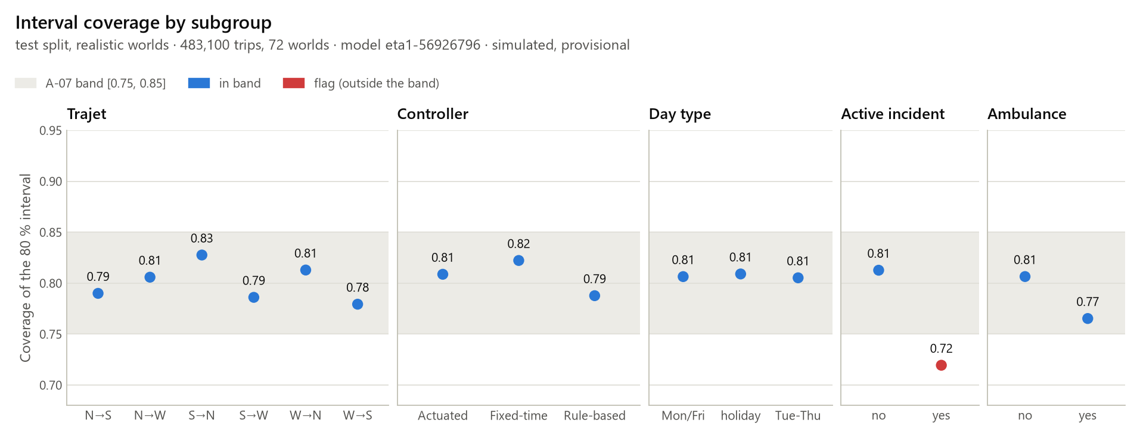
An honest travel time: the 80 % interval covers 80.6 %
A-07 PASS: target band 75-85 %, realistic test worlds generated after the model was frozen
Coverage
80.6 % [80.2 %, 81.0 %]
Median error (MAE)
10.2 s vs 39.6 s for the reference table
Trips
483,100 trips in 72 test worlds
Simulated data · ASSUMED signal program
11
Notes:
XGBoost quantiles plus a conformal step calibrated on separate worlds. The student view always shows the interval and a departure advice. The model learns the simulator, so it is retrained after the field visit.

Slide 12


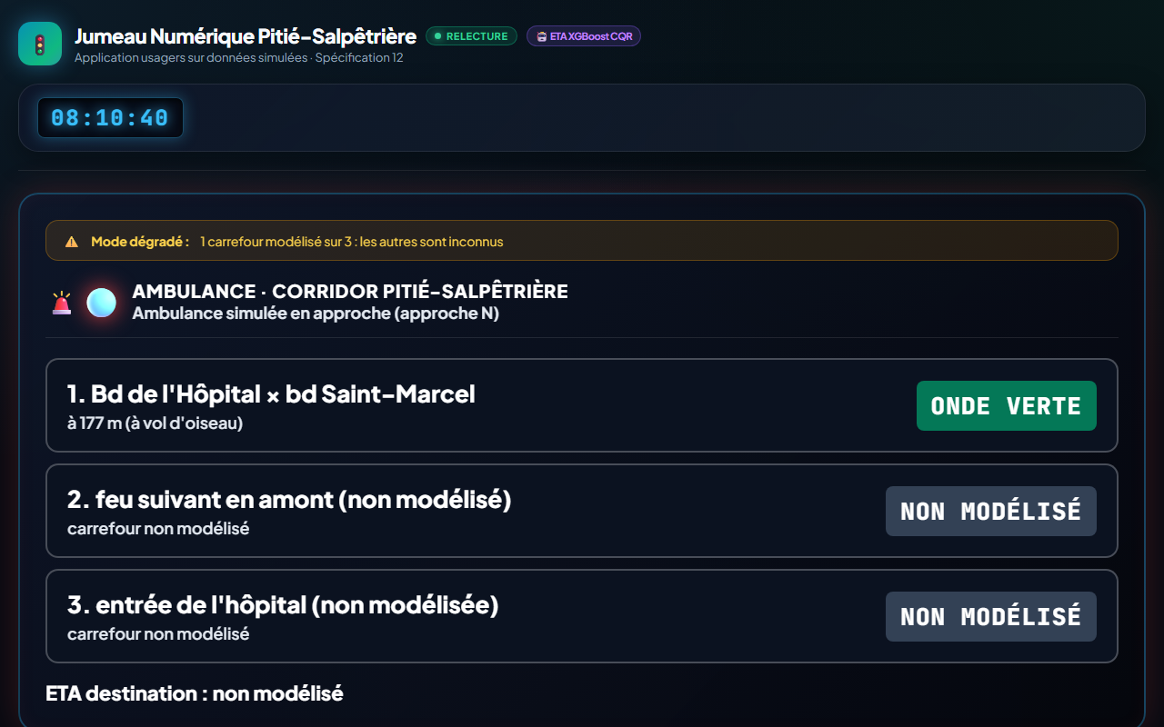
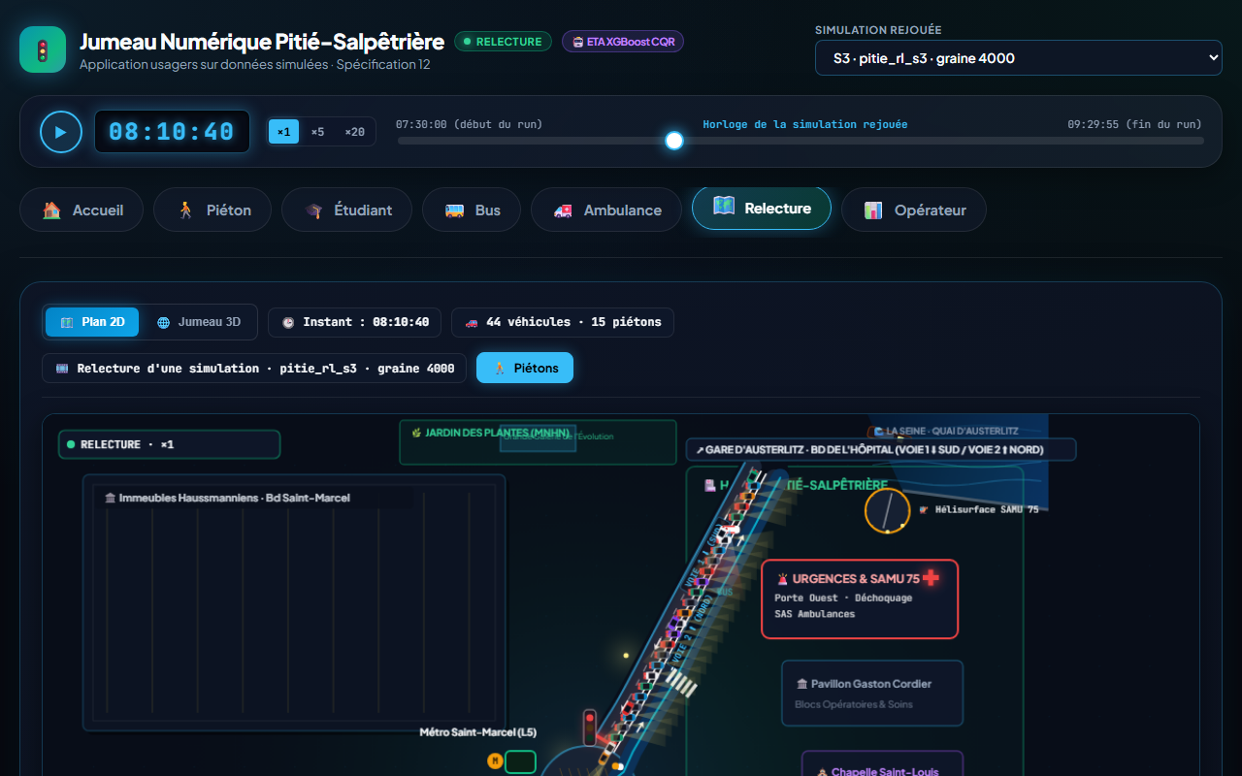
One API, two front ends, every state handled
User app (five profiles and replay) and the Streamlit operator view, both through the API
States (spec 12.1)
loading · ok · degraded · stale · unavailable · error
Honesty
'données simulées' with the calibration date in every view
At most 2 clicks
from the home screen to every answer (ENF-06)
A-08
PASS
Home: five profiles
Pedestrian
Ambulance (kiosk)
Replay
Simulated data · ASSUMED signal program
12
Notes:
The user app is Motez's design, fed only by the API; the operator view is Streamlit. No value is invented on the client: a missing answer shows a degraded or unavailable state with the reason.

Slide 13
Acceptance: 9 of 10 criteria met so far
Spec 17, each status generated from its evidence file
A-01
A-02
A-03
A-04
A-05
PASS
PASS
PASS
PASS
PASS
same seed, same KPIs
simulated flow vs sensors
four controllers, one KPI file
no dangerous sequence, bounded pedestrian wait
preemption speeds up the ambulance
A-06
A-07
A-08
A-09
A-10
PASS
PASS
PASS
PASS
PENDING
RL vs baselines, shown either way
ETA interval coverage
every view via the API, all states
demo without touching the code
3 to 5 real users
Simulated data · ASSUMED signal program
13
Notes:
Each lamp is generated from its evidence file. PENDING means the evidence does not exist yet. Still pending: A-10 (3 to 5 real users): no session yet; 3 to 5 real sessions needed (spec 12.2). The presenter's own rehearsal of the demo is not recorded yet. A-06 passes when the comparison is valid and shown, whatever its direction; A-10 needs three to five real users.

Slide 14
Limitations and what comes next
Limitations
• The twin learns the simulator: one junction, one day type, ten seeds.
• The signal program is ASSUMED until the field visit; timing and queues are NOT_MEASURED.
• Detection is ideal (pedestrians, buses, ambulance before it enters).
• S3 does not observe pedestrians; S4 (S3 without preemption) is out of distribution.
• One ambulance per run gives A-05 little power.
Next
• Field visit 3-5 Nov 2026: measured program, queues, counts.
• If the program differs: rerun Parts 3 to 8, report version 2.
• Real user sessions (A-10), then fixes and a second round.
• RL that observes pedestrians, only as a new pre-registered study.
Simulated data · ASSUMED signal program
14
Notes:
Be direct about the limits: everything is simulated, the program is assumed, and the RL policy is blind to pedestrians. The field visit can change the numbers; the code and the pre-registered procedure stay.

Slide 15
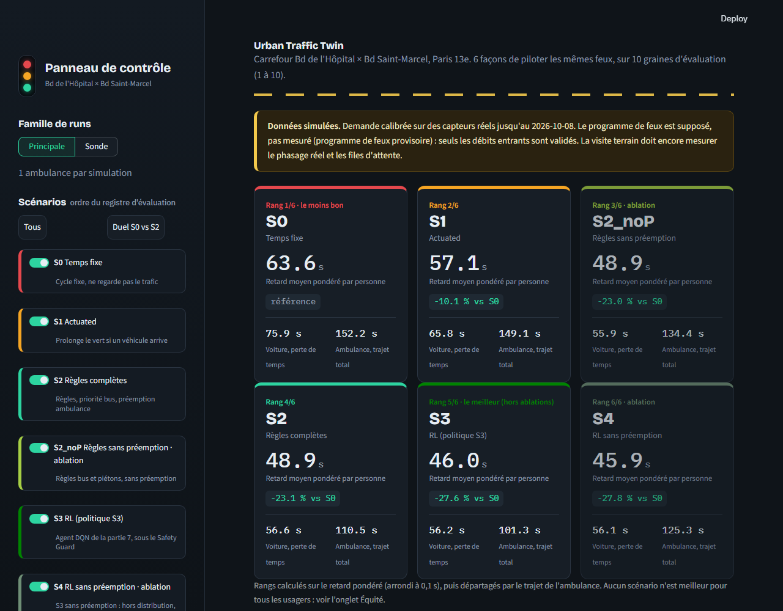
Live demo
tasks.py demo: the API and the operator view, started by one command
1 Home five profiles, two clicks to any answer
2 Pedestrian crossing S at normal walking speed
3 Student Austerlitz to the hospital, exam at 08:18
4 Bus line 91 delay and headway
5 Ambulance kiosk screen, three junctions
6 Replay the S3 run on demo seed 4000
7 Operator comparison, tests, equity, curves
Fallback
If anything fails live: the screenshots of slides 12 and 15 and the precomputed replay. No simulation runs during the demo.
Rehearsal
Automated: A-08 PASS · A-09 PASS
Rehearsed by presenter: PENDING
Replay (fallback)
Operator (fallback)
Simulated data · ASSUMED signal program
15
Notes:
Follow docs/demo/runbook.md. Say that the data are simulated, that the signal program is assumed, that RL is a study after the week-7 FALLBACK, and what A-06 showed. Switch to the fallback screenshots at the first sign of trouble.

