Slide 1
The Napper
The newest addition to the Bridgewater Culture Cornerstones

Slide 2
Our Goals
Visualize synthesized historic user data through analytical user interface
Buy in large, reduce time inefficiency and key man risk
Increase pain, encourage reflection, maximize progress

Slide 3
Our Problems
Theresa’s contacts get really dry if she sleeps in them
Deric is unable to distinguish between practical dots and practical thinking dots
YQ has not yet discovered the meaning of life

Slide 4
Diagnose the Problems
“Teach your people to fish rather than giving them fish.”
~ Genesis 14.18
~ Principle 122

Slide 5
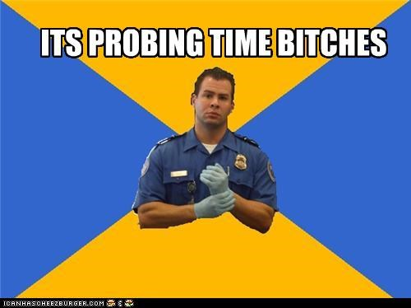
Probing
Principle 99) Make the probing transparent
rather than private. That will help to assure the
quality of the probing.

Slide 6
The Evolutionary Process

Slide 7
PAIN + REFLECTION = PROGRESS

Slide 8
NAP + MAPPER = NAPPER

Slide 9
Key Features
PAIN: it is ugly and difficult to use, causing pain for the user
REFLECTION: Ludacris has a geographically diverse sex life
PROGRESS: the 4.5 hours have ended

