Slide 1


Capstone Project
Member: Mothies Raj D G
Presented by:
Mothies Raj D G

Slide 2
Agenda:
About insurancemarket.ae
Business Objective
Business Requirement
Data Analysis
High Level Architecture-insurance Sales & ConversionFunnel Analysis
Dashboard
Lesson Learnt
© Systech Solutions, Inc.

Slide 3
About insurancemarket.ae
InsuranceMarket.ae is an insurance brokerage and digital insurance platform in the UAE. It connects customers with multiple insurance providers and helps customers compare and purchase insurance policies.
The key business objective is to acquire customers, convert leads into policy purchases, generate premium and commission revenue, and improve the performance of channels and campaigns.
© Systech Solutions, Inc.

Slide 4
Business Objective
Analyze leads through different funnel stages.
1
Analyze premium revenue.
2
Evaluate campaign performance.
3
Business Requirement
Conversion Funnel Monitoring
1
Sales & Premium Performance
2
Channel, Product & Campaign Analysis
3
© Systech Solutions, Inc.

Slide 5
Data Analysis
8,000 leads were analyzed, with 6,803 reaching Stage 2, 5,123 reaching Stage 3, and 3,326 leads completing a policy purchase, resulting in an overall 41.58% conversion rate.
Stage 1 has a 100% conversion rate, while conversion decreases to 85.04% at Stage 2 and 75.31% at Stage 3, indicating increasing customer drop-off as the funnel progresses.
The business generated approximately AED 15.25M in total premium, with an average premium of AED 3.05K per policy.
Health Insurance(AED 5.82M) has the highest number of policies, followed by Motor Insurance(AED 5.53M, making these the strongest product categories by policy volume.
Premium contribution is relatively balanced across channels, with each major channel contributing roughly 19–21% of total premium, indicating no single channel dominates premium revenue.
1,485 repeat customers were identified, with a 61.09% retention rate, indicating a significant base of returning customers.
© Systech Solutions, Inc.

Slide 6
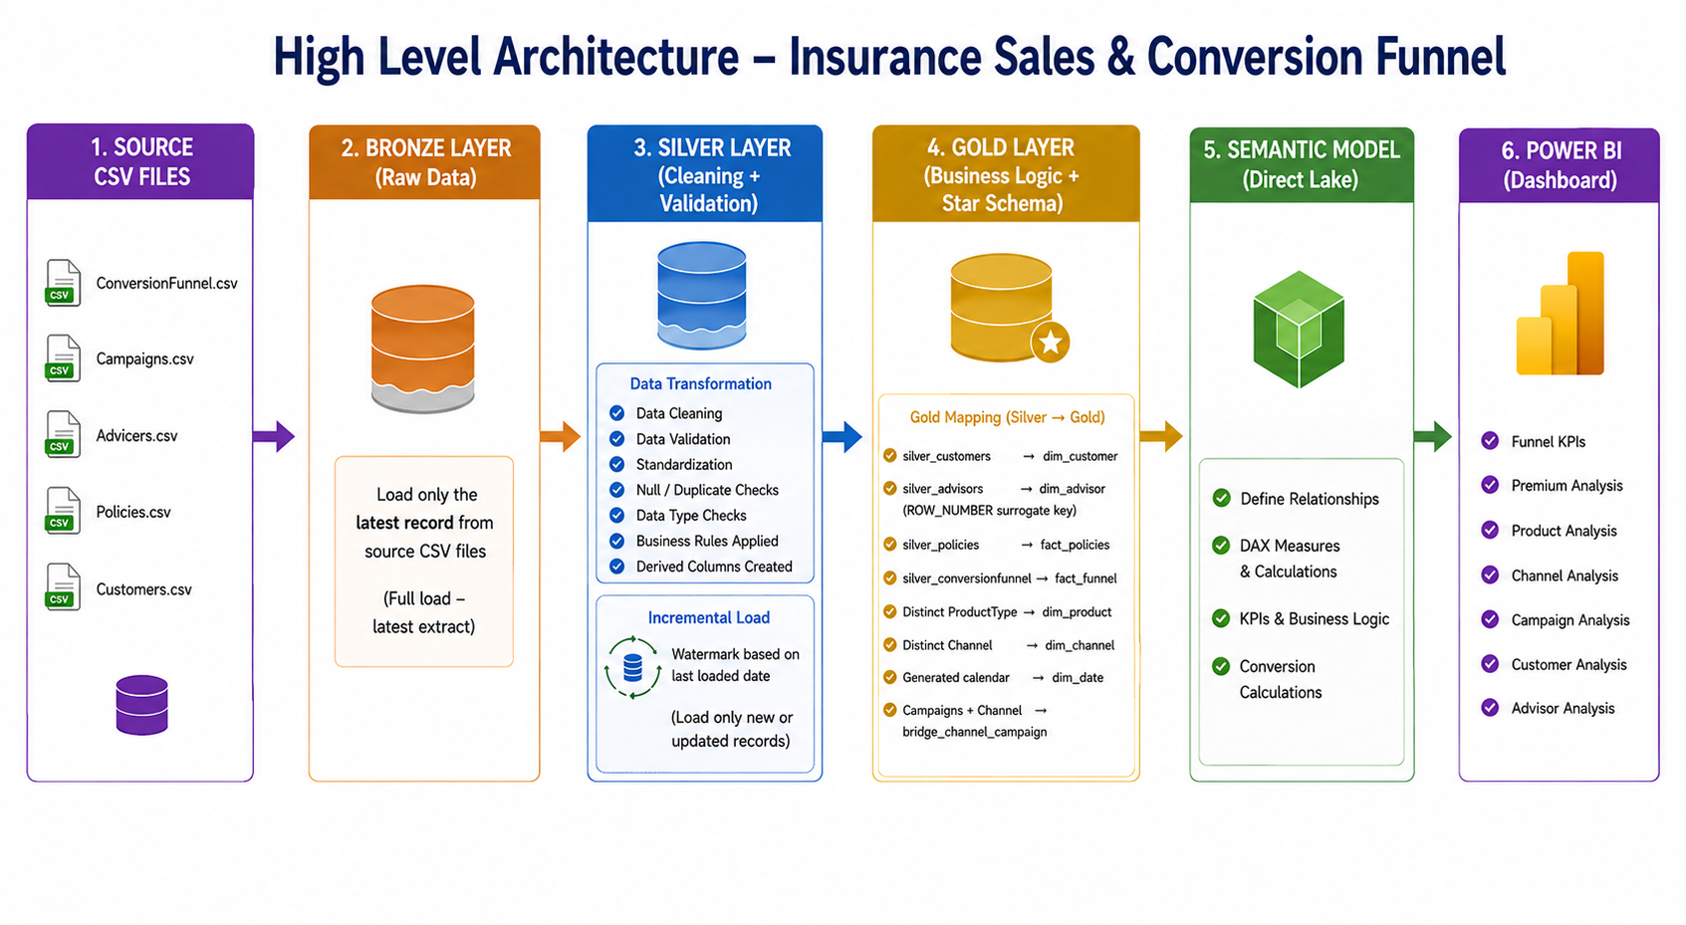

© Systech Solutions, Inc.

Slide 7
Quality Assurance
Types of Testing Performed
Transformation & Business Rule Testing
Validated funnel stages, premium calculations, conversion rates, campaign metrics and other business rules.
Major Issues Found
Invalid Funnel Date Sequence
Some records had funnel stage dates out of the expected sequence(LEAD007110, LEAD007511).
© Systech Solutions, Inc.

Slide 8
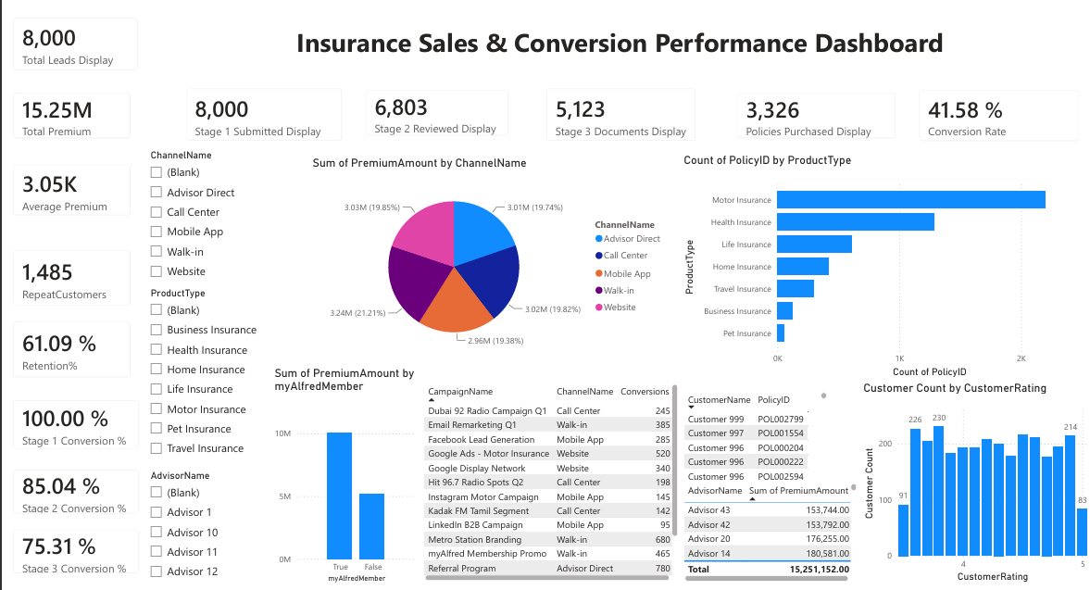

Slide 9
Lesson Learnt
Medallion Architecture – Learned how to build an end-to-end Bronze → Silver → Gold data pipeline.
Data Quality & Validation – Learned how to identify data issues, apply validation rules and maintain a silver_error_log instead of simply removing bad records.
Incremental Data Processing – Learned how watermark-based processing avoids reprocessing already-loaded records.
© Systech Solutions, Inc.

