Slide 1

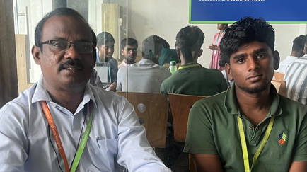
NAME: MOTHISH K
REGISTER No: 192321057
Department: IT
Ongoing Course Attendance
CSA10 Software Engineering - 83%
CSA07 Computer Networks - 91%
RESULTS
CSA03 Data Structures- C Grade - PASS
Slot A & B | Total Marks | Marks Obtained | Class Average Mark
Test 1 ( A Slot) | 20 | 16 | 14.2
Test 2 ( B Slot) | 40 | 36 | 28.6
Test 3 ( A Slot) | 20 | 17 | 14.6
Test 4 ( B Slot) | 40 | 35 | 31.8
No. of Course Completed:9
No. of Credits Completed:36
No. of Arrears:2
CGPA: 7.78
Leetcode Rank
Last Week: 1,93,648
This Week: 1,93,437

Slide 2
Dear Parent,
Mothish K is currently enrolled in new course of CSA10 Software Engineering & CSA07 Computer Networks from last week. In his recent results, he has secured a C Grade and got PASS in the CSA03 Data Structures course.. Attendance: His attendance is 83% for the both course. He was absent to the class for one day in the last week. He is advised to attend the classes regularly to keep the attendance above 80% which makes him eligible for appearing end semester examinations. His Leetcode rank is 350. He is registered for the NPTEL course on Food Management. He has attended the Mentor Mentee meeting on 13.12.2024 Friday. Congratulations to Mothish for successfully clearing the Oracle Database SQL Certified Specialist exam this week! This certification highlights his expertise and dedication to advancing his technical skills. Well done, —your hard work is truly commendable. He has been awarded the prestigious Oracle Certified Professional: Java SE 11 Developer certification. This dual accomplishment showcases his exceptional skills and dedication to advancing him expertise. Well done, Mohith, Wishing you great success!!!
As your mentor, it has been an honor to guide and support you throughout these years. You have now been reallotted to a new mentor who will take over the responsibilities of mentorship, including regular follow-ups and guidance. I am confident that you will continue to excel under their mentorship. Wishing you all the very best for your future endeavors!
Thank you

Slide 3
MENTEE RESPONSE
PARENT’S RESPONSE
No comments
No comments

