Slide 1
Speech to Indian Sign Language
Accent-Adapted Speech Recognition and ISL Video Retrieval
Group 14
Team Members:
ABHISHEK KARTHIK - CB.SC.U4AIE23010
ABHISHEK R-CB.SC.U4AIE23011
MP MOTHISWARAN-CB.SC.U4AIE23041
M.S. BAVESH REDDY -CB.SC.U4AIE23044

Slide 2
1. Problem and Motivation
INTRODUCTION
The problem
Most hearing people do not know Indian Sign Language, and trained interpreters are few. A Deaf person who signs can easily miss a lecture, an announcement or a conversation at a counter.
Our idea
Example
Take spoken English as input.
Recognise it with a speech model tuned to Indian accents.
Look up each word in the ISLRTC sign dictionary.
Play real videos of Deaf signers, one sign after another.
“Where is the hospital?”
speech
where is the hospital
WHERE · HOSPITAL
two ISL videos (“is” and “the” are not signed in ISL)

Slide 3
2. Objectives and Scope
INTRODUCTION
Objectives
Since the mid review
Lower recognition errors for Indian-accented English, and prove it on speakers the model never heard.
Use classical speech processing (energy, zero-crossing rate, pitch, noise reduction) and measure whether it helps.
Sign as many words as possible with real ISL videos, and never drop a word silently.
Run in real time on a laptop.
 | Mid review | Final
Sign vocabulary | 6 signs | 4,068 local + 2,740 online
Speech model | stock Whisper | fine-tuned on Indian English
Recognition time | 833 ms (CPU) | 0.15–0.25 s (GPU)
Speech analysis | offline plots | live in browser + 2 studies
Unknown words | names spelled | Drive, then fingerspell
Evaluation | 6 utterances | 16 unseen speakers + 40 sentences
Scope
Speech-driven ISL video retrieval, not full ISL translation.

Slide 4
3. Literature Survey
BACKGROUND
Work | Main idea | Role in our project
Radford et al. [6]; Vaswani et al. [8] | Whisper: Transformer ASR trained on 680k h of web audio | Base speech recogniser
Javed et al. (Svarah) [7] | English ASR loses accuracy on Indian accents | Fine-tuning and test data
Davis & Mermelstein [9] | Mel-scale spectral features for recognition | Log-mel input to Whisper
Rabiner [10] | Autocorrelation pitch detection | Our live pitch tracker
Boll [11]; Berouti et al. [12] | Spectral subtraction, over-subtraction and floor | Our optional noise reducer
Camgöz et al. [13], [14] | Sign video to text with neural translation | Opposite direction to ours
Saunders et al. [2]; Kapoor et al. [3] | Generate sign poses from text or speech | Needs parallel data; avatar output
Sridhar et al. [15]; Joshi et al. [16], [17] | INCLUDE, ISLTranslate, iSign datasets | No one-sign-per-clip lexicon
Kipp et al. [4]; Quandt et al. [5] | Deaf viewers rate signing avatars critically | Why we use real signer videos
Miller [19]; Reimers & Gurevych [18] | WordNet; Sentence-BERT embeddings | Synonym search (compared)
Zeshan [1]; Efron & Tibshirani [20] | ISL word order; the bootstrap | ISL order option; significance test

Slide 5
4. Research Gaps and How We Address Them
BACKGROUND
Gap 1 – Recognition for Indian accents
Gap 2 – Artificial signing
Missing: Whisper [6] is not tuned for Indian accents, and Svarah [7] shows its error goes up on them. Speech-to-sign work [3] does not report ASR error for Indian speakers.
Our work: fine-tuned Whisper on Indian English → WER 13.2% → 11.3% on 16 unseen speakers.
Missing: Sign production [2], [3] outputs poses or avatars, needs parallel data that ISL lacks [16], and Deaf viewers rate avatars poorly [4], [5].
Our work: play real ISLRTC videos of Deaf signers → no avatar and no parallel data needed.
Gap 3 – Vocabulary and coverage
Gap 4 – Untested classical tools
Missing: ISL datasets [15]–[17] are not a sign-per-word lexicon. Retrieval demos use small vocabularies (ours had 6 signs at mid review) and rarely report coverage.
Our work: whole ISLRTC dictionary, 6,808 phrases → 67% of signable words in unseen sentences (72% with synonyms).
Missing: Spectral subtraction [11], [12] predates neural ASR, and a rising final pitch is assumed to mark questions. Neither is tested on Indian English.
Our work: measured both (18 noise conditions, 774 utterances) → neither was good enough to switch on by default.
In short
Most speech-to-sign work focuses on generating signs and treats recognition as solved. We improve recognition for Indian voices, keep real signers, and measure what works.

Slide 6
5. Datasets
DATA
ISLRTC sign dictionary
Svarah speech corpus (AI4Bharat)
Item | Count
Videos in the online archive (~250 GB) | 15,462
Videos stored on our machine | 5,615
Phrases in the local manifest | 4,068
More phrases fetched on demand | 2,740
Skipped: explanations over 30 s | 1,256
Alphabet clips for fingerspelling | 26
6,656 utterances · 9.6 h · 117 speakers · CC BY 4.0
Split | Speaker groups | Utterances | Hours
Train | 84 | 5,342 | 7.61
Dev | 15 | 694 | 0.99
Test | 16 | 620 | 1.02
Two data decisions
The videos are never redistributed. The repository keeps only the manifest, which points to the files.
Svarah file names are not speaker IDs, so we split by each speaker's demographic profile. No voice appears in two splits.

Slide 7
6. System Architecture
METHODOLOGY
Microphone
browser, 16 kHz mono
Speech analysis
energy, ZCR, pitch
Noise reduction
spectral subtraction (optional)
Whisper base.en
fine-tuned on Svarah
Playback
real ISLRTC clips
Sign order
spoken or ISL rules
Sign lookup
local → Drive → spell
Text processing
numbers, omitted words
Record → Analyse → Recognise → Process → Look up → Play
Built with
Python · FastAPI · faster-whisper (CTranslate2) · HTML + JavaScript (Web Audio) · Google Drive API · WordNet

Slide 8
7. Speech Processing Techniques We Use
METHODOLOGY
Technique | Where it runs | What it does in our system
Resampling to 16 kHz mono, 16-bit PCM | Browser (Web Audio) | One fixed format for every microphone; keeps speech up to 8 kHz
Framing + Hann window + FFT (STFT) | Browser and Whisper | Live spectrogram; first step of the log-mel features
Log-mel spectrogram, 80 bands | Whisper front end | 80 × 3000 feature matrix the recogniser reads
Short-time energy | Browser | Shows speech vs silence while recording
Zero-crossing rate | Browser | Separates noisy sounds like /s/ from vowels
Autocorrelation pitch (F0) | Browser and server | Live pitch track; final rise used in the question study
Spectral subtraction | Server (optional) | Noise reduction before recognition; tested in 18 conditions
Neural ASR: Whisper, fine-tuned | Server (GPU) | Speech to text, 11.3% WER on unseen speakers
Text normalisation | Server | Turns the transcript into a clean word list
WER, SNR, semitones | Evaluation tools | How each step is measured

Slide 9
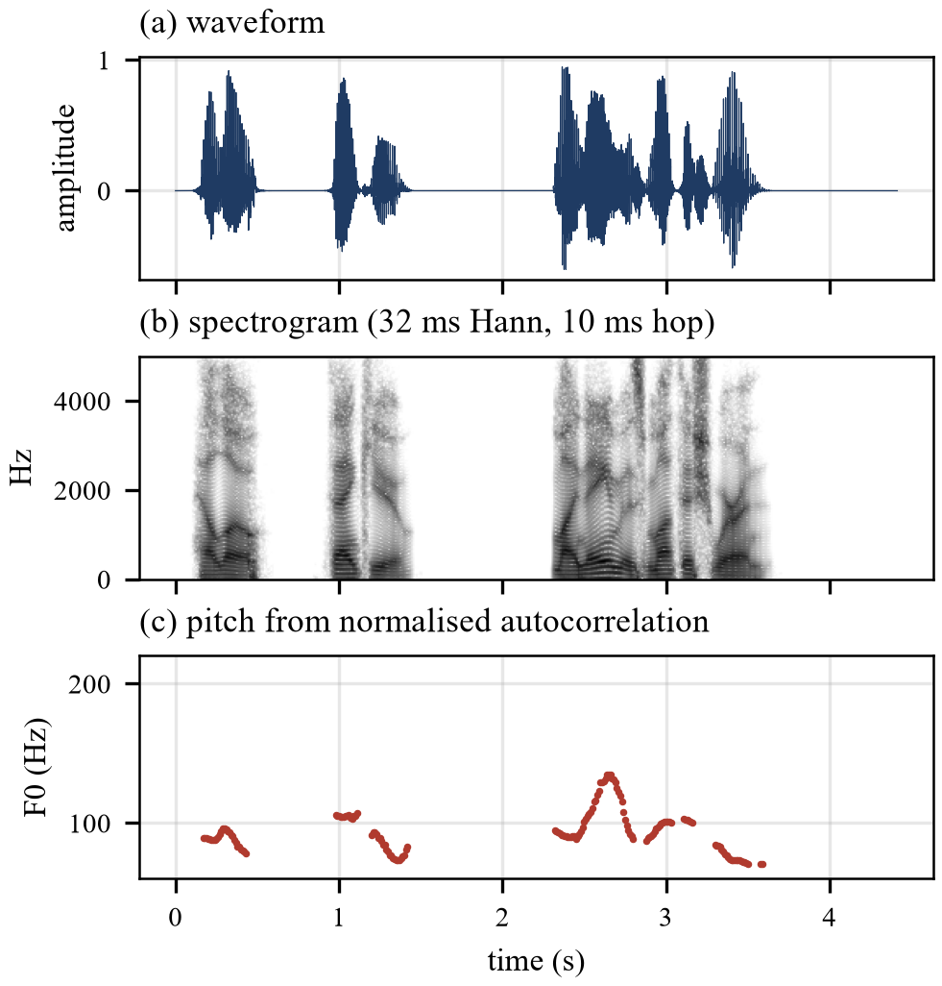
8. Audio Capture and Feature Extraction
METHODOLOGY
Capture, in the browser
MediaRecorder records the microphone.
The recording is decoded and resampled to 16 kHz mono (OfflineAudioContext).
Samples are written as a 16-bit PCM WAV file and uploaded.
The server decodes it to a float32 array for Whisper.
Features
Framing: 25 ms frames, 10 ms hop, Hann window.
Log-mel: STFT → 80 mel filters → log = Whisper input.
Energy and ZCR: speech vs silence, voiced vs noisy.
Live: all of these update while the user speaks.

Slide 10
9. Pitch Tracking and Noise Reduction
METHODOLOGY
Pitch (F0) by autocorrelation
Spectral subtraction
Normalised autocorrelation of each frame:
r(τ) = Σ x[n]·x[n+τ] / √(Σ x²[n] · Σ x²[n+τ])
Search 70–400 Hz; F0 = fs / τ at the chosen peak.
Voiced when the peak is at least 0.5 and energy is above silence.
Octave guard: take the shortest peak within 10% of the best. Without it, a 330 Hz voice was read as 82.5 Hz.
Final rise in semitones: Δ = 12 log₂(F0 end / F0 body), using the last 300 ms.
Remove the estimated noise power from every frame:
|Ŝ|² = max( |Y|² − α·N̂ , β·|Y|² )
α = 2 (over-subtraction), β = 0.02 (spectral floor), as in Boll and Berouti.
Noise N̂ comes from the quietest 10% of frames, so no silent start is needed.
32 ms frames, 8 ms hop; the noisy phase is kept and the signal is rebuilt by overlap-add.
Sanity check: with α = 0 the output matches the input (147 dB SNR).

Slide 11
10. Fine-Tuning Whisper on Indian Accents
METHODOLOGY
Setting | Value
Base model | Whisper base.en (74 M parameters)
Training data | Svarah train split, 84 speaker groups
Epochs / steps | 3 / 1,002
Batch size | 16
Optimiser | AdamW, lr 1×10⁻⁵, 100 warm-up steps
Precision | mixed (fp16)
Hardware / time | RTX 4050 laptop GPU, 69 min
Checkpoint kept | step 600 (lowest dev WER)
Exported as | CTranslate2, 8-bit, 76 MB
Dev WER fell from 11.84% to 8.95% by step 600, then stopped improving.
Checkpoints save the optimiser and random state, so a teammate can resume on another machine.

Slide 12
11. Text Cleaning and Normalisation
METHODOLOGY
Steps applied to the Whisper transcript
Example
Split the transcript into words at spaces.
Strip punctuation from both ends of each word.
Lower-case, and turn curly apostrophes (’) into straight ones (').
Keep only letters, digits and apostrophes, so don't stays one word.
Mark where sentences start (after . ? ! : ;) for names and questions.
Keep the original form too: capitals mark names, digits mark numbers.
“Hello, my friend Ravi! Don’t worry, the doctors come at 7:30.”
Whisper output
Original | Cleaned | Starts sentence
Hello, | hello | yes
Ravi! | ravi | no (capital → name)
Don’t | don't | yes
doctors | doctors | no
7:30. | 7:30 → number | no
Same rules on both sides
Every dictionary phrase is cleaned by the same function when the manifest is built, so speech and dictionary never disagree on spelling.
hello my friend ravi don't worry the doctors come at 730

Slide 13
12. From Words to Signs
METHODOLOGY
Local dictionary
Google Drive
Number
Name
Omitted word
Word form
Reviewed synonym
Fingerspell
Longest dictionary phrase first (“thank you” = one sign); words left over go through the chain in this order.
Word | Rule that fired | Played
Hello, my, friend, worry, come | local dictionary | HELLO, MY, FRIEND, WORRY, COME
Ravi | capital letter mid-sentence → name | R-A-V-I (fingerspelled)
Don’t | not on this laptop → Google Drive, then cached | DON'T
the | omitted word (ISL does not sign it) | —
doctors | word form | DOCTOR
at | no sign anywhere | A-T (fingerspelled)
7:30 | number reading | SEVEN THIRTY
Result
11 words → 8 signed, 2 fingerspelled, 1 omitted, none dropped. (45 → FOUR FIVE: forty has no sign.)

Slide 14
13. Start to Finish: One Sentence Through the System
METHODOLOGY
Step | What happens | Output | Code
1. Record | Browser records and resamples to 16 kHz mono; live waveform, spectrogram, pitch | WAV file | frontend/index.html
2. Denoise | Spectral subtraction (optional, off by default) | cleaner audio | src/denoise.py
3. Recognise | Fine-tuned Whisper, greedy decoding; final pitch movement measured | “Where is the hospital? I am 25 years old.” | src/asr.py, src/prosody.py
4. Clean | Split, strip punctuation, lower-case, mark sentences | where is the hospital i am 25 years old | src/matcher.py
5. Question? | “where” followed by a verb, and a “?” | sentence 1 is a question | src/isl_order.py
6. Look up | Longest phrase first, then the lookup chain | WHERE HOSPITAL TWENTY FIVE YEAR OLD | src/matcher.py, src/drive_fetch.py
7. Order | Spoken order by default; ISL option moves WHERE to the end | play list of 6 clips | src/isl_order.py
8. Play | Two video players take turns, so there is no gap | 6 real ISL videos | frontend/index.html
One request
The browser sends the audio to /translate (src/api.py, FastAPI). The server runs steps 2–7 and returns the play list, the transcript and the pitch reading together.

Slide 15
14. Evaluation Plan
EVALUATION AND RESULTS
Question we asked | Data | Measure
Does fine-tuning help Indian speakers? | Svarah test: 620 utterances, 16 unseen speakers | WER, per speaker, paired bootstrap
Does it survive noise? Does spectral subtraction help? | 200 test utterances + white and babble noise, 20–0 dB | WER, SNR gain
Does pitch mark a question? | 387 questions + 387 statements; threshold set on training speakers | Balanced accuracy
Embeddings or WordNet for synonyms? | 30 true + 30 wrong word pairs | Pairs accepted
How much of a sentence can we sign? | 20 development + 20 held-out sentences, also spoken by a synthetic voice | Coverage, WER
Is it fast enough? | The same sentence on CPU and GPU | Time per step
Measures
WER = (S + D + I) / N: substituted, deleted and inserted words over the reference words.
Coverage: words that get a dictionary sign, over all words (or over the words ISL signs).
Balanced accuracy: average of the share of questions found and the share of statements left alone.

Slide 16
15. Results: Recognition on Unseen Speakers
EVALUATION AND RESULTS
13.2% → 11.3%
test WER, 620 utterances (about 14% fewer errors)
14 of 16
unseen test speakers improved
2,000 / 2,000
bootstrap resamples favour the fine-tuned model
Biggest gains on the hardest voices: 53.8 → 41.0, 37.4 → 28.2, 19.6 → 10.6.
Two speakers got slightly worse, by 0.4 and 0.5 points.
Running both models and keeping the more confident output gave 11.25%, not worth twice the compute.

Slide 17
16. Results: Noise Robustness
EVALUATION AND RESULTS
200 test utterances mixed with white noise and four-speaker babble at 20, 10, 5 and 0 dB. SS = spectral subtraction.
The fine-tuned model was more robust at every white-noise level (5 dB: 44.9% → 34.5%), though it never heard added noise in training.
Spectral subtraction raised SNR by 3.7–7.1 dB on white noise and under 1 dB on babble, but made WER worse in 15 of 18 conditions. It is off by default.

Slide 18
17. Results: Pitch as a Question Cue
EVALUATION AND RESULTS
Tested on unseen dev + test speakers
Method | Questions found | Statements flagged
Pitch alone (yes/no only) | 44.7% | 11.8%
Word order + “?” | 79 / 85 | 1 / 70
Word order, “?” removed | 61 / 85 | 1 / 70
Pitch alone reaches only 66.5% balanced accuracy.
387 questions and 387 statements from Svarah; threshold set on training speakers only.
Finding
In read Indian English, yes/no questions did not rise at the end; they only fell less than statements. So word order decides, and pitch is shown as supporting evidence.

Slide 19
18. Results: Synonyms, Embeddings vs WordNet
EVALUATION AND RESULTS
Test: 30 true synonym pairs, 30 related but different pairs
Method | True pairs accepted | Wrong pairs accepted
Embeddings, threshold 0.70 | 18 / 30 | 8 / 30
Embeddings, threshold 0.80 | 12 / 30 | 2 / 30
Embeddings, threshold 0.85 | 7 / 30 | 2 / 30
WordNet | 11 / 30 | 0 / 30
Embeddings scored Monday–Tuesday and husband–wife at 0.87, higher than many real synonyms.
Showing the sign for a different word is worse than showing nothing.
WordNet proposals were checked by hand: 121 of 171 kept.
984 word forms are also mapped, e.g. children → CHILD.
Decision
WordNet with manual review is used. Embedding similarity was tested and rejected.

Slide 20
19. Results: Sign Coverage
EVALUATION AND RESULTS
Held-out sentences were written after all rules were fixed, so these are the honest numbers.
66% of the words ISL signs had a local sign; Drive raised it to 67% and synonyms to 72%.
The development set reached 87%. Tuning on your own test set inflates results.
Spoken end to end with a synthetic voice: WER 2.0% and 2.4%, and every clip was served.

Slide 21
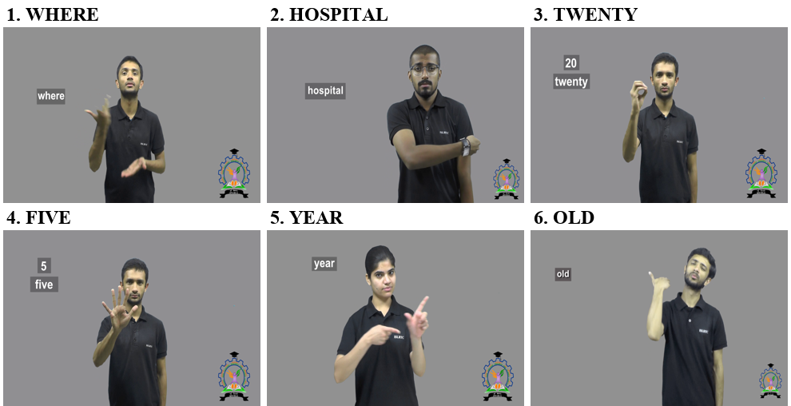
20. Results: End-to-End Output and Speed
EVALUATION AND RESULTS
0.15–0.25 s
speech recognition on the laptop GPU (1.6 to 3.1 s on CPU)
< 1 ms
cleaning, lookup and ordering together
“Where is the hospital? I am 25 years old.”
Spoken order: WHERE HOSPITAL TWENTY FIVE YEAR OLD
ISL order option: HOSPITAL WHERE TWENTY FIVE YEAR OLD
is, the, am are omitted; I has no dictionary sign, so it is left out rather than spelled as a letter.
~5.6 s
first download of a new Drive clip (3.3 MB); instant after that

Slide 22
21. Discussion: Lessons and Limitations
DISCUSSION AND CONCLUSION
What we learned
Limitations
Short phrases are hard. “cricket match” alone was misheard by all three models, so we added a correction box.
Averages hide word errors. In one sentence the fine-tuned model wrote “chicken” where the stock model heard “cricket”.
Check the data, not only the code. Svarah file names are not speaker IDs, and a 0.03 s timestamp made fingerspelling unreadable.
Meaning needs a human. WordNet suggested million → billion; review removed 50 of 171 proposals.
Signs follow English order unless the three-rule ISL option is on.
Facial grammar, such as raised eyebrows for yes/no questions, cannot be shown with joined clips.
Synonyms were checked for English meaning, not yet by an ISL signer.
Few tests with our own voices; some words, like I, have no sign.
1,256 long explanation videos are still unused.
Most important limitation
No Deaf user has judged the output yet. Coverage tells us what the dictionary can express, not what a viewer understands.

Slide 23
22. Conclusion and Future Work
DISCUSSION AND CONCLUSION
What we have achieved
A working system that turns spoken Indian English into a sequence of real ISL dictionary videos, with recognition in under a quarter of a second on a laptop GPU.
Key results
Future work
WER 13.2% → 11.3% on unseen speakers, and more robust to noise.
67% of ISL-signed words covered in unseen sentences (72% with synonyms).
Two honest negative results: spectral subtraction and pitch-only question detection.
Evaluate with Deaf ISL users.
Train on more, and noisier, Indian speech.
Learn ISL word order from parallel data such as ISLTranslate.
Mark the sign inside long explanation videos with an ISL expert.
Speech → Fine-tuned Whisper → Text → Sign lookup → Real ISL video

Slide 24
References
[1] U. Zeshan, “Indo-Pakistani Sign Language grammar: A typological outline,” Sign Lang. Stud., 2003. doi:10.1353/sls.2003.0005
[2] B. Saunders, N. C. Camgöz, R. Bowden, “Progressive transformers for end-to-end sign language production,” ECCV, 2020. doi:10.1007/978-3-030-58621-8_40
[3] P. Kapoor et al., “Towards automatic speech to sign language generation,” Interspeech, 2021. doi:10.21437/Interspeech.2021-1094
[4] M. Kipp et al., “Assessing the deaf user perspective on sign language avatars,” ASSETS, 2011. doi:10.1145/2049536.2049557
[5] L. C. Quandt et al., “Attitudes toward signing avatars vary depending on hearing status, age of signed language acquisition, and avatar type,” Front. Psychol., 2022. doi:10.3389/fpsyg.2022.730917
[6] A. Radford et al., “Robust speech recognition via large-scale weak supervision,” arXiv:2212.04356, 2022. doi:10.48550/arXiv.2212.04356
[7] T. Javed et al., “Svarah: Evaluating English ASR systems on Indian accents,” Interspeech, 2023. doi:10.21437/Interspeech.2023-2588
[8] A. Vaswani et al., “Attention is all you need,” arXiv:1706.03762, 2017. doi:10.48550/arXiv.1706.03762
[9] S. Davis, P. Mermelstein, “Comparison of parametric representations for monosyllabic word recognition,” IEEE Trans. ASSP, 1980. doi:10.1109/TASSP.1980.1163420
[10] L. Rabiner, “On the use of autocorrelation analysis for pitch detection,” IEEE Trans. ASSP, 1977. doi:10.1109/TASSP.1977.1162905
[11] S. Boll, “Suppression of acoustic noise in speech using spectral subtraction,” IEEE Trans. ASSP, 1979. doi:10.1109/TASSP.1979.1163209
[12] M. Berouti, R. Schwartz, J. Makhoul, “Enhancement of speech corrupted by acoustic noise,” ICASSP, 1979. doi:10.1109/ICASSP.1979.1170788
[13] N. C. Camgöz et al., “Neural sign language translation,” CVPR, 2018. doi:10.1109/CVPR.2018.00812
[14] N. C. Camgöz et al., “Sign language transformers: Joint end-to-end sign language recognition and translation,” CVPR, 2020. doi:10.1109/CVPR42600.2020.01004
[15] A. Sridhar et al., “INCLUDE: A large scale dataset for Indian Sign Language recognition,” ACM Multimedia, 2020. doi:10.1145/3394171.3413528
[16] A. Joshi, S. Agrawal, A. Modi, “ISLTranslate: Dataset for translating Indian Sign Language,” Findings of ACL, 2023. doi:10.18653/v1/2023.findings-acl.665
[17] A. Joshi et al., “iSign: A benchmark for Indian Sign Language processing,” Findings of ACL, 2024. doi:10.18653/v1/2024.findings-acl.643
[18] N. Reimers, I. Gurevych, “Sentence-BERT: Sentence embeddings using Siamese BERT-networks,” EMNLP-IJCNLP, 2019. doi:10.18653/v1/D19-1410
[19] G. A. Miller, “WordNet: A lexical database for English,” Commun. ACM, 1995. doi:10.1145/219717.219748
[20] B. Efron, R. J. Tibshirani, An Introduction to the Bootstrap. Springer, 1993. doi:10.1007/978-1-4899-4541-9

Slide 25
Thank You

