Slide 1
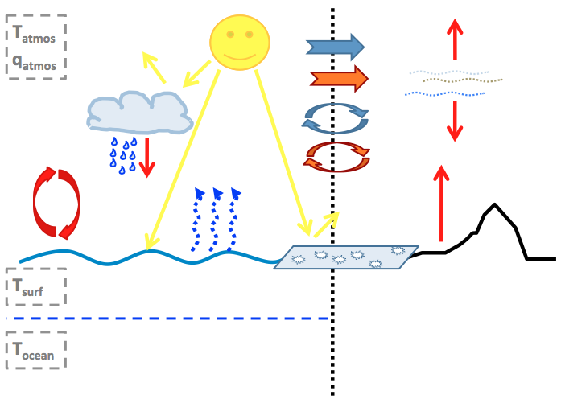
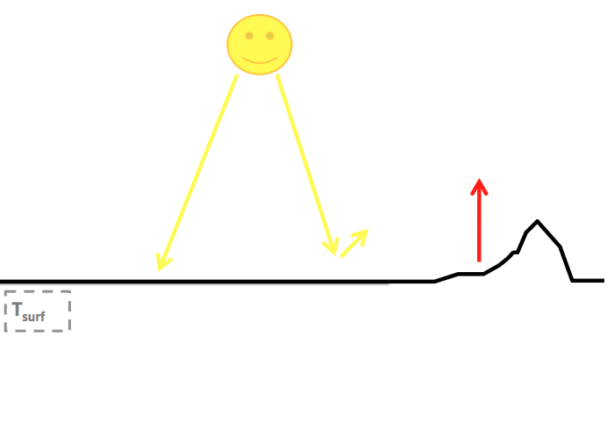
Reference Run
Sensitivity Run
Atmosphere
Diffusion of heat
Advection of heat
CO₂
Oceans
Hydrological cycle
Diffusion of water vapor Advection of water vapor
Clouds
Ice-albedo
Atmosphere
Diffusion of heat
Advection of heat
CO₂
Oceans
Hydrological cycle
Diffusion of water vapor Advection of water vapor
Clouds
Ice-albedo
Model correction terms
Model correction terms

Slide 2
T_{surf}

Slide 3
T_{atmos}
T_{surf}

Slide 4
T_{atmos}
T_{surf}

Slide 5
T_{atmos}
T_{surf}

Slide 6
T_{atmos}
T_{surf}

Slide 7
T_{atmos}
T_{surf}
T_{ocean}

Slide 8
T_{atmos}
q_{atmos}
T_{surf}
T_{ocean}

Slide 9
T_{atmos}
q_{atmos}
T_{surf}
T_{ocean}

Slide 10
T_{atmos}
q_{atmos}
T_{surf}
T_{ocean}

Slide 11
T_{atmos}
q_{atmos}
T_{surf}
T_{ocean}

Slide 12
T_{atmos}
q_{atmos}
T_{surf}
T_{ocean}

