Slide 1
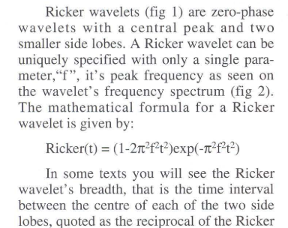

Slide 2
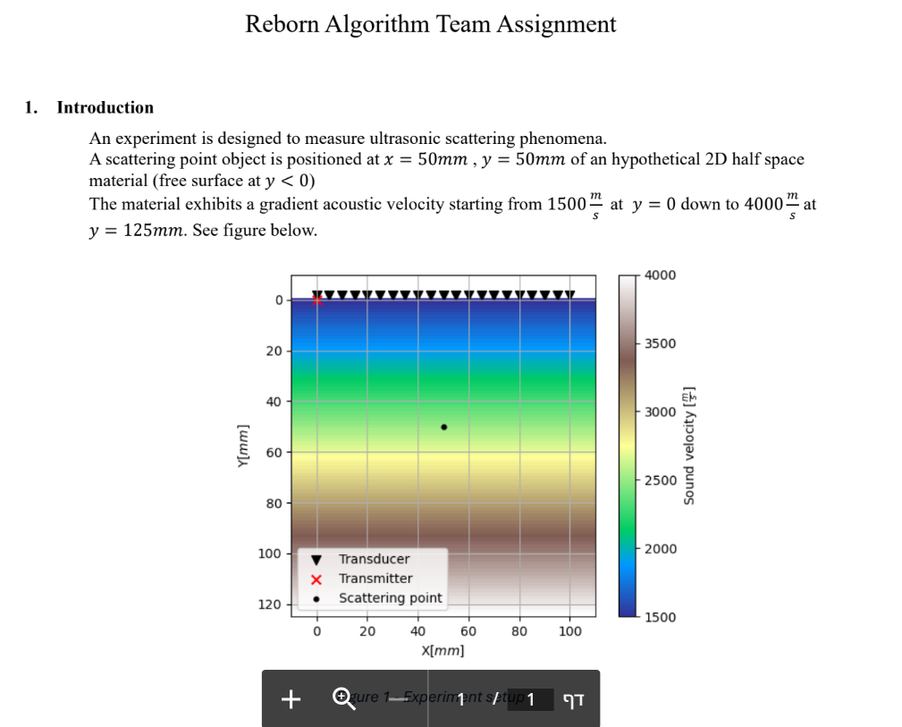

Slide 3
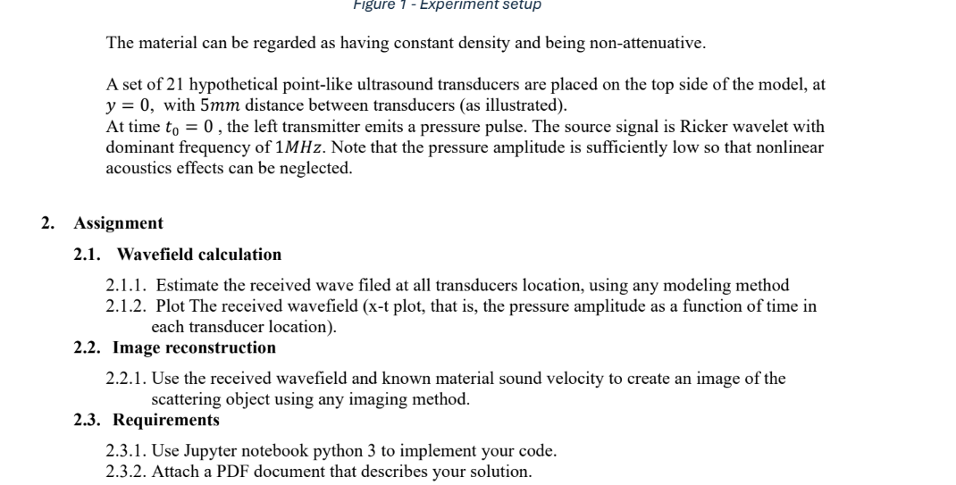

Slide 4
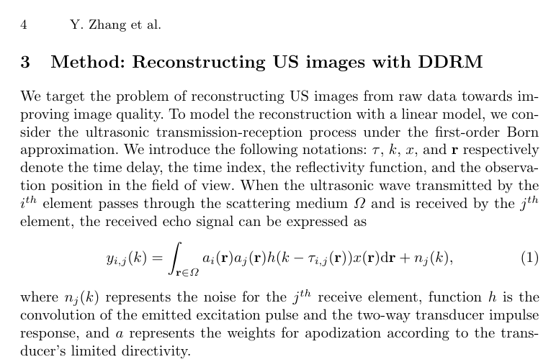
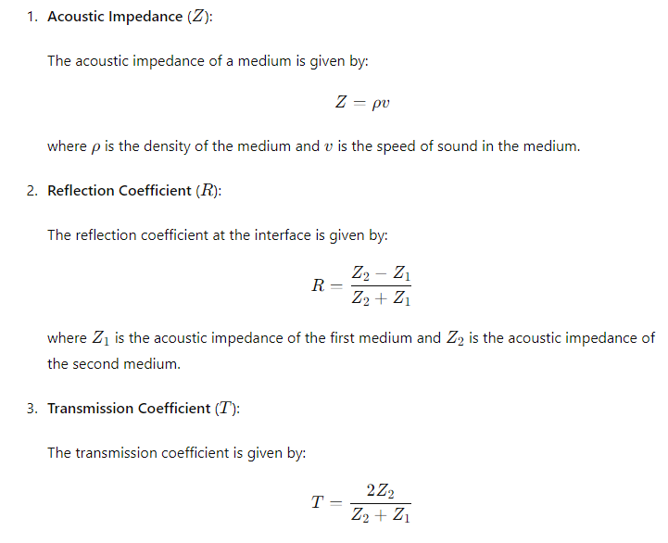

Slide 5
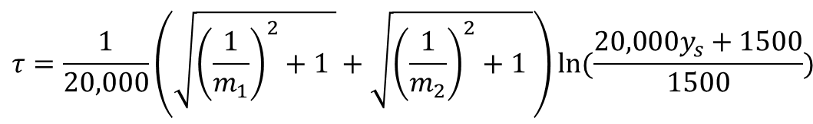
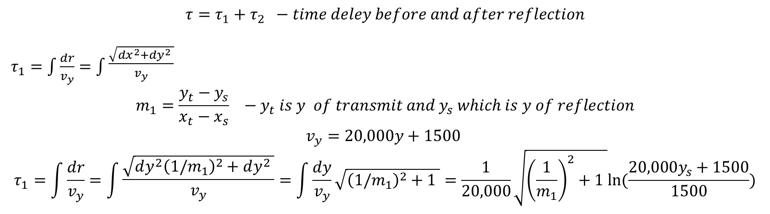
$$τ=τ_{1}+τ_{2} −time deley before and after reflection$$
$τ_{1}=\int{\frac{dr}{v_{y}}}=\int{\begin{aligned}\frac{\sqrt{dx^{2}+dy^{2} }}{v_{y}} \\ \end{aligned}}$
$$m_{1}=\frac{y_{t}−y_{s}}{x_{t}−x_{s}} −y_{t} is y of transmit and y_{s} which is y of reflection$$
$$v_{y}=20,000y+1500$$
$$τ_{1}=\int{\frac{dr}{v_{y}}}=\int{\begin{aligned}\frac{\sqrt{{dy^{2}\left(1/m_{1}\right)}^{2}+dy^{2} }}{v_{y}} \\ \end{aligned}}=\int{\frac{dy}{v_{y}}}\sqrt{{\left(1/m_{1}\right)}^{2}+1 }=\frac{1}{20,000}\sqrt{{\left(\frac{1}{m_{1}}\right)}^{2}+1 }ln(\frac{20,000y_{s}+1500}{1500})$$
$$m_{2}=\frac{y_{r}−y_{s}}{x_{r}−x_{s}} −y_{r} is y of recive and y_{s} which is y of reflection$$
$$τ=\frac{1}{20,000}\left(\sqrt{{\left(\frac{1}{m_{1}}\right)}^{2}+1 }+\sqrt{{\left(\frac{1}{m_{2}}\right)}^{2}+1 }\right)ln(\frac{20,000y_{s}+1500}{1500})$$

Slide 6






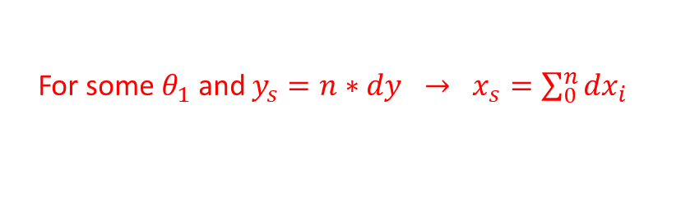




Snell low - from transmitter to reflection point
$\frac{\sin\left(θ_{1}\right)}{v_{1}}=$ $\frac{\sin\left(θ_{2}\right)}{v_{2}}=\frac{\sin\left(θ_{3}\right)}{v_{3}}=\frac{dx_{i}}{r_{i}v_{i}}$
$$θ_{1}$$
$$v_{1}$$
$$θ_{2}$$
For some $θ_{1}$ and $y_{s}=n∗dy → x_{s}=\sum_{0}^{n}{{dx}_{i}}$
$$dy$$
$$v_{2}$$
$$dx_{2 }$$
$$r_{3}$$
$$v_{3}$$
$$dx_{3}$$

Slide 7



Snell low – specular reflection
Tx (x,y)
Rx (x,y)
$\frac{\sin\left(θ_{1}\right)}{v_{1}}=$ $\frac{\sin\left(θ_{2}\right)}{v_{2}}=\frac{\sin\left(θ_{3}\right)}{v_{3}}=\frac{dx_{i}}{r_{i}v_{i}}$
$$θ_{1}$$
$$v_{1}$$
$$dy$$
$$θ_{2}$$
specular
$$v_{2}$$
$$dx_{2 }$$
$$r_{3}$$
$$v_{3}$$
$$dx_{3}$$
Except of scattering point all reflections exhibit specular reflection
For each y slice (const velocity ) the x of reflection will obtain at the average between x value of Tx and Rx

Slide 8
Snell low – scattering point reflection
Tx (x,y)
Rx (x,y)
$$θ_{1}$$
$$v_{1}$$
$$θ_{2}$$
Not specular
$$dy$$
$$v_{2}$$
$$dx_{2 }$$
$$r_{3}$$
$$v_{3}$$
$$dx_{3}$$
Wave scattered from this point impinging all 21 transducers

