Slide 1
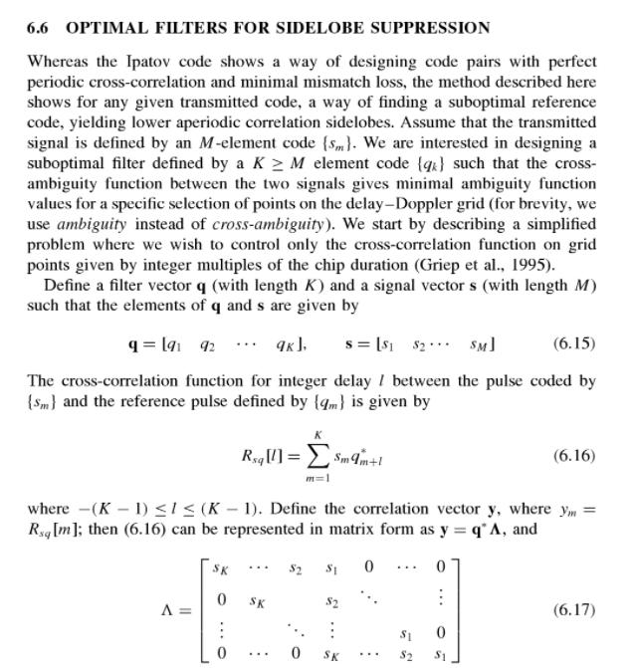
Loss ~1dB
Suppression of ~10 dB

Slide 2
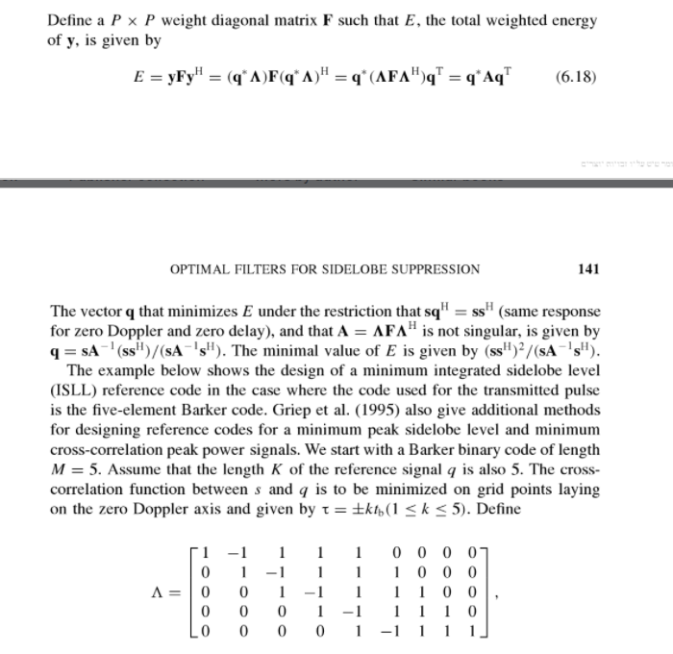

Slide 3
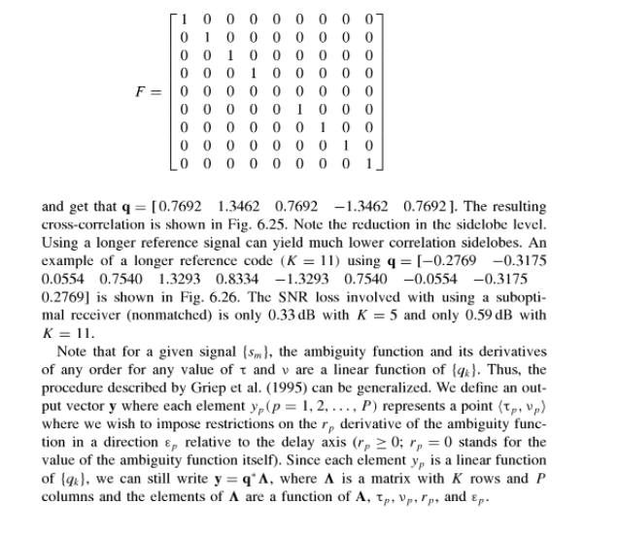
Minimization of Side lobes

Slide 4


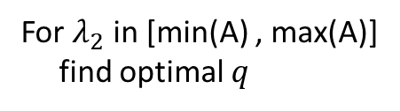
Hybrid solution – Lagrange multiplier & grid search
$h=E+λ_{1}(sq^{H}−ss^{H})$ $+λ_{2}(?)$
$\frac{dh}{dq}=0$
$\frac{dh}{dλ_{1}}=0$
$\frac{d(?)}{dλ_{2}}=0$
$$A−λ_{2}I=…$$
grid search
For $λ_{2}$ in [min(A) , max(A)]
find optimal $q$

