Slide 1
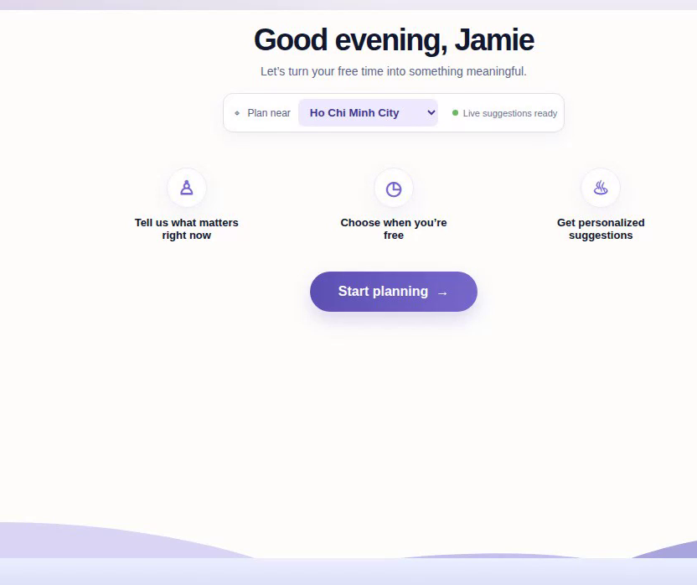
DAYSHAPE
Make free time
feel well spent
A calmer way to choose what to do, based on what you want and the energy you have.
Hackathon pitch
Notes:
Open with the outcome. DayShape helps people use free time in ways that feel meaningful, without turning planning into work.

Slide 2
DAYSHAPE
02
Free time creates a
decision problem
When the day opens up, people still need to answer three personal questions:
What do I actually want?
What do I have energy for?
What can fit today?
A calendar can show an empty slot. It cannot tell you how to spend it.
Notes:
Most planning tools stop at availability. An empty evening is not the same as a clear decision. DayShape starts with what the person needs right now.

Slide 3
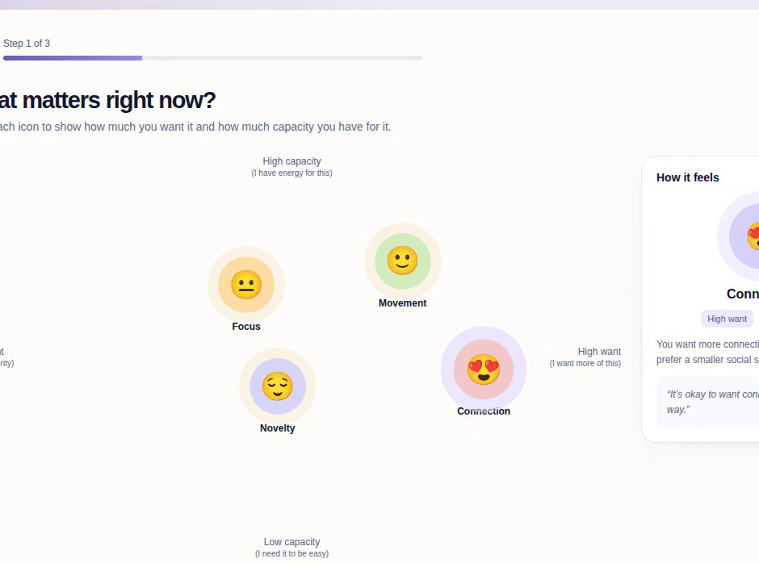
DAYSHAPE
03
The mood map makes
preferences visible
Each icon sits on two simple axes: how much the person wants it and how much capacity they have for it.
In the demo, Focus, Novelty, Connection, and Movement all move. The selected icon updates the explanation beside it.
Notes:
This is the core interaction. It avoids a long questionnaire and gives users a direct way to describe their current state. Mention the two axes: want and capacity.

Slide 4
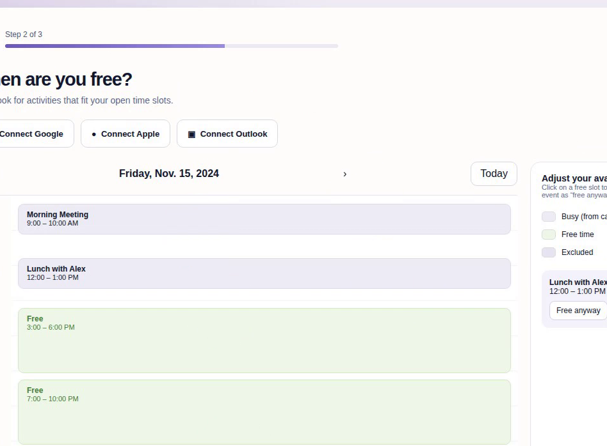
DAYSHAPE
04
Availability adds
real-world constraints
The user chooses open time, connects a calendar if they want, and can override individual events.
The goal is a plan that fits the evening, not another list to browse.
Notes:
After preferences, DayShape checks the practical boundary: time. The calendar view makes the recommendation window transparent and editable.

Slide 5
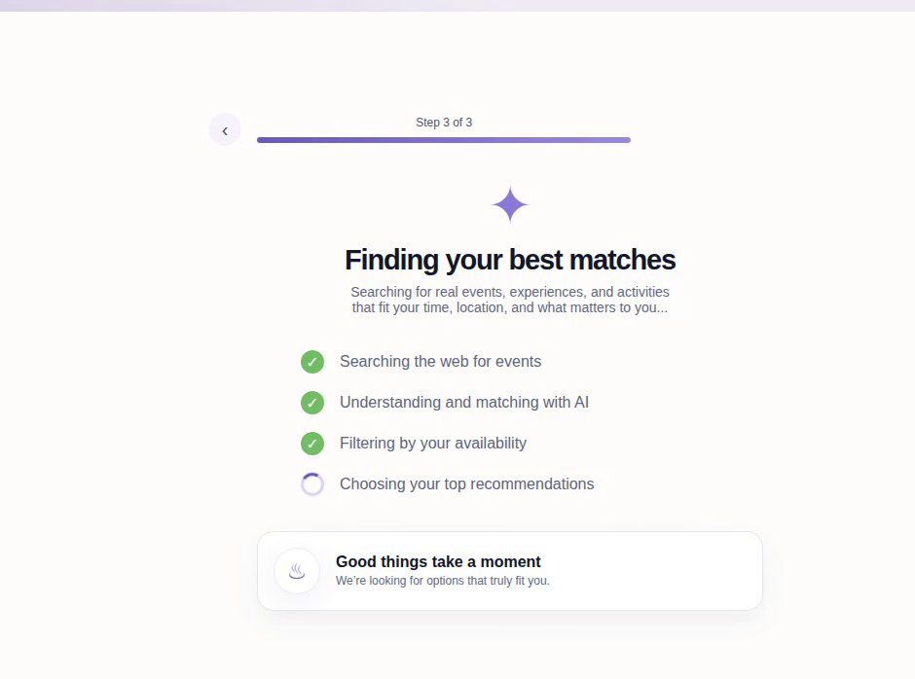
DAYSHAPE
05
Matching combines
context and options
DayShape considers mood, capacity, available time, and location before ranking local activities.
The interface makes the matching process visible, so the recommendation does not feel like a black box.
Notes:
Keep this brief in the live pitch. We search for event options, use AI-assisted matching, and filter against availability. The user sees what the product is doing.

Slide 6
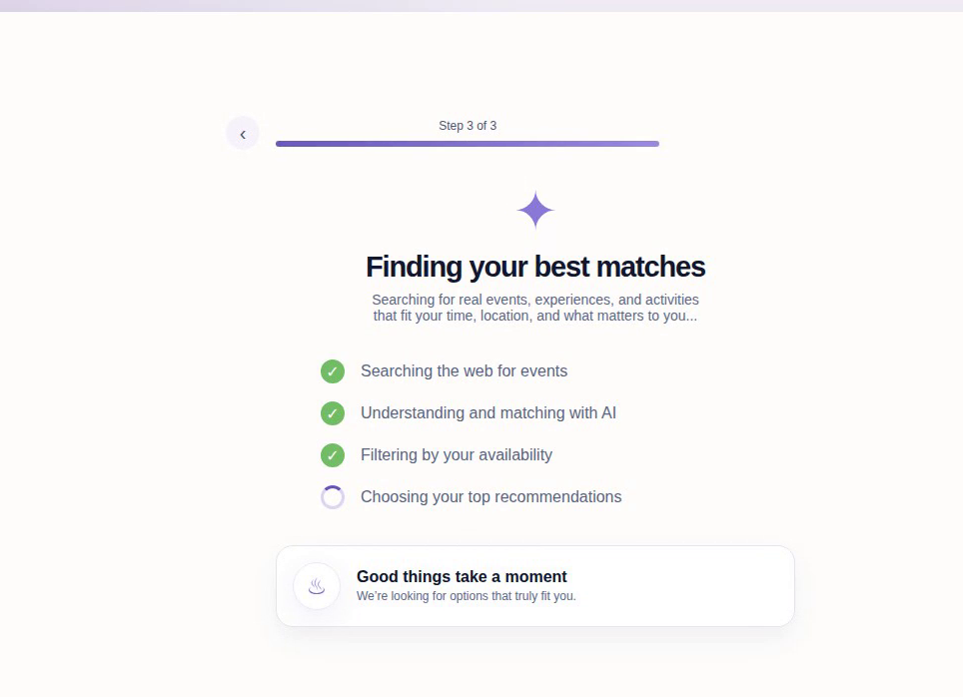
DAYSHAPE
06
Recommendations
with a reason
Each pick shows time, distance, cost, tags, and a match score. The user can see why it belongs in their evening.
Live demo cue
Play the DayShape video here. It stays on each screen long enough to narrate the flow.
Notes:
Play the 59-second DayShape demo here. Let the results screen breathe, then transition to the final plan. Keep the phone on silent and use its speaker notes only as a timing cue.

Slide 7
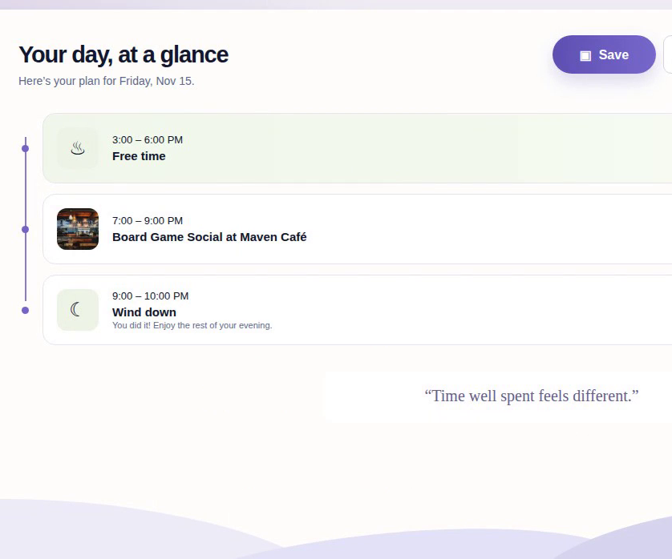
DAYSHAPE
07
A better answer to
“What should I do tonight?”
DayShape turns an open slot into a plan that fits the person, the moment, and the city around them.
Time well spent feels different.
Notes:
Close on the outcome: a plan the person can actually follow. Invite questions after the final line.

