Slide 1
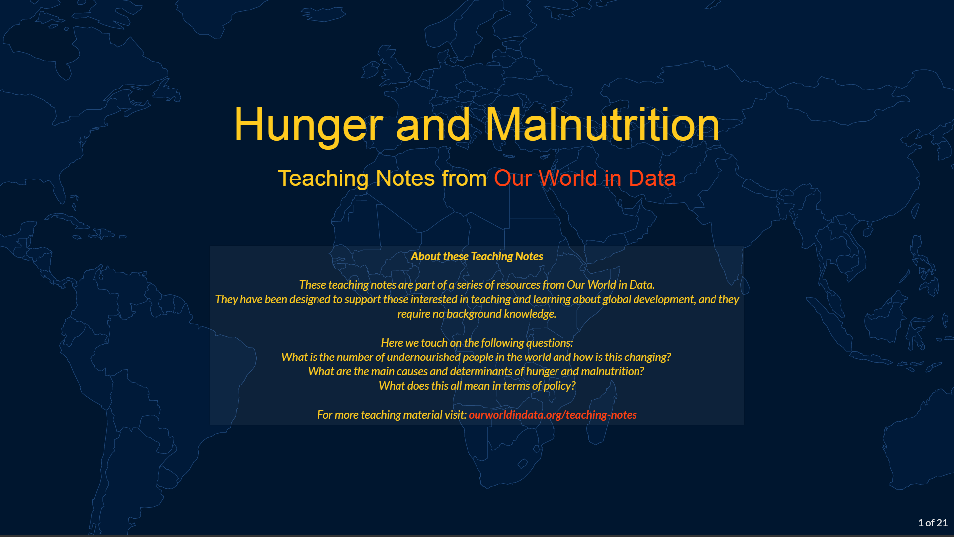

Slide 2
Outline
Undernourishment is an important challenge
Undernourishment has important consequences
Undernourishment is not the result of a world without enough food
Permanently ending hunger requires more than a one-off push in incomes
Malnutrition is not only about calories
What does this mean in terms of policy?

Slide 3
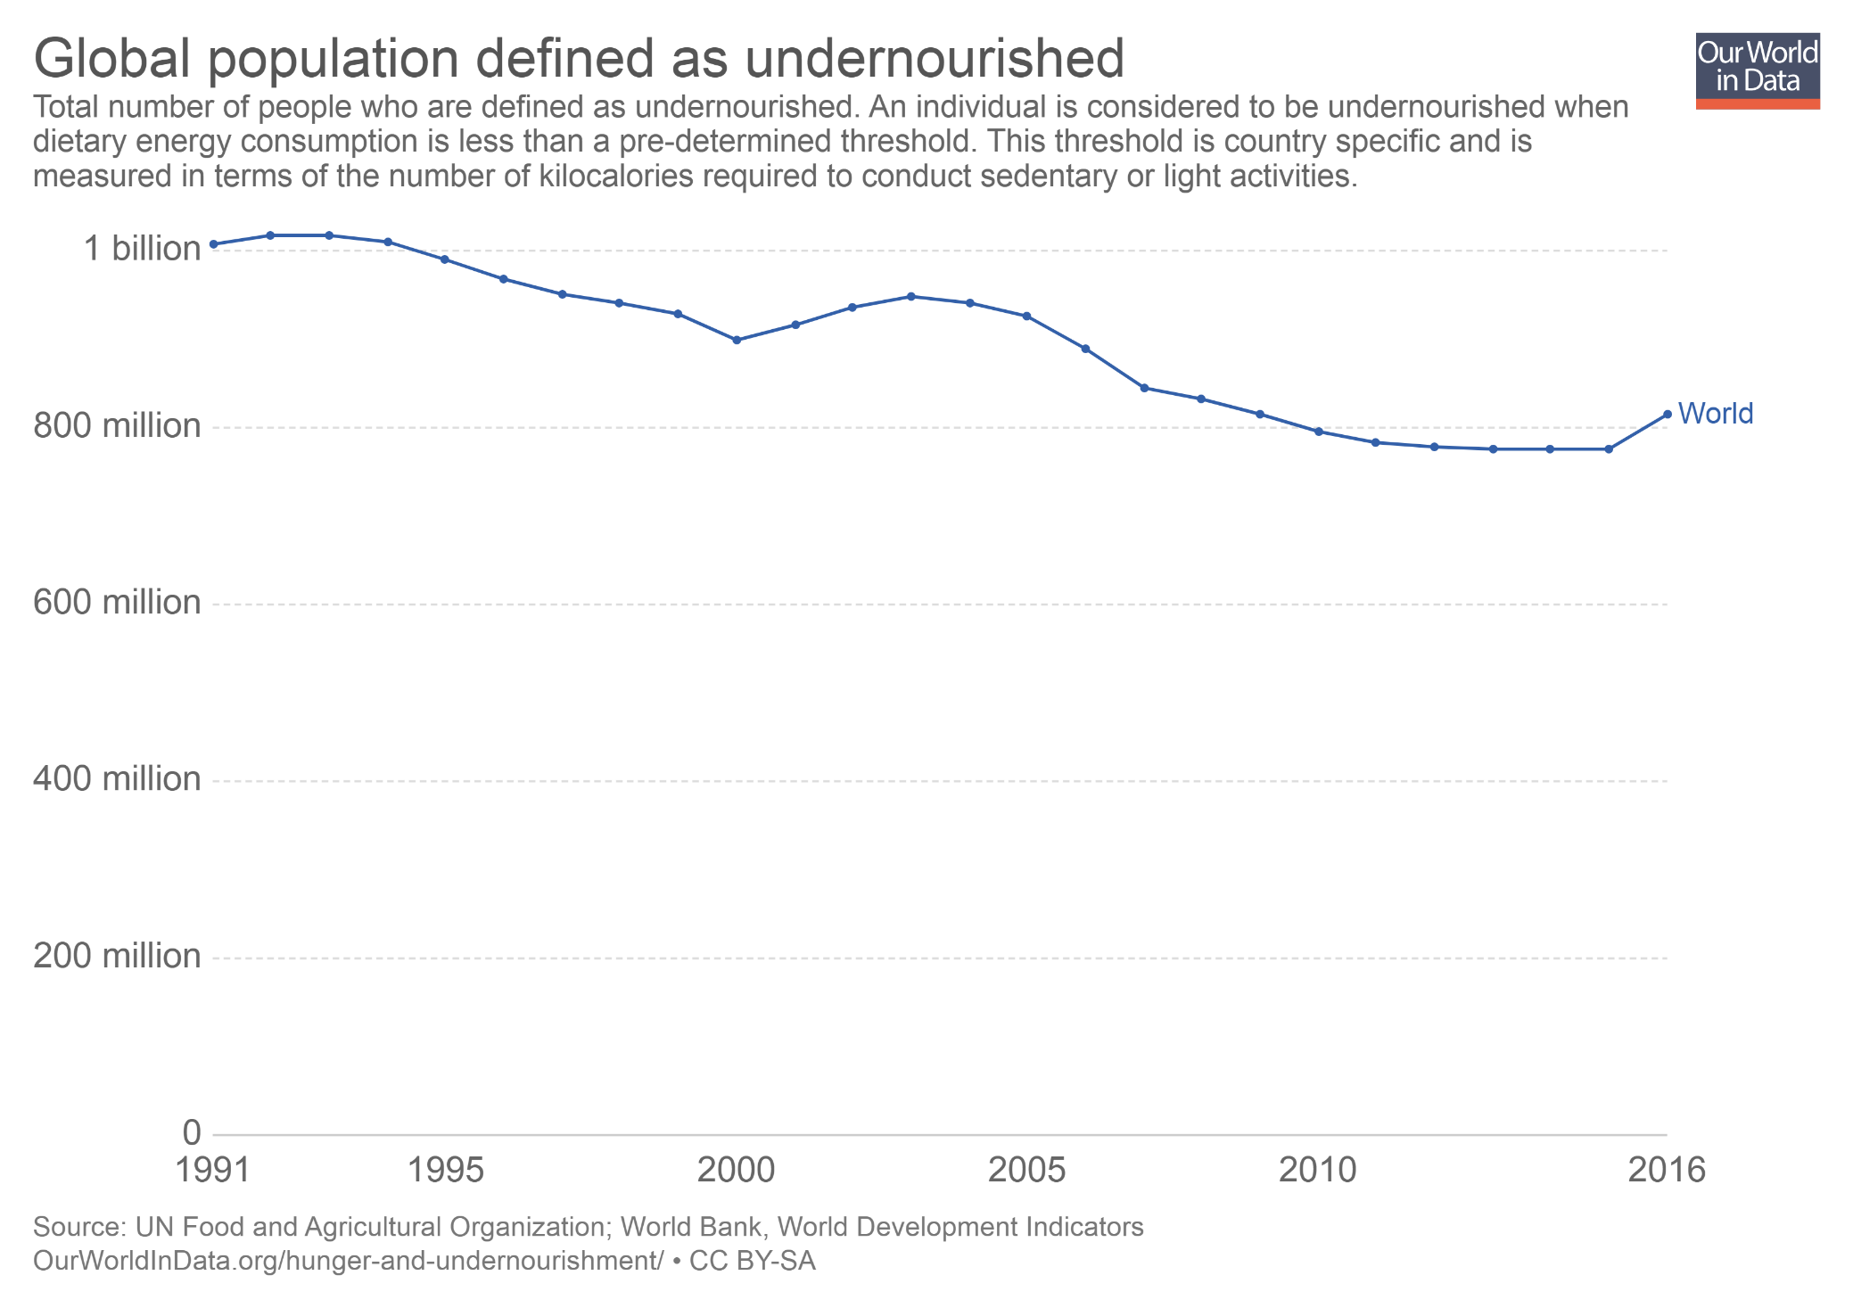
An individual is considered to be undernourished when their dietary caloric intake is less than their minimum requirements. The number of undernourished people in the world has declined since 1991. However, in 2016 we have seen an increase back to the level of 2009. You can read more about how undernourishment is defined and measured here; and you can read more about global and regional trends here.

Slide 4
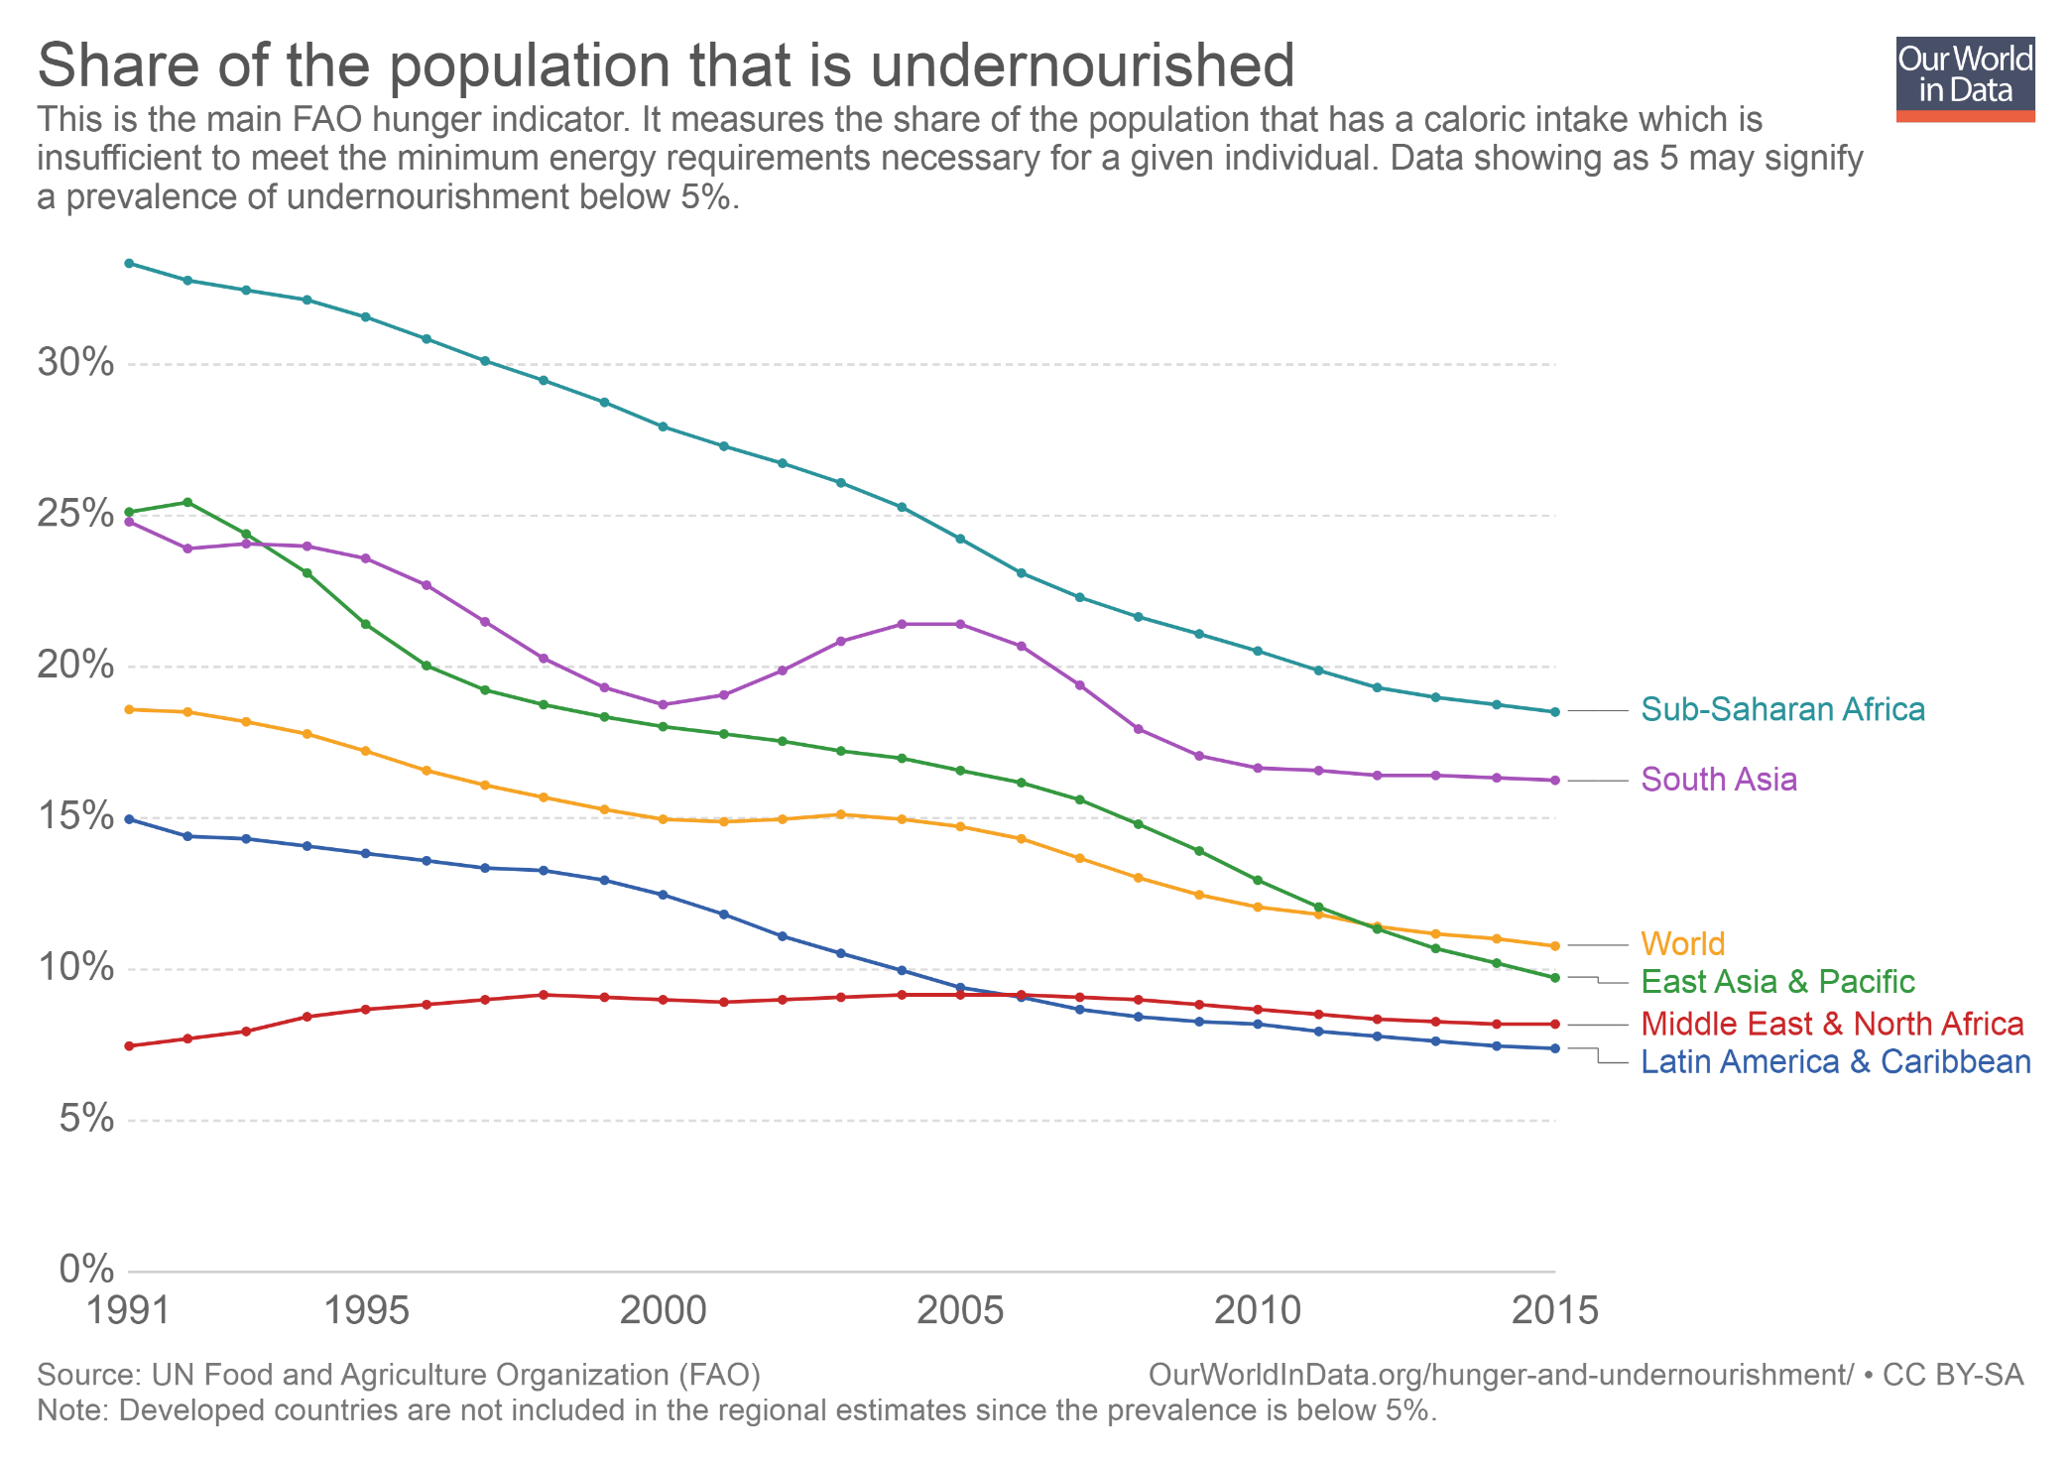
Undernourishment is still very common in sub-Saharan Africa: about 18% of the population in this region do not consume sufficient calories. This is the region with the highest rates of undernourishment; but this is also the region where we have seen the largest progress in recent decades. In the MENA region rates are lower, but there has been no progress. On the whole, the world average has almost halved since 1991. (Note: In the interactive version of this chart you can click on the option "Add country" to plot numbers for any country or world region. You can also select the "Map" tab to show levels for all countries. )

Slide 5
Outline
Undernourishment is an important challenge
Undernourishment has important consequences
Undernourishment is not the result of a world without enough food
Permanently ending hunger requires more than a one-off push in incomes
Malnutrition is not only about calories
What does this mean in terms of policy?

Slide 6
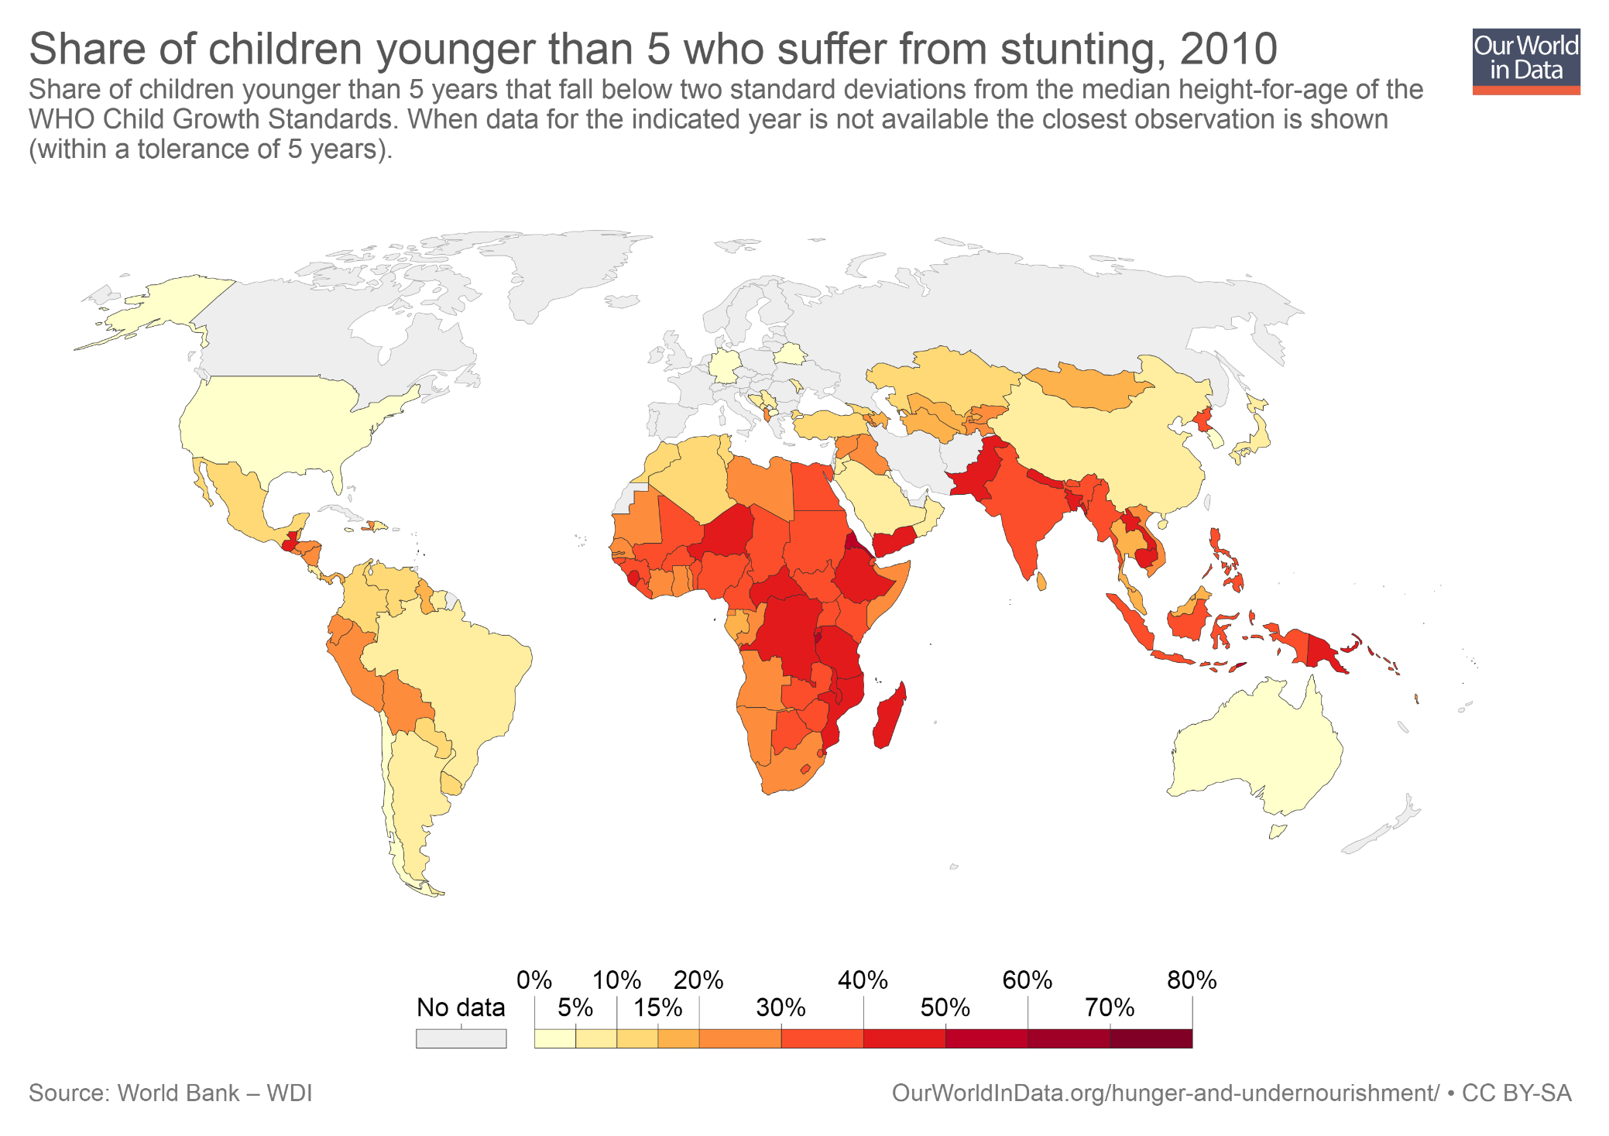
Undernourished children are more prone to poor health outcomes, likely to have lower educational achievement, and to give birth to smaller infants in the future. Malnutrition is also associated with lower economic status and labor market opportunities in adulthood. Stunting is an important symptom of malnutrition. You can read more about the correlates, determinants and consequences of malnutrition here. (Note: In the interactive version of this map you can use the slider at the bottom to show estimates for any year.)

Slide 7
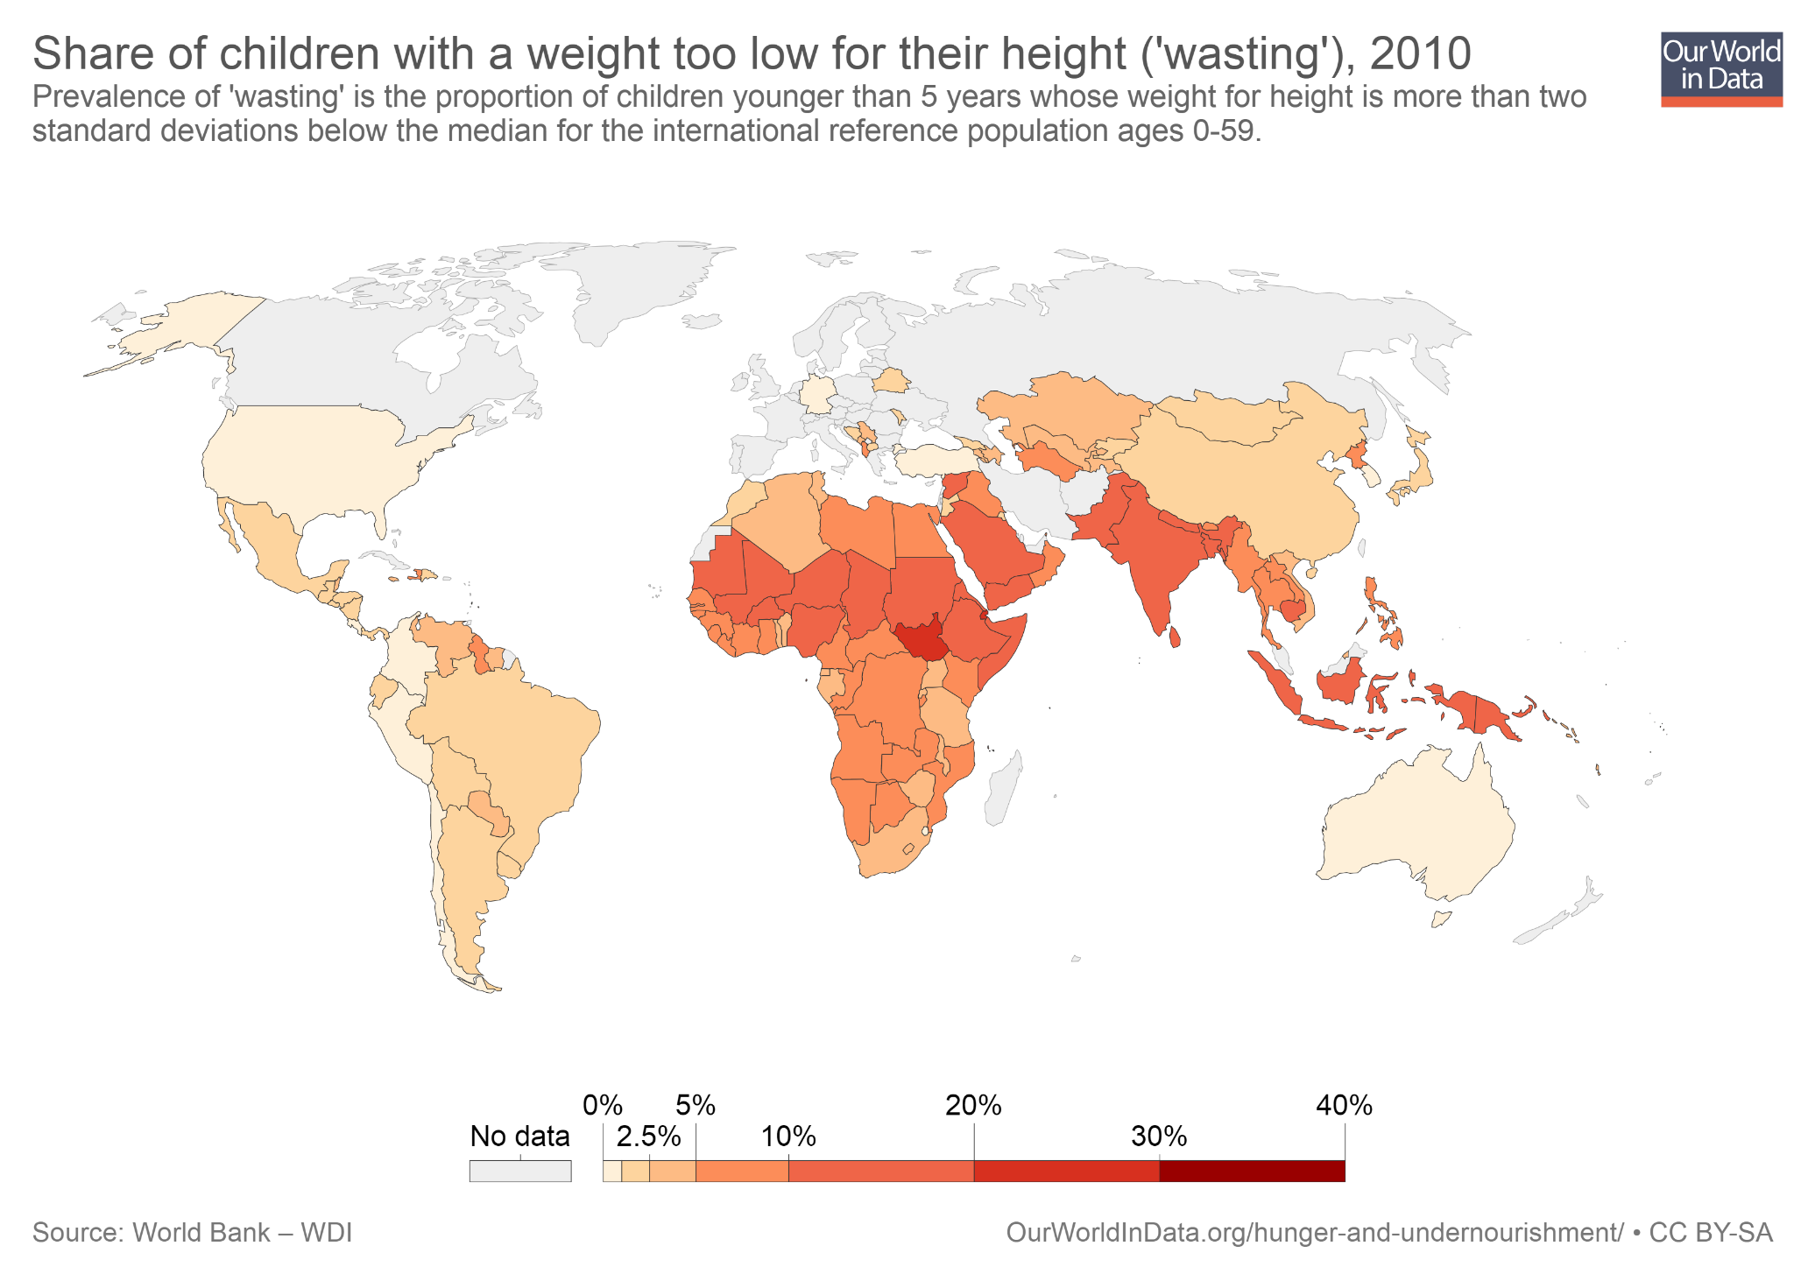
'Wasting' is also a common symptom of malnutrition. In South Sudan, for example, more than 20% of children under five have weight that is too low for their height. You can read more about 'wasting' here.

Slide 8
Outline
Undernourishment is an important challenge
Undernourishment has important consequences
Undernourishment is not the result of a world without enough food
Permanently ending hunger requires more than a one-off push in incomes
Malnutrition is not only about calories
What does this mean in terms of policy?

Slide 9
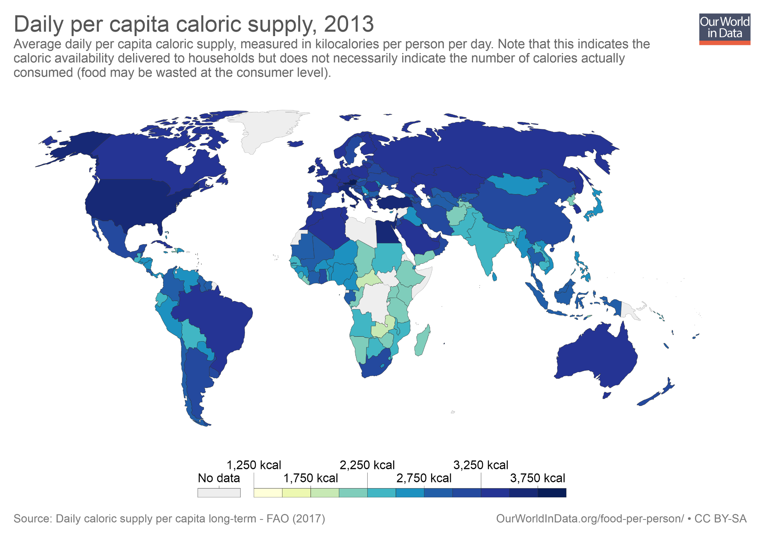
In virtually all countries with available data, if we divided the total amount of available calories by the number of people, we would be able reach the threshold of 2,000 kilocalories per person per day.

Slide 10
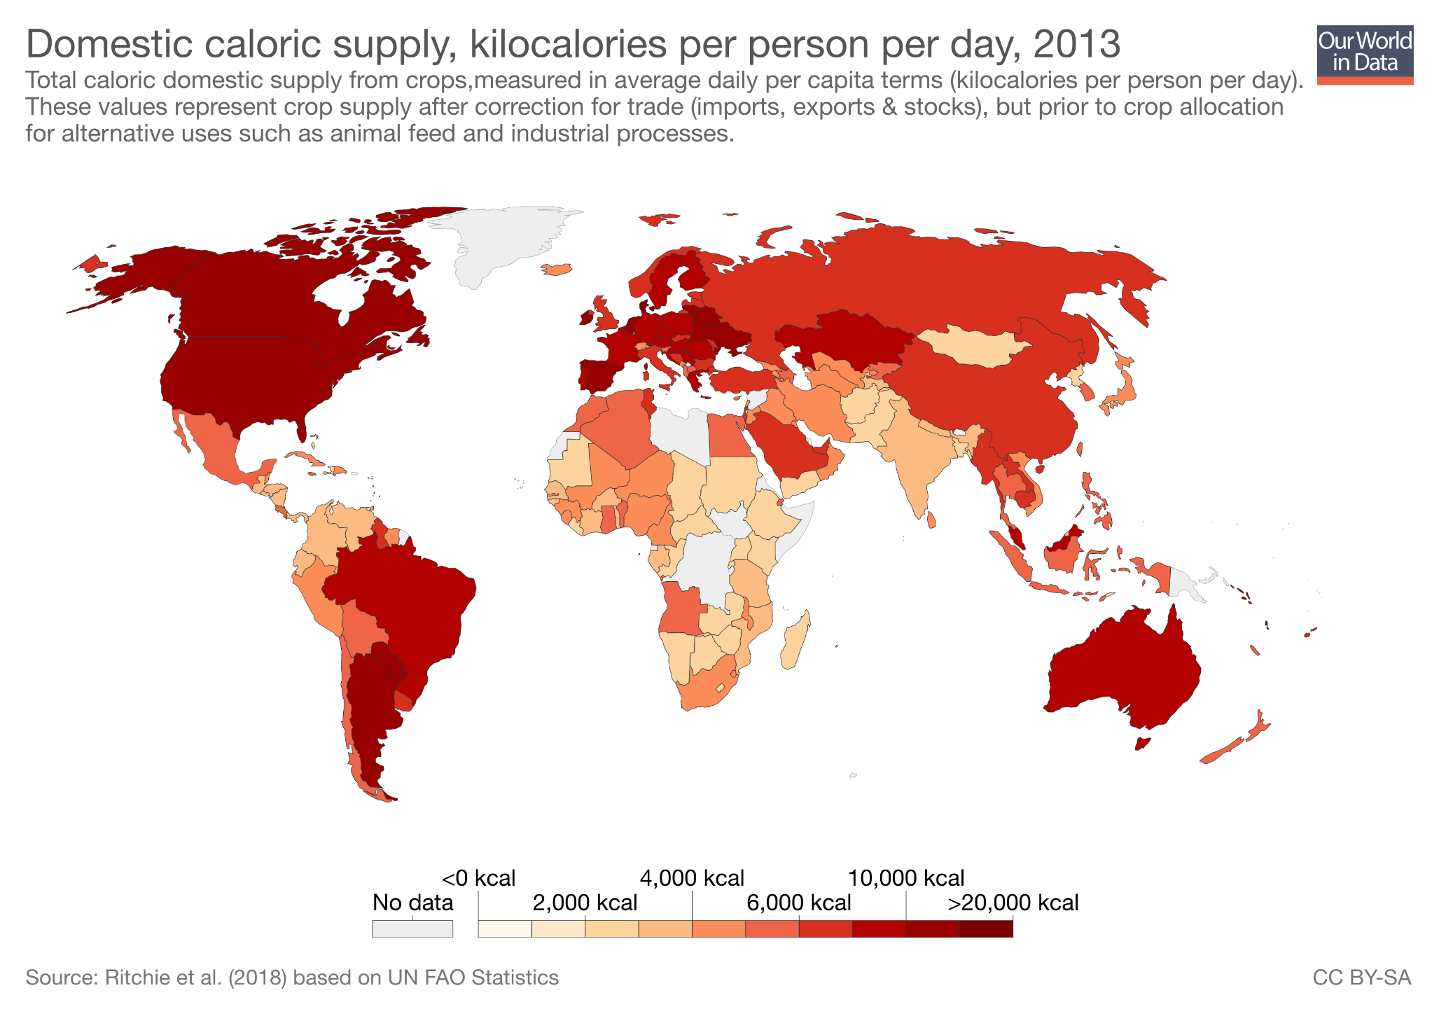
In fact, in every country in the world the total amount of available calories from crops (before animal feed and including imports and exports) is enough to reach the average threshold of 2,000 kilocalories per day. In some countries almost ten times over! You can read more about food supply here.

Slide 11
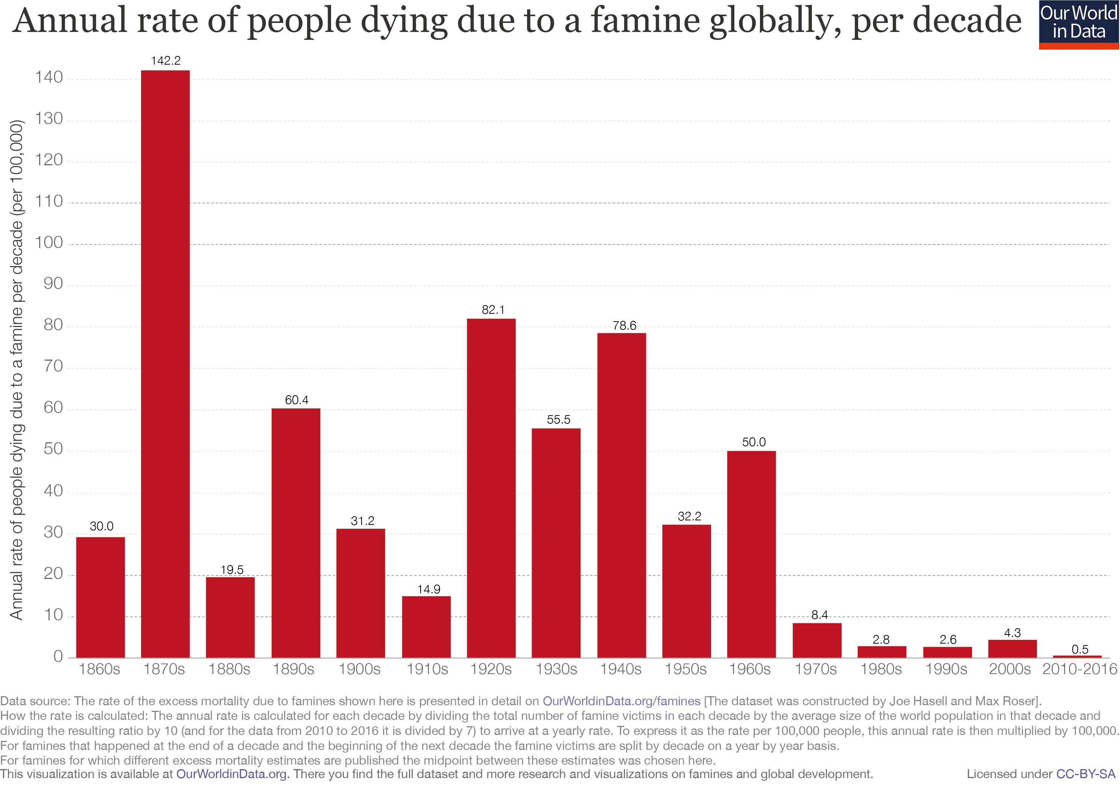
Abundant food supply is not enough to guarantee that people will have access to food. But famines, where people starve due to lack of available food, are also much less common today. Food scarcity is certainly a problem in specific contexts. But malnutrition is much more than lack of aggregate supply. You can read more about famines here.

Slide 12
Outline
Undernourishment is an important challenge
Undernourishment has important consequences
Undernourishment is not the result of a world without enough food
Permanently ending hunger requires more than a one-off push in incomes
Malnutrition is not only about calories
What does this mean in terms of policy?

Slide 13
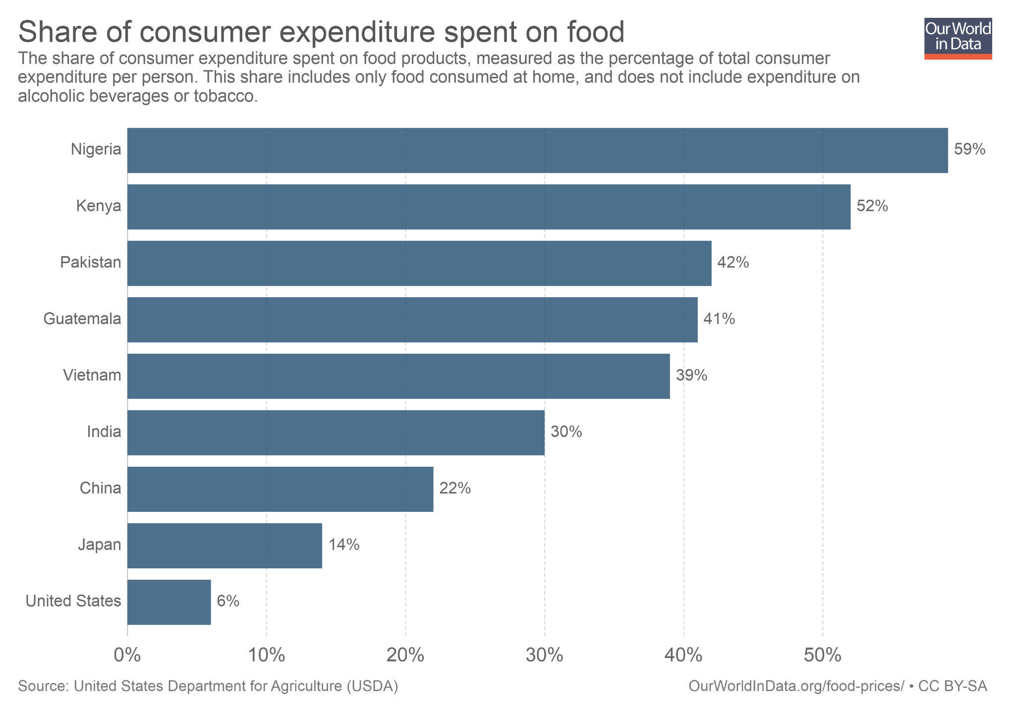
If hunger prevented poor people from working and earning enough to buy sufficient food, we would see most people in poverty spending everything on food and necessities. This is rarely the case. 'Food poverty traps' seem to be uncommon. Even for very poor people within low-income countries, food expenditures increase much less than one-for-one with household budgets (and even when extra income does lead to more food expenditure, this doesn't always imply more calories, but rather better-tasting calories). In India, for example, per capita consumption of calories has gone down while incomes have gone up (see Deaton and Dreze 2009).

Slide 14
Outline
Undernourishment is an important challenge
Undernourishment has important consequences
Undernourishment is not the result of a world without enough food
Permanently ending hunger requires more than a one-off push in incomes
Malnutrition is not only about calories
What does this mean in terms of policy?

Slide 15
Independently of caloric intake, low consumption of key vitamins and minerals can also lead to malnutrition. This is referred to as 'hidden hunger'

Slide 16
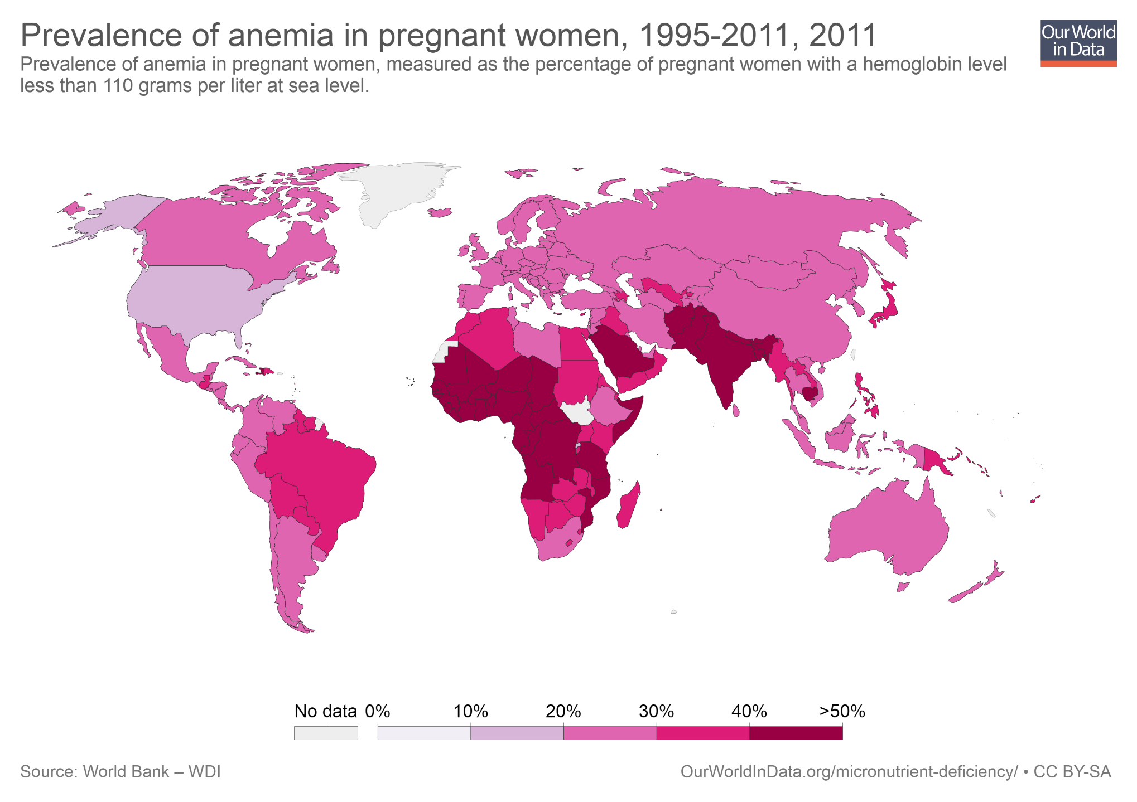
Malnutrition can arise from micro-nutrient deficiencies (i.e. lack of key vitamins and minerals which are consumed in small quantities). Anemia is an important example of 'hidden hunger'. Anemia is associated with low aerobic capacity, general weakness and lethargy, and in some cases (especially for pregnant women) it can be life-threatening.

Slide 17
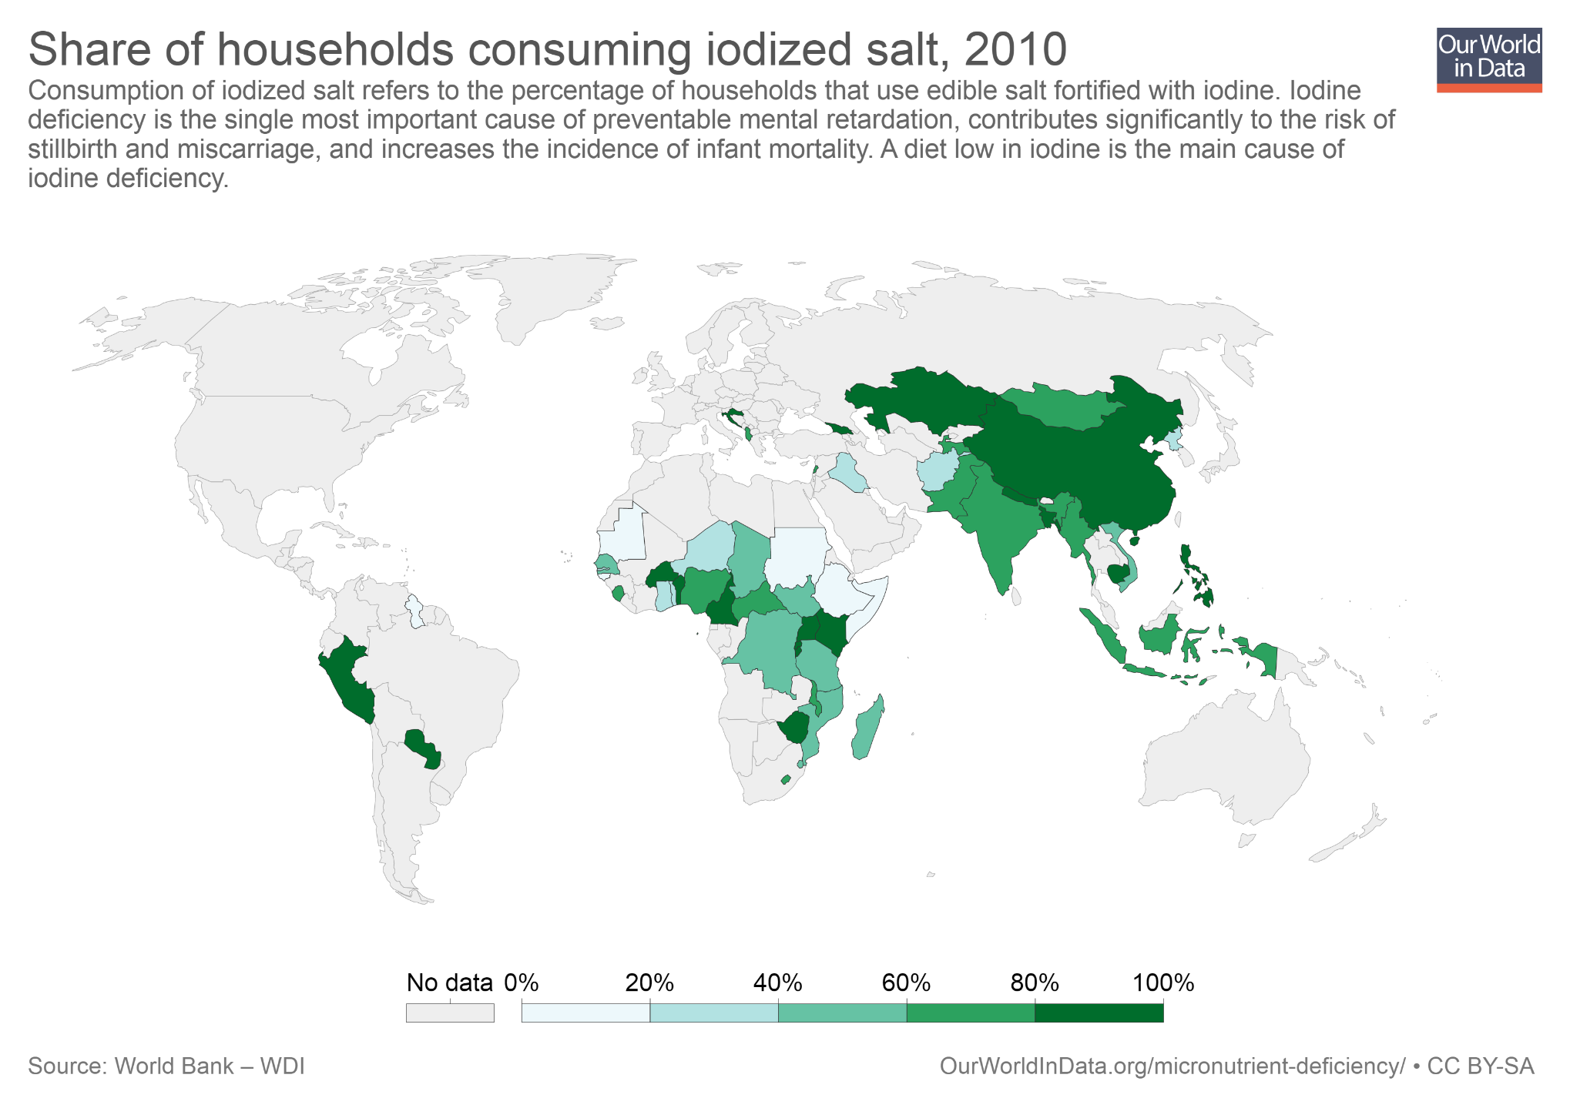
Micro-nutrient deficiencies can be met through judiciously balanced diets, or by taking fairly cheap supplements (e.g. pills) or fortified products (e.g. iodized salt). This map shows the proportion of households who use iodized salt. As we can see, consumption remains very low in many low-income countries where iodized salt could make a huge difference. You can read more about micro-nutrient deficiencies here.

Slide 18
Outline
Undernourishment is an important challenge
Undernourishment has important consequences
Undernourishment is not the result of a world without enough food
Permanently ending hunger requires more than a one-off push in incomes
Malnutrition is not only about calories
What does this mean in terms of policy?

Slide 19
The problem of nutrition requires thinking beyond quantity of food
The quality of food matters a lot, but following a careful diet is expensive even if food is cheap (information, time, and 'mental space').
"The benefits of good nutrition may be particularly strong for two sets of people who do not decide what they eat: unborn babies and young children... Small differences in investments in childhood nutrition (in Kenya, deworming costs $1.36 USD PPP per year; in India, a packet of iodized salt sells for $0.62 USD PPP; in Indonesia, fortified fish sauce costs $7 USD PPP per year) make a huge difference later on. This suggests that governments and international institutions need to completely rethink food policy. Although this may be bad news for American farmers, the solution is not to simply supply more food grains, which is what most food security programs are currently designed to do.“
(Banerjee and Duflo, Poor Economics, Page 48)

Slide 20
Further Resources from Our World in Data
Blog posts and data entries on this topic: – ourworldindata.org/hunger-and-undernourishment – ourworldindata.org/famines – ourworldindata.org/micronutrient-deficiency – ourworldindata.org/food-per-person – ourworldindata.org/diet-compositions
Reading list and Teaching Notes for other topics: ourworldindata.org/teaching-notes

Slide 21
About the author: Esteban Ortiz-Ospina is an economist at the University of Oxford. He is a Senior Researcher at the Oxford Martin Programme on Global Development.
About Our World in Data: Our World in Data is an online publication that shows how living conditions are changing. The aim is to give a global overview and to show changes over the very long run, so that we can see where we are coming from, where we are today, and what is possible for the future.
www.ourworldindata.org/about | @eortizospina

