Slide 1

ML Ops=ML + Dev Ops

Slide 2
Example:
So, your company decided to invest in machine learning. You have a talented team of Data Scientists churning out models to solve important problems that were out of reach just a few years ago. All performance metrics are looking great, the demos cause jaws to drop and executives to ask how soon you can have a model in production.
It should be pretty quick, you think. After all, you already solved all the advanced scienc-y, math-y problems, so all that’s left is routine IT work. How hard can it be?
Pretty hard, it turns out. Deeplearning.ai reports that “only 22 percent of companies using machine learning have successfully deployed a model”. What makes it so hard? And what do we need to do to improve the situation?

Slide 3
DevOps
In the world of traditional software development, a set of practices known as DevOps have made it possible to ship software to production in minutes and to keep it running reliably. DevOps relies on tools, automation and workflows to abstract away the accidental complexity and let developers focus on the actual problems that need to be solved.

Slide 4
So why can’t we simply keep doing the same thing for ML?
The root cause is that there’s a fundamental difference between ML and traditional software: ML is not just code, it’s code plus data. An ML model, the artifact that you end up putting in production, is created by applying an algorithm to a mass of training data, which will affect the behavior of the model in production.
While code is carefully crafted in a controlled development environment, data comes from that unending entropy source known as “the real world”. It never stops changing, and you can’t control how it will change.
A useful way to think of their relationship is as if code and data live in separate planes, which share the time dimension but are independent in all others. The challenge of an ML process is to create a bridge between these two planes in a controlled way.

Slide 5
Problems
This fundamental disconnect causes several important challenges that need to be solved by anyone trying to put an ML model in production successfully, for example:
Slow, brittle and inconsistent deployment
Lack of reproducibility
Performance reduction (training-serving skew)

Slide 6
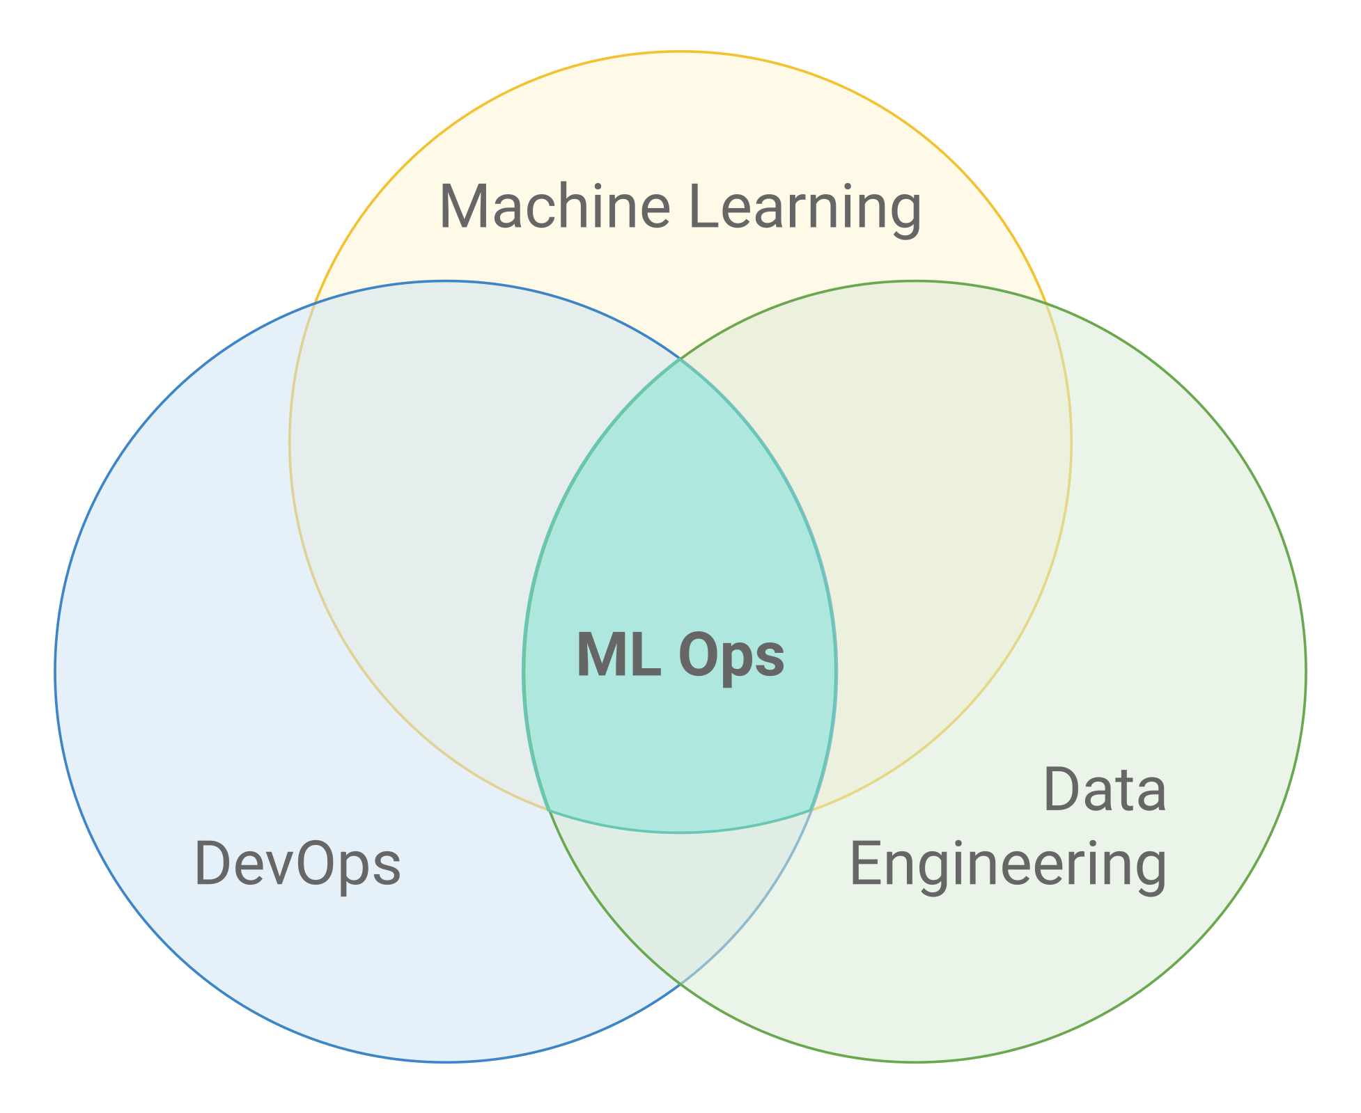
Solution
In order to crack it, we need to combine practices from DevOps and Data Engineering, adding some that are unique to ML.

Slide 7
Hybrid Teams
Another important change is that Data Scientists must be proficient in basic software engineering skills like code modularization, reuse, testing and versioning; getting a model to work great in a messy notebook is not enough. This is why many companies are adopting the title of ML Engineer, which emphasizes these skills. In many cases, ML Engineers are, in practice, performing many of the activities required for ML Ops.

Slide 8
ML Pipelines
One of the core concepts of Data Engineering is the data pipeline. A data pipeline is a series of transformations that are applied to data between its source and a destination.
ML models always require some type of data transformation, which is usually achieved though scripts or even cells in a notebook, making them hard to manage and run reliably. Switching to proper data pipelines provides many advantages in code reuse, run time visibility, management and scalability.

Slide 9
Since ML training can also be thought of as a data transformation, it is natural to include the specific ML steps in the data pipeline itself, turning it into an ML Pipeline. Most models will need 2 versions of the pipeline: one for training and one for serving.
This is because, usually, the data formats and way to access them are very different between each moment, especially for models that are served in real-time requests (as opposed to batch prediction runs).
The ML Pipeline is a pure code artifact, independent from specific data instances.
This means that it’s possible to track its versions in source control and automate its deployment with a regular CI/CD pipeline, a core practice from DevOps.

Slide 10
Note that there are two distinct ML pipelines: the training pipeline and the serving pipeline.
What they have in common is that the data transformations that they perform need to produce data in the same format, but their implementations can be very different. For example, the training pipeline usually runs over batch files that contain all features, while the serving pipeline often runs online and receives only part of the features in the requests, retrieving the rest from a database.
It is important, however, to ensure that these two pipelines are consistent, so one should try to reuse code and data whenever possible.

Slide 11
Model and Data Versioning
In order to have reproducibility, consistent version tracking is essential. In a traditional software world, versioning code is enough, because all behavior is defined by it. In ML, we also need to track model versions, along with the data used to train it, and some meta-information like training hyperparameters.
Models and metadata can be tracked in a standard version control system like Git, but data is often too large and mutable for that to be efficient and practical.
It’s also necessary to version data and tie each trained model to the exact versions of code, data and hyperparameters that were used. The ideal solution would be a purpose-built tool, but so far there is no clear consensus in the market and many schemes are used, most based on file/object storage conventions and metadata databases.

Slide 12
Model validation
Another standard DevOps practice is test automation, usually in the form of unit tests and integration tests. Passing these tests is a prerequisite for a new version to be deployed. Having comprehensive automated tests can give great confidence to a team, accelerating the pace of production deployments dramatically.
ML models are harder to test, because no model gives 100% correct results. This means that model validation tests need to be necessarily statistical in nature, rather than having a binary pass/fail status. In order to decide whether a model is good enough for deployment, one needs to decide on the right metrics to track and the threshold of their acceptable values, usually empirically, and often by comparison with previous models or benchmarks.
It’s also not enough to track a single metric for the entirety of the validation set. Just as good unit tests must test several cases, model validation needs to be done individually for relevant segments of the data, known as slices. For example, if gender could be a relevant feature of a model, directly or indirectly, tracking separate metrics for male, female and other genders.
If you manage to get models validated in an automated and reliable way, along with the rest of the ML pipeline, you could even close the loop and implement online model training, if it makes sense for the use case.

Slide 13
Data validation
A good data pipeline usually starts by validating the input data. Common validations include file format and size, column types, null or empty values and invalid values. These are all necessary for ML training and prediction, otherwise you might end up with a misbehaving model and scratching your head looking for the reason.
In addition to basic validations that any data pipeline performs, ML pipelines should also validate higher level statistical properties of the input. For example, if the average or standard deviation of a feature change considerably from one training dataset to another, it will likely affect the trained model and its predictions. This could be a reflection of actual change in the data or it could be an anomaly caused by how the data is processed, so it’s important to check and rule out systemic errors as causes that could contaminate the model, and fix them if necessary.

Slide 14
Monitoring
Monitoring production systems is essential to keeping them running well. For ML systems, monitoring becomes even more important, because their performance depends not just on factors that we have some control over, like infrastructure and our own software, but also on data, which we have much less control over.
Therefore, in addition to monitoring standard metrics like latency, traffic, errors and saturation, we also need to monitor model prediction performance.
An obvious challenge with monitoring model performance is that we usually don’t have a verified label to compare our model’s predictions to, since the model works on new data. In some cases we might have some indirect way of assessing the model’s effectiveness, for example by measuring click rate for a recommendation model. In other cases, we might have to rely on comparisons between time periods, for example by calculating a percentage of positive classifications hourly and alerting if it deviates by more than a few percent from the average for that time.
Just like when validating the model, it’s also important to monitor metrics across slices, and not just globally, to be able to detect problems affecting specific segments.

Slide 15
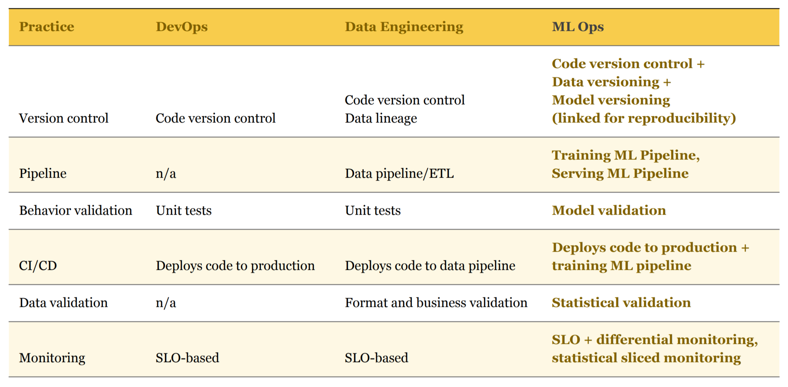

Slide 16
Data drift
https://machinelearningmastery.com/gentle-introduction-concept-drift-machine-learning/
PSI,CSI

Slide 17
Model Retraining

Slide 18
Link
https://library.stanford.edu/research/data-management-services/data-best-practices/data-versioning
https://www.youtube.com/watch?v=6gdrwFMaEZ0
https://www.youtube.com/watch?v=06-AZXmwHjo
https://www.youtube.com/watch?v=_Ni6JWdeCew
https://www.youtube.com/watch?v=TZ1lGrJLEZ0
https://www.altexsoft.com/blog/mlops-methods-tools/
https://cloud.google.com/architecture/mlops-continuous-delivery-and-automation-pipelines-in-machine-learning
https://cloud.google.com/architecture/architecture-for-mlops-using-tfx-kubeflow-pipelines-and-cloud-build
https://cloud.google.com/architecture/cicd-pipeline-for-data-processing
https://medium.com/codex/build-a-docker-image-with-cloud-build-in-google-cloud-platform-5f6840af2c05
Build a Docker image automatically with Cloud Build in Google Cloud Platform. | by Guanglin Kuang | CodeX | Mar, 2021 | Medium
CI/CD Pipeline on GCP using Cloud Build | The Startup (medium.com)
CI/CD with Google Cloud
Quickstart: Automate App Engine deployments with Cloud Build (google.com)
https://www.youtube.com/playlist?list=PLTPXxbhUt-YWjDg318nmSxRqTgZFWQ2ZC

Slide 19
https://stackoverflow.blog/2020/10/12/how-to-put-machine-learning-models-into-production/
https://neptune.ai/blog/mlops-what-it-is-why-it-matters-and-how-to-implement-it-from-a-data-scientist-perspective
Mlflow vs Kubeflow: https://medium.com/weareservian/the-cheesy-analogy-of-mlflow-and-kubeflow-715a45580fbe#:~:text=MLflow%20is%20a%20single%20python,model%20development%20and%20production%20tools.
https://colab.research.google.com/github/amygdala/code-snippets/blob/master/ml/notebook_examples/hosted_kfp/event_triggered_kfp_pipeline_bw.ipynb
https://cloud.google.com/ai-platform/pipelines/docs/getting-started
https://stackoverflow.com/questions/55943097/how-to-create-kubernetes-cluster-in-google-cloud-platform-in-python-using-google
https://cloud.google.com/kubernetes-engine/docs/reference/rest/v1/projects.locations.clusters
https://cloud.google.com/kubernetes-engine/docs/reference/rest/v1/projects.zones.clusters/create
https://neptune.ai/blog/the-best-kubeflow-alternatives
https://stackoverflow.com/questions/60787646/kubeflow-vs-other-options
https://www.youtube.com/watch?v=tXtz3XQs1ow
https://towardsdatascience.com/making-the-ai-journey-from-public-cloud-to-on-prem-ee33996e085c
https://itnext.io/machine-learning-model-serving-options-1edf790d917
https://towardsdatascience.com/safely-rolling-out-ml-models-to-production-13e0b8211a2f
https://towardsdatascience.com/machine-learning-experiment-tracking-93b796e501b0

Slide 20
https://www.infoq.com/news/2020/03/spotify-terraform-kubeflow/
https://medium.com/google-cloud/2018-google-deployment-manager-5ebb8759a122#:~:text=Infrastructure%20as%20code%20is%20the,by%20describing%20it%20using%20code.
https://cloud.google.com/recommender/docs/tutorial-iac
https://www.kubeflow.org/docs/components/pipelines/overview/pipelines-overview/
https://www.cncf.io/wp-content/uploads/2020/08/Arrikto-Webinar-Scalable-ML-Workflows-with-Advanced-Data-Management-on-Kubeflow.pdf
https://towardsdatascience.com/the-way-you-version-control-your-ml-projects-is-wrong-42910cba9bd9
https://www.montecarlodata.com/why-production-machine-learning-fails-and-how-to-fix-it/

