Slide 1

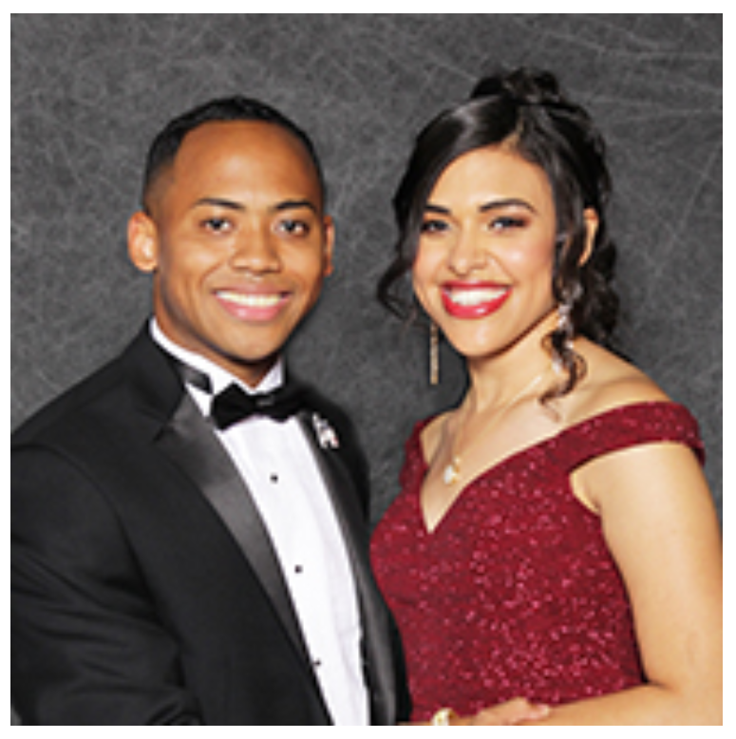
Nwoke, Nick & Stephanie

Slide 2
Just Getting Started
Getting started
Principle of success
We are here to make positive difference.
The choice is yours
Notes:
Photo by neil godding on Unsplash

