Slide 1

MTN SA ML OPS
MOTILAL MEHER
KAUSTAV KHATUA
SHAHRUKH MOHAMMAD
NAVEEN K
27th Jul 2021

Slide 2

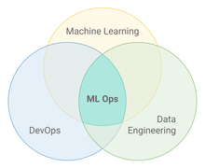
What is MLOps
MLOps or ML Ops is a set of practices that aims to deploy and maintain machine learning models in production reliably and efficiently.

Slide 3
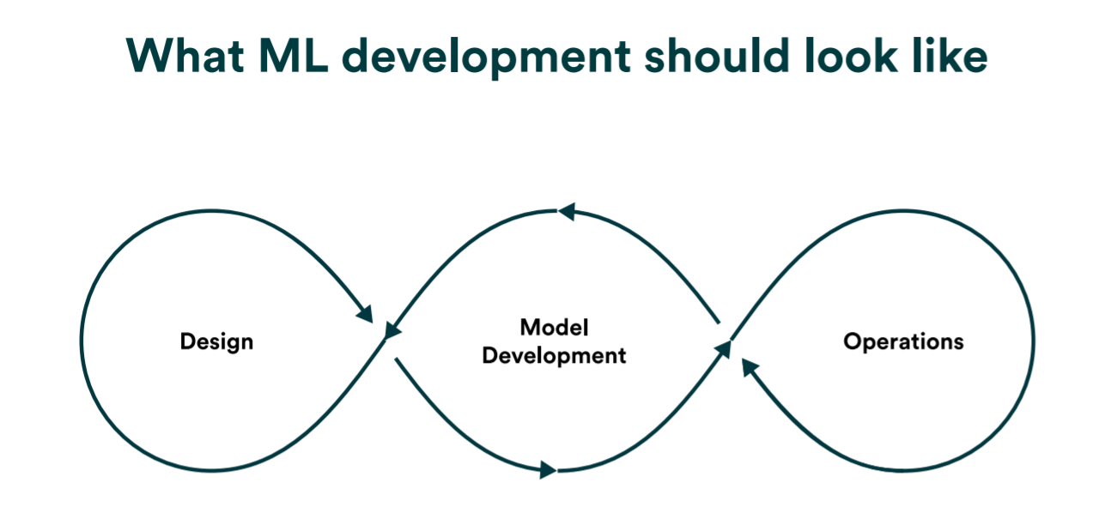
What MLOps Development should look like ?
.
Notes:
When we look at how the current literature describes a model lifecycle, we often see a picture like this
However, in reality, most organizations today still operate in a cycle where hand-overs between model development and operations are – simply put – messy and manual.

Slide 4
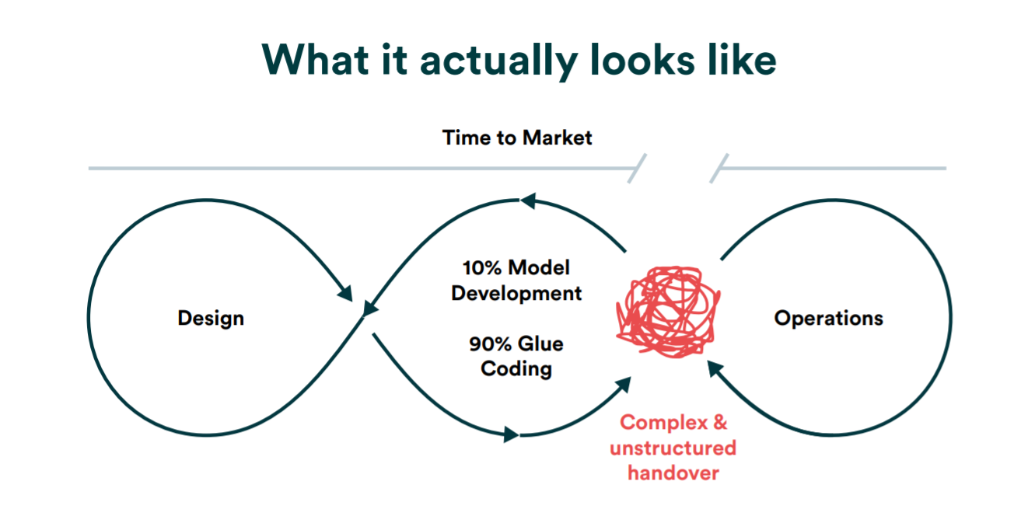
How MLOps Development looks ?
.
Notes:
The goal of MLOps is to reduce technical friction to get the model from an idea into production in the shortest possible time to market with as little risk as possible.
For traditional software development, reproducibility is mostly taken care of by proven version control tools like Git.
In ML, a model is a combination of code, data, parameters, and the training environment. To pick up where someone else (or yourself six months ago) left off with a model, you’ll need much more than just a Git repository.
we recommend a version control system that can track your whole pipeline from raw data to the model, including your code, environment, configurations, and parameters.
your model needs to be updated all the time to keep up with the pace at which the underlying data is changing.

Slide 5
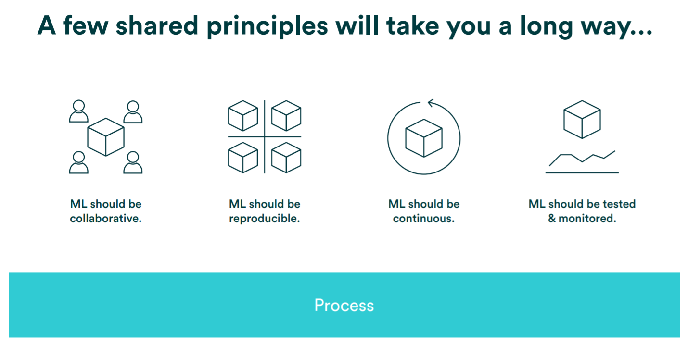
MLOps Principles
.

Slide 6
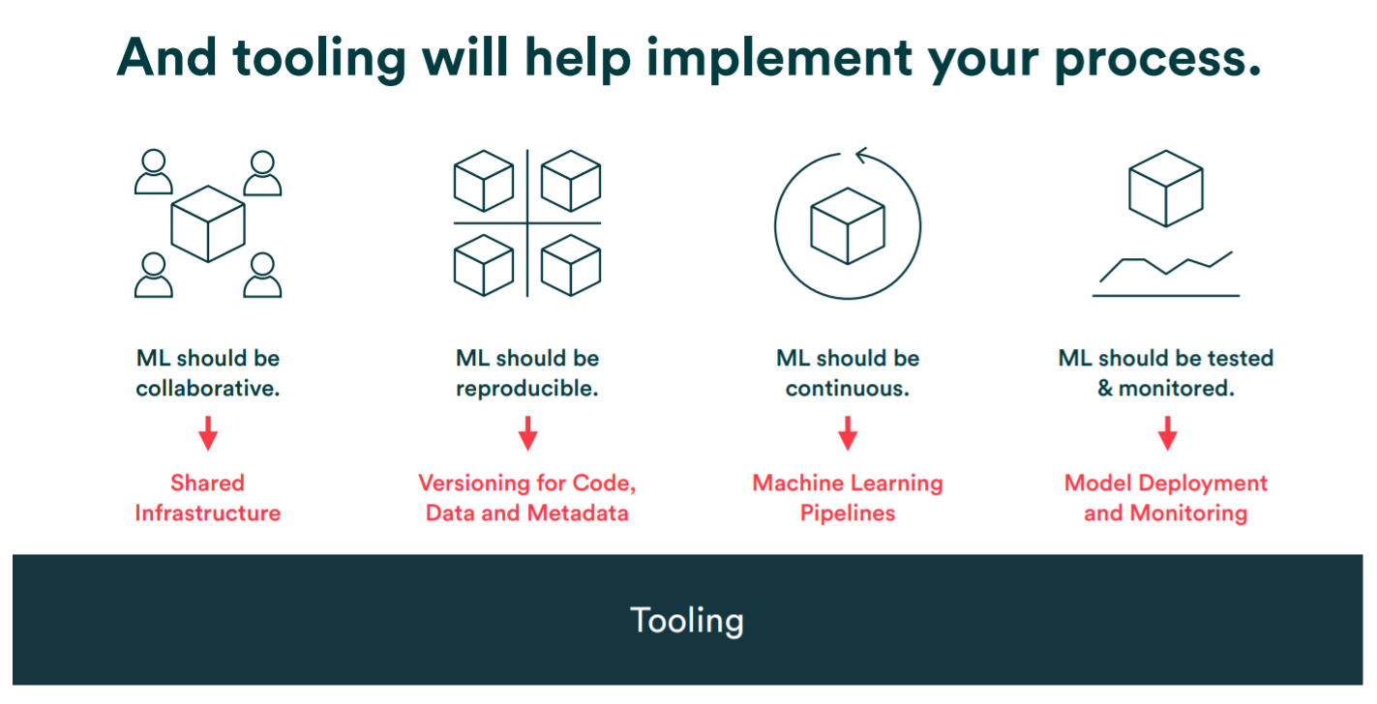
MLOps Principles
.

Slide 7
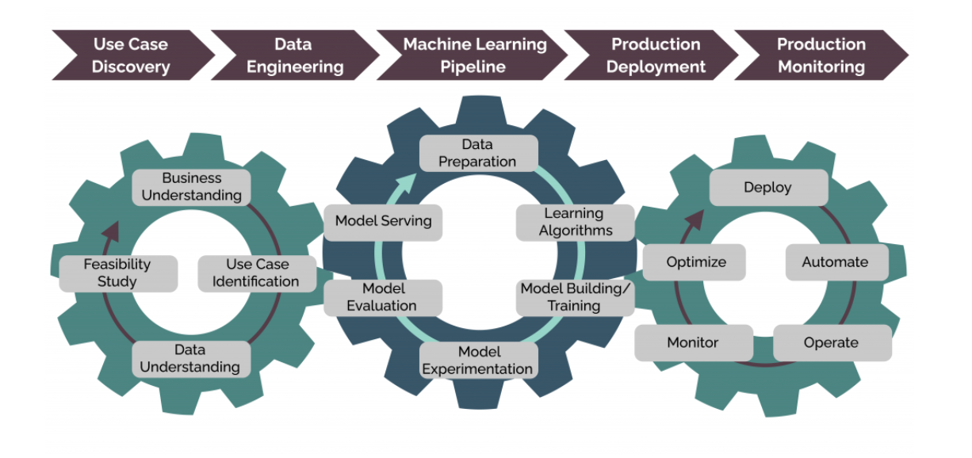
ML Life Cycle
.

Slide 8
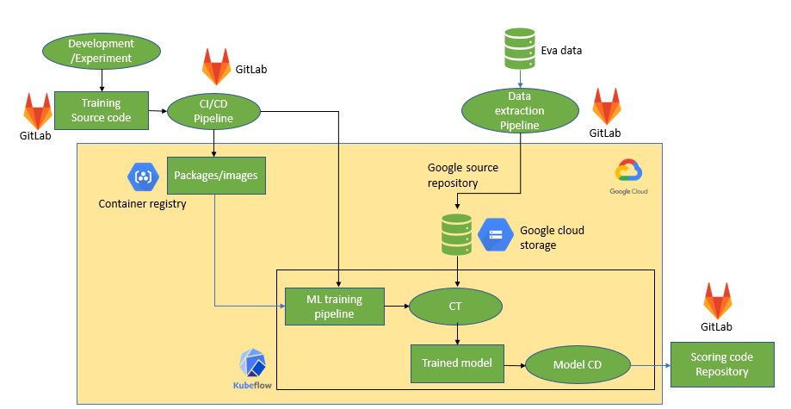
ML OPS PROCESS FLOW FOR MTN SOUTH AFRICA (TRAINING)
.

Slide 9
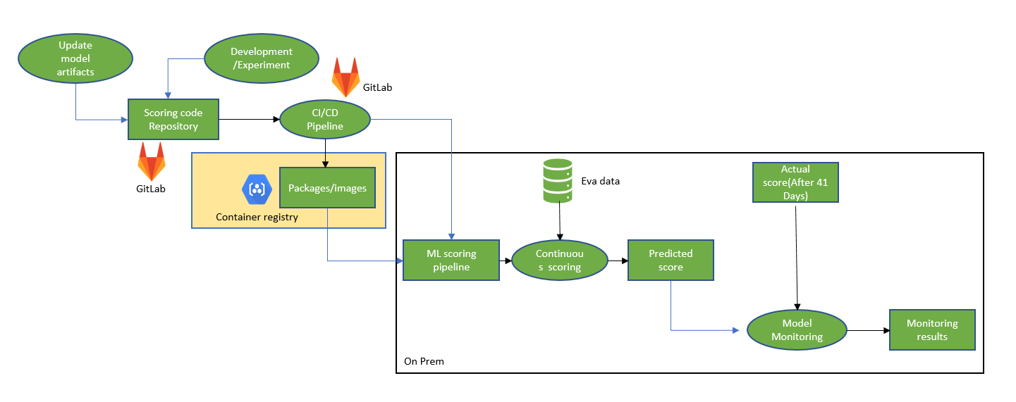
ML OPS PROCESS FLOW FOR MTN SOUTH AFRICA (SCORING)
.

Slide 10
.
DEMO

Slide 11
Thank You!
Deloitte refers to one or more of Deloitte Touche Tohmatsu Limited, a UK private company limited by guarantee (“DTTL”), its network of member firms, and their related entities. DTTL and each of its member firms are legally separate and independent entities. DTTL (also referred to as “Deloitte Global”) does not provide services to clients. Please see www.deloitte.com/about for a more detailed description of DTTL and its member firms.
This communication is for internal distribution and use only among personnel of Deloitte Touche Tohmatsu Limited, its member firms, and their related entities (collectively, the “Deloitte network”). None of the Deloitte network shall be responsible for any loss whatsoever sustained by any person who relies on this communication.
© 2021. For information, contact Deloitte Touche Tohmatsu Limited

